Slide 1
Subject Name : Applied grammar Subject Code : 17UARl12 Class : all ug first year language
R.Minnal vizhi
Assistant Professor of Arabic
Hajee Karutha Rowther Howdia College

Slide 2
The demonstrative pronoun - اَلْاَسْمَاءُ الْاِرشَارَةِ
In English “this”& “that” are called demonstrative pronouns, they are common for both masculine & feminine genders.
The demonstrative pronouns are used to refer a specific thing (or) pointing out something a finger.
The vowel sign on the last letter of all demonstrative pronouns it will never change.
The demonstrative pronoun plural masculine & feminine “ these and those are used for a human being (or) persons.
The demonstrative pronoun plural pointed for things (or) non human being then singular feminine must be used.
The demonstrative pronouns are two types( Near, Far (or) distance ).
1) The demonstrative pronoun for the near
اِسْمُ الْإِسَارَةِ لِلْقَرِيْبِ
2) The demonstrative pronoun for the far (or) distance
اِسْمُ الْإِسَارَةِ لِلْبَعِيْدِ

Slide 3
1) The demonstrative pronoun for the near masculine & feminine اِسْمُ الْإِسَارَةِ لِلْقَرِيْبِ مُذَكَّرٌ وَ مُؤَنَّث
Near feminine لِلْقَرِيْبِ مُذَكَّرٌ وَ مُؤَنَّث
Near masculine لِلْقَرِيْبِ مُذَكَّر
This (is a) - هَذَهِ
These (both are) - هَاتاَنِ
These (all are) - هَؤُلاَءِ
This (is a) - هَذاَ
These (both are) - هَذاَنِ
These (all are) - هَؤُلاَءِ
Notes:
The demonstrative pronouns are two types(Near,Far).

Slide 4
2) The demonstrative pronoun for the near masculine & feminine اِسْمُ الْإِسَارَةِ لِلْبَعِيْدِ مُذَكَّرٌ وَ مُؤَنَّث
For, distance feminine
لِلْبَعِيْدِ مُؤَنَّث
For, distance feminine
لِلْبَعِيْدِ مُذَكَّر
That (is a) - تِلْكَ
Those (both are) - تاَنِكَ
Those (all are) - اُوْلاَئِكَ
That (is a) - ذاَلِك
Those (both are) - ذاَنِكَ
Those (all are) - اُوْلاَئِكَ

Slide 5
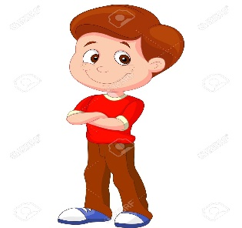
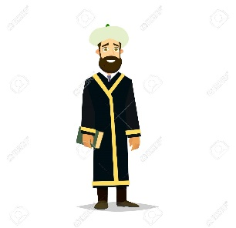
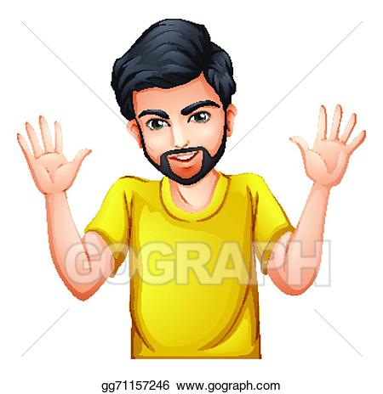
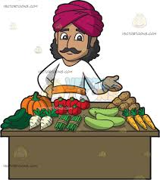
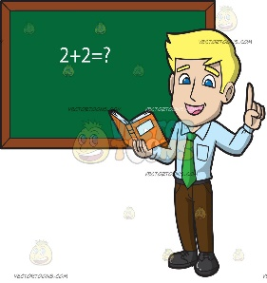
The demonstrative pronouns used as a subject with human being masculine.
Indefinite article “a”(or)“an” used in a sentence and its last letter gets vowelled damma with thanwin
هَـٰذَا This is a
طَبِيبٌ
وَلَدٌ
طَالِبٌ
إِمَامٌ
ذاَلِك That is a
رَجُلٌ
تَاجِرٌ
مُدَرَّسٌ
Notes:
Arabic has no word which is equal to the English word "is" which is referred to as a “copula” in grammar.
هَـٰذَا طَبِيبٌ If read literally this sentence would read "This a doctor“ , however, the word "is" can be implied in this sentence so that it reads "This is a doctor".
There is no word in Arabic corresponding to "a" in English as in: "This is a doctor".
The n-sound, i.e. the /tanwīn/ (doubled vowel sign) at the end of the Arabic noun (kitābu-n, baitu-n, masĴidu-n) is the Arabic indefinite article corresponding to the English "a/an".

Slide 6
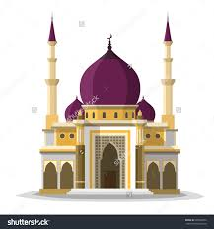
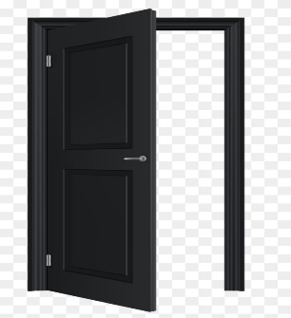
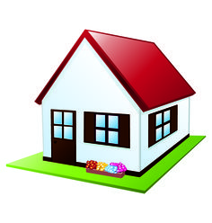
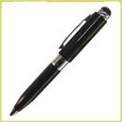
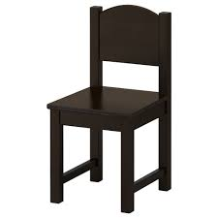
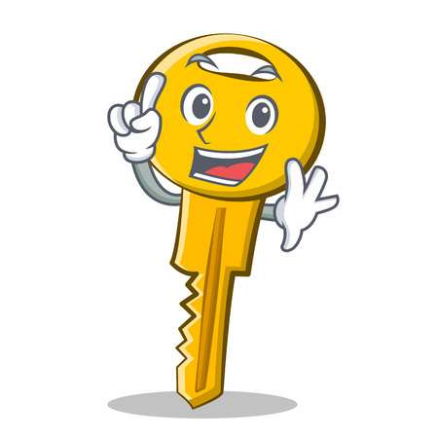
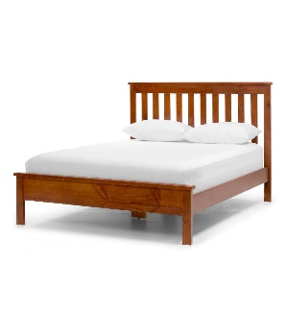
The demonstrative pronouns used as a subject with non human being masculine.
Indefinite article “a”(or)“an” used in a sentence and its last letter gets vowelled damma with thanwin
هَـٰذَا This is a
كِتَابٌ
مَسْجِدٌ
بَابٌ
بَيْتٌ
ذاَلِك That is a
قَلَمٌ
كُرْسِىٌّ
مِفْتَاحٌ
سَرِيرٌ

Slide 7
How to ask a question ( ? )
مَا - means “what”?,
أَ - means “ Is” ?,
means “Who”
مَنْ -

Slide 8
(مَا - what?) for using non human being sentences
مَا هَـٰذَا؟ - What is this? / ؟ مَا ذاَلِك – What is that?
This is a /an ..… (..… هَـٰذَا ) / That is a /an ..… (..… ذاَلِك )
مَا هَـٰذَا؟ what is this? ذاَلِك؟ مَا What is that?
كِتَابٌ
مَسْجِدٌ
بَابٌ
بَيْتٌ
قَلَمٌ
كُرْسِىٌّ
مِفْتَاحٌ
سَرِيرٌ

Slide 9
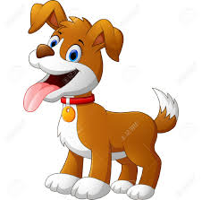
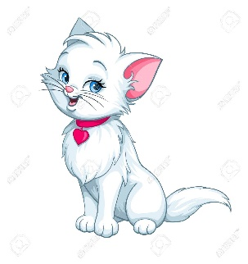
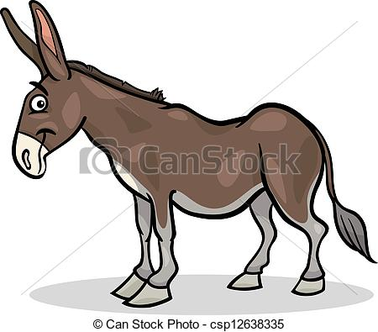
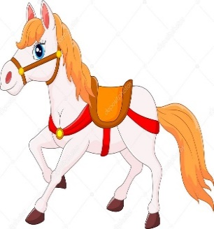
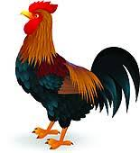
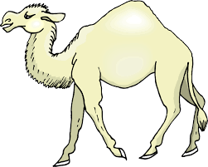
مَا هَـٰذَا؟ what is this? ( و ) and ذاَلِك؟ مَا What is that?

Slide 10
أَ - "Is”? for using human being & non human being sentences
أَهَـٰذَا….؟ - Is this...? / أَ ذاَلِك ….؟ - Is that...?
The word for Yes in Arabic is نَعَمْ , No in Arabic is لا.
Yes, this / that is a .… ….ذاَلِك / هَـٰذَا. نَعَمْ
No, this/that is a …. …. ذاَلِك/ هَـٰذَا. لا
أَهَـٰذَا…..؟ Is this….? أَذاَلِك…..؟ Is that….?
كِتَابٌ
مَسْجِدٌ
بَابٌ
بَيْتٌ
قَلَمٌ
كُرْسِىٌّ
مِفْتَاحٌ
سَرِيرٌ

Slide 11
هَـٰذَا بَيْتٌ.
مَا هَـٰذَا؟
This a house?
What is this?
نَعَمْ، هَـٰذَا بَيْتٌ.
أَهَـٰذَا بَيْتٌ؟
Yes, this is a house.
Is this a house?
بَيْتٌ
هَـٰذَا مَسْجِدٌ.
مَا هَـٰذَا؟
This a house?
What is this?
لا، هَـٰذَا مَسْجِدٌ
أَهَـٰذَا بَيْتٌ؟
Yes, this is a house.
Is this a house?
مَسْجِدٌ

Slide 12
ذاَلِك كِتَابٌ.
مَا ذاَلِك؟
That is a book?
What is that?
نَعَمْ، ذاَلِك كِتَابٌ.
أَ ذاَلِك كِتَابٌ؟
Yes, that is a book.
Is that a book?
كِتَابٌ
ذاَلِك قَلَمٌ.
مَا ذاَلِك؟
That is a pen?
What is that?
لا، ذاَلِك قَلَمٌ
أَ ذاَلِك كِتَابٌ؟
Yes, that is a pen.
Is that a book?
قَلَمٌ

