Slide 1
Subject Name : Applied grammar Subject Code : 17UARl12 Class : all ug first year language
R.Minnal vizhi
Assistant Professor of Arabic
Hajee Karutha Rowther Howdia College

Slide 2
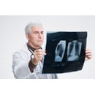
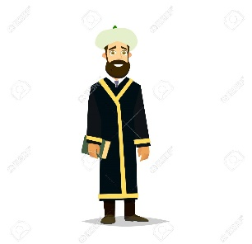
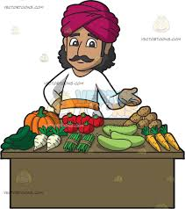
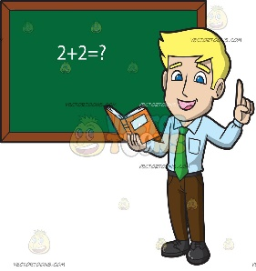
The demonstrative pronouns used as a subject with human being masculine.
Indefinite article “a”(or)“an” used in a sentence and its last letter gets vowelled damma with thanwin
مَنْ هَـٰذَا؟ Who is this?
طَبِيبٌ
طَبِيبٌ
طَالِبٌ
وَلَدٌ
طَالِبٌ
إِمَامٌ
إِمَامٌ
مَنْ ذاَلِك؟ Who is that?
تَاجِرٌ
رَجُلٌ
تَاجِرٌ
رَجُلٌ
مُدَرَّسٌ
مُدَرَّسٌ

Slide 3
أَ - "Is”? for using human being
أَهَـٰذَا…..؟ Is this….? أَ ذاَلِك…..؟ Is that….?
طَبِيبٌ
طَبِيبٌ
طَالِبٌ
وَلَدٌ
طَالِبٌ
وَلَدٌ
إِمَامٌ
إِمَامٌ
تَاجِرٌ
رَجُلٌ
تَاجِرٌ
رَجُلٌ
مُدَرَّسٌ
مُدَرَّسٌ

Slide 4
هَـٰذَا ٌطَبِيبٌ.
مَنْ هَـٰذَا؟
This a house?
What is this?
نَعَمْ، هَـٰذَا طَبِيبٌ.
أَهَـٰذَا طَبِيبٌ؟
Yes, this is a house.
Is this a house?
هَـٰذَا رَجُلٌ.
مَنْ هَـٰذَا؟
This a house?
What is this?
لا، هَـٰذَا رَجُلٌ
أَهَـٰذَا طَبِيبٌ؟
Yes, this is a house.
Is this a house?

Slide 5
ذاَلِك وَلَدٌ.
مَنْ ذاَلِك؟
That is a boy?
What is that?
نَعَمْ، ذاَلِك وَلَدٌ.
أَ ذاَلِك وَلَدٌ؟
Yes, that is a boy.
Is that a boy?
ذاَلِك طَالِبٌ.
مَنْ ذاَلِك؟
That a student?
What is that?
لا، ذاَلِك طَالِبٌ
أَ ذاَلِك وَلَدٌ؟
Yes, that is a student.
Is that a boy?

Slide 6
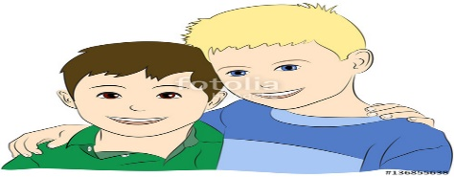
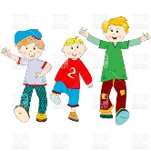
The demonstrative pronoun plural pointed for things (or) non human being then singular feminine must be used.
for using human being
وَلَدٌ
وَلَداَنِ
أَوْلاَدٌ
This (is a) - هَذاَ
These (both are) - هَذاَنِ
These (all are) - هَؤُلاَءِ
for using human being
كِتَابٌ
كِتَاباَنِ
كُتُبٌ
This (is a) - هَذاَ
These (both are) - هَذاَنِ
These (all are) - هَذَهِ

Slide 7
The demonstrative pronoun plural masculine & feminine “ these and those are used for a human being (or) persons.
The demonstrative pronoun plural pointed for things (or) non human being then singular feminine must be used.

Slide 8
This is a doctor?
هَـٰذَا ٌطَبِيبٌ.
Who is this?
مَنْ هَـٰذَا؟
Yes, this is a doctor.
نَعَمْ، هَـٰذَا طَبِيبٌ.
أَهَـٰذَا طَبِيبٌ؟
No, this is a teacher.
لا، هَـٰذَا مُدَرِّسٌ
هَـٰذَا رَجُلٌ.
مَنْ هَـٰذَا؟
This is a man?
Is this a doctor?
Who is this?
أَهَـٰذَا طَبِيبٌ؟
Is this a house?

Slide 9
Types of Nouns انواع الاسم -
Nouns are two types
معرفة Definite
نكرة Indefinite

Slide 10
Definite معرفة -
A definite noun refers to a specific thing.
Definite Nouns are of Seven categories
اسم علم
المعرف بالام
المنادي
اسم الضمير
المضاف الي معرفة
الاسم الموصول
اسم الاشارة

Slide 11
Indefinite نكرة -
An Indefinite noun is a word
Which refers to a general thing.
It Does not refer to any specific person
It Does not refer to any Particular Thing

Slide 12
Particles of تعريف and تنكير
The tanwin is generally attached to a word that is indefinite
The Definite article of arabic is ال.
Whenال is prefixed to a word having tanwin, the tanwin falls off.
Examples
A Book – كتابٌ is Indefinite
The Book – الكتابُ is Definite

Slide 13
Particle & preposition حَرْفٌ -
It is a word that does not indicate its meaning without joined to any noun or verb
After preposition it will change in to the genitive case(kasra )on the last letter of a word.
Examples:-
من From
الي To
علي On
في In
ب With

