Slide 1
EVS - Unit II
Ecology & Ecosystem
- Prof. M.Seyid Abdul Kadher

Slide 2
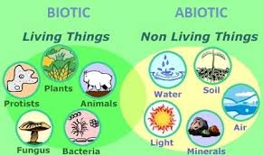
What is environment?
Environment is the sum of the biotic(living) and abiotic(non-living) components around us

Slide 3
What are the biotic components of our environment?
Plants, animals, Micro organisms

Slide 4
What are the abiotic components of our environment?
Lithosphere, Hydrosphere, atmosphere, Sunlight, wind

Slide 5
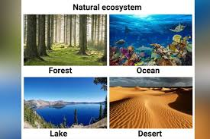
What is Ecosystem?
Systematic interaction of Biotic and Abiotic components in our environment

Slide 6
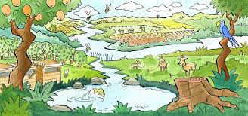
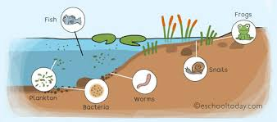
What are the two types of ecosystems?
Land ecosystem and Aquatic ecosystem

Slide 7
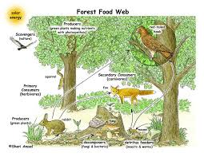
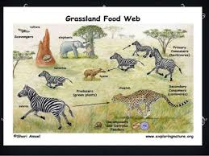
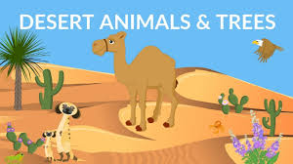
What are the different types of Land ecosystem?
Forest, Grassland and Desert ecosystems

Slide 8
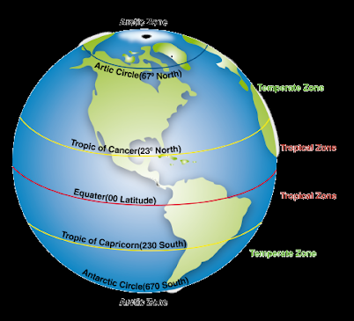
How the land ecosystems are broadly divided?
Tropical ecosystem – Closer to equator with less rainfall
Temperate ecosystem – Away from equator with changing climate and lower temperatures

Slide 9
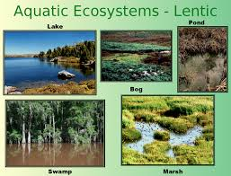
What are the different types of Aquatic ecosystems?
Flowing(Lotic) - Rivers, Streams, Oceans
Stagnant(Lentic) – Ponds, Lakes, Tanks

Slide 10
What is Stratification?
The division of the Aquatic ecosystems on the basis of Light, Temperature and Nutrients is called Stratification.

Slide 11
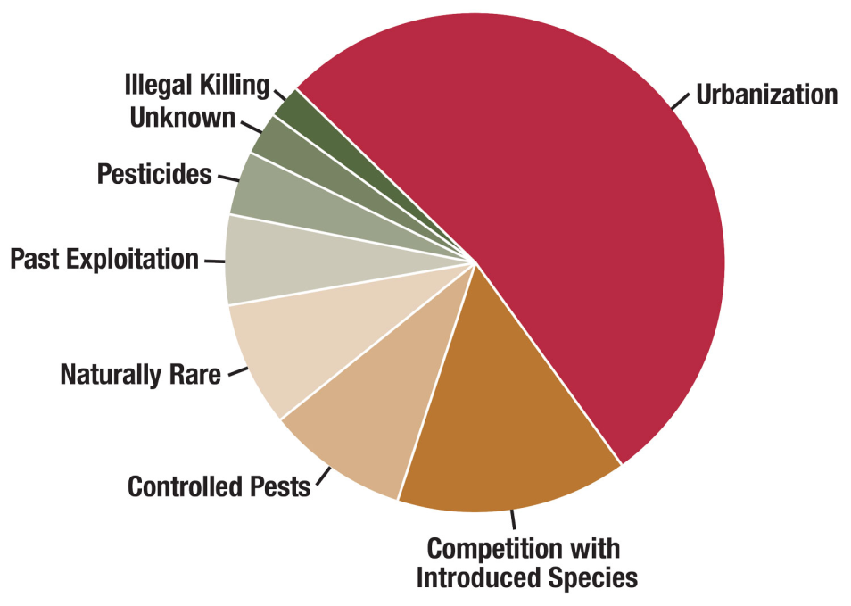
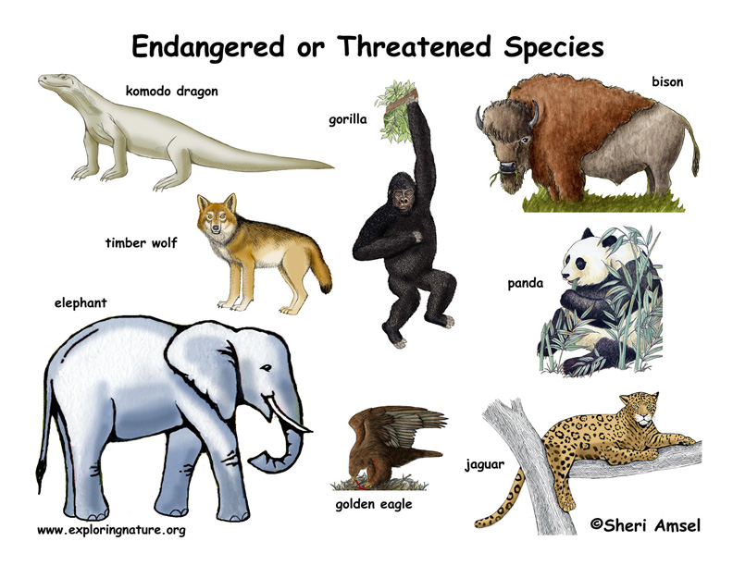
How are the components of biodiversity classified on the basis of conservation?
Endangered, Threatened, Rare

Slide 12
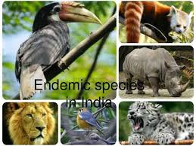
What is Endemic species?
Unique species of Plants or animals that are found only in a particular ecosystem are classified as Endemic species.

Slide 13
What are Hot spots?
Regions that harbour a high concentration of Endemic species are called hotspots

Slide 14
How many hot spots are there in India? What are they?
Two hot spots
Eastern Himalayas and Western Ghats

Slide 15
What are the two types of Conservation of Biodiversity?
In-situ conservation – Plants and animals are conserved within their own habitat
Ex-situ conservation – DNA or Germ plasm samples are taken from endangered species and stored in Tissue culture banks or Gene banks

Slide 16
What are the classifications under biotic components of an ecosystem?
Producer - Plants
Consumer – Primary, Secondary, Tertiary
Decomposer

Slide 17
What is a food web?
Interconnected food chains

Slide 18
What is Biodiversity?
It is the study of the variety and variability of an ecosystem

Slide 19
What are the different types of diversities?
Genetic diversity
Species diversity
Ecosystem diversity

Slide 20
What are the values of biodiversity?
Religious values
Medicinal values
Productive values
Consumptive values

Slide 21
What are the threats to biodiversity?
Poaching – illegal trading of wildlife or wildlife related products
Loss of habitat – due to farming activities in forests
Man wildlife conflict

Slide 23
