Slide 1
Arabic alphabet and pronounce Part 1 – Sun letters
Subject Code: 20UARL11
Subject: Applied Grammar 1
K. BUSHRA
Assistant Professor
Department of Arabic
Hajee Karutha Rowther Howdia College

Slide 2
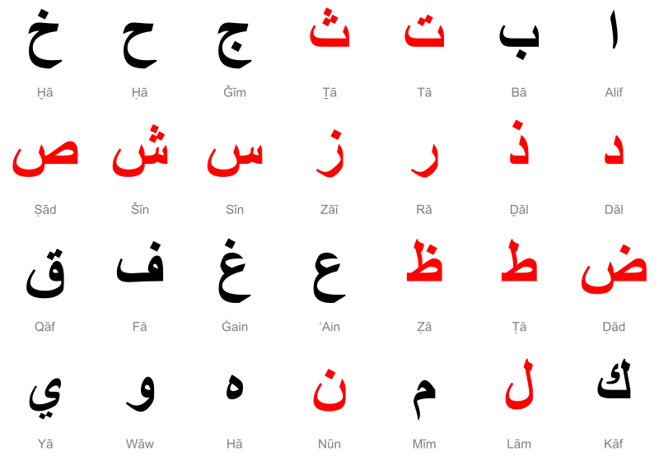
Arabic Alphabet Letters Sun Letters indicated in Red Colour

Slide 3
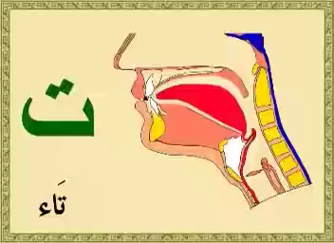
The different forms letter can take
Similar sounding letter

Slide 4
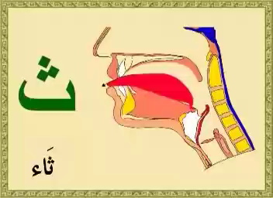
The different forms letter can take

Slide 5
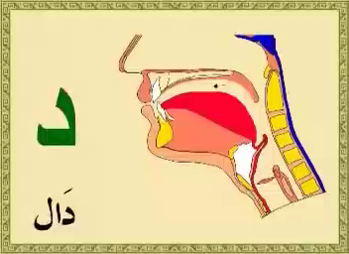
The different forms letter can take
Similar sounding letter

Slide 6
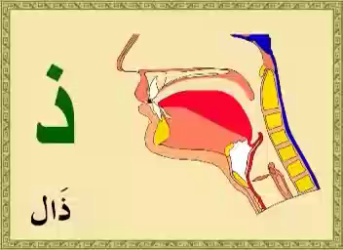
The different forms letter can take
Similar sounding letters

Slide 7
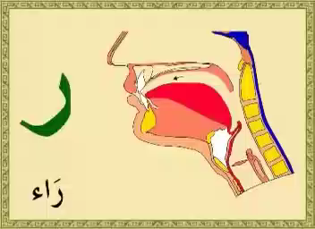
The different forms letter can take

Slide 8
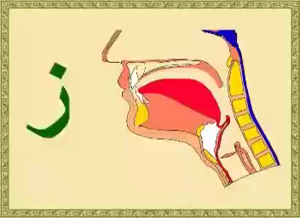
The different forms letter can take
Similar sounding letters

Slide 9
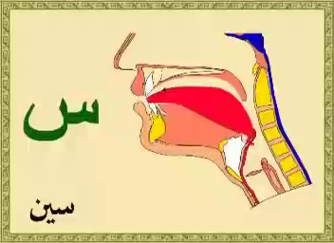
The different forms letter can take
Similar sounding letters

Slide 10
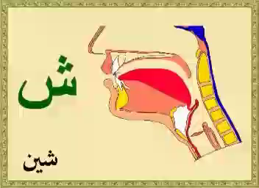
The different forms letter can take

Slide 11
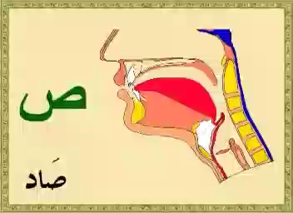
The different forms letter can take
Similar sounding letters

Slide 12
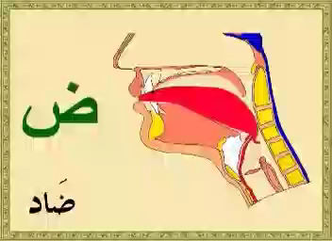
The different forms letter can take
Similar sounding letter

Slide 13
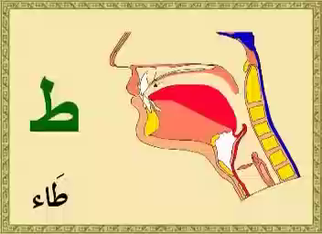
The different forms letter can take
Similar sounding letter

Slide 14
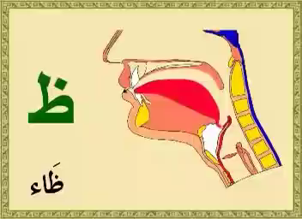
The different forms letter can take
Similar sounding letters

Slide 15
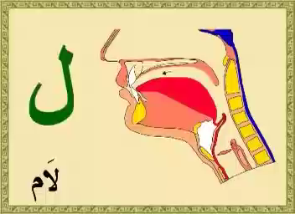
The different forms letter can take

Slide 16
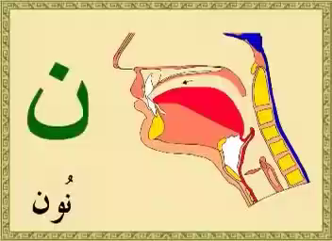
The different forms letter can take

Slide 17
‘Glottal Stop’

