Slide 1
Subject Name - Grammar – III Subject Code –17UARC32
Handled by
K. Bushra
Assistant Professor
Department of Arabic
Hajee Karutha Rowther Howdia College
Uthamapalayam.

Slide 2
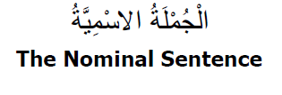

Slide 3
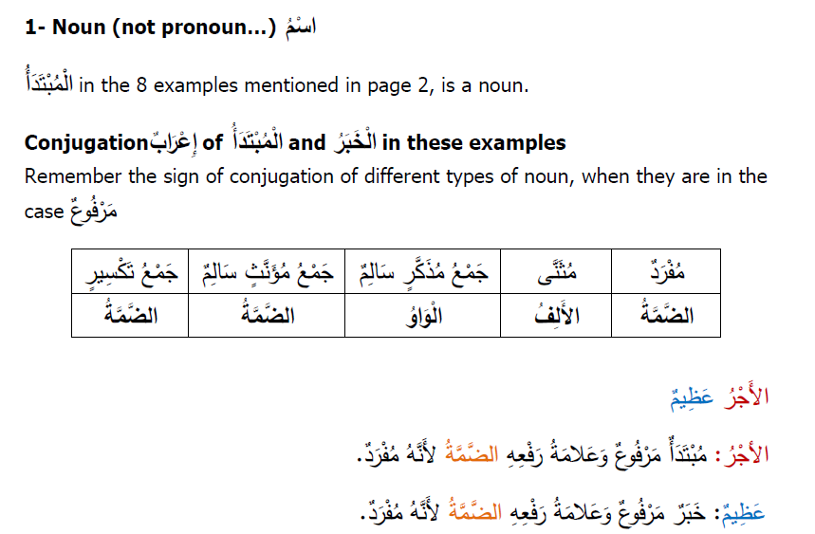

Slide 4
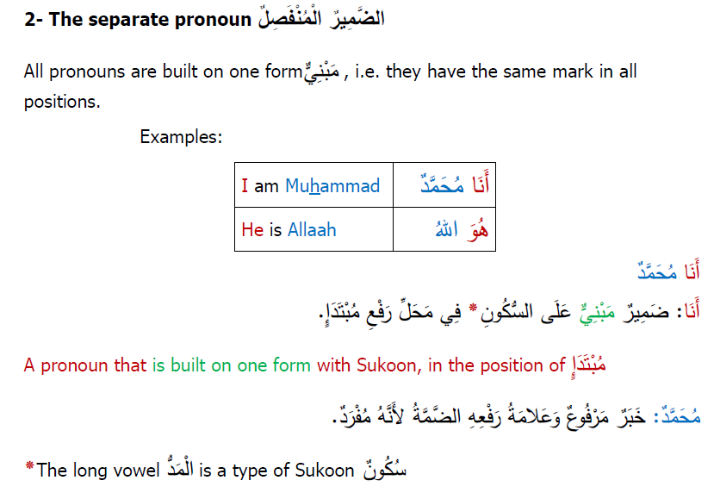

Slide 6
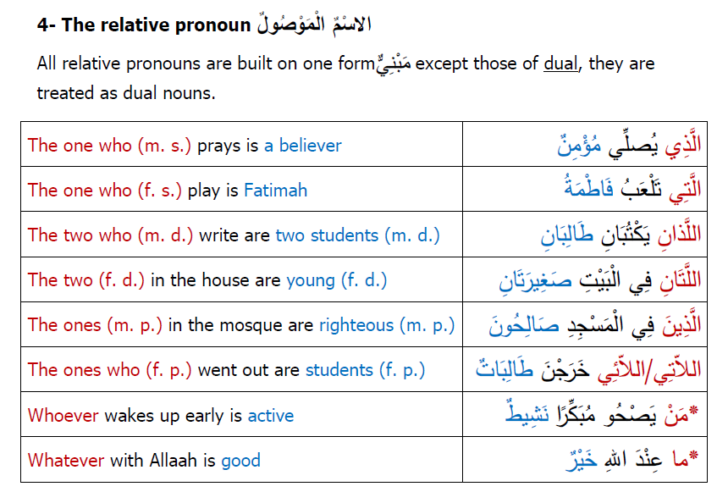

Slide 7
