Slide 1
BATTLE OF BADHR
Subject Name – Seerath - V Subject Code –17UARC53
K. Bushra
Assistant Professor
H.K.R.H. College
Uthamapalayam

Slide 2
The Battle of Badr, fought March 17, 624 C.E. (17
Ramadan 2 AH in the Islamic calendar)
The Most Decisive Battle Between Truth & Falsehood

Slide 3
Introduction
At the time of the battle, Arabia was sparsely populated by a number of Arabic-speaking peoples. Some were Bedouin; pastoral nomads organized in tribes; some were agriculturalists living either in oases in the north or in the more fertile and thickly settled areas to the south (now Yemen and Oman). The majority of Arabs were adherents of numerous polytheistic religions.
The battle of Badr however was the first large-scale engagement between the two forces

Slide 4
Muhammad (p.b.u.h)
Muhammad was born in Mecca around 570 C.E. into the Banū
Hāshim clan of the Quraish tribe. When he was about forty years
old, he is said to have experienced a divine revelation while he was meditating in a cave outside Mecca. He began to preach to his kinfolk first privately and then publicly. Response to his preaching both attracted followers and antagonized others. During this period Muhammad was protected by his uncle Abū Tālib. When his uncle died in 619, the leadership of the Banū Hāshim passed to one of Muhammad's enemies, 'Amr ibn Hishām,[2] who withdrew the protection and stepped up persecution of the Muslim community.
In 622, with open acts of violence being committed against the
Muslims by their fellow Quraishi tribesmen, Muhammad and many
of his followers fled to the neighboring city of Medina. This migration is called the Hijra and marked the beginning of Muhammad's reign as both a political as well as a religious leader.

Slide 5
Battle of Badr
Date March 17, 624 C.E./17Ramadan, 2 AH
Location Badr, 80 miles (130 km) southwest of Medina
Result Decisive Muslim victory
Combatants
Muslims of Medina
Commanders
Muhammad
Quraish of Mecca
Abu Jahl†
Strength
313
Casualties
14 killed 70 killed
43-70 captured
<900-1000

Slide 6
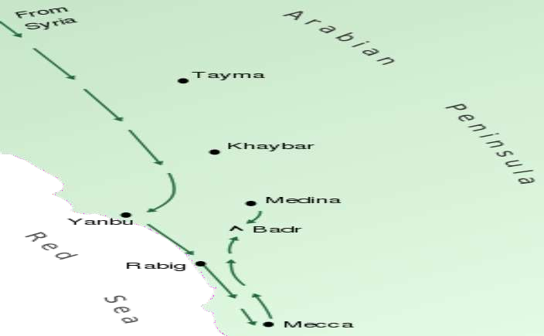
A map of the Badr

Slide 7
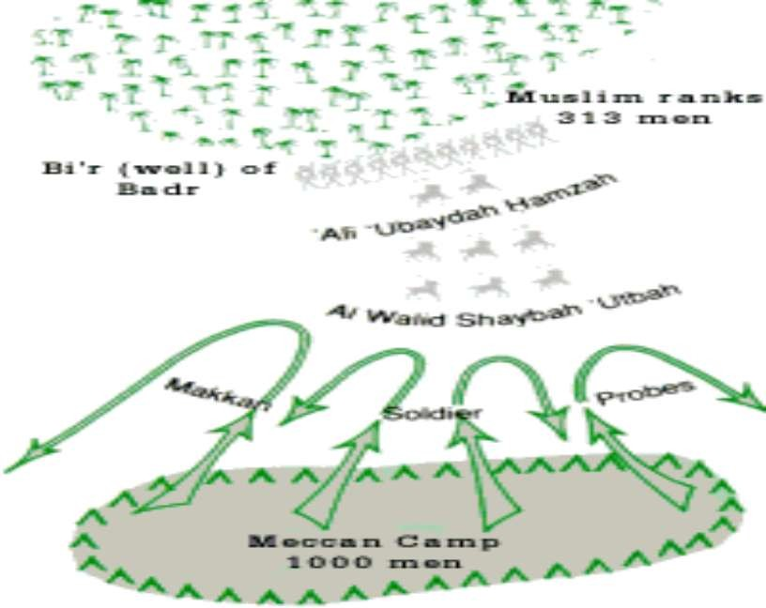

Slide 8
Reasons of the battle.
Makkan tribe (Quraysh)
Quraysh tribe had always been very
unfriendly towards the prophet, popularity of
Islam intimated them and started considering Muslims as a serious threat.
Quraysh tried to join hands with Jews,
hypocrites even people who lived between
makkah and madina to stand against Muslims
Due to there ill behavior Prophet and his
companions had to migrate towards madina

Slide 9
Allah permission to fight
Allah revealed verses of the Qur'aan giving permission
to the Muslims to fight the disbelievers. Now the
Muslims had the support of the Ansaar, they had a place where Islam prevailed and where they could retreat. It was an appropriate time for Jihad.
After the extreme and prolong attidude of Makkans
Allah allow his prophet to retaliate but in
selfdefence, because Islam seeks peace.
"Permission to fight is given to those (i.e.
believers against those disbelievers), who are
fighting them, (and) because they (believers) have been wronged, and surely Allah is Able to give them (believers) victory." [(22): 39)]

Slide 10
The policy of deterrence or
p•reventing something to happen
The state of war was between to cities
The main strength of Quraysh was their
trade, so Rasulallah directed his
companions to attack caravans passing through route of madina to bring an economic pressure on the tribe.
Among one of the raids by muslims Amr Bin
Hadrami was killed a guard of the caravan
which gave an excuse to Makkans to revolt against muslims.

Slide 11
On an other occasion caravan of abu Sufyaan was to
be attack ,one of the worst enemy of islam,the
intentions were to use this event as a bait to bring Makkans to battle.
Abu Suffayan sends a call for help to makka.
On early relization Abu Suffyah changed course.
As soon as Abu Sufyaan got his caravan safely
away from the Muslims, he sent another message to
Makkah that they were safe and no longer required assistance.
But it was to late.
Abu Jahl was looking for an excuse to attack the
He had been making preparations for almost a year, thus he was not prepared to turn back after receiving
Muslims.

Slide 12
ABU JAHL
He marched towards Madinah with an army of 1000 men,
700 camels and
300 horses.
Abu Jahl's men were well trained and well armed with spears, swords, bows and arrows, and shields.

Slide 13
On hearing the news that the Kuffaar of
Makkah had left with 1000 men to destroy
the Muslims, Rasulullah made(consultation) with the sahaba at Masji-e-Nabwi in Madinah.
Hazrat Abu Bakr Siddique (R.A.), Hazrat
Umar (R.A.) from Muhajireen and Hazrat
Saad bin Mu'az from the Ansaar and the rest of the Muslims showed their willingness and desire to defend Islaam against falsehood.

Slide 14
When Rasulullah was satisfied with the
decision, he began preparations for the
defence of Islaam.
Rasulullah left Madinah with 313 men including some teenage boys.
They only had:
3 horses,
70 camels
and a few swords.

