Slide 1
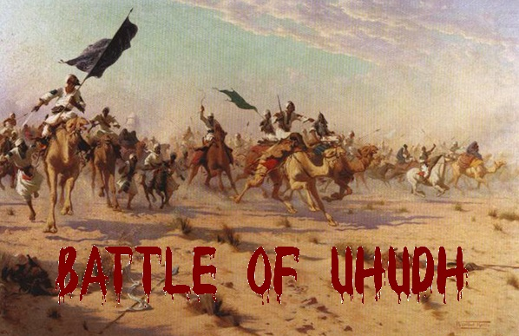
Subject Name – Seerath - V Subject Code –17UARC53
K. Bushra
Assistant Professor
H.K.R.H. College
Uthamapalayam
Historical Events

Slide 2
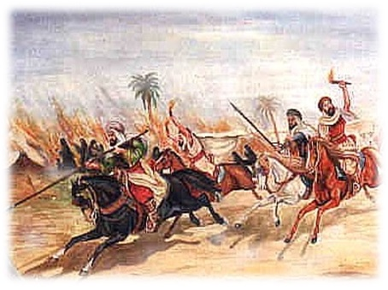
Maps of the Battle
Basic details Strength of Muslims Strength of Quraish
Reasons for the Battle Events
Map of the Battle (with events) Result
Banu Nazir exiled
Conduct of Prophet in the Battle of Uhud
Importance of Battle
Impact of the Battle
What Muslims learn from the Battle

Slide 3
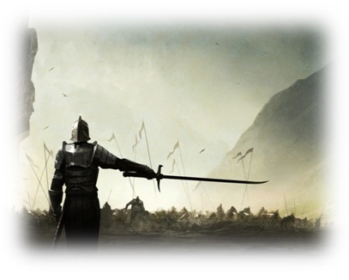
DATE:
3 AH, Saturday 15 Shawal 625AD
TEAMS:
Muslims, Quraish (Jews and Hypocrites)
LEADERS:
Muslims: Holy Prophet (PBUH)
Quraish: Abu Sufyan
PLACE:
Uhud- a hill residing 3 miles to the North of Madinah

Slide 4
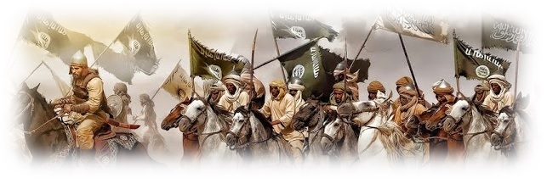
Men (Total 1000)
Men | Women | Horsemen
700 |  | 300 Went to Quraish Why? They complained that their demand of fighting inside Madinah was not fulfilled.
100 out of 700 had coats of mail | This was the first time in the history of Islam that women participated in a battle. Their main duty was: -Supply water to wounded soldiers -Wash and dress wounds Among these women were: -Aisha -Umm Salamah -Umm Ammara

Slide 5
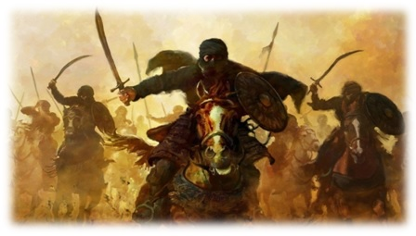
Men |  | Horses | Camels
3000 |  | 200 | 3000
Men | Women
700 out of 3000 had coats of mail | Almost 16 women participated Women who participated include: -Hind bin Utha (wife of Abu Sufyan) -Umm e Hakeem (grand daughter of Abu Jahl) -Fatima (sister of Khalid bin Waleed)

Slide 6
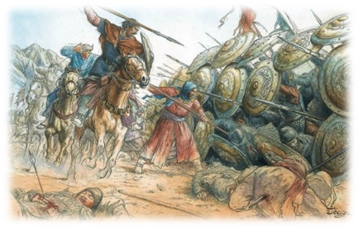
Defeat at Badr intensified the hatred and enmity of Quraish
Wanted to regain their lost prestige
Rise of Madinah was a threat to their political and commercial interests
Those who had losttheir family members at Badr
Wanted to take revenge
Those who had invested their profit at war
Their important leaders were killed at battle of Badr

Slide 7
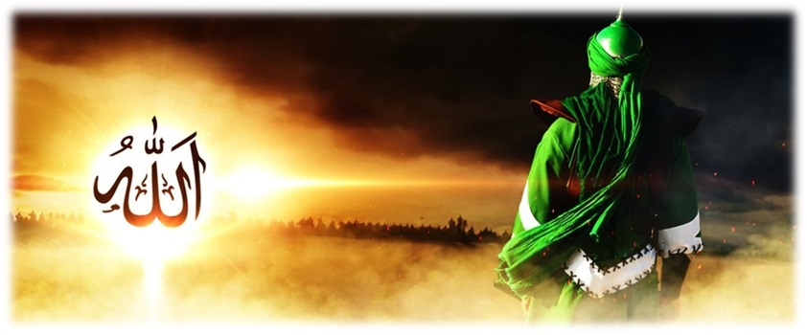
Quraish sent their poets to different tribes:
-To seek
revenge
-To write abusive poems to Holy Prophet.
People who joined Abu Sufyan in the war:
-the Jewish poet: Kab bin Ashraf
-Banu Nazir
-Hypocrites of Madinah
People made request to Abu Sufyan (Quraish leader) to wage a war against Muslims
Abu Sufyan decided that he wont take a bath till he had avenged defeat at Badr
He agreed to
request

Slide 8
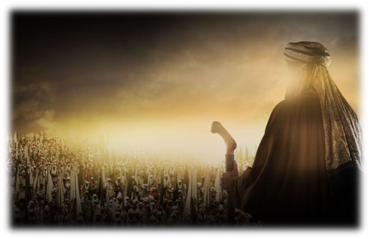
Prophet decided to fight outside Madinah upon the suggestion of most of his followers, although he himself had a different opinion
Muslims, numbered 700, marched to Uhud and encamped on the rising ground with mount Uhud on their back- their position was advantageous as the Makkan army couldn’t approach them
Upon reaching the battlefield, Prophet appointed 50 archers under the command of Abdullah bin Jubair- why?
To protect the pass in Uhud mountain
To defend Muslims from any possible attack by the enemy from the back
He instructed them clearly not leave their position under any circumstances
This strategy of the Holy Prophet is mentioned in the Quran as:
“Remember that morning you left your household to post the faithful at their station for the battle”
(3:121, Al-Imran )

Slide 9
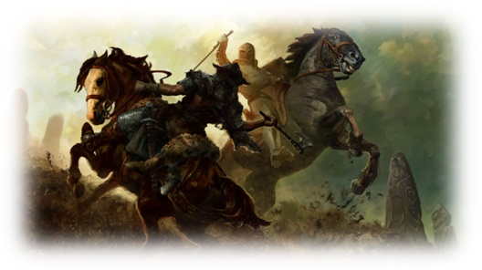
#Single Combat
MUSLIMS
QURAISH
Hazrat Ali Hazrat Hamza
KILLED
Talha Uthman
Pagan Army

Slide 10
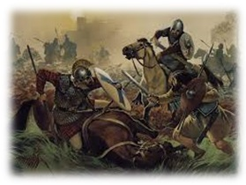
#General Fighting
Quraish attacked first
Muslims fought bravely, had an upper hand in the battle
They killed and wounded many warriors of the Quraish
The Quraish began to flee in disorder leaving behind a great deal of booty (spoils of war)
Muslims began to collect it
When the 50 archers saw that the victory was certain, about 35- 36 of them left their positions and came to collect booty
The Quran refers to these people as:
“When you, with (Allah's) permission were about to annihilate your enemy- until you (the archers) flinched and fell disputing about the order and disobeyed it” (3:152, Al-Imran )

Slide 11
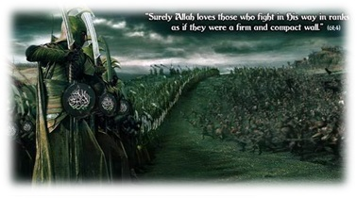
Now, the pass was left unguarded
Khalid bin Waleed (head of enemy cavalry) found the opening undefended, and attacked them
Muslims got panic-stricken
They started to run away from the battlefield
Some retreated
Quraish attacked the Holy Prophet, who was surrounded by a group of companions:
He got:
Wounded badly (specially on face)
Lost a tooth
Became unconscious
2 rings from his helmet embedded in his cheek
Including:
Saad bin Abi Waqaas
Abdur Rahman bin Auf
Abu Talha
Abu Dujaira
Rumors spread that the Prophet was killed

Slide 12
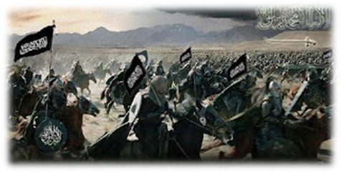
This disheartened the Muslims, they lost hope
He, therefore, stood firmly and ordered his companions to come back
Fighting was now one sided
Both parties were extremely exhausted
Soon fighting ended and the armies decided to leave
The Quraish while leaving said:
They challenged Muslims for a war next year
Abu Sufyan said: “This is a day of
(revenge) for the day of Badr and the
issue of war is undecided.”

