Slide 1
Classification of Cost
H. ANIS FATHIMA
ASSITANT PROFESSOR
DEPARTMENT OF B.COM BANKING
HKRH COLLEGE
UTHAMAPALAYAM

Slide 2
Classification of Cost
Costs can be classified based on the following attributes:

Slide 3
By Nature
In this type, material, labour and overheads are three costs, which can be further sub-divided into raw materials, consumables, packing materials, and spare parts etc.

Slide 4
By Degree of Traceability of the Product
Direct and indirect expenses are main types of costs come under it. Direct expenses may directly attributable to a particular product. Leather in shoe manufacturing is a direct expense and salaries, rent of building etc. come under indirect expenses.

Slide 5
By Controllability
In this classification, two types of costs fall:
Controllable - These are controlled by management like material labour and direct expenses.
Uncontrollable - They are not influenced by management or any group of people. They include rent of a building, salaries, and other indirect expenses.

Slide 6
By Relationship with Accounting Period
Classifications are measured by the period of use and benefit. The capital expenditure and revenue expenditure are classified under it. Revenue expenses relate to current accounting period. Capital expenditures are the benefits beyond accounting period. Fixed assets come under category of capital expenditure and maintenance of assets comes under revenue expenditure category.

Slide 7
By Association with the Product
Product cost - Product cost is identifiable in any product. It includes direct material, direct labour and direct overheads. Up to sale, these products are shown and valued as inventory and they form a part of balance sheet. Any profitability is reflected only when these products are sold. The Costs of these products are transferred to costs of goods sold account.
Time/Period base cost - Selling expenditure and Administrative expenditure, both are time or period based expenditures. For example, rent of a building, salaries to employees are related to period only. Profitability and costs are depends on both, product cost and time/period cost.

Slide 8
By Functions
Under this category, the cost is divided by its function as follows:
Production Cost - It represents the total manufacturing or production cost.
Commercial cost - It includes operational expenses of the business and may be sub-divided into administration cost and selling and distribution cost.

Slide 9
By Change in Activity or Volume
Under this category, the cost is divided as fixed, variable, and semi-variable costs:
Fixed cost - It mainly relates to time or period. It remains unchanged irrespective of volume of production like factory rent, insurance, etc. The cost per unit fluctuates according to the production. The cost per unit decreases if production increases and cost per unit increases if the production decreases.
Variable cost - Variable cost directly associates with unit. It increases or decreases according to the volume of production. Direct material and direct labour are the most common examples of variable cost. It means the variable cost per unit remains constant irrespective of production of units.

Slide 10
By Change in Activity or Volume
Semi-variable cost - A specific portion of these costs remains fixed and the balance portion is variable, depending on their use. For example, if the minimum electricity bill per month is Rs 5,000 for 1000 units and excess consumption, if any, is charged @ Rs 7.50 per unit. In this case, fixed electricity cost is Rs 5,000 and the total cost depends on the consumption of units in excess of 1000 units. Therefore, the cost per unit up to a certain level changes according to the volume of production, and after that, the cost per unit remains constant @ Rs 7.50 per unit.
The following chart shows the various elements of cost and how they are classified.

Slide 11
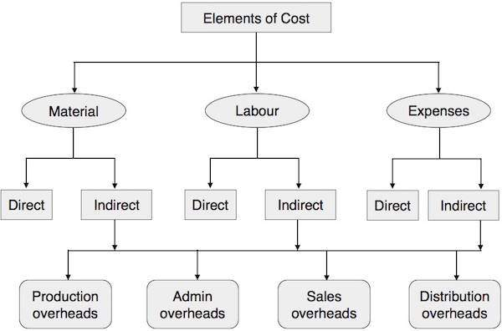

Slide 12
Direct or Indirect Materials
The materials directly contributed to a product and those easily identifiable in the finished product are called direct materials. For example, paper in books, wood in furniture, plastic in water tank, and leather in shoes are direct materials. They are also known as high-value items. Other lower cost items or supporting material used in the production of any finished product are called indirect material. For example, nails in shoes or furniture.

Slide 13
Direct Labour
Any wages paid to workers or a group of workers which may directly co-relate to any specific activity of production, supervision, maintenance, transportation of material, or product, and directly associate in conversion of raw material into finished goods are called direct labour. Wages paid to trainee or apprentices does not come under category of direct labour as they have no significant value.

Slide 14
Overheads
Indirect expenses are called overheads, which include material and labour. Overheads are classified as:
Production or manufacturing overheads
Administrative expenses
Selling Expenses
Distribution expenses
Research and development expenses

Slide 15
Cost Sheet
A cost sheet is prepared to know the outcome and breakup of costs for a particular accounting period. Columnar form is most popular. Although cost sheets are prepared as per the requirements of the management, the information to be incorporated in a cost sheet should comprise of cost per unit and the total cost for the current period along with the cost per unit and the total cost of preceding period. Data of financial statement is used for preparation of cost sheet. Therefore, reconciliation of cost sheet and financial statement should be done on a regular interval.
Format

Slide 16
COST SHEET OR STATEMENT OF COST
Opening Stock of Raw material
Add: Purchases
Less: Closing Stock
Cost of material Consumed →
Add: Direct Labour/Wages
Prime Cost →
Add: Works overheads
Works Cost →
Add: Administration overheads
Cost of Production →
Add: Selling and distribution overheads
Total Cost or Cost of Sale →
... ... ... ...

