Slide 1
DEPARTMENT OF BUSINESS ADMINISTRATION
L.SARAVANAPRIYA
SUBJECT : BUSINESS STATISTICS
CLASS : II BBA

Slide 2
Statistics
Statistics is a form of mathematical analysis that uses quantified models, representations and synopses for a given set of experimental data or real-life studies. Statistics studies methodologies to gather, review, analyze and draw conclusions from data.

Slide 3
collection of data
The bedrock of data analysis and interpretation is formed by the collection of data. ‘Data’ is basically unorganized statistical facts and figures collected for some specific purposes, such as analysis. There can be different sources of data, such as statistical and non-statistical sources.

Slide 4
Classification
Data classification is the process of sorting and categorizing data into various types, forms or any other distinct class. Data classification enables the separation and classification of data according to data set requirements for various business or personal objectives. It is mainly a data management process.

Slide 5
Tabulation
Tabulation is a systematic & logical presentation of numeric data in rows and columns to facilitate comparison and statistical analysis. It facilitates comparison by bringing related information close to each other and helps in further statistical analysis and interpretation.
In other words, the method of placing organised data into a tabular form is called as tabulation. It may be complex, double or simple depending upon the nature of categorisation.

Slide 6
Sampling
Sampling is a process used in statistical analysis in which a predetermined number of observations are taken from a larger population. The methodology used to sample from a larger population depends on the type of analysis being performed, but it may include simple random sampling or systematic sampling.

Slide 7
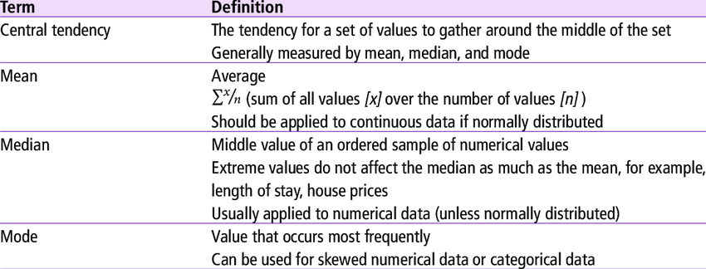
Measures of Central Tendency

