Slide 1
DEPARTMENT OF BCOM(BANKING)
K.ABDULLAH
SUBJECT :ECONOMIC DEVELOPMENT OF NDIA
CLASS : BBA

Slide 2
Economic Development
Economic development is the growth of the standard of living of a nations people from a low-income (poor) economy to a high-income (rich)economy. When the local quality of life is improved, there is more economic development.

Slide 3
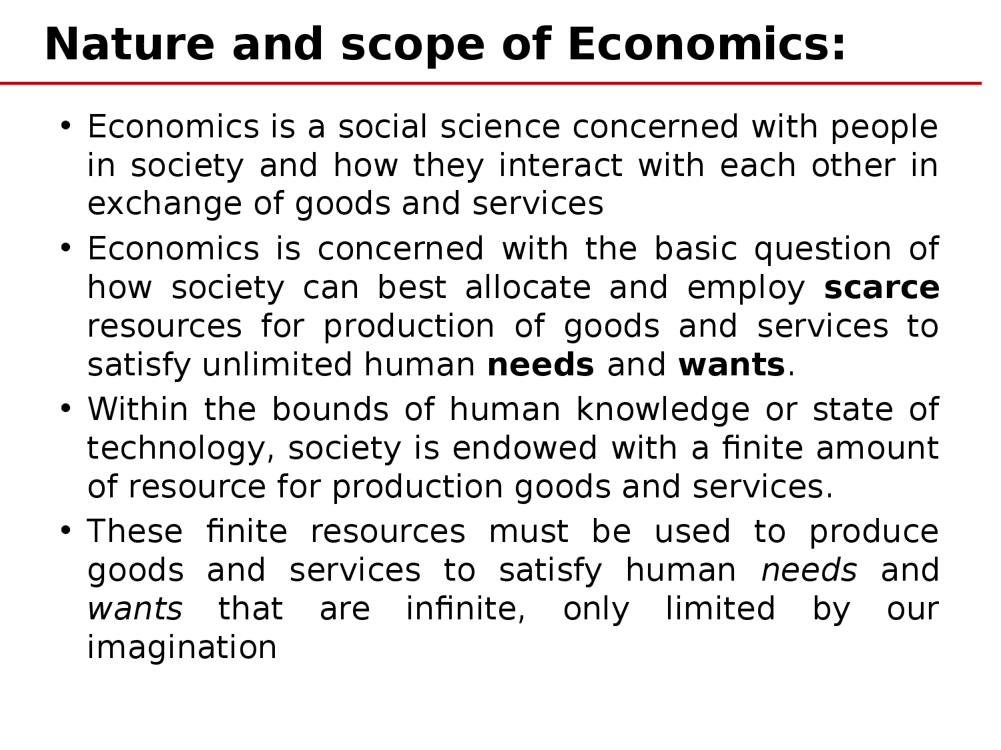
NATURE AND SCOPE OF ECONOMICS

Slide 4
BASIC ECONOMIC CONCEPTS

Slide 5
TYPES OF ECONOMICS

Slide 6
PRODUCTIVE EFFICIENCY
Productive efficiency can be defined as, or achieved by, producing at a minimum cost
By producing at a minimum cost, FEWER RESOURCES are used and MORE can be produced. This reduces scarcity and gives us more satisfaction from our existing resources.

Slide 7
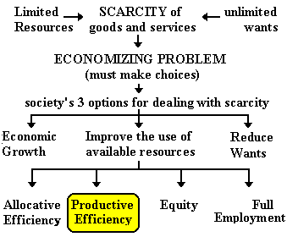
PRODUCTIVE EFFICIENCY

