Slide 1
DEPARTMENT OF BUSINESS ADMINISTRATION
S.FAIZAHAMED
SUBJECT : HUMAN RESOURCE MANAGEMENT
CLASS : III BBA

Slide 2
Human Resource Management
Human Resource Management, or HRM, is the practice of managing people to achieve better performance. For example, if you hire people into a business, you are looking for people who fit the company culture as they will be happier, stay longer, and be more productive than people who won't fit into the company culture.

Slide 3
Job Analysis
Job Analysis is a method of collecting and studying about the information related to a particular job. It includes the operations and tasks of a specific job.
This process involves two sets of information:
Job Description
Job Specificatio

Slide 4
Job Description
Job Description: This is a very vital document which is usually explanatory in nature. It consists of both organizational as well as functional information. It provides information as to the scope of activities, position of the job and the responsibilities. It gives the employees a very clear picture of what is required of him to meet the goals of his job.

Slide 5
Job Specification
Job Specification: Job Specification converts the job description to qualifications that are required for, in performing the job. This is usually a statement which consists of qualification, characteristics, traits etc, for an employee to possess to perform his duties. The first thing here is to prepare a directory of all jobs and then the next step is to make a write up of each and every job.

Slide 6
Selection
Selection is the process of choosing a qualified person for specific role who can successfully deliver valuable contributions to the organization. The term selection can be applied to many aspects of the process, such as recruitment, hiring, and acculturation.

Slide 7
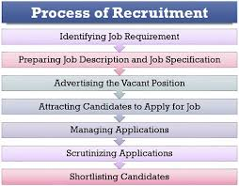
RECRUITMENT

