Slide 1
DEPARTMENT OF BUSINESS ADMINISTRATION
A.ABDULHAKEEM
SUBJECT : INTERVIEW PROCEDURE
CLASS : IIIBBA

Slide 2
Interview
The interview process is a multi-stage process for hiring new employees. The interview process typically includes the following steps: writing a job description, posting a job, scheduling interviews, conducting preliminary interviews, conducting in-person interviews, following up with candidates and making a hire.

Slide 3
Interview Process Steps
Interviews are typically broken down into these 5 stages of the interview process:
Introductions
Small Talk
Information Gathering
Question/Answer
Wrapping Up
Understanding the steps in the interview process will help your company standardize its interview process; leading to better, more qualified hires over the long term.

Slide 4
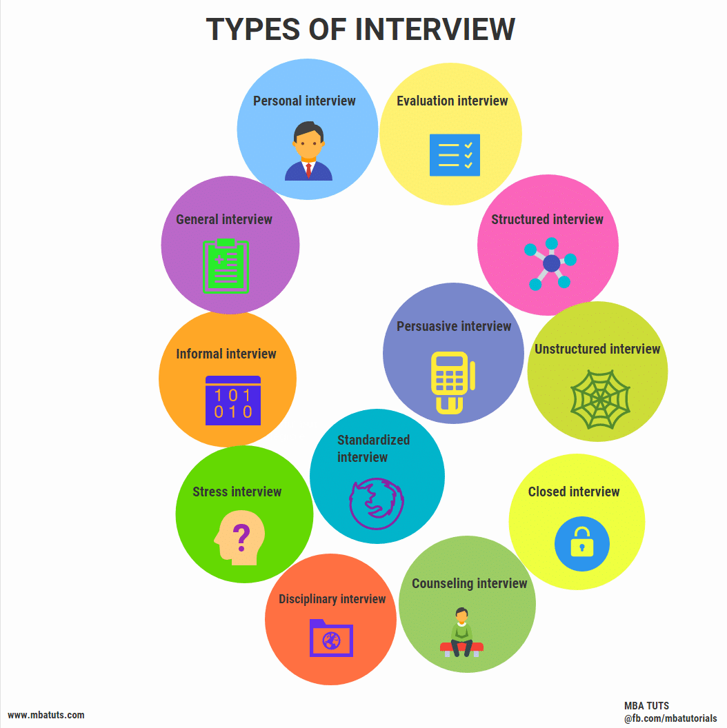
TYPES OF INTERVIEW

Slide 5
INTERVIEW SKILLS
A positive attitude and polite behaviour can go a long way in impressing people. Remember, the interview is all about you and how well you represent yourself. So be confident and follow the above tips. We are sure you will be able to do a good job.

Slide 6
10 INTERVEW SKILLS
1. Do your background research.
This may not seem like an actual interview skill, but it is. If you walk into an interview saying, "Now, what do you do again?" and "Do you guys have funding yet?" you're doomed before you begin. No matter how sparkly your personality is, you have to do the background research.
2. Be polite to everyone.
You may have heard stories of people who were rude to the receptionist, cut someone off in the parking lot, or yelled at the barista at the coffee shop around the corner and then didn't get the job. These things happen, and they can ruin your chances. I will never, ever, not in a million years hire the person who is rude to the receptionist or barista. Many recruiters and hiring managers feel the same.
3. Watch your body language.
This one is a bit harder. My Inc. colleague Minda Zetlin listed 21 body language mistakes that people make. Some of them are especially important in an interview. For instance:
Lean in or sit up straight to show you're interested.
Keep eye contact so you look honest, but don't just lock in a stare, because then you look aggressive.
Don't nod too much. Yes, you want to show agreement, but too many nods and you start to look like you don't truly care.
4. Watch your real language.
If you have a potty mouth, save it for your friends, and not for the interview. If the interviewer is letting the f-bombs fly, you can feel more comfortable doing the same, but otherwise, use words that express your actual feelings and ideas.
5. Review your own resume.
You know what you did, right? Are you sure? I once got caught off guard in an interview when the hiring manager asked me a specific question about an accomplishment on my resume. I had to stumble for a minute before my brain latched on to what she was talking about. Don't make that mistake. Refresh your memory, especially old jobs.

Slide 7
6. Prepare for standard questions.
Lots of interviewers are going to ask you to "tell me about a time when ..." followed by something appropriate for your field and this particular job. You should have great answers prepared for this. Brainstorm a list of possible questions and work on your answers. Another Inc. colleague, Jeff Haden, just listed the 27 Most Common Job Interview Questions and Answers. Definitely, review these questions before arriving at a job interview.
7. Prepare your wardrobe.
Yes, people judge you by what you're wearing. Most interviewers aren't going to care the brand of your jacket, or if the heel of your shoe is scuffed, but you should be dressed appropriately. Generally, for most professional jobs that means a suit, or one step lower. If you're concerned, go to their parking lot before the interview and watch people come out. If their style is business casual, you should wear a suit. If they are wearing jean and flip flops, you're probably fine in business casual, but better to be overdressed than underdressed, in most industries.
8. Prepare your questions.
Don't ask questions that could be answered by looking at the company website. Do ask questions about the challenges of the position, what success looks like, and how this position fits in with the organization's goals. Remember, you want to look like you're really interested in succeeding in this position, and you need this information to do so.
9. Don't badmouth your former employer.
You're most likely going to be asked why you're looking to leave your current job (or why you left your last job if you're unemployed). Don't lie, but don't be super negative either. "My boss is a huge jerk. She is nit-picky, plays favorites, and smells like tuna fish." These things may all be true, but you don't come out looking good. Figure out how to explain why you're leaving, why you got fired, what you learned from it, and how this all means this new job is a great fit.
10. Don't forget the thank you card.
It doesn't have to be a card anymore; an email will do just fine. You can get hired without one, but it's a nice gesture to send a quick follow up email to the hiring manager and recruiter. It keeps you in their minds and shows your politeness, which brings this full circle. You begin by being nice to everyone, and you end the interview by being nice to everyone, and you increase your chances.

