Slide 1
DEPARTMENT OF BUSINESS ADMINISTRATION
DR.P.KAVIMANI
SUBJECT :MARKETING MANAGEMENT
CLASS:III BBA

Slide 2
Marketing
DEFINITION
Marketing is the process of planning and executing the conception, pricing, promotion and distribution of ideas, goods and services to create exchanges that satisfy individual and organizational objectives.
American Marketing Association Definition: Marketing is the process of planning and executing the conception, pricing, promotion, and distribution of ideas, goods, services to create exchanges that satisfy individual and organizational goals.

Slide 3
Marketing Management
Marketing Management is the Art and Science of choosing target markets and getting, keeping and growing customers through creating, delivering and communicating superior customer value.

Slide 4
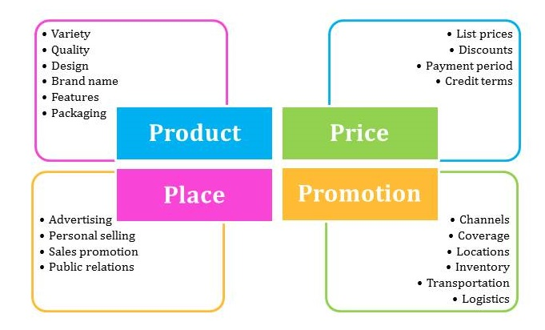
MARKETING MIX

Slide 5
Marketing Strategy
A marketing strategy can be defined as a process for allowing a company to target limited resources on the best opportunities. It results in increased sales and achieving a sustainable competitive benefit. Generally, this strategy combines all their marketing targets into one plan and achieving maximum profit. This strategy is designed for optimal allocation of scarce resources at the disposal of the organization to deliver excellent customer experiences. The Scarce resources consist of human capital, technology, time and monetary capital.

Slide 6
Types of Marketing Strategy
1. Paid Advertising
It consists of multiple approaches for the marketing. Additionally, one of the well-known marketing approaches is internet marketing.
2. Relationship Marketing
Relationship marketing mainly targets on the customer building and enhance the present relationships with the customers.

Slide 7
Types of Marketing Strategy- cont
3. Internet Marketing
Also known as cloud marketing, it takes place on the internet. Every marketing product or service shares on the internet and promotes on different platforms through several approaches.
4. Transactional Marketing
The retailers encourage their potential customers to buy the products by offering coupons, discounts, etc. This type of marketing is very common these days.

Slide 8
Advantages of Marketing Strategy
Have a look at some of the best advantages of having a marketing strategy:
Improved efficiency
There is a need of an investment in the message development, project management, design, etc. in all the marketing tools. The business owners can get more out of their budget by leveraging parts of one project across the several platforms by having a strong marketing strategy.
Targeted Approach
A marketing strategy can give marketing efforts and campaigns a target to a business. It can help the business to look different from the others and creating more customers.

Slide 9
Advantages of Marketing Strategy -cont
Better Information
The business owners are allowed to get access to a great piece of information by having a strong marketing strategy. Market research often demands by the marketing strategies that helps the owners to get a better understanding of the market. In addition to this, it can help in making goals based on a combination of future projections and past performances.
Branding
The business owners can create an impression of their company by having a marketing strategy. They can give their customers the impression that their organization is not viable if the strategy for a specific service become ineffective.

