Slide 1
DEPARTMENT OF BUSINESS ADMINISTRATION
L.SARAVANAPRIYA
SUBJECT : OPERATIONS MANAGEMENT
CLASS : III BBA

Slide 2
Operations management
Operations management is the administration of business practices to create the highest level of efficiency possible within an organization. It is concerned with converting materials and labor into goods and services as efficiently as possible to maximize the profit of an organization. Operations management teams attempt to balance costs with revenue to achieve the highest net operating profit possible.

Slide 3
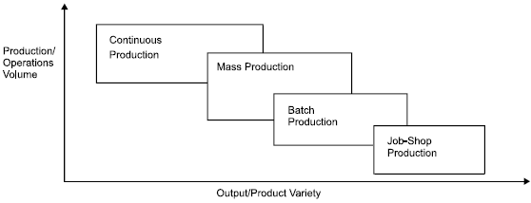
Production System
The production system of an organization is that part, which produces products of an organization.
Classification of production systems:

Slide 4
Scheduling and Routing
Scheduling is the process of arranging, controlling and optimizing work and workloads in a production process or manufacturing process. Scheduling is used to allocate plant and machinery resources, plan human resources, plan production processes and purchase materials.
Routing is the process of selecting a path for traffic in a network or between or across multiple networks. Broadly, routing is performed in many types of networks, including circuit-switched networks, such as the public switched telephone network, and computer networks, such as the Internet.

Slide 5
Plant layout
Plant layout is the most effective physical arrangement, either existing or in plans of industrial facilities i.e arrangement of machines, processing equipment and service departments to achieve greatest co-ordination and efficiency of 4M’s (Men, Materials, Machines and Methods) in a plant.
Objectives of Good Plant Layout:
A good rather an optimum layout is one which provides maximum satisfaction to all concerned i.e. shareholders, management employees and consumers.

Slide 6
PERT
Project Evaluation and Review Technique (PERT) is a procedure through which activities of a project are represented in its appropriate sequence and timing. It is a scheduling technique used to schedule, organize and integrate tasks within a project. PERT is basically a mechanism for management planning and control which provides blueprint for a particular project. All of the primary elements or events of a project have been finally identified by the PERT.

Slide 7
CPM
Critical Path Method (CPM) is a method used in project planning, generally for project scheduling for the on-time completion of the project. It actually helps in the determination of the earliest time by which the whole project can be completed. There are two main concepts in this method namely critical task and critical path. Critical task is the task/activity which can’t be delayed otherwise the completion of the whole project will be delayed. It must be completed on-time before starting the other dependent tasks.

