Slide 1
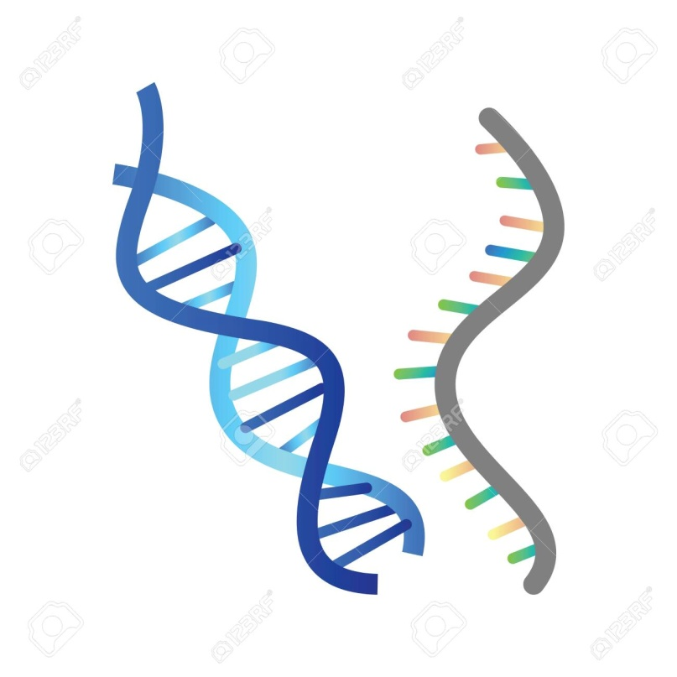
Nucleic acid as the genetic material
B.NITHYA, ASSOCIATE PROFESSOR & HEAD, DEPARTMENT OF BIOCHEMISTRY,
H.K.R.H. COLLEGE, UTHAMAPALAYAM.

Slide 2
Introduction
The progeny of organism develops characters similar to that organism
The resemblance of offspring to their parents depends on the precise transmission of principle component from one generation to the next
That component is-
The Genetic Material

Slide 3
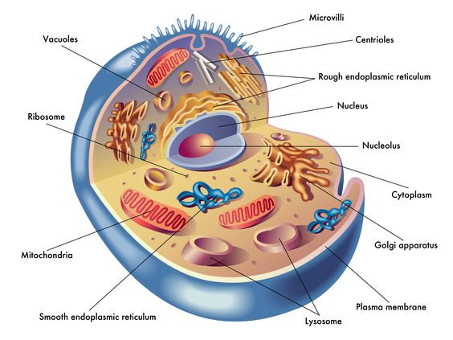
The genetic material of a cell or an organism refers to those materials found in the nucleus, mitochondria and cytoplasm, which play a fundamental role in determining the structure and nature of cell substances, and capable of self-propagating and variation.

Slide 4
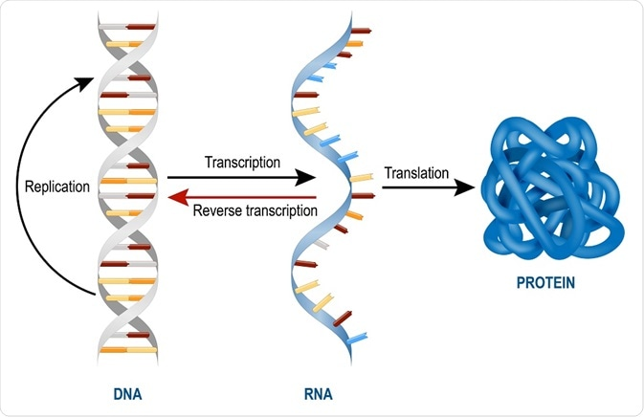
What is Genetic material ?
DNA Protein RNA Protein,RNA and DNA were thought as genetic material. But many experiments suggest DNA as genetic material rather than protein and RNA.

Slide 5
FOUR REQUIREMENTS FOR GENETIC MATERIAL
Must carry information – Cracking the genetic code
Must self replicate – DNA replication
Must allow for information to change – Mutation
Must govern the expression of the phenotype – Gene function

Slide 6
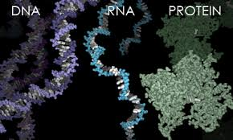
Identificaation of genetic material
DNA RNA PROTEINDNA

Slide 7
Identificaation of genetic material
The process of identification of genetic material began in 1928 with experiments of Griffith and concluded in 1952 with the studies of Hershey and Chase.
• Between these two experiments other three scientists, Avery, Macloed and McCarty were did an experiment to identify the genetic material.

Slide 15
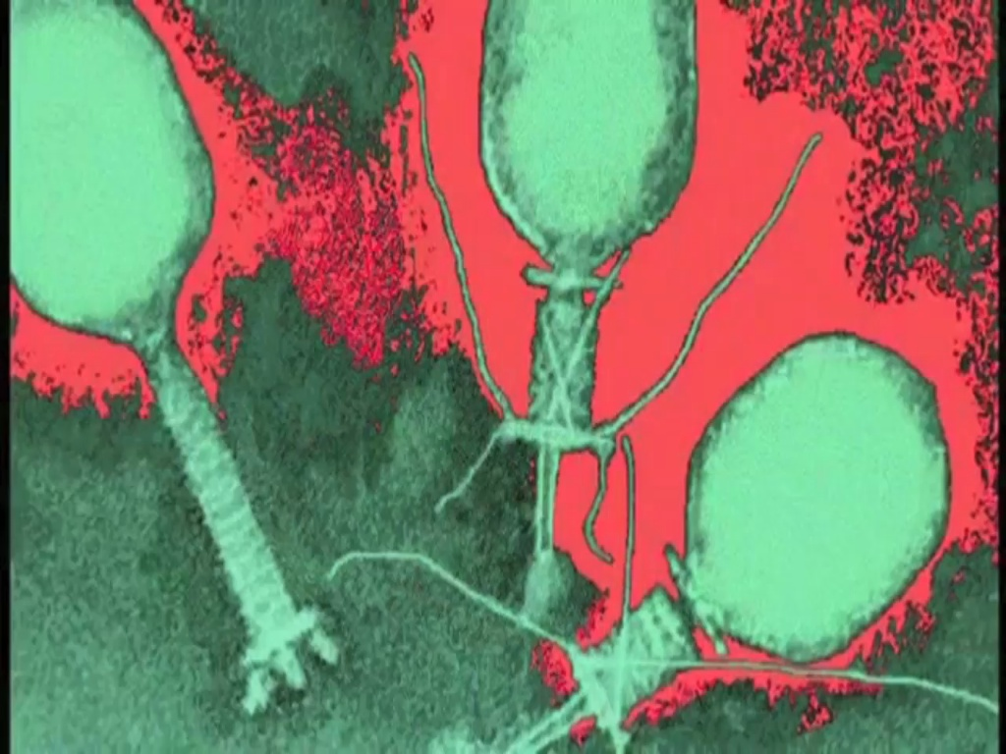

Slide 17
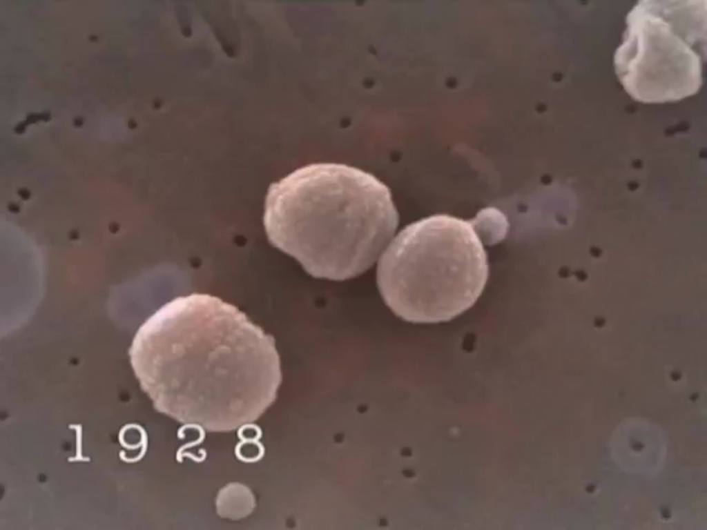
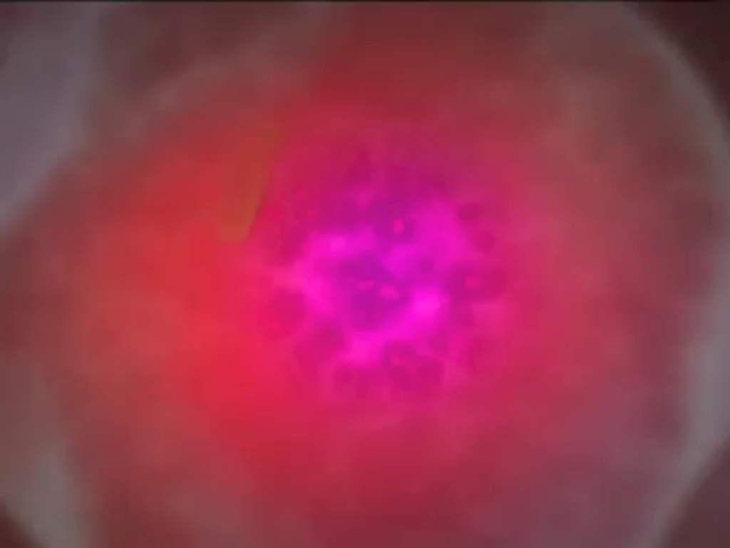

Slide 18
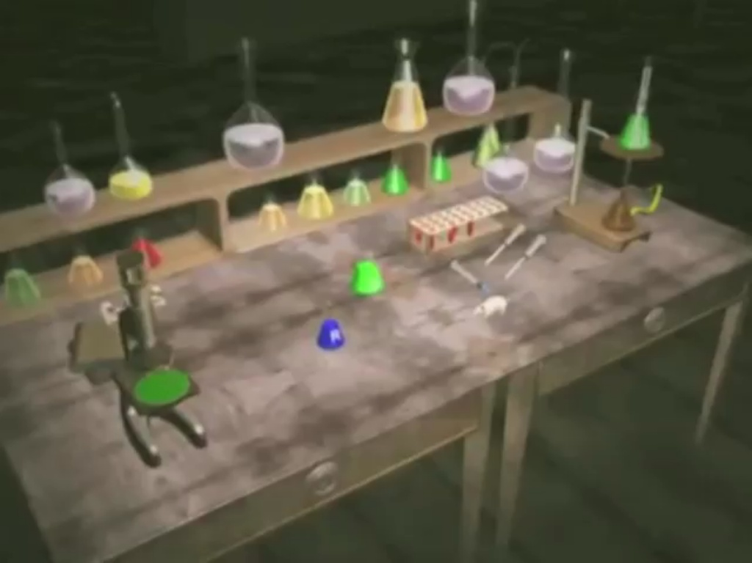

Slide 20
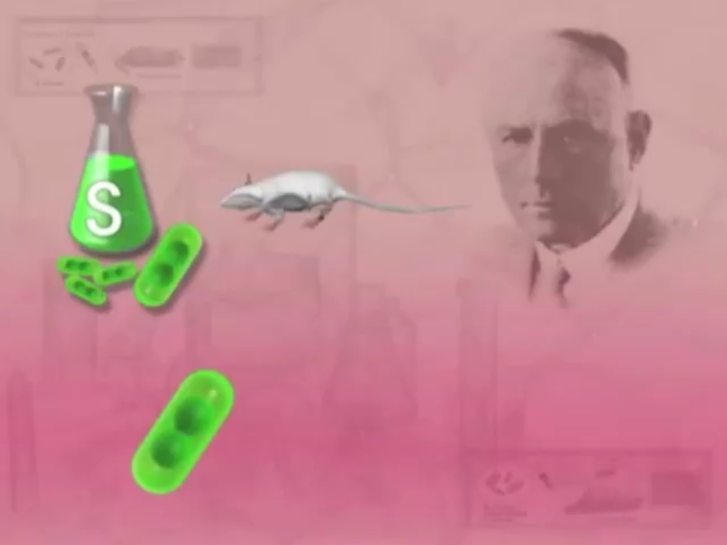

Slide 21
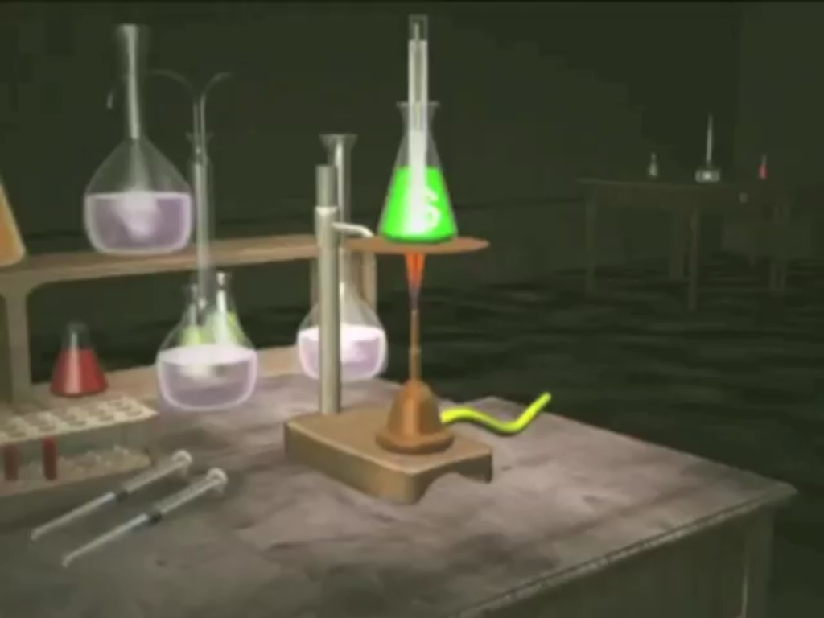

Slide 22
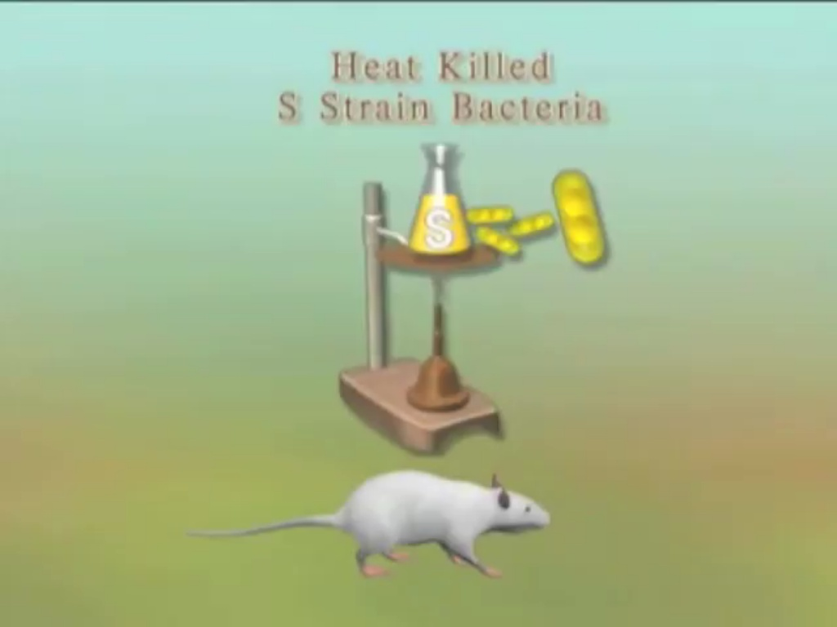

Slide 23
