Slide 1
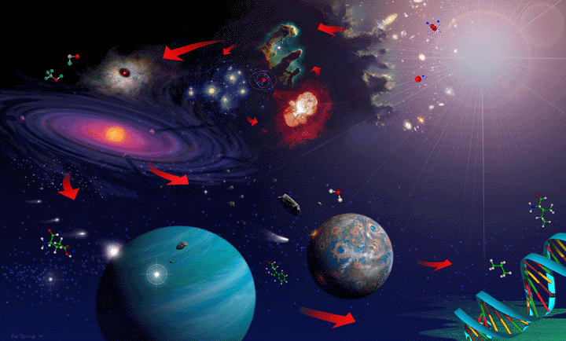
PERIODIC ORIGIN OF BIOMOLECULES
B.NITHYA, ASSOCIATE PROFESSOR, HEAD, DEPARTMENT OF BIOCHEMISTRY, H.K.R.H. COLLEGE, UTHAMAPALAYAM.

Slide 2
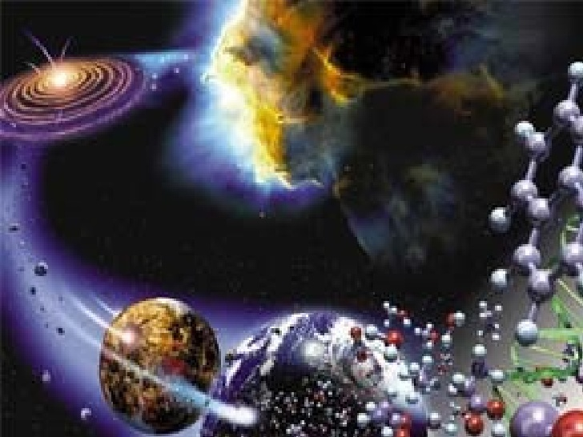
In 1864, Louis Pasteur described his experiments showing that microbial life could not originate spontaneously in the absence of preexisting life.
Does Spontaneous generation is the idea that organisms could form miraculously from non-living material.
Rapid spontaneous generation of whole organisms in a few weeks, but from a long and gradual process of chemical evolution.

Slide 3
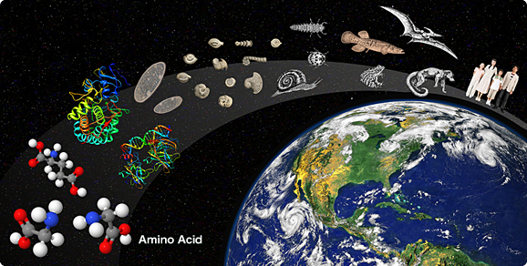
In the early years after the formation of the solar system, the terrestrial planets continued to be bombarded by smaller bodies of various sizes as the last of the particulate material from the formation of the planets was swept-up by their gravitational pull.
This bombardment, measured from radioactive dating of the moon's craters, and by comparing lunar, martian, and mercurian cratering records, gradually declined in intensity until it reached present-day levels about 3.5 billion years ago.
The effect of the bombardment on the origin of life was significant. Bombardment affected:
1. the temperature of the early Earth
2. the composition of the atmosphere
3. delivered biogenic elements to Earth (biogenic elements are those chemicals common to all living organisms - like phosphates)
4. Finally, the high energy released could also have delayed the origin of life.

Slide 4
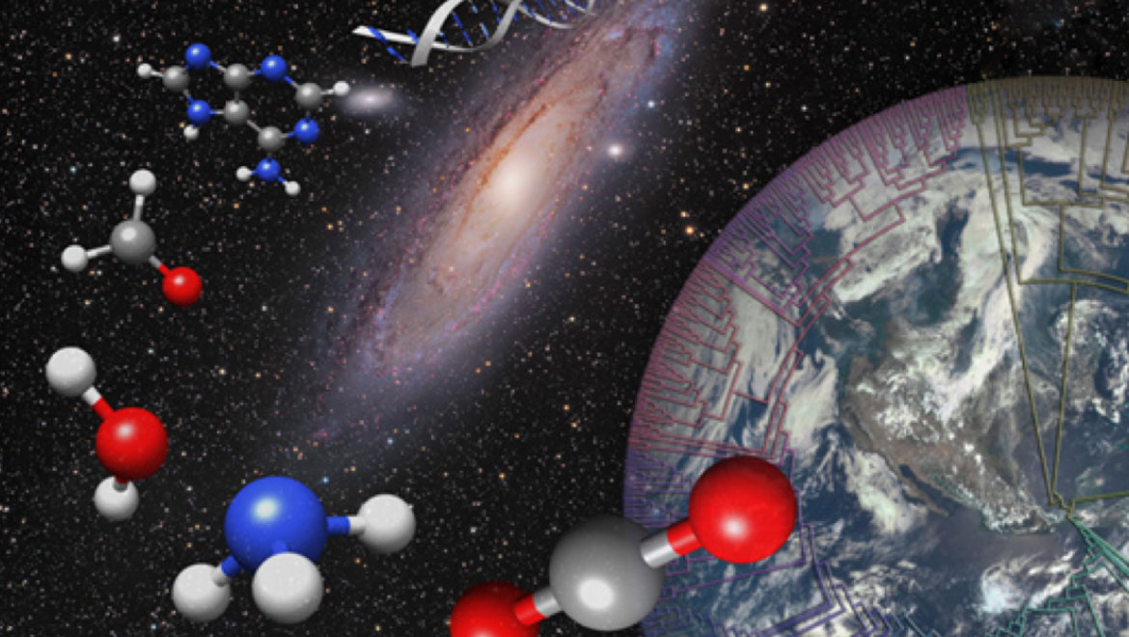
Because most of the matter in the solar system is hydrogen the early atmosphere of Earth must have been rich in hydrogen. Therefore, they concluded other elements (such as carbon, oxygen, nitrogen, and sulfur) would be bound to hydrogen in their reduced forms as
CH4 (methane),
NH3 (ammonia),
H2S (hydrogen sulfide), and
H2O (water)
As these organic compounds accumulated they formed an "organic soup" in which additional reactions could take place.

Slide 5
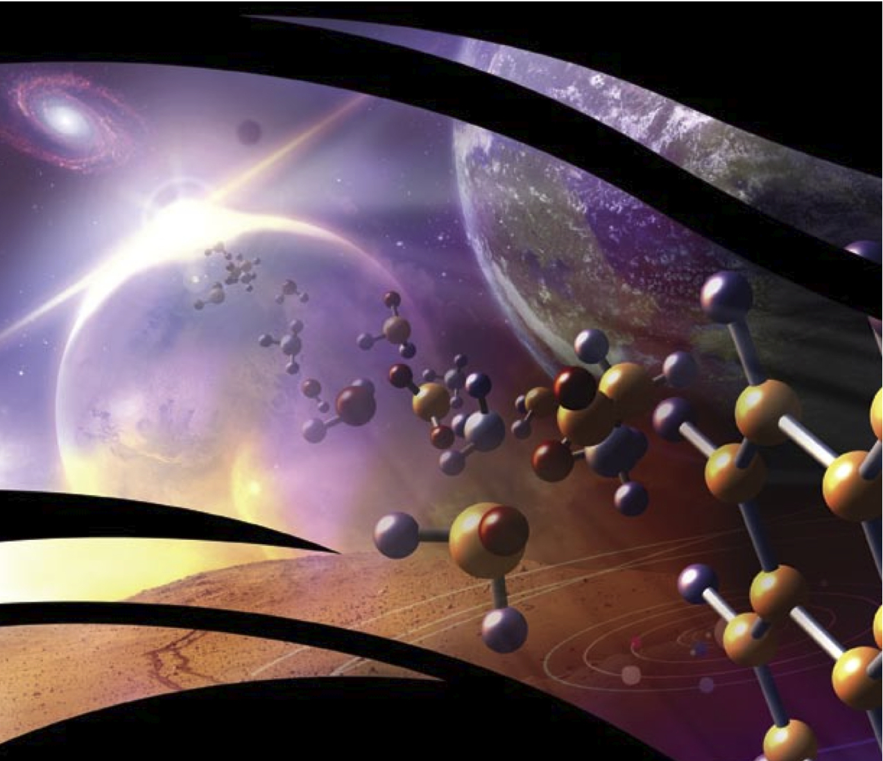
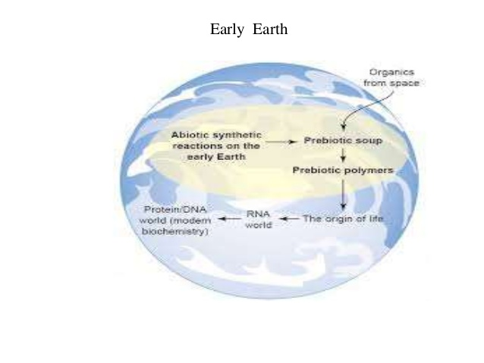

Slide 6
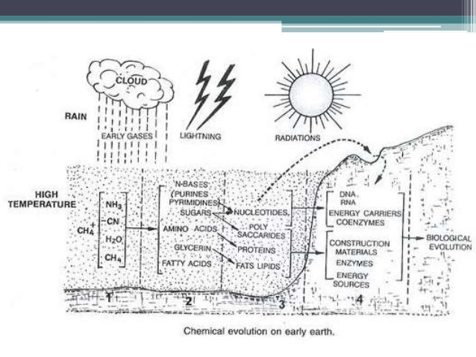

Slide 7
The ease of formation of amino acids, purines, pyrimidines, sugars and a wide variety of other organic compounds under plausible prebiotic conditions suggests that these molecules may have been present in the primitive terrestrial environment.
It is likely that collisions of cometary nuclei with the primitive Earth, combined with the contribution from other extraterrestrial bodies such as meteorites and interplanetary dust particles, may have supplemented the primordial broth with extraterrestrial organic molecules.
Submarine hydrothermal vents also likely played some role in prebiotic organic evolution.
The primordial soup may have been a bewildering organic chemical wonderland, but it likely did not include all the compounds or molecular structures found in modern living systems.
Regardless of their ultimate origin, simple organic compounds dissolved in the primitive oceans would need to be concentrated and polymerized by simple physicochemical mechanisms

Slide 8
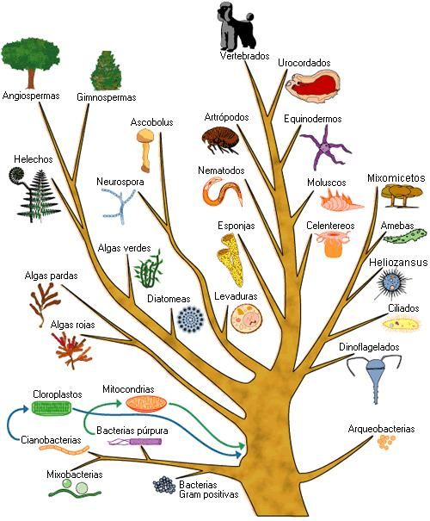

Slide 18
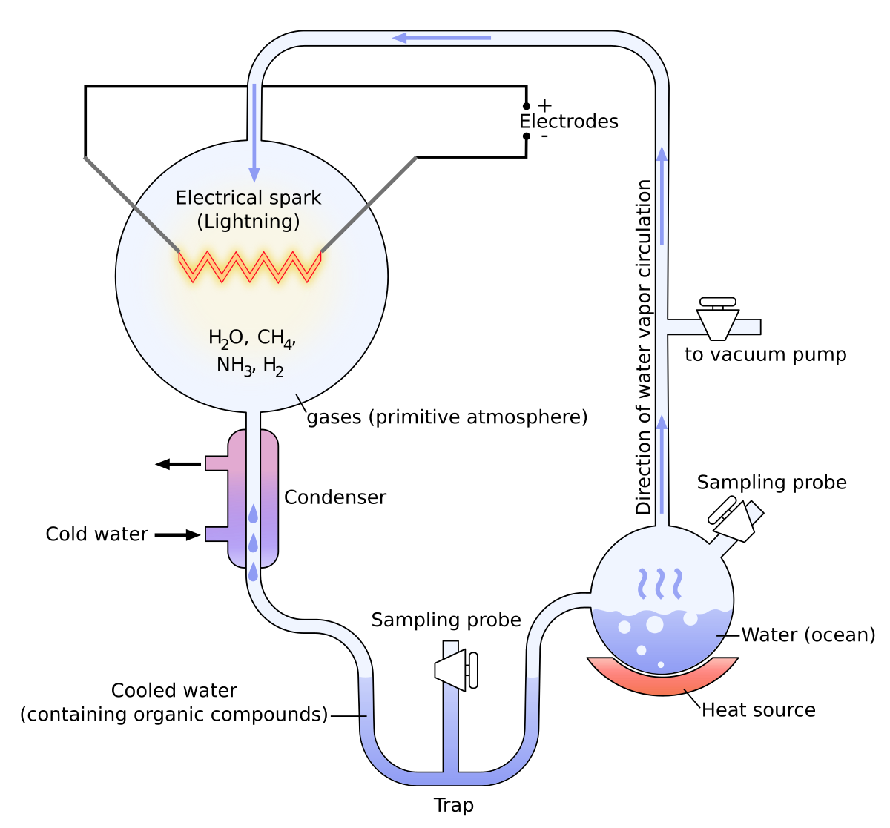

Slide 21
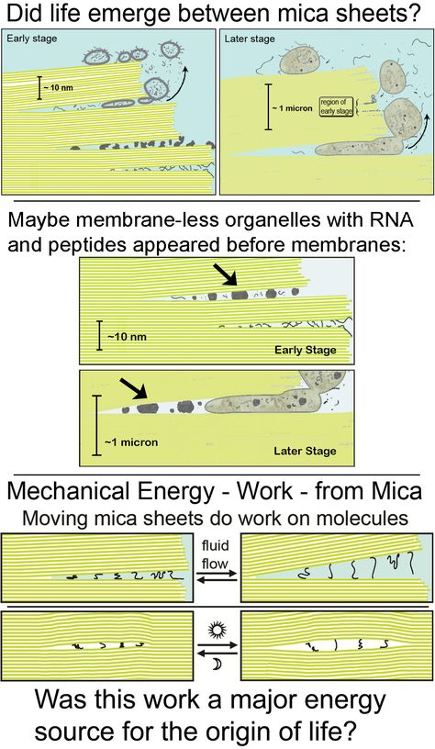
The mica hypothesis is a new hypothesis about how life might have originated. The mica hypothesis provides simple solutions to many basic questions about the origins of life.
In the mica hypothesis, the spaces between mica sheets functioned as the earliest cells. These ‘cells’ between mica sheets are filled with potassium ions, and they provide an environment in which: polymer entropy is low; cyclic wetting and drying can occur; molecules can evolve in isolated spaces and also migrate and ligate to form larger molecules.
The mica hypothesis also proposes that mechanical energy (work) is a major energy source that could have been used on many length scales to form covalent bonds, to alter polymer conformations, and to bleb daughter cells off protocells.

Slide 22
The mica hypothesis is consistent with many other origins hypotheses, including the RNA, lipid, and metabolic ‘worlds’.
Therefore the mica hypothesis has the potential to unify origins hypotheses, such that different molecular components and systems could simultaneously evolve in the spaces between mica sheets.

Slide 23
