Slide 1
HAJEE KARUTHA ROWTHER HOWDIA COLLEGE
UTHAMAPALAYAM
DEPARTMENT OF BIOCHEMISTRY
NAME : S. MUTHUPRIYA
STAFF CODE: TNMK021SFT127
COURSE NAME: BIOCHEMICAL TECHNIQUES
COURSE CODE: 17UBCC21
TOPIC: THIN LAYER CHROMATOGRAPHY

Slide 2
Thin layer chromatography (TLC)
It is a method for identifying substances and testing the purity of compounds.
TLC is a useful technique because it is relatively quick and requires small quantities of material.

Slide 3
Separations in TLC involve distributing a mixture of two or more substances between a stationary phase and a mobile phase.
The stationary phase:
It is a thin layer of adsorbent (usually silica gel or alumina) coated on a plate.

Slide 4
The mobile phase:
It is a developing liquid which travels up the stationary phase, carrying the samples with it.
Components of the samples will separate on the stationary phase according to how much they adsorb on the stationary phase versus how much they dissolve in the mobile phase.

Slide 5
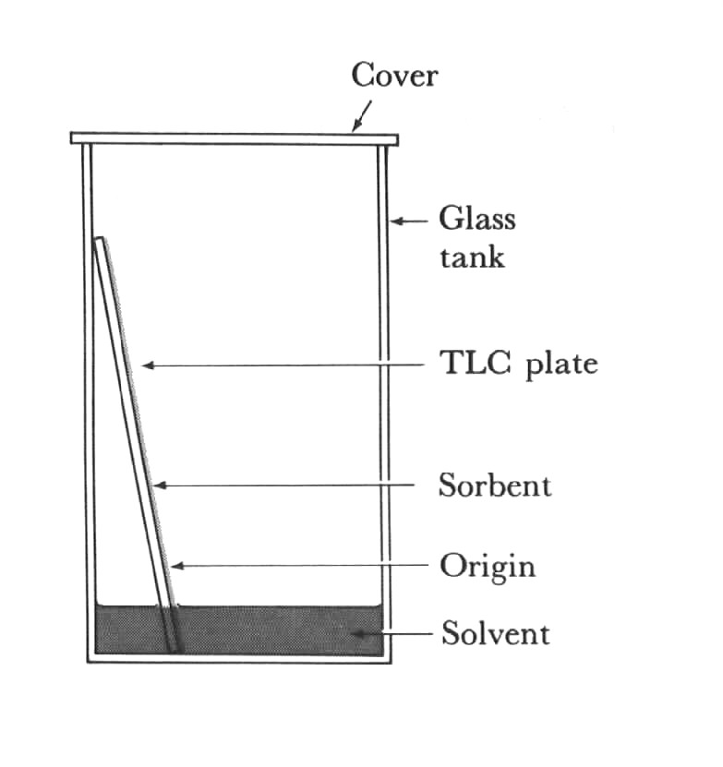
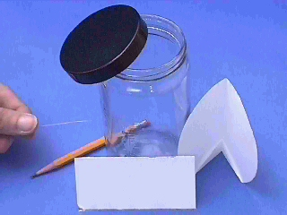
Thin Layer Chromatography (TLC)

Slide 7
Preparing the Chamber
To a jar with a tight-fitting lid add enough of the appropriate developing liquid so that it is 0.5 to 1 cm deep in the bottom of the jar.
Close the jar tightly, and let it stand for about 30 minutes so that the atmosphere in the jar becomes saturated with solvent.

Slide 8
Preparing the Plates for Development
With a pencil, each two small notches into the adsorbent about 2 cm from the bottom of the plate.
The notches should be on the edges of the plate, and each notch should be the same distance up from the bottom of the plate.
The notches must be further from the bottom of the plate than the depth of the solvent in the jar.
Using a drawn-out capillary tube, spot the samples on the plate so that they line up with the notches you etched.

Slide 9
Developing the Plates
After preparing the development chamber and spotting the samples, the plates are ready for development.
Be careful to handle the plates only by their edges, and try to leave the development chamber uncovered for as little time as possible.
When the plates are removed from the chamber, quickly trace the solvent front (the highest solvent level on the plate) with a pencil.

Slide 10
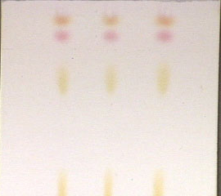
Identifying the Spots (visualization)
If the spots can be seen, outline them with a pencil.
If no spots are obvious, the most common visualization technique is to hold the plate under a UV lamp.
Many organic compounds can be seen using this technique, and many commercially made plates often contain a substance which aids in the visualization of compounds.

Slide 11
Visualizing Agents
Alkaloids: Dragendorff’s reagent
Cardiac glycosides: Antimony trichloride
Sugar: Aniline phthalate
Amino acids: Ninhydrin

Slide 12
Interpreting the Data
The R_{f} (retention factor) value for each spot should be calculated.
It is characteristic for any given compound on the same stationary phase using the same mobile phase for development of the plates.
Hence, known R_{f} values can be compared to those of unknown substances to aid in their identifications.

Slide 13
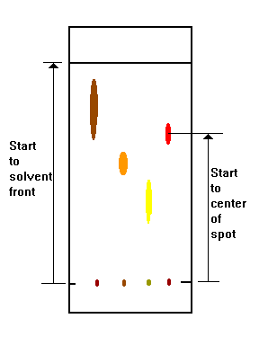

Slide 14
(Note: R_{f} values often depend on the temperature and the solvent used in the TLC experiment.
The most effective way to identify a compound is to spot known substances – authentic - next to unknown substances on the same plate)

Slide 15
In addition, the purity of a sample may be estimated from the chromatogram.
An impure sample will often develop as two or more spots, while a pure sample will show only one spot

Slide 16
REFERANCE:
SEPARATION METHODS IN Biochemistry. CJOR Morris and Maris
Manometric and Biochemical techniques. Umbrit and Burris.

