Slide 1
HAJEE KARUTHA ROWTHER HOWDIA COLLEGE UTHAMAPALAYAM DEPARTMENT OF BIOCHEMISTRY NAME: V.VALAVANTHAL STAFF CODE: TNMK021SFT145 COURSE NAME: PLANT BIOCHEMISTRY COURSE CODE: 17UBCC62 TOPIC: PHOTOSYNTHESIS

Slide 2
Photosynthesis
Photosynthesis process
Photosynthetic apparatus
Photosynthetic pigment
Light photosynthetic reaction
Dark photosynthetic reaction

Slide 3
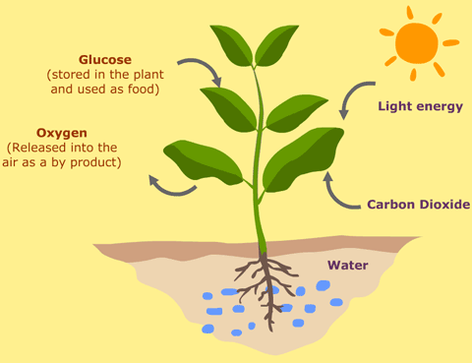

Slide 4
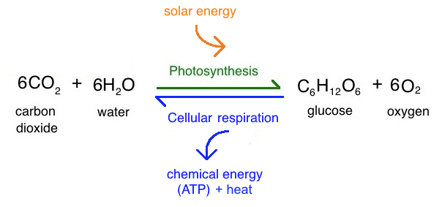
Photosynthesis process
Photosynthesis is a process used by plant and other organisms to convert light energy into chemical energy
The chemical energy is stored as carbohydrate or sugar which was synthesis from CO2 , H2O sunlight
O2 is released as the waste product.
it carried out by green pigment chlorophyll

Slide 5
apparatus
Chloroplast is the site of photosynthesis ,which is the part of plastids present in cytoplasm
Chloroplast contain a internal membrane called thylakoid .
It contain stomata which enter the CO2 and contain the chlorophyll pigment which function to produce glucose
It present in palisade mesophyll, spongy mesophyll, and paranchyma cell

Slide 8
pigments
The photosynthetic pigment present in chloroplast and capture the light energy necessary for photosynthesis
chlorophyll - green coloured pigment
Carotene - orange pigment
Xanthophyll - yellow pigment
Phaeophytin a - grey coloured pigment
Phaeophytin b - yellow brown pigment
Chlorophyll a - blue green pigment
Chlorophyll b - yellow green pigment

Slide 10
Chlorophyll perform photosynthesis
Molecular formula C55H70O6N4Mg
It pump H⁺ ion across thylakoid membrane set up ac chemiosmotic potential used in production of ATP to reduce NADP to NADPH which was universal agent used to reduce CO2
Chlorophyll a absorbs a wave length about 400-450nm and at 650-700nm
It passing the energized electron on to molecule
Chlorophyll b absorb a wave length about 450-500nm and at 600-650nm

Slide 11
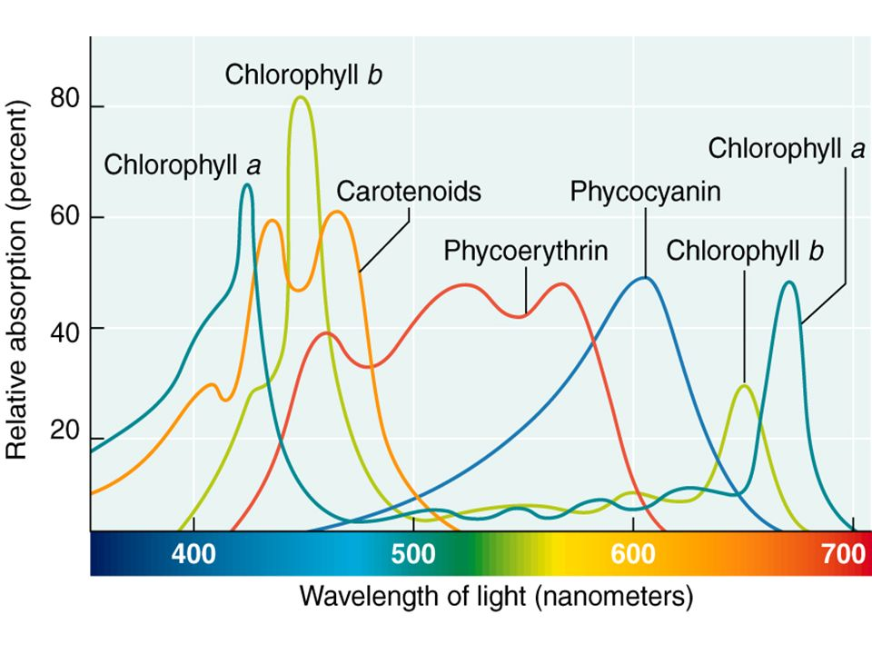

Slide 12
Carotenoid cannot transfer sunlight energy directly to the photosynthetic pathway so called as accessory pigment .they do not soluble in water.
It absorbs 460- 550nm
Phycobilins are water soluble pigment it present in a stoma of the chloroplast
Xanthophylls also a accessory pigment .they do not absorb energy and it was fat soluble
Anthocyanin contain copper are stored in vacuole of a plant .it was fat soluble.

Slide 13
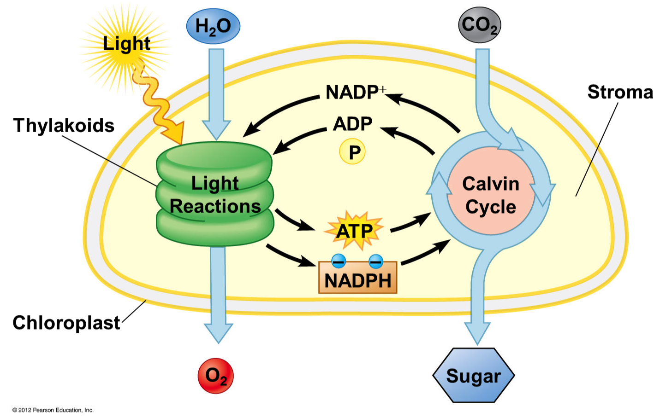

Slide 14
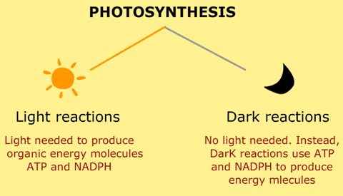
Light reaction
The light dependent reaction occurs in the thylakoids in chloroplast, chlorophyll is required for the process .
The main purpose of light reaction is to generate organic energy molecule . Such as ATP and NADPH .

Slide 15
In ETC
When light fall on the plant chlorophyll absorb the red and blue segment in a white light and electron in it get excited
It occur in the complex protein collectively called as photosystem .PSІ and PSІІ.
Chlorophyll are excited give up the electron and to compensate for the loss of electron
Water split to release a four H⁺ ion and four electron and O2
The electron lost from PSІІ enter into electron transport chain (ETC)

Slide 17
Cyclic photophosphorylation
The electron follow a different ,circular path and only ATP is produce (no NADPH)
The process occurs in the thylakoid and help of PSІ and chlorophyll P700.
The H⁺ ion buildup inside the lumen creates positive gradient in the presence of ATP synthetase. H⁺ ion combine with ADP to form ATP.
Electron transfer back to P700 moving to NADP from the electron acceptor in the downward due to formation of ATP
2H20+2NADP+3ADP+3PI → 2NADPH+3ATP+O2

Slide 19
Non cyclic photophosphorylation
The electron released by P700 are carried by primary acceptor and passed to NADP
Electron combine with H⁺ and split by water molecule to reduce NADP to NADPH
the lost electron by P680 photosystemІІ are occupied by the P700 of PSІ and is not return back to P680 so is called non cyclic phosphorylation

Slide 20
Dark reaction
Light independent reaction do not directly require light , but require NADPH and ATP produced by light reaction to produce glucose
It also called the Calvin cycle and occur in stroma and Co2 was absorb it
Co2 enter in the Calvin cycle it combine with ribulose biphosphate or RuBp to produce 3 carbon molecule and 3 PGA by the help of enzyme rubisco is called carbon fixation

Slide 21
ATP and NADPH from the light reaction gives a electron to 3 carbon molecule it convert into glyceraldehyde-3-phosphate
Three turn of cycle is need for one G3P molecule exit the cycle.
Glucose is made up of 6 carbon ,so 2G3P was needed to make 1glucose

Slide 23
Hatch –slack pathway
C4​ plants minimize photorespiration by separating initial 2CO2​ fixation and the Calvin cycle in space, performing these steps in different cell types.
Atmospheric 2CO2​ is fixed in the mesophyll cells to form a simple, 44-carbon organic acid (oxaloacetate). This step is carried out by a non-rubisco enzyme, PEP carboxylase,

Slide 24
ATP must be expended to return the three-carbon “ferry” molecule from the bundle sheath cell and get it ready to pick up another molecule of atmospheric 2CO2​
C4​ plants are common in habitats that are hot, but are less abundant in areas that are cooler. In hot conditions, the benefits of reduced photorespiration likely exceed the ATP cost of moving 2CO2​ from the mesophyll cell to the bundle-sheath cell.

Slide 25
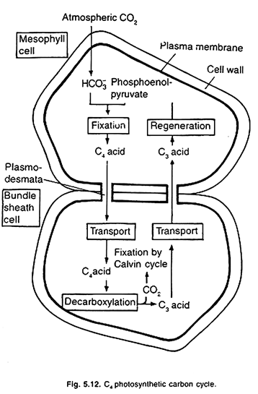

Slide 26
REFERANCE:
Plant Biochemistry by Devlin and Witham
Plant Biochemistry by Ross and Salisburry

Slide 27
Thank you

