Slide 1
Euphorbiaceae
A.MAAJITHA BEGAM
ASST.PROF.OF BOTANY
HKRH COLLEGE
UTHAMAPALAYAM

Slide 2
Distinguishing characters
Diagnostic characters
Habit: Annual perennial Herbs, shrubs, or tree; most of plants are xerophytic; presence of milky juice.
Roots: Tap root
Stem: Herbaceous and fleshy; spiny;

Slide 3
Leaves Sessile or petiolate; alternate; simple; there is general tendency of reduction in leaves. Sometimes, leaves are reduced to scales or spines.
Inflorescence: Racemose or cymose; Often a cyathium, cyathium has single naked female flower in the centre. Five involucral bracts surround it. In the axil of each flower, there are naked male flowers.

Slide 4
Flower: Pedicillate; bracteate; actinomorph lc: Regular; incomplete; unisexual; hypogynous;
Perianth: 5 perianth leaves; free: sometimes perianth is totally absent.
Stamens: 5 stamens; free;
Carpel: Tricarpillary; syncarpous ovary superior; Axile placentation.
Fruits: Shizocarpic fruit regma, rarely a capsule
Seed: Endospermic.

Slide 5
DISTRIBUTION
Distribution: Euphorbiaceae includes 214 genera and about 5600 species. The plants of this family are found throughout the world. Well represented in Africa and South America.

Slide 6
HABIT
Habit: Mostly shrubs (Ricinus communics, Jatropha gossypifolia) or tree Emblica officinalis, herbs (Phyllanthus amarus) , twiners (Tragia involucrata) some are xerophytic (Euphorbia) with cactus – like (phylloclades) plants usually contain milky or watery sap.

Slide 7
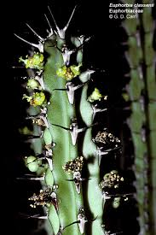
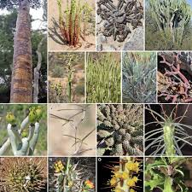
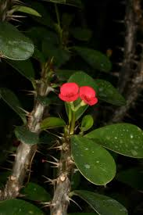
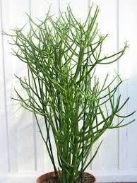
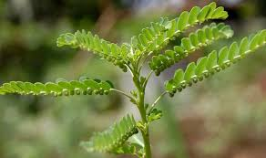

Slide 8
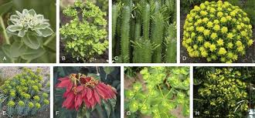
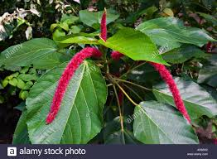
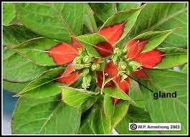
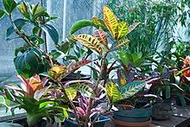
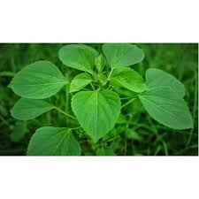

Slide 9
ROOT
Root: Well branched tap root system.

Slide 10
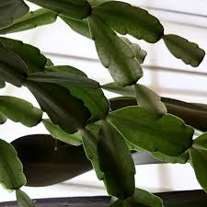
STEM
Stem: Aerial, erect or prostrate (E.prostrata), herbaceous or woody. Stem becomes modified into flattened, leaf-like and becomes succulent in several species of Euphorbia. Such modified stem is called phylloclades. Cylindrical, branched, solid or hollow, usually contain latex either milky (E.tirucalli) or watery (Jatropha curcas).

Slide 11
LEAVES
Leaf: Stipulate or exstipulate. Mostly simple, alternate, often reduced or deciduous as in several species of Euphorbia, palmately lobed in Ricinus or deeply lobed in Manihot. The stiplues are modified into a pair of spines (E.splendens) or glandular hairs (Jatropha curcas ). The leaves around the cyathium inflorescence become beautifully coloured in E.pulcherrima (Paalperukki tree) with unicostate or multicostate reticulate venation.

Slide 12
INFLORESCENCE
Inflorescence: The inflorescence of Euphorbiaceae varies greatly, Terminal raceme – Croton, Ricinus, Catkin – Acalypha hispida Cyme - Jatropha, solitary axillary – Phyllanthus asperulatus, cyathium – Euphobia species.

Slide 13
CYATHIUM
Cyathium is the an unique and special inflorescence of this family. Each cyathium contains centrally a single, naked terminal female flower, usually represented by a tricarpellary gynoecium. The female flower is surrounded by a cup-like involucre formed by 4 or 5 connate sepaloid bracts. In the axil of each bract develops a group of stamens in a scorpioid manner. Each stamen represents a naked male flower because it is a jointed structure, its upper portion is the filament bearing the anther and its lower portion represents the pedicel of the male flower bearing stamen. A nectar secreting gland is present on the rim of the involucre. Glands are oval or crescent shaped and often brightly coloured. Though cyathium appears like a single flower, it actually an inflorescence.

Slide 15
FLOWERS
Flowers: Flowers are always unisexual, and are highly variable. Bracteate, ebracteolate, generally unisexual, homochlamydeous, rarely heterochlamydeous, monoecious (Baliospermum) or dioecious (Bridelia), actinomorphic, rarely zygomorphic, hypogynous, rearly perigynous (Bridelia).

Slide 16
PERIANTH
Perianth: Tepals 0 to 5 biseriate (male flowers of Croton bonplandianum) uniseriate or aphyllous (Euphorbia), valvate or imbricate when present, apophyllous or synphyllous.

Slide 17
ANDROECIUM
Androecium: The number of stamens vary from 1 to many. In Euphorbia a single stalked stamen represents a single male flower. In Ricinus usually 5 stamens are present, but each stamen is profusely branched. In Jatroph a they are arranged in two whorls each of 5 stamens. The stamens are indefinite (Crotons), the filaments may be free or connate. The anthers are dithecous, dehisce either by apical or by transverse or longitudinal slits.

Slide 18
GYNOECIUM
Gynoecium: Tricarpellary, rarely bicarpellary (Bridelia, Mercurialis), tetra or pentacarpellary
(Wielandia), syncarpous, ovary superior, rarely semi-inferior, ovules one or two in each locule on axile placentation, rarely locule splits into two forming six chambers (Phyllanthus ). Styles 3, each split into two feathery stigma. Nectaries are usually present, gynoecium is present as a pistillode in staminate flowers.

Slide 19
FRUIT
Fruit:Fruits are capsule orschizocarp. It breaks violently and dehisce into three one seeded cocci called regma (Ricinus ), drupe in Emblica officinalis and berry or samara.

Slide 20
Economic Importance
Source of food: The plant Monihot gives starchy food from its tuberous roots.
Oils: Some plants give wood oil, artist oil and other drying oils. These oils are used in paints. These oils are extracted from the seeds of several species.
Lubricant and purgative: Castor oil are used as purgatives.
Poisons: The milky juice of many plants like Manillal. Mercuriolis has deadly poisons. Some are very dangerous for stomach. Some can cause blindness of eyes, Therefore, these poisons are used for murder and suicides. These are also used to kill some insects.

