Slide 1
Name : A.M.RASHIDA BANU, M.Sc.,B.Ed.,SET. department: BOTANY programme: B.Sc course code :17UBYA11 TITTLE: ALGAE, FUNGI, BRYOPHYTES, PTERIDOPHYTES AND GYMNOSPERMS

Slide 2
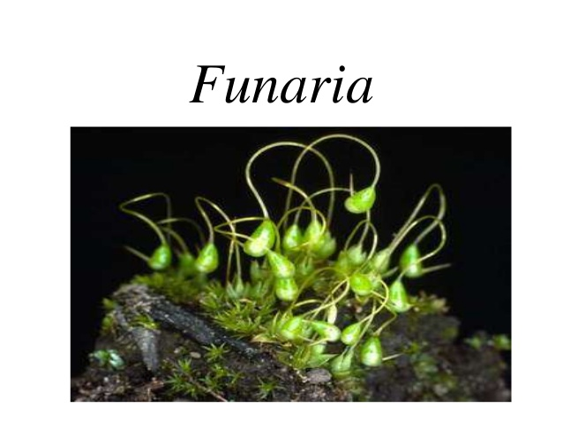
FUNARIA

Slide 3
SYSTEMATIC POSITION
Kingdom – Plantae
Division - Bryophyta
Class - Bryopsida
Order - Funariales
Family - Funariaceae
Genus - Funaria

Slide 4
GENERAL CHARACTERS
Funaria is a genus of approximately 210 species of moss and 18 species found in india.
The name is derived from Latin word ‘Funis’ meaning a Rope.
Funaria hygrometrica is the most common species. Funaria hygrometrica is called”cord moss” because of a twisted seta.

Slide 5
Funaria are primitive, multicellular, autotrophic, shade loving , amphibious plants.
Grows in dense patches or cushions in moist shady and cool places during rainy seasons.

Slide 6
Height of 3-5 cm, a radial symmetry differentiated into an axis or stem,leaves or phylloids and multicellular, colourless, branched rhizoids.
No vascular system.
Reproduce by spore formation.
Shows alternation of generation i.e. the gametophytic stage alternates with the sporophytic stage.

Slide 7
GAMETOPHYTIC PHASE
This phase in the life cycle of funaria consists of two growth stages:
Juvenile stage
The leafy gametophore

Slide 8
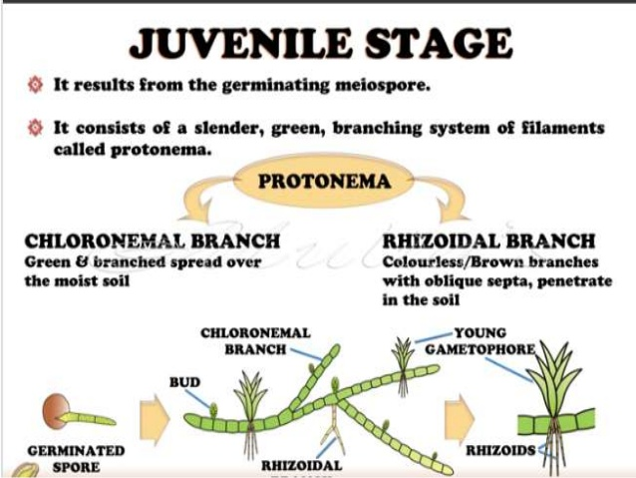
JUVENILE STAGE
It results from the germinating meiospores.
It consists of the slender, green, branching system of filaments known as protonema.

Slide 9
GAMETOPHORE STAGE
Dominant stage in the life cycle.
Erect leafy structure that reaches upto 3 cm in height.
It has slender cylindrical upright central axis known as cauloid or stem on which the flat, green and lateral expansions phylloids or leaves are present.
Cauloid and phylloids are not structurally similar to stem and leaves. Because these are without vascular tissues and gametophytic in origin.

Slide 10
The leaves are simple, small and spirally arranged.
The upper leaves are large and the lower leaves are crowded.

Slide 11
INTERNAL STRUCTURE - STEM
Epidermis- outermost, single layered and made up of thick walled cells.
Cortex – multilayered, parenchymatous situated just below the epidermis.
Central cylinder – vertically elongated, thin walled cells, provide mechanical strength and does conduction of water and minerals.

Slide 12
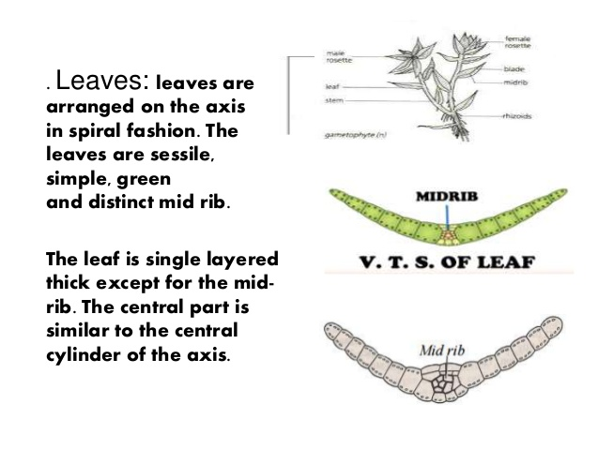
INTERNAL STRUCTURE - LEAVES
Leaves are arranged around the stem in spiral manner. These are simple, sessile, green and distinct midrib.
The leaves are single layer thick except midrib. The central part is similar to the central cylinder of the axis.

Slide 13
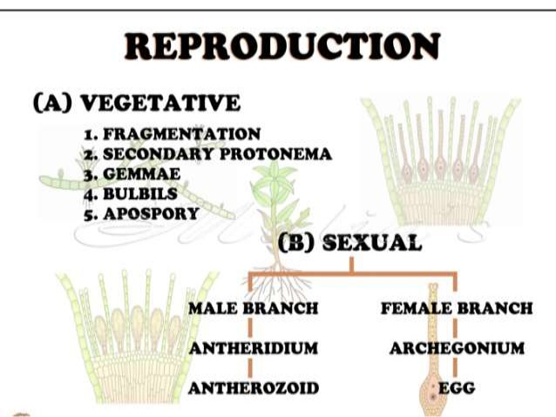

Slide 14
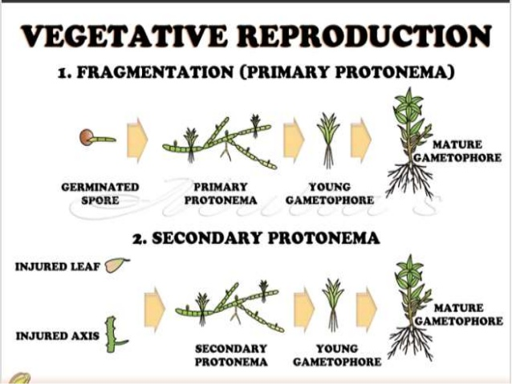

Slide 15
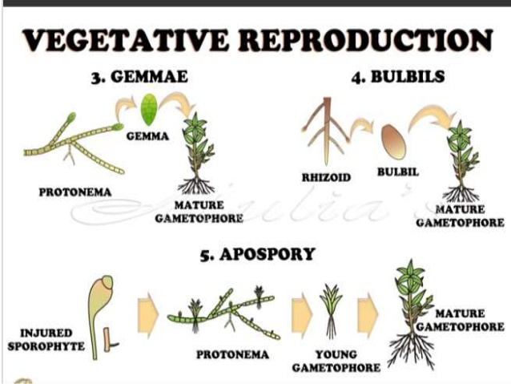

Slide 16
SEXUAL REPRODUCTION
Monoecious, autoicous and protandrous.
The sex organs are developed in groups at the apex of stem (male branch) and lateral branch (female branch).
The male sex oragn is known as antheridia and female sex organ is known as archegonia.
the lateral female branch eventually grow taller than the male branch.

Slide 17
MALE BRANCH -ANTHERIDIUM
0.25 mm in length.
Elongated, club shaped, orange colour body raised on a short, multicellular stalk.
Body has a jacket layer of polyhedral and flattened cells.
Within the antheridial wall is a dense mass of small cells. They are known as androcytes.
Each androcyte produces a single biflagellated sperm cell.

Slide 18
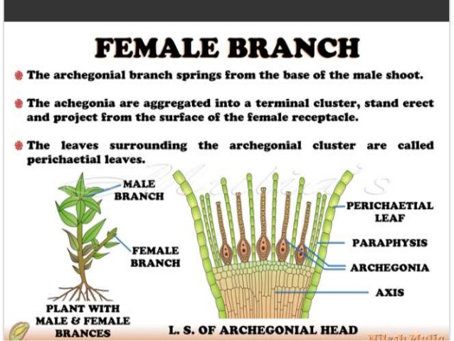
FEMALE BRANCH
It springs from the base of male shoot.
Archegonia is aggregated into a terminal cluster, stand erect and project from the surface of the female receptacle.
The leaves surrounding the archegonial clusters are known as perichaetial leaves.

Slide 19
ARCHEGONIUM
Flask shaped consist of venter and neck.
Archegonium is borne on a distinct multicellular stalk which is long and massive.
Venter consist of a double layer of sterile cells. In it lie a egg cell below and venter canal cell above it.
Long, tubular and slightly twisted neck consist of six rows of neck cells

Slide 21
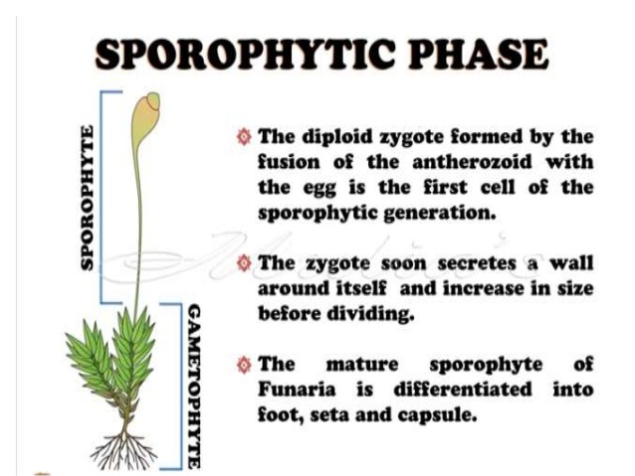

Slide 22
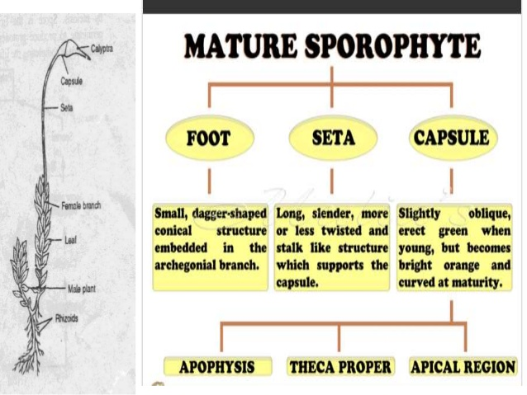

Slide 24
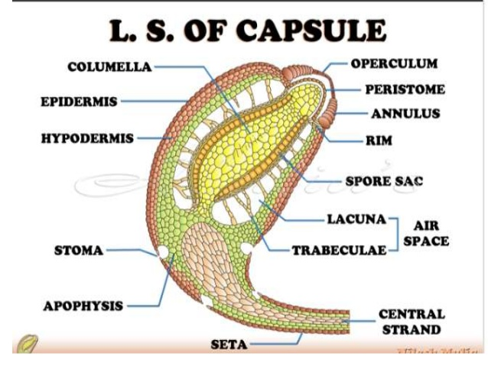

Slide 27
THANK YOU

