Slide 1
GARDENING
Dr. A. Maajitha Begam, M. Sc., M. Phil, Ph. D., SET, DCA.,
Assistant Professor of Botany
HKrh college, uthamapalayam

Slide 2
GARDENING
Gardening is the practice of growing and cultivating plants as part of horticulture.
Gardening is the art of growing plants with the aim of creating a beautiful landscape.

Slide 3
GARDENING
IT IMPROVES THE SCENERY OF THE LOCATION.
In gardens, ornamental plants are often grown for their flowers, foliage, or overall appearance; useful plants, such as root vegetables, leaf vegetables, fruits, and herbs, are grown for consumption, for use as dyes, or for medicinal or cosmetic use.
Gardening is considered by many people to be a relaxing activity.

Slide 4
The plants can be chosen based on climate, soil type, water condition and personal choice of the grower.
It has one or more different types of shrubs, trees, and herbaceous plants, to residential back gardens including lawns and foundation plantings, and to container gardens grown inside or outside.
Gardening may be very specialized, with only one type of plant grown, or involve a variety of plants in mixed plantings.

Slide 5
Types of Garden
Formal Garden – Formal Style (Gardens in which garden components are arranged in some symmetric manner)
Eg: Mughal Garden- Tajmahal, Akbar Tomb
Informal Garden – In formal Style(Garden looks so natutral)
Eg: British Style garden

Slide 6
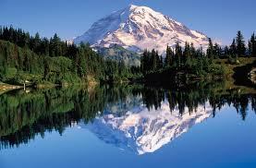
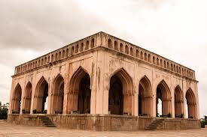
Formal Garden
Garden elements are in very formal way.
Right Side is the replica of left side.
Almost all features can be seen from one side of the garden.
There is perfect symmetry in the design.
Features - Layout is symmetric with squares / rectangle and roads cut at right angles.
A boundary around the garden
Flowerbeds are in geometric designs
Fountain, pools, cascades, are for further attraction.
Baradari – Arbour like stone and masonary structure with a pucca roof and a raised platform for sitting. There are 12 or more doors.

Slide 7
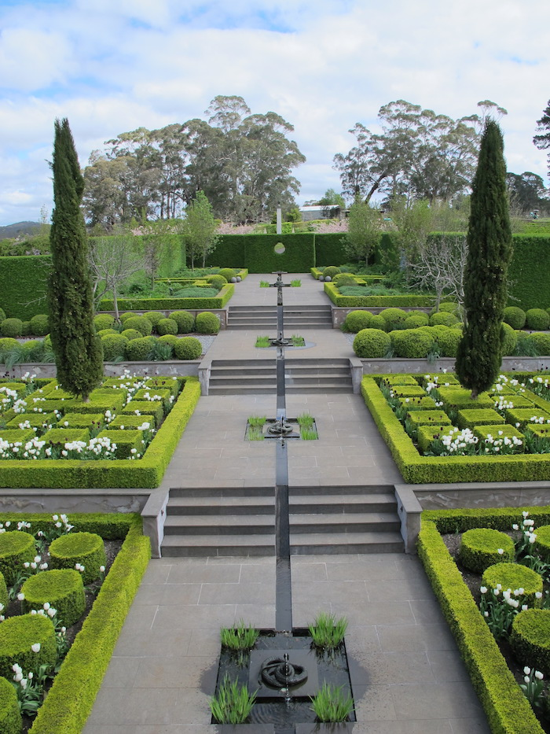
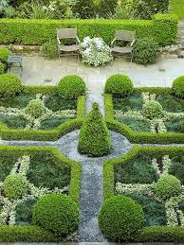

Slide 8
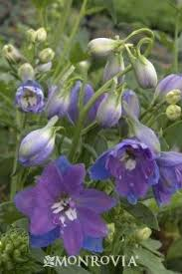
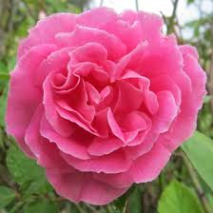
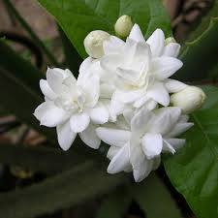
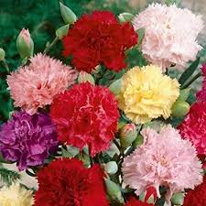
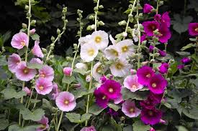
Formal garden
Cypress represents death and eternity
Fruit trees considered as symbols of life
Seasonal flowerbeds are in geometric patterns includes
Rose, jasmine, carnation, hollyhock, phinium

Slide 9
Informal garden
There is no symmetry anywhere in the design
There is no repetition
Looks amazingly different
Elements like umbrella, seats, cascades, rockery, water pool are used
Contrast to the formal style
Irregular shape of water bodies
No trimmed plants and bordered beds

Slide 10
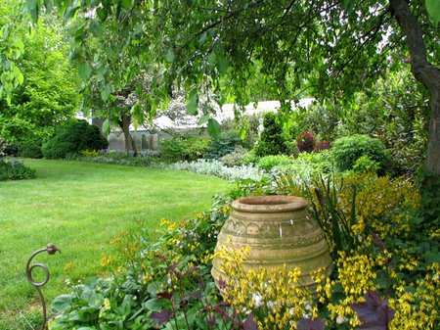

Slide 11
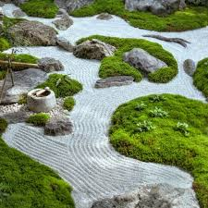
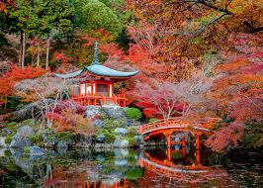
advantages
The designer can use his imagination to create a wide range of designs
Existing place need not be altered drastically since symmetry is not essential
Decorative material can be used
Ca be mixed with other style of gardens.
Eg: Japanese, Zen

Slide 12
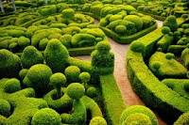
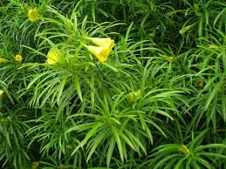
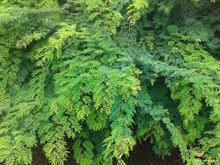
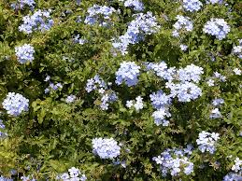
Living Elements-Hedges (living wall composed of plants)
A row of shrubs planted close together to form a boundary for field or garden
It is essential to enclose the garden
Plants in hedges are frequently pruned to maintain a height of 50-100cm.
Thevetia nereifolia, Divi Divi, Plumbago

Slide 13
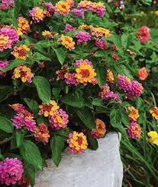
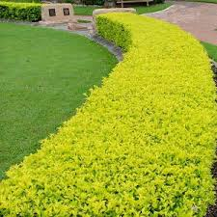
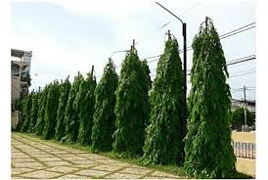
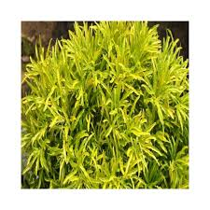
Demarcation plants &Internal Hedges

Slide 14
Lawn
Dense growth of grasses over the soil is called lawn
It looks like a green carpet over the land
Important component
Without lawn, garden is not completed
Receives full sunshine
Eg: Cyanodon dactylon, Stenolaphrum secundatum, Festuca rubra, Zoysia japonica

Slide 15
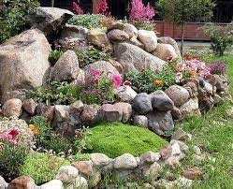
Rockery
Artificial mound of large stones and mud planted with rock plants
Mountain like appearance
Plants are planted in the crevices of the stones or between the stones
Increases the asthetic value of the garden

Slide 16
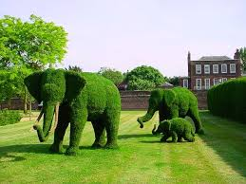
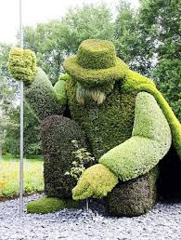
Topiary
Plant which is trimmed and clipped into ornament shapes such as cone or bird or animal.
Bushy shrubs generally suitable
Casuarina, Cupressus, Bougainvillaea

Slide 17
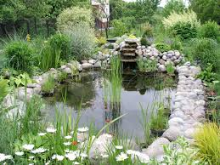
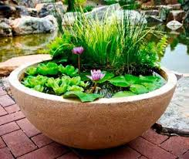
Water Garden
Water pool of a garden with attractive plants is called water garden or lily pool.
Adding the beauty of garden.
Water lilies, Pistia, Lemma, Nymphaea, Cypreus alternifolius.

Slide 18
THANKS

