Slide 1
ADAPTATIONS
HYDROPHYTES
Dr. A. MAAJITHA BEGAM
ASSISTANT PROFESSOR OF BOTANY
HAJEE KARUTHA ROWTHER HOWDIA COLLEGE (AUTONOMOUS)
UTHAMAPALAYAM

Slide 2
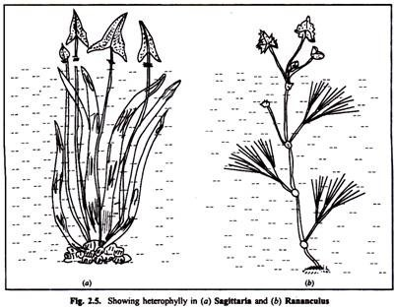
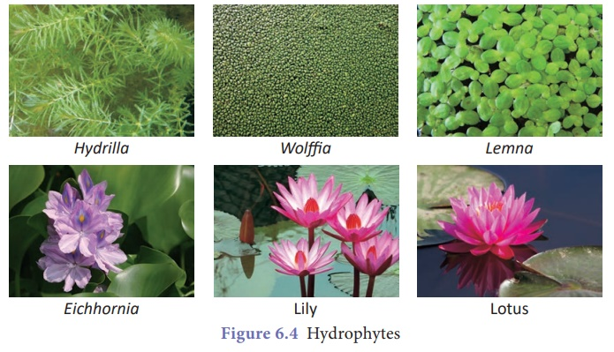
Morphological and Anatomical adaptations of Hydrophytes

Slide 3
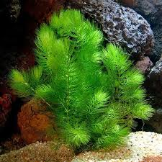
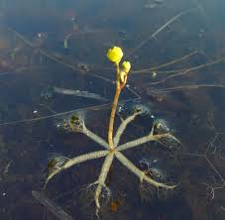
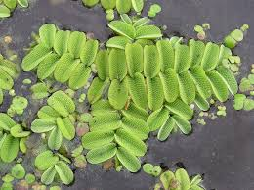
Morphological adaptations
1. Root system is poorly developed.
2. Roots of floating hydrophytes show very poor development of root hairs, absence of true root caps, with root pockets to protect their tips from injuries. (e.g. Eichhornia)
3. Rooted hydrophytes like Hydrilla, Vallisnera, Elodia derive their nourishment through their body surfaces. More plants partly depend on their roots for the absorption of minerals from the soil. Roots are totally absent in Ceratophyllum, Salvinia, Azolla, Utricularia etc.,

Slide 4
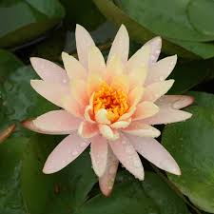
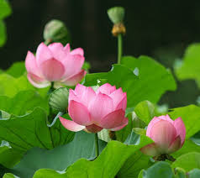
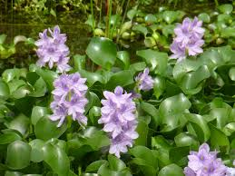
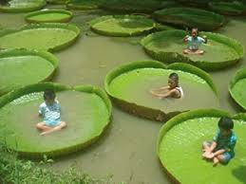
6. In Jussticea repens two types of roots develop. Some of them are normal, while others are negatively geotropic, floating roots, spongy in nature and keep the plants afloat.
5. In free floating hydrophytes, the stem is thick and short, floating on the surface of water (e.g.) Eichhornia.
In Nymphaea and Nelumbium the stem is a rhizome. These rhizomes live for many years and produce leaves every year.
7. In rooted plants with floating leaves, the leaves are large, flat and entire (e.g.) Nymphaea, Victoria regia. Their upper surface is coated with wax. The wax coating protects the leaves from mechanical and physical injuries and also prevents clogging of stomata by water.

Slide 5
In floating plants of Eichhornia, Trapa etc., the petioles become characteristically swollen and become spongy, providing buoyancy.
9. Plants such as Limnophylla heterophylla, Sagittaria, Ranunculus, Salvinia, Azolla etc show heterophylly, with submerged dissected leaves offering little resistance against the water currents, and absorbing dissolved carbon-di-oxide from water. The aerial leaves show typical mesophytic features. It acts as foliage leaf.
10. Pollination (e.g. Vallisneria) and dispersal of fruits and seeds are accomplished by the agency of water.

Slide 6
Anatomical adaptations
1. The root and shoot systems show common features such as cuticle which is very thin or absent.
2. Epidermis is usually a single layer of thin walled cells, not protective in function.
3. Cortex is well developed. It has numerous air chambers. It helps in buoyancy and rapid gaseous exchange.
4. Mechanical tissues are generally absent.
5. In the vascular tissue, xylem vessels are less common. Only tracheids are present in submerged forms.
6. In amphibious form, the xylem and phloem are well developed (e.g.) Limnophylla heterophylla or vascular bundles may be aggregated towards the centre. (e.g. Jussiaea)

Slide 7
7. Epidermal cells of Phloem leaves contain chloroplasts and they can function as photosynthetic tissue, especially where the leaves and stems are very thin. eg. Hydrilla
8. Stomata are totally absent in submerged, but in floating leaves, stomata are confined only to the upper surface. In amphibious plants stomata may be scattered on all the aerial parts.
9. In submerged leaves, air chambers are filled with respiratory and other gases and moisture.
10. In Water Lilly (Nymphaea) and some other plants, special type of star shaped lignified cells called asterosclereids are developed. It gives mechanical support to the plants.
11. The aquatic plants exhibit a low compensation point and low osmotic concentration of cell sap.
12. Mucilage cells and mucilage canals secrete mucilage to protect the plant body from decay under water.

Slide 8
