Slide 1
Hajee Karutha Rowther Howdia College (Autonomous) PG Department of Commerce With Computer Application Subject: Business Law – I Subject Code : 17UCAC51 Topic: Introduction to Law, Law of Contract K . Mohammed Abdul Kader Assistant Professor of Commerce CA

Slide 2
Understanding Laws of India
A person is a social human being living in the group, called society. He has to do various activities for his livelihood. Some activities are good or some are bad. In other words, some are beneficial for the society and some are harmful to the society. To regulate the activities of human behavior a group of set activities is introduced by regulatory authorities so that no one could harm the other one, this set of rules is called Law.

Slide 3
Define a law
A rule or set of rules, enforceable by the courts, regulating the government of a state, the relationship between the structures of government and the subjects of the state, and the relationship or conduct of subjects to each other. a rule or body of rules made by the government See order law.

Slide 4
Examples of laws
Simple things like putting on clothes are required by law. Going to school, road rules, laws about marriages and juvenile laws are all examples of laws. Laws have been around for over 4000 years. Laws in ancient civilisations were strict, usually resulting in physical punishments or even death

Slide 5
Purpose of the law
The law serves many purposes.
Four principal ones are
Establishing standards,
Maintaining order,
Resolving disputes, and
Rotating rights.

Slide 6
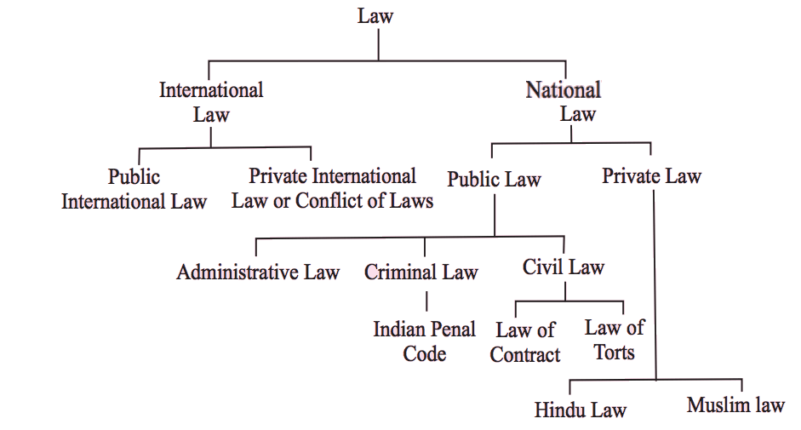
Types of Law

Slide 7
Criminal law
This is the kind of love that the police enforce. Murder, assault, robbery, and rape are examples of it. An offense which is seen as being against everybody even though it does not come under the Criminal law.
For example, if a car is stolen then the theft is against the individual, but it threatens all car owners because they might have stolen their car. Because the view is taken that everybody is threatened by the crime this law is dealt with the public services and not by private investigators.

Slide 8
Civil law
Different areas such as a right to an education or to A trade union membership and divorce problems assets is a split between the couple and who receives custody of the children. The best way to describe civil law is that it looks at actions that are not the crime. But the individuals to sort their own problems by going to court themselves or with a lawyer. It is a section of law dealing with disputes between individuals and organizations.
For example, a car crash victims claims from the driver for loss or injury sustained in an accident or one company sue another over a trade dispute.

Slide 9
Common law
Common law is a body of unwritten laws based on legal examples established by the courts.
Common law influences the decision-making process in rare cases where the outcome cannot be determined based on existing statutes or written rules of law.
Example of a common law marriage is when two people have lived together for 10 or more years. They have thus and legal rights to share their assets because of it.

Slide 10
Statutory law
It is termed used to define return loss usually enacted by a legislative body. It varies from regulatory or administrative laws common law or the law created by prior Court decisions. A bill is proposed in the legislature and voted upon.

Slide 11
Business Law
Commercial law or business law is the body of law which governs business and commerce and is often considered to be a branch of civil law and deals both with issues of private law and public law. Commercial law regulates corporate contracts, hiring practices, and the manufacture and sales of consumer goods, etc.

Slide 12
Business Law
Commercial law or business law is the body of law which governs business and commerce and is often considered to be a branch of civil law and deals both with issues of private law and public law. Commercial law regulates corporate contracts, hiring practices, and the manufacture and sales of consumer goods, etc.

Slide 13
Contract Act
The Indian Contract Act, 1872 defines the term “Contract” under its section 2 (h) as “An agreement enforceable by law”. In other words, we can say that a contract is anything that is an agreement and enforceable by the law of the land.

Slide 14
Contract
A contract is a legally binding document that recognizes and governs the rights and duties of the parties to the agreement.
A contract typically involves the exchange of goods, service, money, or promise of any of those is known as agreement.
An Agreement, Enforced by law is a contract.

Slide 15
Every promise and every set of promises, formed by Considerations for each other is an agreement.
“A proposal when accepted, becomes a promise”
An Agreement means a promise. It is created when a person makes an offer to another person and that other person accepts it
Agreement = Offer + Acceptance

Slide 16
Definition of a Contract
The definition of a contract is an agreement between two or more people to do something. An example of contract is a loan agreement between buyers and sellers of a car. An example of contract is an agreement between two people to be married.

Slide 17
Essential Elements of a valid Contact
According to Section 10 of the act …
Offer and acceptance (சலுகை மற்றும் ஏற்றுக்கொள்ளல்)
Intention to create legal relations (சட்ட உறவுகளை உருவாக்கும் நோக்கம்)
Lawful consideration (சட்டபூர்வமான கருத்தில்)
Capacity of parties (கட்சிகளின் திறன்)
Free and genuine contract (உண்மையான ஒப்பந்தம்)
Lawful objectives (சட்டபூர்வமான நோக்கங்கள்)
Agreement not declared void
Contract Should be clear
Performance not be impossible
Legal Formalities, if any

Slide 18
Thank You……………………

