Slide 1
Hajee Karutha Rowther Howdia College (Autonomous) PG Department of Commerce With Computer Application Subject: Human Resource Management Subject Code : 17UCAC34 Topic: Introduction, Definitions, Introduction to HRM, Functions of HRM K . Mohammed Abdul Kader Assistant Professor of Commerce CA

Slide 2
Management
Management is basically concerned with performance of planning, organizing, directing, co-ordination and controlling which in fact its main function.
Management is also art of getting work done through others.
It is not possible for any individual to do all work himself; the work is always shared by others.

Slide 3
Definition Management
Management is art of knowing exactly what you want your man to do and then seeing that they do it in the best and the cheapest way.
F.W. Taylor.

Slide 4
Application of Management Concepts
Production
Marketing
Finance
Personnel

Slide 5
Human Resource Management
Human Resource or manpower management effectively describes the process of planning and direction the application, development and utilization of human resources in employment.
The functions performed in organizations that facilitate the most effective use of people (employees) to achieve organizational and individual goals.

Slide 6
Definition of Human Resource Management
HRM is the process of managing the human resources of an organization to achieve the vision of the top management.
HRM is planning; organizing directing and controlling of the procurement, development, compensation, integration, maintenance, and separation of human resources to the end those individual, organizational and social objectives are accomplished.

Slide 7
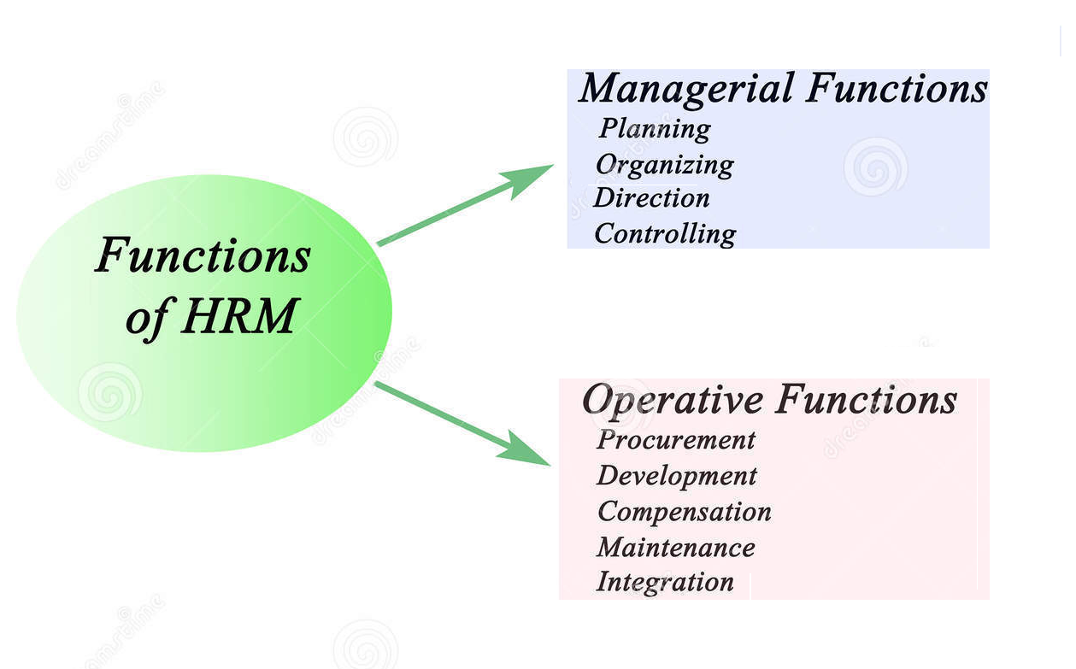
Functions of Human Resource Management

Slide 8
Managerial functions
Planning
Work to be done in systematic manner
Planning determining objective, policies, procedures, rules, strategies, budgets.
Manpower needs.
Organising
Division of work
Delegation of authority

Slide 9
Directing
Instructions to the subordinate
The process of Supervising, guiding and motivating the employees to get best from them.
Controlling (Planning without control is useless )
Establishing Standards
Measuring actual performance
Comparing the actual performance with the standards laid down already.

Slide 10
Operative Functions
Procurement
Job analysis
Human resource planning
Recruitment
Selection
Placement
Transfer
Promotion

Slide 11
Development
Performance appraisal
Training
Executive development
Career planning and development
Organization Development

Slide 12
Compensations
Job evaluation
Wage and salary admiration
Incentive
Bonus
Benefits
Social security schemes

Slide 13
Integration
Motivating employees to work Better
Boosting the morale of the employees
Ensuring effective communication
Enhancing leadership
Redressing Grievance
Managing Conflicts

Slide 14
Maintenance
Promoting job satisfaction among the employees
Tackling the problems of labour turnover
Human resource accounting and audit and research

Slide 15
Objectives of Human Resource Management
To achieve the organizational goals by proper utilization of human resources.
To develop and maintain healthy working relationships among all the employees , desirable organization structure.
To integrate individual and group goals within an organization
To create opportunities and facilities for individual or group developments according to the growth and development of the organization.
To ensure that the employees have higher job satisfaction
To provide scope for participation in the decision Making (Management)

Slide 16
Importance of Human Resource Management
It helps the organisation to identify correctly its manpower needs.
It ensures that the organisation does not suffer from either surplus or shortage of manpower
It facilitates the selection of the right man for right job
It focuses on the development of skill of every individual in order to make him up-to – date.
It gives importance to securing a favorable employees.
It recognizes the need for the appraisal of the employees performances

Slide 17
Evaluation and Development of HRM
Evaluation:
Evaluation of HRM refers to appraising the degree of success of HRM being performed in an organization. For a good evaluation, it is important to assess how well and how far employees of the organization have been utilized in achieving the organizational goals.
Development :
Human Resource Development includes such opportunities as employee training, employee career development, performance management and development, coaching, mentoring, succession planning, key employee identification, tuition assistance, and organization development.

Slide 18
Human Resource Planning
Meaning:
HRP, in simple terms, is the process of determining the manpower needs of an enterprise so that it is possible to fill up any vacancy as and when it arises. Such a plan eliminates the risk of surplus or shortage of staff at any time.

Slide 19
Definition of Human Resource Planning
HRP is the process by which management determines how the organisation should from its current manpower position to its desired manpower position.
Through planning the management strives to the right number and right kind of people at t right places, at the right time, doing things which result in both the organisation and the individual receiving maximum long – range benefit

Slide 20
Importance of Human Resource Planning
It helps the organisation to procure the requires manpower
It further helps to replace employees
It helps in expansion programmes
It ensure optimum investment in human resource
It helps to tackle the problem of surplus or shortage of manpower
It become necessary to meet the need of changing technology.

Slide 21
Objectives
To keep the cost of recruitment and selection of employees low
To ensure that the organisation does not face the problem of surplus or shortage
To ensure the selection of right person for the right job
To ensure the amount invested in human resource is at its optimum.

Slide 22
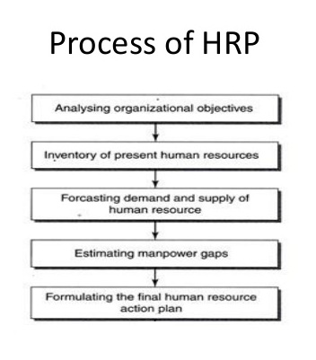
Production level
–
No of workers

Slide 23
HRP at Various Levels

Slide 24
Thank You……………………

