Slide 1
Hajee Karutha Rowther Howdia College (Autonomous) PG Department of Commerce With Computer Application Subject: Human Resource Management Subject Code : 17UCAC34 Topic: Recruitment, Selection, Interview K . Mohammed Abdul Kader Assistant Professor of Commerce CA

Slide 2
RECRUITMENT
Meaning:
Recruitment refers to the process of identifying, attracting, interviewing, selecting, hiring and onboarding employees.
In other words, it involves everything from the identification of a staffing need to filling it. .

Slide 3
Definition
According Edwin B flippo defined, “Recruitment as the process of searching for prospective employee and stimulating them to apply for jobs in the organization.”
If employer chosen right people for right job gives them assurance for the success of organization and management is able to achieve its target.

Slide 4
What Causes Job Vacancies to Occur ?
Vacancies may occur for the following reasons:
An employee may be discharged for unsatisfactory work or failure to get along with others.
An employee may die.
An employee may retire, or resign to start in business, or take a job elsewhere.
An employee may be away from work because of illness or accident or a vacation period and this may create a temporary vacancy.
Cont……

Slide 5
An employee may be promoted to a higher position and reshuffling of staff may mean there will be a job vacancy.
An increase in the demand for products or services offered by a company or other organization may mean that the staff will have to be increased.
A new organization has been established and so staff is required.
A change in work procedures and/or equipment may create openings for individuals who have special combinations of skill and training.

Slide 6
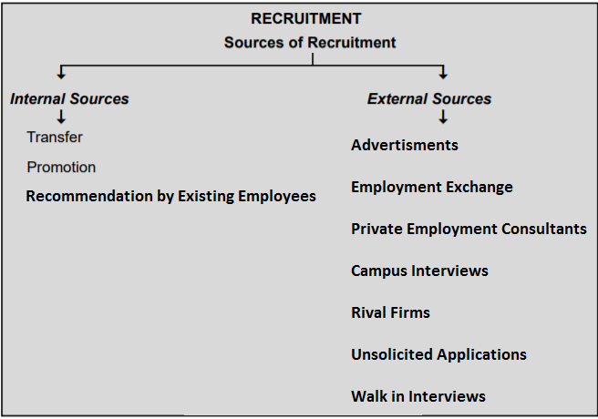
Sources of Recruitment

Slide 7
Internal Sources
Transfer

Slide 8
Promotion

Slide 9
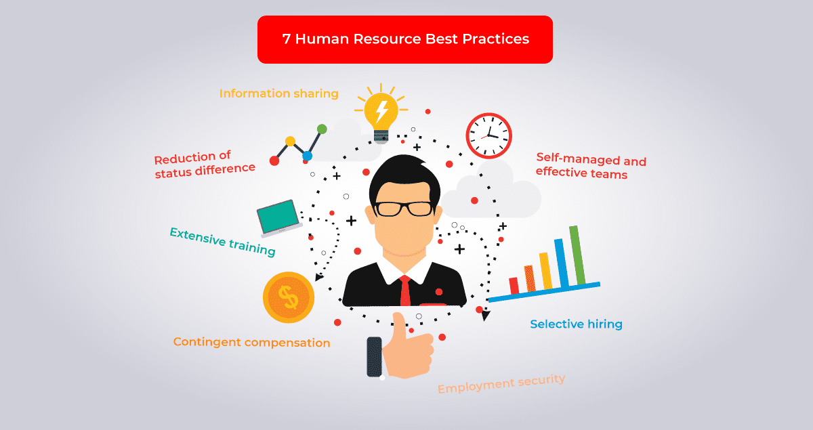
Recommendation from Existing Employees

Slide 10
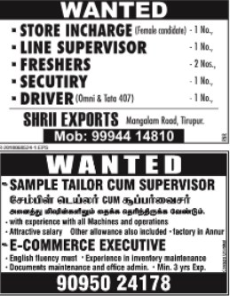
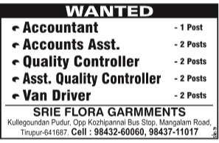
External Sources
Advertisement

Slide 11
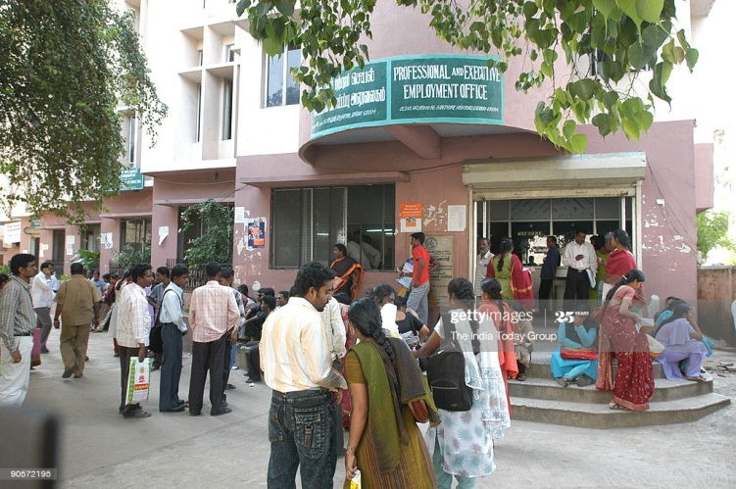
Employment Exchange

Slide 12
Private Employment Consultants

Slide 13
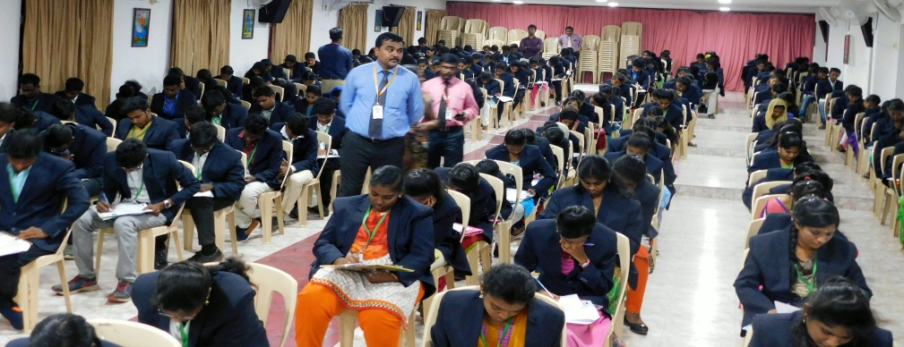
Campus Interviews

Slide 14
Rival Firm Employee

Slide 15
Unsolicited Application

Slide 16
Walk in Inteview

Slide 17
Selection
Recruitment refers to the process of identifying, attracting, interviewing, selecting, hiring and onboarding employees.
Meaning:
Selection is the process of picking or choosing the right candidate, who is most suitable for a vacant job position in an organization.
Definition:
Selection is the process in which candidates for employment are divided in two classes, those who are to be offered job and those who are not to be.
----- Dale Yoder….

Slide 18
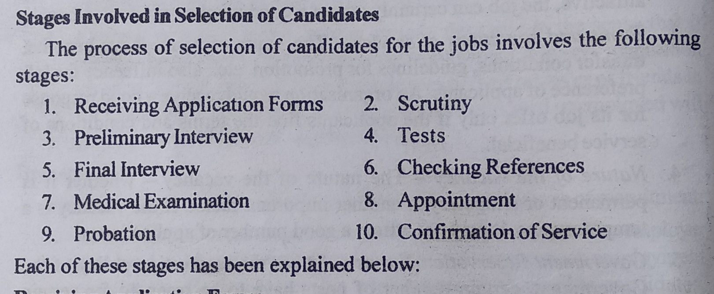
Stages of Selection Process

Slide 19
Receiving of Application Forms
Printed Format
Self Prepared

Slide 20
Scrutiny
The next step of selection Scrutinise applicant
Checking whether the applicant where fulfills the eligibility criteria like
age
Gender
Education Qualification, and
Experiences.

Slide 21
Preliminary Interview
All those applicant, whose application have been considered by employer may called for interview it is Preliminary Interview.
The main object of Preliminary Interview is to ensure personally whether the applicant is physically and mentally suitable for the job.

Slide 22
Test
A test is a measurement of a candidates ability and interest fore job.
Aptitude Test:

Slide 23
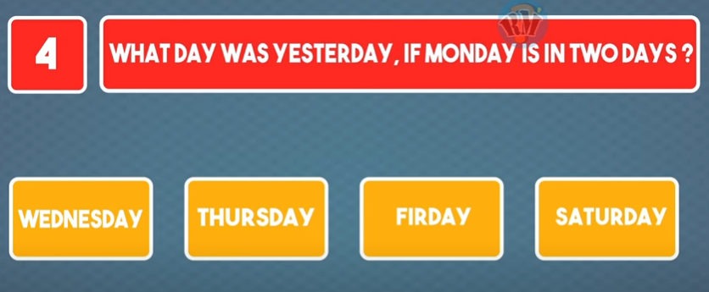
Intelligence Test:

Slide 24
Proficiency Test:
Persons Job skills –
Typist need Speed and Without Committing Mistakes.
Interest Test:
Interest on particular job-
Office record and files maintences, sending and receiving mails and calls, managing cash etc.,m

Slide 25
Personality test:
Communication skills
Honesty
Flexibility
Self- Discipline
Loyalty
Problem-solving
Quick-learner
Self – Motivated
Work effectively

Slide 26
Interview
What is interview?
An interview is essentially a structured conversation where one participant asks questions, and the other provides answers.
In common parlance, the word "interview" refers to a one-on-one conversation between an interviewer and an interviewee.
An interview is a face to face oral examination of a candidate by an employer.

Slide 27
Guidelines for Interview
All the eligible candidates must be well informed of the date, correct time and place of interview.
Interview should be start in right time.
Interviewer must maintain a proper record of the credentials of all the interviewees.
Question asked by interviewer must be relevant.
The interviewer can record his/her remark on the performance before leaves the hall after the interview.

Slide 28
Types of interview
i. Structured interview
ii. Unstructured interview
iii. Depth interview
iv. Stress interview
v. Board interview
vi. Group interview

Slide 29
Structured Interview
A structured interview is a standardized way of interviewing job candidates based on the specific needs of the job they are applying for. Candidates are asked the same questions in the same order, and are all compared on the same scale.

Slide 30
Unstructured Interview
An unstructured interview is an interview in which there is no specific set of predetermined questions, although the interviewers usually have certain topics in mind that they wish to cover during the interview.

Slide 31
Depth Interview
A type of qualitative research involving an unstructured personal interview with a single respondent, conducted by a highly skilled interviewer. The purpose of in-depth interviews is to understand the underlying motivations, beliefs, attitudes, and feelings of respondents on a particular subject.

Slide 32
Stress Interview
A stress interview is an interviewing style that companies use to gauge a candidate's response to stress. The idea is that it'll give the hiring team an idea of how you'll respond when juggling various high-priority tasks, dealing with challenging clients, or facing a difficult co-worker or manager.

Slide 33
Board Interview
That's more or less what happens during a panel interview (also called a board interview), when several employees from a company come together as a group to audition a candidate. Typically formal and organized, this interview format is often used in academia and government or for high-level executives.

Slide 34
Group Interview
A group interview is a screening process where you interview multiple candidates at the same time. The point of a group interview is to see how candidates choose to stand out from each other, how well candidates function in a group of people they do not know and if candidates show the teamwork attributes that you need.

Slide 36
Thank You……………………

