Slide 1
Hajee Karutha Rowther Howdia College (Autonomous) PG Department of Commerce With Computer Application Subject: Financial Accounting - I Subject Code : 20UCAC11 Topic: Introduction K . Mohammed Abdul Kader Assistant Professor of Commerce CA

Slide 2
Business
A business is defined as an organization or enterprising entity engaged in commercial, industrial, or professional activities.
Businesses can be for-profit entities or they can be non-profit organizations

Slide 3
Commerce
Commerce is a branch of business. It is concerned with the exchange of goods and services.
Commerce is the exchange of goods and services, especially on a large scale. It includes legal, economic, political, social, cultural and technological systems that operate in a country or in international trade.

Slide 4
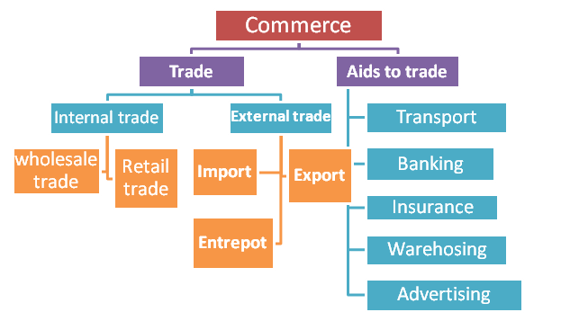

Slide 5
Finance
Financing is the process of providing funds for business activities, making purchases, or investing.
Financial institutions, such as banks, are in the business of providing capital to businesses, consumers, and investors to help them achieve their goals.

Slide 6
Accounting
Accounting is the process of recording financial transactions pertaining to a business. The accounting process includes summarizing, analyzing and reporting these transactions to oversight agencies, regulators and tax collection entities.

Slide 7
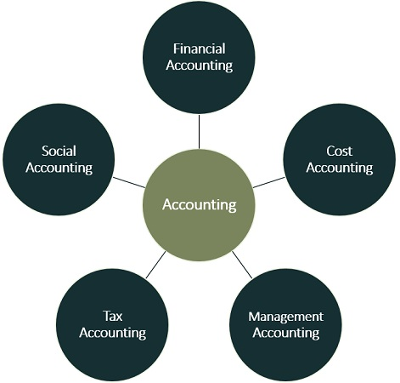
BRANCHES OF ACCOUNTING

Slide 8
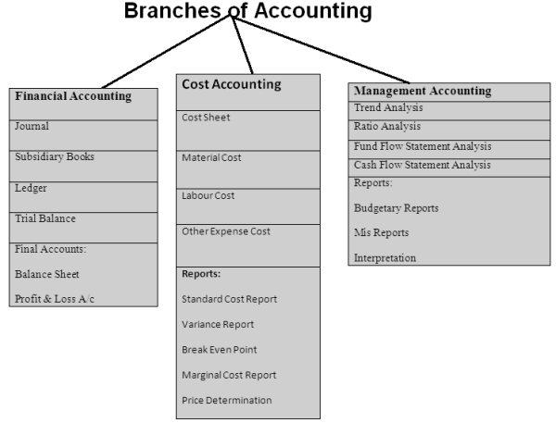

Slide 9
Financial Accounting
Financial accounting is a specialized branch of accounting that keeps track of a company's financial transactions.
Using standardized guidelines, by the transactions are recorded, summarized, and presented in a financial report or financial statement such as an income statement or a balance sheet.

Slide 10
Meaning of Book Keeping
The book keeping is the art and science of recording, classifying and summarizing business transactions in money worth accurately and systematically.
Book keeping is thus the recording business transactions in a systematic manner. It may done manually or through the use of mechanical and electronic device.

Slide 11
Definition of Book Keeping
“Book- keeping is the art of recording business transactions in a systematic manner”. A.H.Rosenkamph.
“Book- keeping is the science and art of correctly recording in books of account all those business transactions that result in the transfer of money or money’s worth”.
R.N.Carter

Slide 12
Objectives of Accounting
Permanent record of all business transaction
To give trade results
To know financial position of business
To facilitates the performance evaluation by comparing of one year to another year.
To determine the amount of tax
To use as evidence in case of disputes
To provide information for decision making
To control over the assets
To know the solvency position

Slide 13
Functions of Accounting
i) Record Keeping Function:
ii) Managerial Function: Decision making programme
iii) Legal Requirement function: Auditing
iv) Language of Business: Accounting is the language of business.

Slide 14
Classification of Accounts
Accounts are classified into three categories
I. Personal account
(i) Natural persons account
(ii) Artificial persons account
(iii) Representative persons accounts
II. Real Account
Tangible account
Intangible real account
III. Nominal Account
Items that relates to person. Every business unit incurs certain expenses such as payment of salaries to employees, payment of wages to workers etc

Slide 15
Accounts
Personal Accounts | Impersonal Accounts
 | Real Account | Nominal Account
Ram | Furniture | Salaries
Ragu | Building | Wages
Loan from Ram | Machinery | Interest
Salaries outstanding | Vehicles | Rent
Prepaid insurance | Cash | Commission

Slide 16
Examples of various accounts
Personal A/c | Real A/c | Nominal A/c
Yuvraj’s A/c | Sales | Salary
K Co. Ltd. A/c | Sales Returns | Printing and Stationery
Capital | Purchases | Postage
Drawings | Purchase Returns | Loss on sale of fixed
Bank | Cash | Assets
Bank overdraft | Machinery | Profit on sale of fixed Assets
Bills Receivable | Furniture | Wages
Bills Payable | Buildings | Discount
Outstanding expenses | Motor Vehicle Stock | Commission
Prepaid expenses | Good will | Carriage
Income received in Advance | Copy rights, Patent Rights | Freight, Advertisement
Income Accrued but not received | Trade marks | Interest

Slide 17
Rules of Debit and Credit
Class of Account | Debit | Credit
Personal Accounts | The Receiver | The Giver
Real Accounts | What comes in | What goes out
Nominal Accounts | Expenses and losses | Income and gains

Slide 18
Classification of Accounts
Financial accounting is a specialized branch of accounting that keeps track of a company's financial transactions.
Accounts are classified into three categories
I. Personal account ஆள்சார் கணக்குகள்
(i) Natural Persons Account
Example. Manoj account.
(ii) Artificial persons account
Example Karim & Bros account, Bank account. Radha ltd.,
(iii) Representative persons accounts
Example: Prepaid insurance account, outstanding account.

Slide 19
II. Real Account சொத்து கணக்குகள்
1. Tangible account
Example: machinery account, cash account, furniture account
2. Intangible real account
Example: good will account, patents account and trademarks account etc.
III. Nominal Account பெயரளவு கணக்குகள்
Items that relates to person. Every business unit incurs certain expenses such as payment of salaries to employees, payment of wages to workers etc,.

Slide 20
Accounts
Personal Accounts | Impersonal Accounts
 | Real Account | Nominal Account
Ram | Furniture | Salaries
Ragu | Building | Wages
Loan from Ram | Machinery | Interest
Salaries outstanding | Vehicles | Rent
Prepaid insurance | Cash | Commission

Slide 21
Examples of Various Accounts
Personal A/c | Real A/c | Nominal A/c
Yuvraj’s A/c | Sales | Salary
K Co. Ltd. A/c | Sales Returns | Printing and Stationery
Capital | Purchases | Postage
Drawings | Purchase Returns | Loss on sale of fixed
Bank | Cash | Assets
Bank overdraft | Machinery | Profit on sale of fixed Assets
Bills Receivable | Furniture | Wages
Bills Payable | Buildings | Discount
Outstanding expenses | Motor Vehicle Stock | Commission
Prepaid expenses | Good will | Carriage
Income received in Advance | Copy rights, Patent Rights | Freight, Advertisement
Income Accrued but not received | Trade marks | Interest

Slide 22
Rules of Debit and Credit
Class of Account | Debit (பற்று) | Credit (வரவு
Personal Accounts ஆள்சார் கணக்குகள் | The Receiver | The Giver
Real Accounts சொத்துகணக்குகள் | What comes in | What goes out
Nominal Accounts பெயரளவு கணக்குகள் | Expenses and losses | Income and gains

Slide 23
BOOK OF PRIME ENTRY
Books of prime entry are the books in which transactions are first recorded.
These are not accounts; they are simply books that records the details of transactions, almost like a diary.
The firm will have a separate book for each kind of transaction.
The type of the transaction will affect which book it, is entered into. Sales will be entered in one book, purchases in another book, cash in another book, and so on.

Slide 24
Journal
Journal is a record of daily transactions. It is derived from the French word jour which means a day, journal is one of the books of original entry or prime entry in which transactions are first recorded. For every transaction. Journal entry is passed. At the end of the entry, narration, that is, details of the transactions is given.
Specimen of a journal
Date | Particulars | L.F | Debit (Rs) | Credit (Rs)
 | Name of the account ( to be debited )Dr To name of the account ( to be credited narration)

Slide 25
Thank You……………………

