Slide 1
K.Deepalakshmi M.Com.,M.Phil.,(Ph.D) Asst.Professor PG Dept. of Commerce with CA II B.Com.,(CA)-PPT Business Statistics

Slide 2
INDEX NUMBERS
Index numbers are the indicators which measure percentage changes in a variable (or a group of variables) over a specified time.
It is typically used in economics to measure trends in a wide variety of areas including: stock market prices, cost of living, industrial or agricultural production, and imports. Index numbers are one of the most used statistical tools in economics.
Index numbers are not directly measurable, but represent general, relative changes. They are typically expressed as percents.

Slide 3
CHARACTERISTICS OF INDEX NUMBERS
Index numbers are expressed in terms of percentages to show the extent of relative change ·
Index numbers measure relative changes. They measure the relative change in the value of a variable or a group of related variables over a period of time or between places.
Index numbers measures changes which are not directly measurable. The cost of living, the price level or the business activity in a country are not directly measurable but it is possible to study relative changes in these activities by measuring the changes in the values of variables/factors which effect these activities.

Slide 4
USES OF INDEX NUMBERS
(i) Index numbers are economic barometers. They
measure the level of business and economic
activities and are therefore helpful in gauging
the economic status of the country.
(ii) Index numbers measure the relative change in a
variable or a group of related variable(s) understudy.
(iii) Consumer price indices are useful in measuring the
purchasing power of money, thereby used in
compensating the employes in the form of increase
of allowances.

Slide 5
TYPES OF INDEX NUMBERS
Price Index : Measure changes in price over a specified period of time. It is basically the ratio of the price of a certain number of commodities at the present year as against base year.
Quantity Index : As the name suggest, these indices pertain to measuring changes in volumes of commodities like goods produced or goods consumed, etc.
Value Index : These pertain to compare changes in the monetary value of imports, exports, production or consumption of commodities. 38.6 CONSTRUCTION OF INDEX NUMBERS

Slide 6
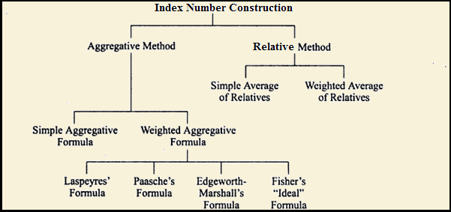
METHODS OF INDEX NUMBER

Slide 7
SIMPLE AGGREGATIVE METHOD
P= (∑P1÷∑P2)×100
Here, ∑P1= Summation of the prices of all commodities in current year.
∑P2= Summation of prices of all commodities in base year.

Slide 8
WEIGHTED AGGREGATIVE METHOD
A] Laspeyre’s Method :
P=(∑P₁Q₀÷∑P₀Q₀)×100
B] Paasche’s Method :
P=(∑P₁Q₁÷∑P₀Q₁) ×100
C] Fisher’s Method :
P = √[ (∑P₁Q₀÷∑P₀Q₀) × (∑P₁Q₁÷∑P₀Q₁) ] ×100
D] MARSHALL EDGEWORTH METHOD :
P= ∑P₁Q₀ ₊ ∑P₁Q_{1 x 100}
∑P₀Q₁ ₊ ∑P₀Q₀

Slide 9
RELATIVE METHOD
Simple Average or Price Relatives Method
Price relative (R) = (P1÷P2) × 100
Here, P1= Current year value of item with respect to the variable ;
P2= Base year value of the item with respect to the variable.

Slide 10
RELATIVE METHOD
WEIGHTED PRICE RELATIVE METHOD :
P=∑RW÷∑W
Here, R= Price relative and W= weight.

Slide 11
Thank you

