Slide 1
Marketing management
M.PAPPATHI M.COM.,M.PHIL., ASSISTANT PROFESSOR, II B.COM.,(CA) – PPT MARKETING MANAGEMENT, P.G DEPARTMENT OF COMMERCE(CA).

Slide 2
Product life cycle

Slide 3
Meaning and definition of PLC
Product life cycle is the progression of an item through the four stages of its time on the market. The four life cycle stages are: Introduction, Growth, Maturity and Decline. Every product has a life cycle and time spent at each stage differs from product to product.
Product life cycle (PLC) is the cycle through which every product goes through from introduction to withdrawal or eventual demise. In this stage, sales take off, the market knows of the product; other companies are attracted, profits begin to come in and market shares stabilize.

Slide 4
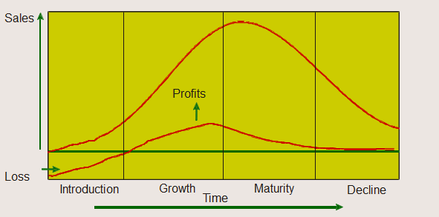
Common Product Life Curves

Slide 5
Introduction Stage
The introductory stage is viewed as fairly risky and quite expensive because large amounts of money is spent on advertising and other tools of marketing communications to create consumer awareness in sufficiently large numbers, and encourage trial.
3D Televisions: 3D may have been around for a few decades, but only after considerable investment from broadcasters and technology companies are 3D TVs available for the home, providing a good example of a product that is in the Introduction Stage.

Slide 6
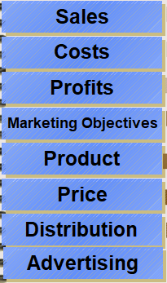
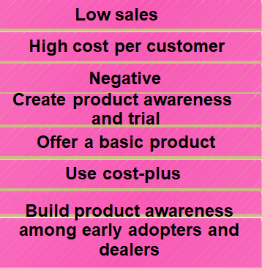
Introduction Stage of the PLC

Slide 7
Growth Stage
The growth stage of life cycle is characterised by a sharp rise in sales. Only a small percentage of new products introduced survive to reach the growth stage.
Tablet PCs: There are a growing number of tablet PCs for consumers to choose from, as this product passes through the Growth stage of the cycle and more competitors start to come into a market that really developed after the launch of Apple’s iPad. Another example is NANO car.

Slide 8
Maturity Stage
Most products after surviving competitive battles, winning customer confidence and successful through growth phase enter their maturity stage. The sales plateau, and this flattening of sales usually lasts for some time because most products in the category have reached their maturity stage, and there is stability in terms of demand, technology, and competition.
Laptops: Laptop computers have been around for a number of years, but more advanced components, as well as diverse features that appeal to different segments of the market, will help to sustain this product as it passes through the Maturity stage.

Slide 9
Decline Stage
Decline stage sets in when customer preferences change due to the availability of technologically superior products and consumers’ shift in values, beliefs, and tastes to products offering more value.

Slide 10
Implications and Limitations of Product Life Cycle Concept
Product life cycle concept shows a framework to spot the occurrence of opportunities and threats in a product market and the industry. This can help firms to reassess their objectives, strategies, and different elements of marketing program.

Slide 11
Thank you

