Slide 1
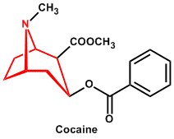
ALKALOIDS
Presented by
Dr. M.P. KESAVAN M.Sc., Ph.D.,
Assistant Professor
Department of Chemistry
Hajee Karutha Rowther Howdia College
Uthamapalayam.

Slide 2
What is Alkaloid?

Slide 3
Alkaloids
Definition
Alkaloids are a class of naturally occurring organic compounds that mostly contain basic nitrogen atoms, which have pronounced physiological actions on humans. Some synthetic compounds of similar structure may also be termed alkaloids. In addition to carbon, hydrogen and nitrogen, alkaloids may also contain oxygen, sulfur and, more rarely, other elements such as chlorine, bromine, and phosphorus.
Source
Alkaloids are produced by a large variety of organisms including bacteria, fungi, plants, and animals. They can be purified from crude extracts of these organisms by acid-base extraction.

Slide 4
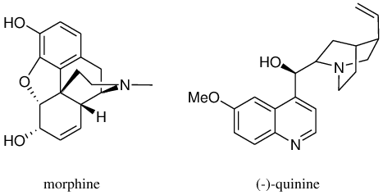
Types of alkaloids
Alkaloids have a wide range of pharmacological activities including antimalarial (e.g. quinine), antiasthma (e.g. ephedrine), anticancer (e.g. homoharringtonine), analgesic (e.g. morphine), and antihyperglycemic activities (e.g. piperine). Other alkaloids possess psychotropic (e.g. psilocin) and stimulant activities (e.g. cocaine, caffeine, nicotine, theobromine). Alkaloids can be toxic too (e.g. atropine). Although alkaloids act on a diversity of metabolic systems in humans and other animals, they almost uniformly evoke a bitter taste.

Slide 5
General methods of structural determination
The following pattern of procedure is adopted to establish the molecular structure of an alkaloid:
1. Molecular Formula determination:
After a pure specimen has been obtained, its elemental composition, and hence the empirical formula, is found by combustion analysis.
Then, its molecular weight is determined by the Rast procedure (depression of the freezing point) to establish its Molecular formula.
Its calculation is based upon the simple fact that the introduction of a double bond or cyclisation of the chain decreases the molecular formula by two hydrogen atoms relative to the corresponding saturated aliphatic hydrocarbon.

Slide 6
For example, the difference between hexene (C6H12) from hexane (C6H14) is two hydrogen's and this difference is called a double bond equivalent. Similarly, the difference between benzene (C6H6) and hexane (C6H14) is eight hydrogen’s which will correspond to 8/2 or 4 double bond equivalents (accommodated by the three double bonds and one ring).
The above procedure is valid for simpler compounds only. However, for complex formulae, where elements other than hydrogen and carbon are present, the simpler method is that for any formula CaHbNcOd the number of double bond equivalents is given by the following expression:
a – ½ b + ½ c + 1

Slide 7
The above method for the calculation of double bond equivalents is useful to calculate the number of rings in a given compound.
For example, hygrine has the molecular formula, C8H15NO which corresponds to
8 – 15/2 + 1/2 + 1 = 2 (double bond equivalents)
However, chemical tests reveal that hygrine contains only one carbonyl group (one double bond equivalent) and does not show other form of unsaturation. Thus hygrine must be monocyclic to account for the other double bond equivalent.
The presence of unsaturation in an alkaloid may also be ascertained by treating the alkaloid with bromine or halogen acid or alkaline potassium permanganate when a glycol is obtained.

Slide 8
Functional Group Analysis:
Application of classical techniques of organic analysis (especially if the alkaloid is available in appreciable amounts) and/or infra-red spectroscopic examination (especially if the alkaloid is available only in small amounts) can reveal the nature of the functional groups present.
3. Functional Nature Of Oxygen:
If an alkaloid contains oxygen, it may be present as -OH (phenolic or alcoholic), methoxy (–OCH3), acetoxy (–OCOCH3 ), benzoxyl (–OCOC6H5 ), carboxylic (–COOH), carboxylate (–COOK) or carbonyl (=C=O).

Slide 9
Occasionally, lactone ring systems have also been encountered (e.g., narcotine, hydrastine). These functions have been detected by the usual methods of organic analysis including infra‐red spectroscopic examination.
Various oxygen functional groups can be characterized according to the following characteristics:
a) Hydroxyl group:
Its presence in an alkaloid can be ascertained by the formation of acetate, on treatment with acetic anhydride or acetyl chloride or by the formation of benzoate on treatment with benzoyl chloride in the presence of sodium hydroxide.

Slide 10
However, the above test for oxygen should be applied carefully because primary amines if present in an alkaloid also yield acetyl and benzoyl derivatives.
Then the number of hydroxyl groups is determined by acetylation or Zerewitnoff’s method. In the former method, the number of hydroxyl groups is determined by acetylating the alkaloid and hydrolyzing the acetyl derivative with a known volume of 1N NaOH.
The excess of alkali is estimated by titration with a standard solution of HCl. The number of acetyl groups or hydroxyl groups can be calculated from the volume of alkali used for hydolysis.

Slide 11
b) Carboxylic group:
The solubility of an alkaloid in aqueous sodium carbonate or ammonia reveals the presence of carboxylic group. The formation of ester on treatment with an alcohol also reveals the presence of carboxylic group.
The number of carboxylic groups may be determined by volumetrically by titration against a standard barium hydroxide solution using phenolphthalein as an indicator or gravimetrically by silver salt method.
c) Oxo group:
The presence of this group is ascertained by the reaction of an alkaloid with hydroxylamine, semicarbazide or phenylhydrazine when the corresponding oxime, semicarbazone or phenylhydrazone are formed.

Slide 12
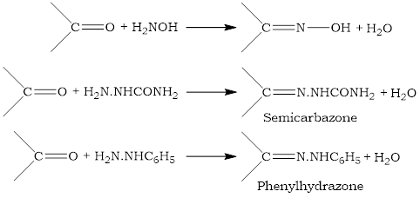
Distinction between an aldehyde and a ketone can be made on the basis of reduction and oxidation reactions.
d) Methoxy group:
The detection of this group and its number may be determined by the Zeisel determination, analogous to the Herzeg-Meyern method for N-methyl groups.

Slide 13
In this method, a known weight of alkaloid is heated with hydriodic acid at its boiling point (126°C) when the methoxyl groups are thereby converted into methyl iodide, which is then absorbed by ethanolic silver nitrate and the precipitated silver iodide is filtered, dried and weighed. From the weight of silver iodide, the number of methoxyl groups may be calculated.
For example, papavarine, C20H21O4N, when treated with hydrogen iodide, consumes 4 moles of hydrogen iodide, producing 4 moles of silver iodide and thus confirming the presence of four -OCH3 groups.

Slide 14
e) Ester and amide groups:
These groups can be detected and estimated by observing the products of their alkali or acid hydrolysis.

Slide 15
4. Nature of Nitrogen:
All alkaloids contain nitrogen. But in the majority of alkaloids it is present as a part of a heterocyclic system. Therefore, it must be either a secondary (=NH) or tertiary(=N–CH3 or =N–).
However, there are phenyl alkyl amine type of alkaloids (adrenaline, ephedrine, etc) which do not contain nitrogen as a part of a heterocyclic ring, but in the form of a primary amino (–NH2) group.
a) Reaction with acetic anhydride and methyl iodide:
The general reactions of the alkaloid with acetic anhydride, methyl iodide and nitrous acid often show the nature of the nitrogen.
If the alkaloid reacts with one mole of methyl iodide to form an N-methyl derivative, it means that a secondary nitrogen atom is present.

Slide 16
For example, coniine, C8H17N reacts with one mole of methyl iodide to form an N-methyl derivative, indicating that coniine must contain secondary nitrogen atom.
If an alkaloid reacts additively with one mole of methyl iodide to form crystalline quaternary salt, this indicates that nitrogen atom present in this alkaloid is tertiary.
For example, nicotine reacts additively with two moles of methyl iodide, indicating that it contains both nitrogen atoms as tertiary.

Slide 17
One can detect the tertiary nitrogen atom in an alkaloid by treating it with 30% hydrogen peroxide when tertiary nitrogen is oxidized to amine oxide.
b) Herzig‐Meyer’s method:
This method is used to detect and estimate the number of methyl groups attached N atom. This method consists in cleaving N-methyl amine present in an alkaloid with hydriodic acid at 150-300 °C and estimating the amount of methyl iodide so formed by conversion to silver iodide with silver nitrate solution.

Slide 18
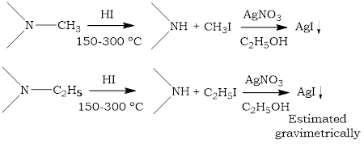
NMR spectroscopy may also be utilized for the rapid detection of N-methyl and N-ethyl groups in alkaloids.
5. Estimation of C-Methyl groups:
C-methyl groups are quantitatively estimated by the Kuhn-Roth oxidation, the acetic acid formed being distilled off and distillate titrated against standard base.

Slide 19
Degradation of Alkaloids
The analytical steps, described as above, establish the nature of nitrogen atom (s) and usually at least some of the oxygen atoms in the alkaloid molecule. In those cases, where these preliminary investigations fail to identify nitrogen and oxygen atoms, then one must perform usual laboratory tests for the common functional groups like aldehyde, ketone, ester, amide, etc. This problem is tackled by degradation of the molecule and identification of the fragments formed from each reaction.
Types of degradation method:
(a) Hofmann exhaustive methylation method.
(b) Emde's degradation.
(c) Von Braun's method.

Slide 20
(a) Hofmann exhaustive methylation method.
In this method, heterocyclic rings are opened with the elimination of nitrogen. From the nature of the remaining carbon skeleton, the nature of the heterocyclic ring can be ascertained.
Principle:
The principle of this method is that compounds, which are contain the structural unit of quaternary ammonium hydroxide, eliminate eliminate a trialkylamine on pyrolysis at 200°C or above to yield an olefin.
olefin by further degradation - enables the position of the nitrogen atom in the original compound to be ascertained.

Slide 21
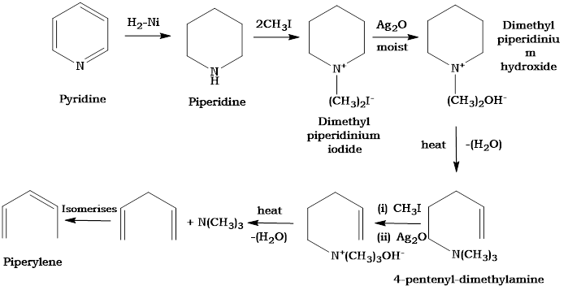
Discussion with example:
If the nitrogen atom forms a part of a cyclic structure, two or three such cycles are essential to liberate the nitrogen and expose the carbon skeleton. However, this method is applicable only to reduced ring systems such as piperidine and actually fails with analogous unsaturated compounded such as pyridine.

Slide 22
Limitations:
When a molecule of water is eliminated from quaternary ammonium hydroxide, hydrogen atom is always eliminated from the β-position, if this hydrogen is not available, the reaction fails.
Therefore Hoffmann's exhaustive methylation fails
with unsaturated heterocyclic rings,
when there is no β-hydrogen atom
(iii) with tetrahydroquinoline.

Slide 23
Example
“Even though the compound contains a β-hydrogen atom, the exhaustive methylation method may fail”

Slide 24
References
K.W. Bently, Alkaloids, Vol I & II, Intersicence, 1957.
I. L. Finar, Organic chemistry, Vol. II. ELBS, 1975.
Organic Chemistry of Natural Products- Vol-I & II – Gurdeep Chatwal, Himalaya publishing house, Mumbai.
https://www.slideshare.net/VIKASMATHAD1/alkaloids-84892003

Slide 25
Thank You

