Slide 1


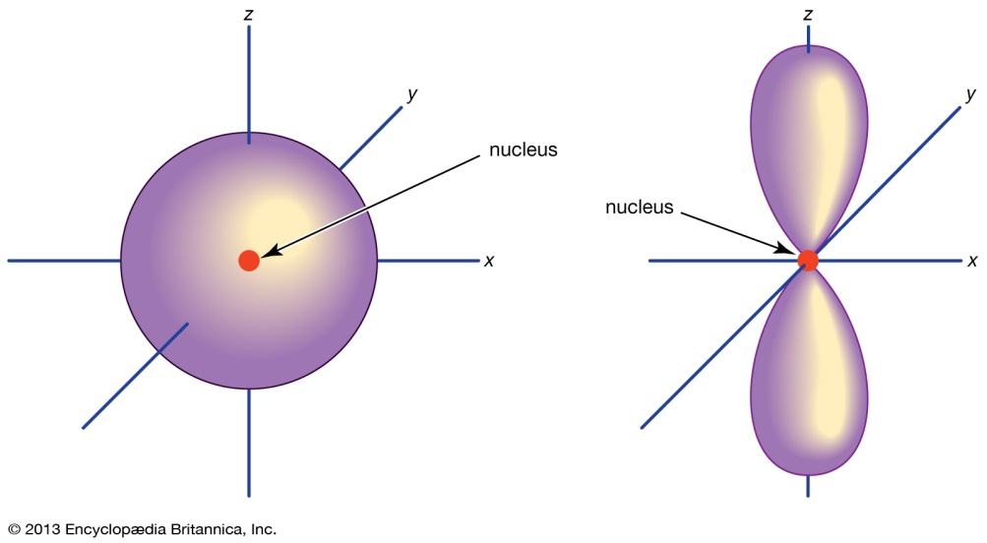
ATOMIC STRUCTURE
Presented by
Dr. M.P. KESAVAN M.Sc., Ph.D.,
Assistant Professor
Department of Chemistry
Hajee Karutha Rowther Howdia College
Uthamapalayam.

Slide 2

What is an Atom?

Slide 5
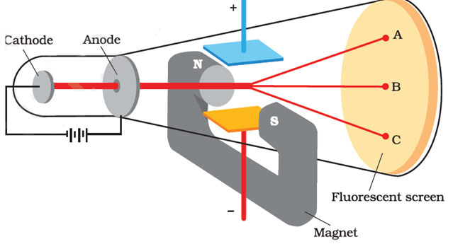

Slide 8
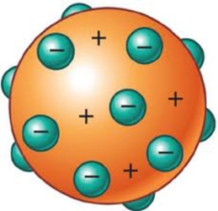

Slide 10
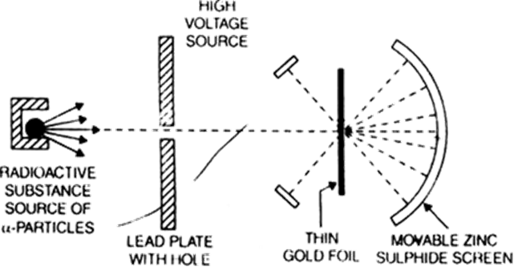

Slide 14
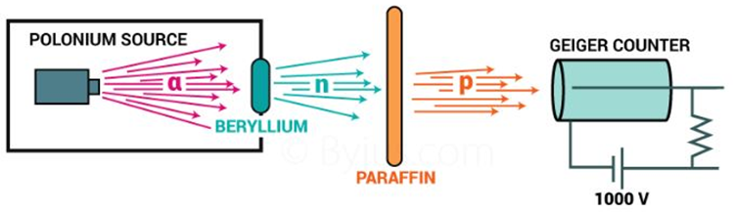

Slide 16
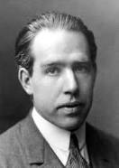

Slide 23


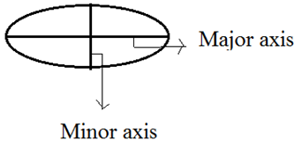
SOMMERFIELD ATOMIC MODEL
(MODIFICATION)
Postulates
1. The orbits may be both circular or elliptical.
2. When path is elliptical , then there are two axis – major axis & minor axis. When length of major & minor axis become equal then orbit is circular.

Slide 24
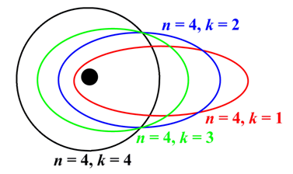
Postulates (cont.)
3. The angular momentum of electron moving in an elliptical orbit is kh/ 2π. k is an integer except zero. Value of k = 1,2,3,4…..
n/k = length of major axis / length of minor axis
With increase in value of k, ellipticity of the orbit decreases. When n = k,then orbit is circular.

Slide 25
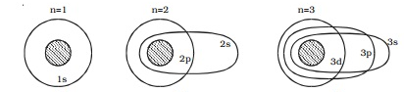
Postulates (cont.)
4. Sommerfield suggested that orbits are made up of sub energy levels. These are s,p,d,f. These sub shells possess slightly different energies. Bohr gave a quantum number ‘n’, which determines the energy of electron. Sommerfield introduced a new quantum number called Orbital or Azimuthal Quantum number (l) which determines the orbital angular momentum of electron. Values of l = 0 to (n-1).
For,
n = 1; l = 0; 1s sub shell
n = 2; l = 0,1; 2s , 2p sub shell
n = 3; l = 0,1 ,2; 3s , 3p , 3d sub shell
n = 4; l = 0, 1, 2 , 3; 4s , 4p , 4d , 4f sub shell

Slide 26
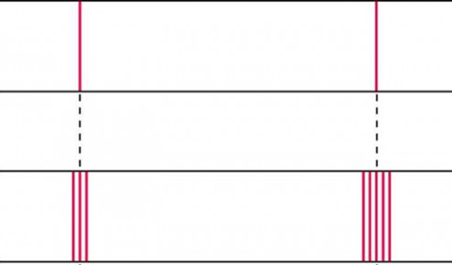
Postulates (cont.)
5. When an electron jumps from one orbit to another orbit, the difference of energy (ΔE ) depends upon sub energy levels.
6. It explains the splitting of individual spectral lines of hydrogen & thus fine spectrum. It could not predict the exact number of lines which are actually present in the fine spectrum.

Slide 27
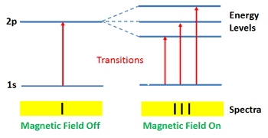
Defects
1. This model does not explain the behavior of system having more than one electron.
2. This model does not explain the Zeeman & Stark effect.

Slide 28
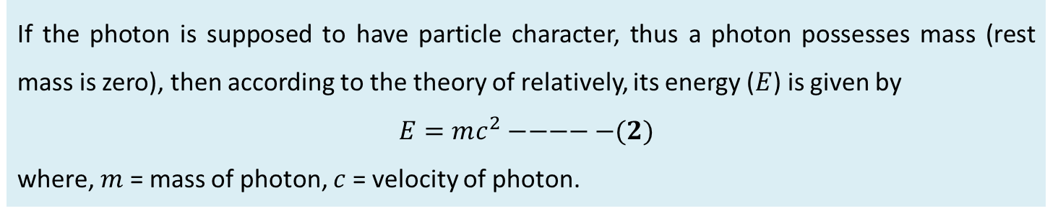
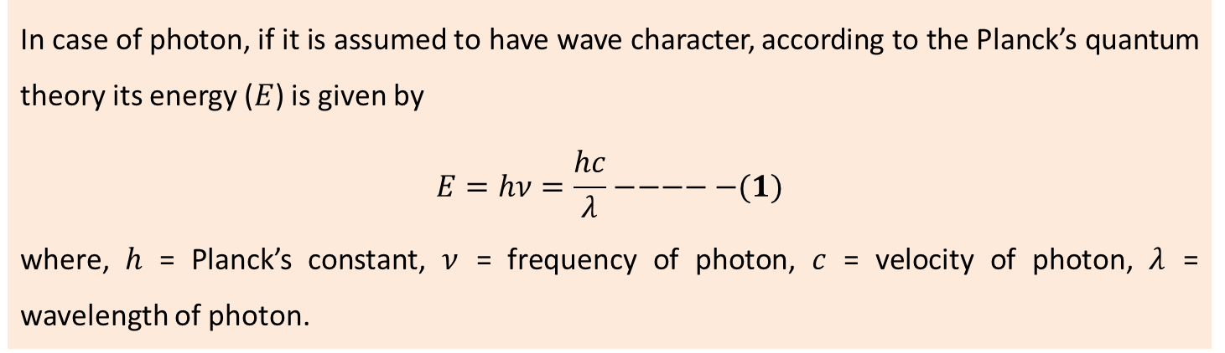
DE BROGLIE’S CONCEPT (DUAL NATURE OF MATTER)
Derivation of de-Broglie Equation
The wavelength of the wave associated with any material particle was calculated by analogy with photon.
In case of photon, if it is assumed to have wave character, according to the Planck’s quantum theory its energy ($E$) is given by
$$E=hν=\frac{hc}{λ}−−−−−(1)$$
where, $h$ = Planck’s constant, $ν$ = frequency of photon, $c$ = velocity of photon, $λ$ = wavelength of photon.
If the photon is supposed to have particle character, thus a photon possesses mass (rest mass is zero), then according to the theory of relatively, its energy ($E$) is given by
$$E=mc^{2}−−−−−(2)$$
where, $m$ = mass of photon, $c$ = velocity of photon.

Slide 29
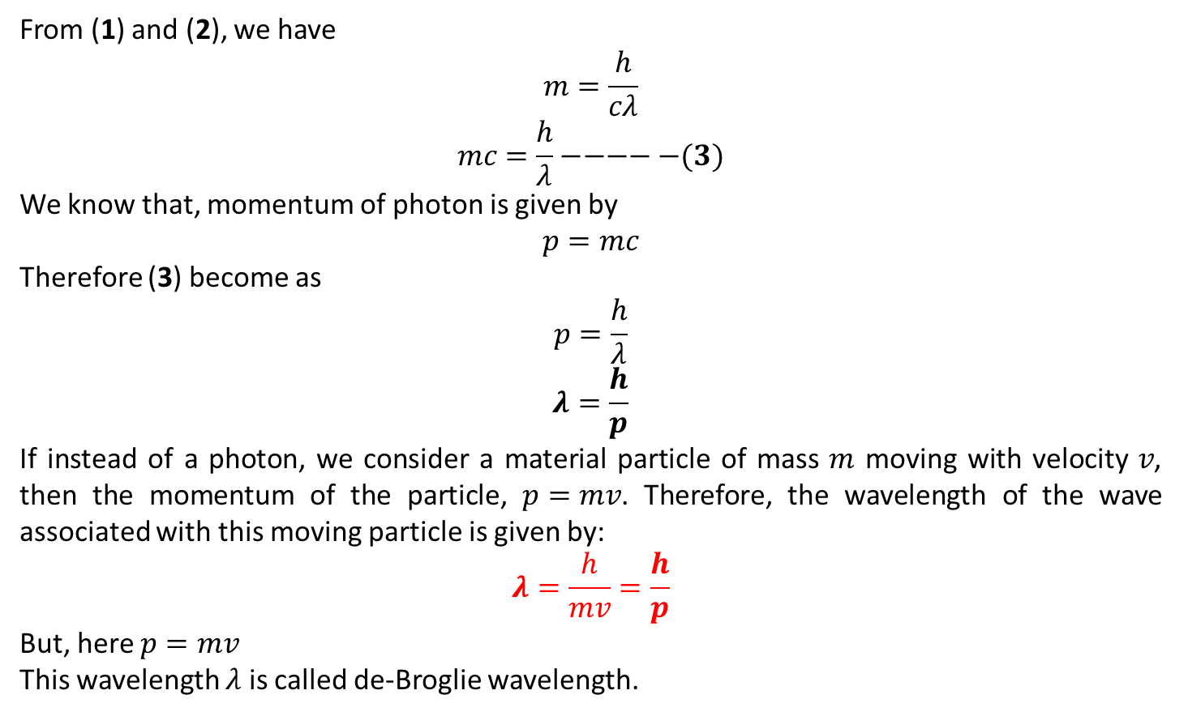
Derivation of de-Broglie Equation (cont.)
From (1) and (2), we have
$$m=\frac{h}{cλ}$$
$$mc=\frac{h}{λ}−−−−−(3)$$
We know that, momentum of photon is given by
$$p=mc$$
Therefore (3) become as
$$p=\frac{h}{λ}$$
$$λ=\frac{h}{p}$$
If instead of a photon, we consider a material particle of mass $m$ moving with velocity $v$, then the momentum of the particle, $p=mv$. Therefore, the wavelength of the wave associated with this moving particle is given by:
$$λ=\frac{h}{mv}=\frac{h}{p}$$
But, here $p=mv$
This wavelength $λ$ is called de-Broglie wavelength.

Slide 30
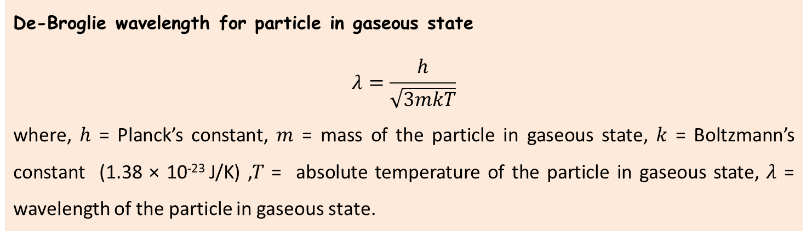
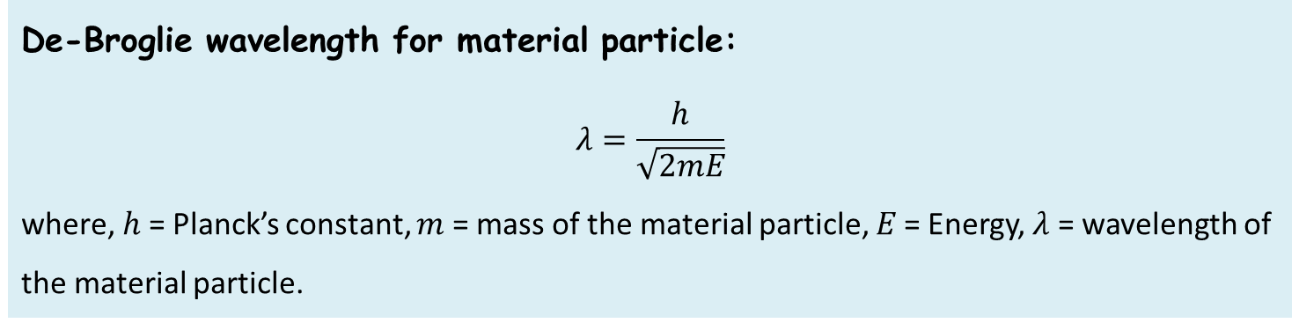
Special Cases
De-Broglie wavelength for material particle:
$$λ=\frac{h}{\sqrt{2mE}}$$
where, $h$ = Planck’s constant, $m$ = mass of the material particle, $E$ = Energy, $λ$ = wavelength of the material particle.
De-Broglie wavelength for particle in gaseous state
$$λ=\frac{h}{\sqrt{3mkT}}$$
where, $h$ = Planck’s constant, $m$ = mass of the particle in gaseous state, $k$ = Boltzmann’s constant (1.38 × 10⁻²³ J/K) ,$T$ = absolute temperature of the particle in gaseous state, $λ$ = wavelength of the particle in gaseous state.

Slide 31
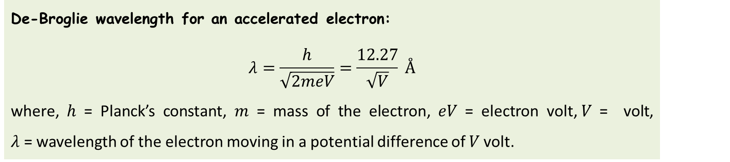
Special Cases (cont.)
De-Broglie wavelength for an accelerated electron:
$$λ=\frac{h}{\sqrt{2meV}}=\frac{12.27}{\sqrt{V}} Å$$
where, $h$ = Planck’s constant, $m$ = mass of the electron, $eV$ = electron volt,$V$ = volt, $λ$ = wavelength of the electron moving in a potential difference of $V$ volt.
Limitations
De-Broglie equation is good work on microscopic particle like an electron, proton and neutron, but it fails in the case of the large size object, it gets fail because they have more mass and their wavelength become smaller and smaller that is not an easy task to measure.

Slide 32
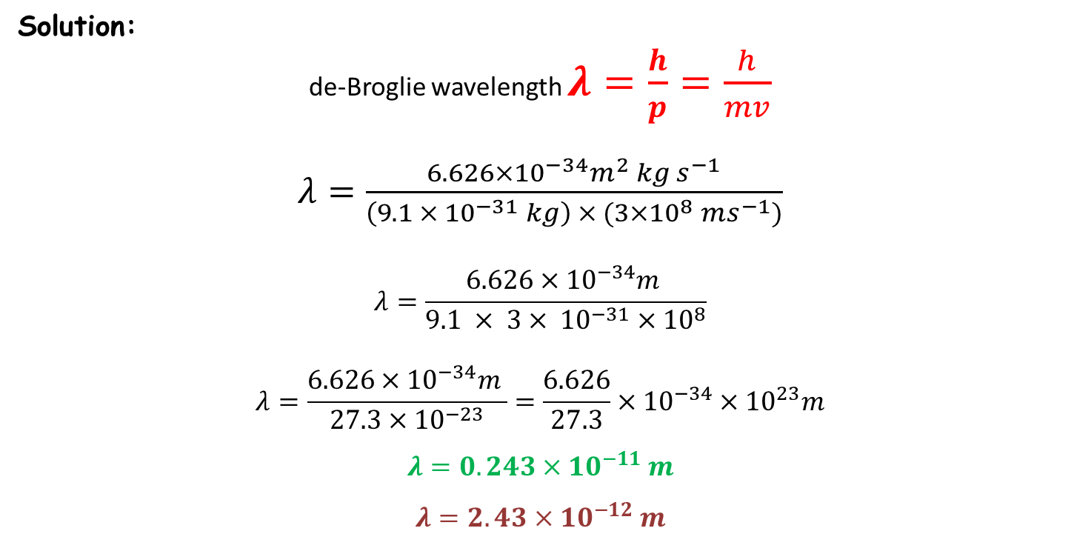

PROBLEM-1
Given:
m = $9.1 × {10}^{−31} kg$
v = $3×{10}^{8} ms^{−1}$
Solution:
de-Broglie wavelength $λ=\frac{h}{p}=\frac{h}{mv}$
$λ=\frac{6.626×{10}^{−34}m^{2} kg{ s}^{−1}}{\left(9.1 × {10}^{−31} kg\right) × (3×{10}^{8} ms^{−1})}$
$$λ=\frac{6.626×{10}^{−34}m }{9.1 × 3{× {10}^{−31}×10}^{8}}$$
$$λ=\frac{6.626×{10}^{−34}m }{27.3×{10}^{−23}}=\frac{6.626}{27.3}×{10}^{−34}×{10}^{23}m$$
$$λ=0.243×{10}^{−11} m$$
$$λ=2.43×{10}^{−12} m$$

Slide 33


PROBLEM-2
Given:
m = $5 kg$
v = $1 ms^{−1}$
Solution:
de-Broglie wavelength $λ=\frac{h}{p}=\frac{h}{mv}$
$λ=\frac{6.626×{10}^{−34}m^{2} kg{ s}^{−1}}{\left(5 kg\right) × (1 ms^{−1})}$
$$λ=\frac{6.626×{10}^{−34}m }{5}$$
$$λ=\frac{6.626}{5}×{10}^{−34} m$$
$$λ=1.325×{10}^{−34} m$$

Slide 34
References
B.R. Puri and L.R. Sharma and Madan S. Pathania, Principles of Physical Chemistry, Vishal Publishing Co., Jalandhar, 2005.
P. L. Soni, O. P. Dharmarha and U. N. Dash, Textbook of Physical Chemistry, Sulthan & Sons publication, 22nd revised edition, 2001.
https://courses.lumenlearning.com/boundless-chemistry/chapter/the-structure-of-the-atom/

Slide 35


