Slide 1
CATALYSIS
Dr. N.M. Abdul Khader Jailani M.Sc., Ph.D., SLET.,
Associate Professor
Department of Chemistry
Hajee Karutha Rowther Howdia College
Uthamapalayam.

Slide 2
Definition of catalysis
A substance which changes the speed of a reaction without being used itself is called a catalyst.
The phenomenon of increasing the rate of reaction by the use of catalyst is called catalysis.
If а catalyst increases (accelerates) the speed of а reaction, it is called а positive catalyst and the phenomenon is called positive catalysis. On the other hand, if а catalyst decreases (retards) the speed of а reaction, it is called а negative catalyst and the phenomenon is called negative catalysis.
1

Slide 3
Catalysis
Catalysts increase reaction rate without themselves being changed
Can accelerate a reaction in both directions
Do not affect the state of equilibrium of reaction
  simply allow equilibrium to be reached faster

Slide 4
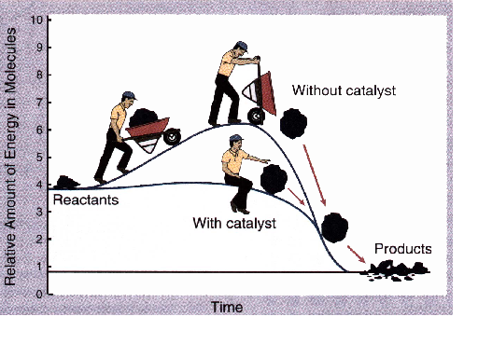
Activation Energy
Catalyst Affect
Catalyst lowers the activation energy for both forward and reverse reactions.

Slide 5
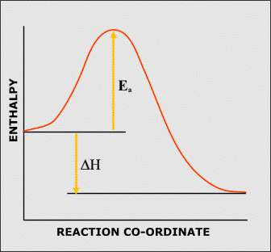
CATALYSTS - background
All reactions are accompanied by changes in enthalpy.
The enthalpy rises as the reaction starts because energy is being put in to break bonds.
It reaches a maximum then starts to fall as bonds are formed and energy is released.
ENTHALPY CHANGE DURING
AN EXOTHERMIC REACTION

Slide 6
CATALYSTS - background
All reactions are accompanied by changes in enthalpy.
The enthalpy rises as the reaction starts because energy is being put in to break bonds.
It reaches a maximum then starts to fall as bonds are formed and energy is released.
If the…
FINAL ENTHALPY < INITIAL ENTHALPY
it is an EXOTHERMIC REACTION
and ENERGY IS GIVEN OUT
ENTHALPY CHANGE DURING
AN EXOTHERMIC REACTION

Slide 7
CATALYSTS - background
All reactions are accompanied by changes in enthalpy.
The enthalpy rises as the reaction starts because energy is being put in to break bonds.
It reaches a maximum then starts to fall as bonds are formed and energy is released.
If the…
FINAL ENTHALPY < INITIAL ENTHALPY
it is an EXOTHERMIC REACTION
and ENERGY IS GIVEN OUT
FINAL ENTHALPY > INITIAL ENTHALPY
it is an ENDOTHERMIC REACTION
and ENERGY IS TAKEN IN
ENTHALPY CHANGE DURING
AN EXOTHERMIC REACTION

Slide 8
CATALYSTS - background
ACTIVATION ENERGY - E_{a}
Reactants will only be able to proceed to products if they have enough energy
The energy is required to overcome an energy barrier
Only those reactants with enough energy will get over
The minimum energy required is known as the ACTIVATION ENERGY
ACTIVATION ENERGY E_{a} FOR
AN EXOTHERMIC REACTION

Slide 9
CATALYSTS - background
COLLISION THEORY
According to COLLISON THEORY a reaction will only take place if…
PARTICLES COLLIDE
PARTICLES HAVE AT LEAST A MINIMUM AMOUNT OF ENERGY
PARTICLES ARE LINED UP CORRECTLY
To increase the chances of a successful reaction you need to...
HAVE MORE FREQUENT COLLISONS
GIVE PARTICLES MORE ENERGY or
DECREASE THE MINIMUM ENERGY REQUIRED

Slide 10
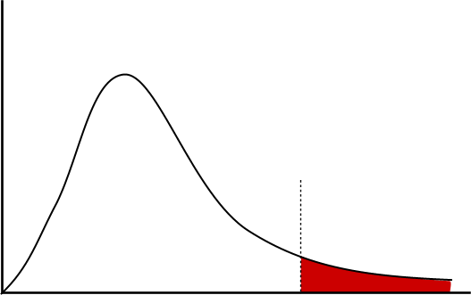
MAXWELL-BOLTZMANN DISTRIBUTION
DUE TO THE MANY COLLISONS TAKING PLACE IN GASES, THERE IS A SPREAD OF MOLECULAR ENERGY AND VELOCITY
NUMBER OF MOLECUES WITH
A PARTICULAR ENERGY
NUMBER OF MOLECULES WITH SUFFICIENT ENERGY TO OVERCOME THE ENERGY BARRIER
MOLECULAR ENERGY
E_{a}
The area under the curve beyond E_{a} corresponds to the number of molecules with sufficient energy to overcome the energy barrier and react.
If a catalyst is added, the Activation Energy is lowered - E_{a} will move to the left.

Slide 11
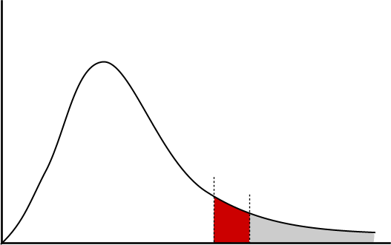
MAXWELL-BOLTZMANN DISTRIBUTION
DUE TO THE MANY COLLISONS TAKING PLACE IN GASES, THERE IS A SPREAD OF MOLECULAR ENERGY AND VELOCITY
NUMBER OF MOLECUES WITH
A PARTICULAR ENERGY
EXTRA NUMBER OF MOLECULES WITH SUFFICIENT ENERGY TO OVERCOME THE ENERGY BARRIER
MOLECULAR ENERGY
E_{a}
The area under the curve beyond E_{a} corresponds to the number of molecules with sufficient energy to overcome the energy barrier and react.
Lowering the Activation Energy, E_{a}, results in a greater area under the curve after E_{a} showing that more molecules have energies in excess of the Activation Energy

Slide 12
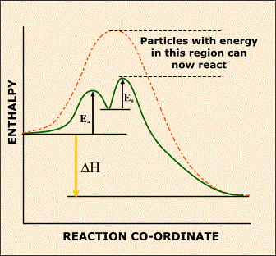
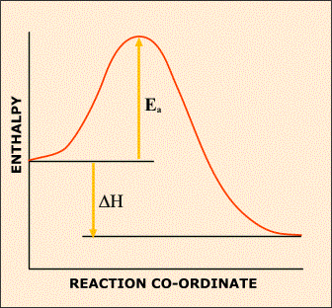
CATALYSTS - lower E_{a}
Catalysts work by providing…
“AN ALTERNATIVE REACTION PATHWAY WHICH HAS A LOWER ACTIVATION ENERGY”
WITHOUT A CATALYST
WITH A CATALYST
A GREATER PROPORTION OF PARTICLES WILL HAVE ENERGIES
IN EXCESS OF THE MINIMUM REQUIRED SO MORE WILL REACT

Slide 13
There are different types of catalysis:
Acid-base catalysis
Electrocatalysis
Photocatalysis
Redox Catalysis
Homogeneous Catalysis
Enzymatic Catalysis
Heterogeneous catalysis
Supported Catalysis
Metallodendritic Catalysis
Biphasic Catalysis

Slide 14
Catalysis Types
Classification of Catalytic Systems
Heterogeneous
Homogeneous
Enzymatic
No phase
boundary exists
Phase Boundary separates catalyst from the reactants
Complex organic molecules,
usually protein, which form
a lyophilic colloid

Slide 15
Heterogeneous Catalysis
Format Catalysts are in a different phase to the reactants
e.g. a solid catalyst in a gaseous reaction
Action takes place at active sites on the surface of a solid
gases are adsorbed onto the surface
they form weak bonds with metal atoms
Catalysis is thought to work in three stages...
Adsorption
Reaction
Desorption

Slide 16
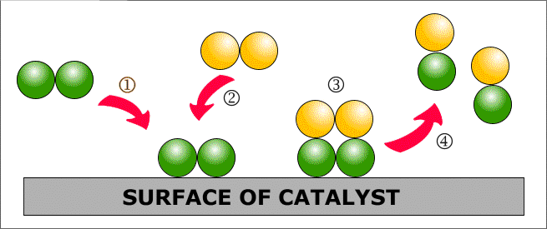
Heterogeneous Catalysis
For an explanation of what happens click on the numbers in turn, starting with 

Slide 17

Heterogeneous Catalysis
Adsorption (STEP 1)
Incoming species lands on an active site and forms bonds with the catalyst. It may use some of the bonding electrons in the molecules thus weakening them and making a subsequent reaction easier.

Slide 18

Heterogeneous Catalysis
Adsorption (STEP 1)
Incoming species lands on an active site and forms bonds with the catalyst. It may use some of the bonding electrons in the molecules thus weakening them and making a subsequent reaction easier.
Reaction (STEPS 2 and 3)
Adsorbed gases may be held on the surface in just the right orientation for a reaction to occur.
This increases the chances of favourable collisions taking place.

Slide 19
Heterogeneous Catalysis
Adsorption (STEP 1)
Incoming species lands on an active site and forms bonds with the catalyst. It may use some of the bonding electrons in the molecules thus weakening them and making a subsequent reaction easier.
Reaction (STEPS 2 and 3)
Adsorbed gases may be held on the surface in just the right orientation for a reaction to occur.
This increases the chances of favourable collisions taking place.
Desorption (STEP 4)
There is a re-arrangement of electrons and the products are then released from the active sites

Slide 20
Heterogeneous Catalysis
Adsorption (STEP 1)
Incoming species lands on an active site and forms bonds with the catalyst. It may use some of the bonding electrons in the molecules thus weakening them and making a subsequent reaction easier.
Reaction (STEPS 2 and 3)
Adsorbed gases may be held on the surface in just the right orientation for a reaction to occur.
This increases the chances of favourable collisions taking place.
Desorption (STEP 4)
There is a re-arrangement of electrons and the products are then released from the active sites

Slide 21
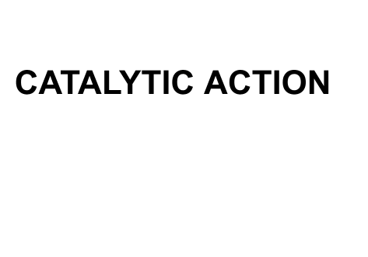
Heterogeneous Catalysis

Slide 22
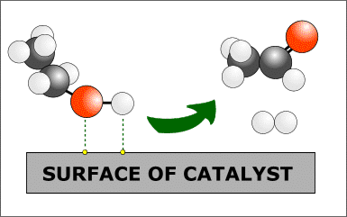
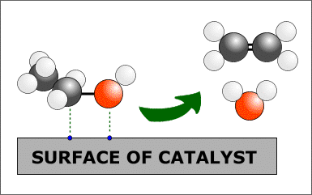
Specificity
In some cases the choice of catalyst can influence the products
Ethanol undergoes different reactions depending on the metal used as the catalyst.
The distance between active sites and their similarity with the length of bonds
determines the method of adsorption and affects which bonds are weakened.
Copper Dehydrogenation (oxidation)
Alumina Dehydration
C₂H₅OH ——> CH₃CHO + H₂ C₂H₅OH ——> C₂H₄ + H₂O

Slide 23
Specificity
Ethanol undergoes two different reactions depending on the metal used as the catalyst.
COPPER Dehydrogenation (oxidation)
C₂H₅OH ——> CH₃CHO + H₂
The active sites are the same distance
apart as the length of an O-H bond
It breaks to release hydrogen
ALUMINA Dehydration (removal of water)
C₂H₅OH ——> C₂H₄ + H₂O
The active sites are the same distance
apart as the length of a C-O bond
It breaks to release an OH group

Slide 24

Catalytic converters
PURPOSE To remove pollutant gases formed in internal combustion engines
CONSTRUCTION made from alloys of platinum, rhodium and palladium
catalyst is mounted in a support medium to spread it out
honeycomb construction to ensure maximum gas contact
finely divided to increase surface area / get more collisions
involves HETEROGENEOUS CATALYSIS
POLLUTANTS CARBON MONOXIDE, NITROGEN OXIDES, UNBURNT HYDROCARBONS

Slide 25
Quiz 1:
What is catalysis?
Describe Activation energy?
Describe the theory of collision?
What type of catalysis is there?
What is heterogenous catalysis?
Describe the four steps of heterogenous catalysis?

Slide 26
Kinetics in heterogeneous catalysis

Slide 27


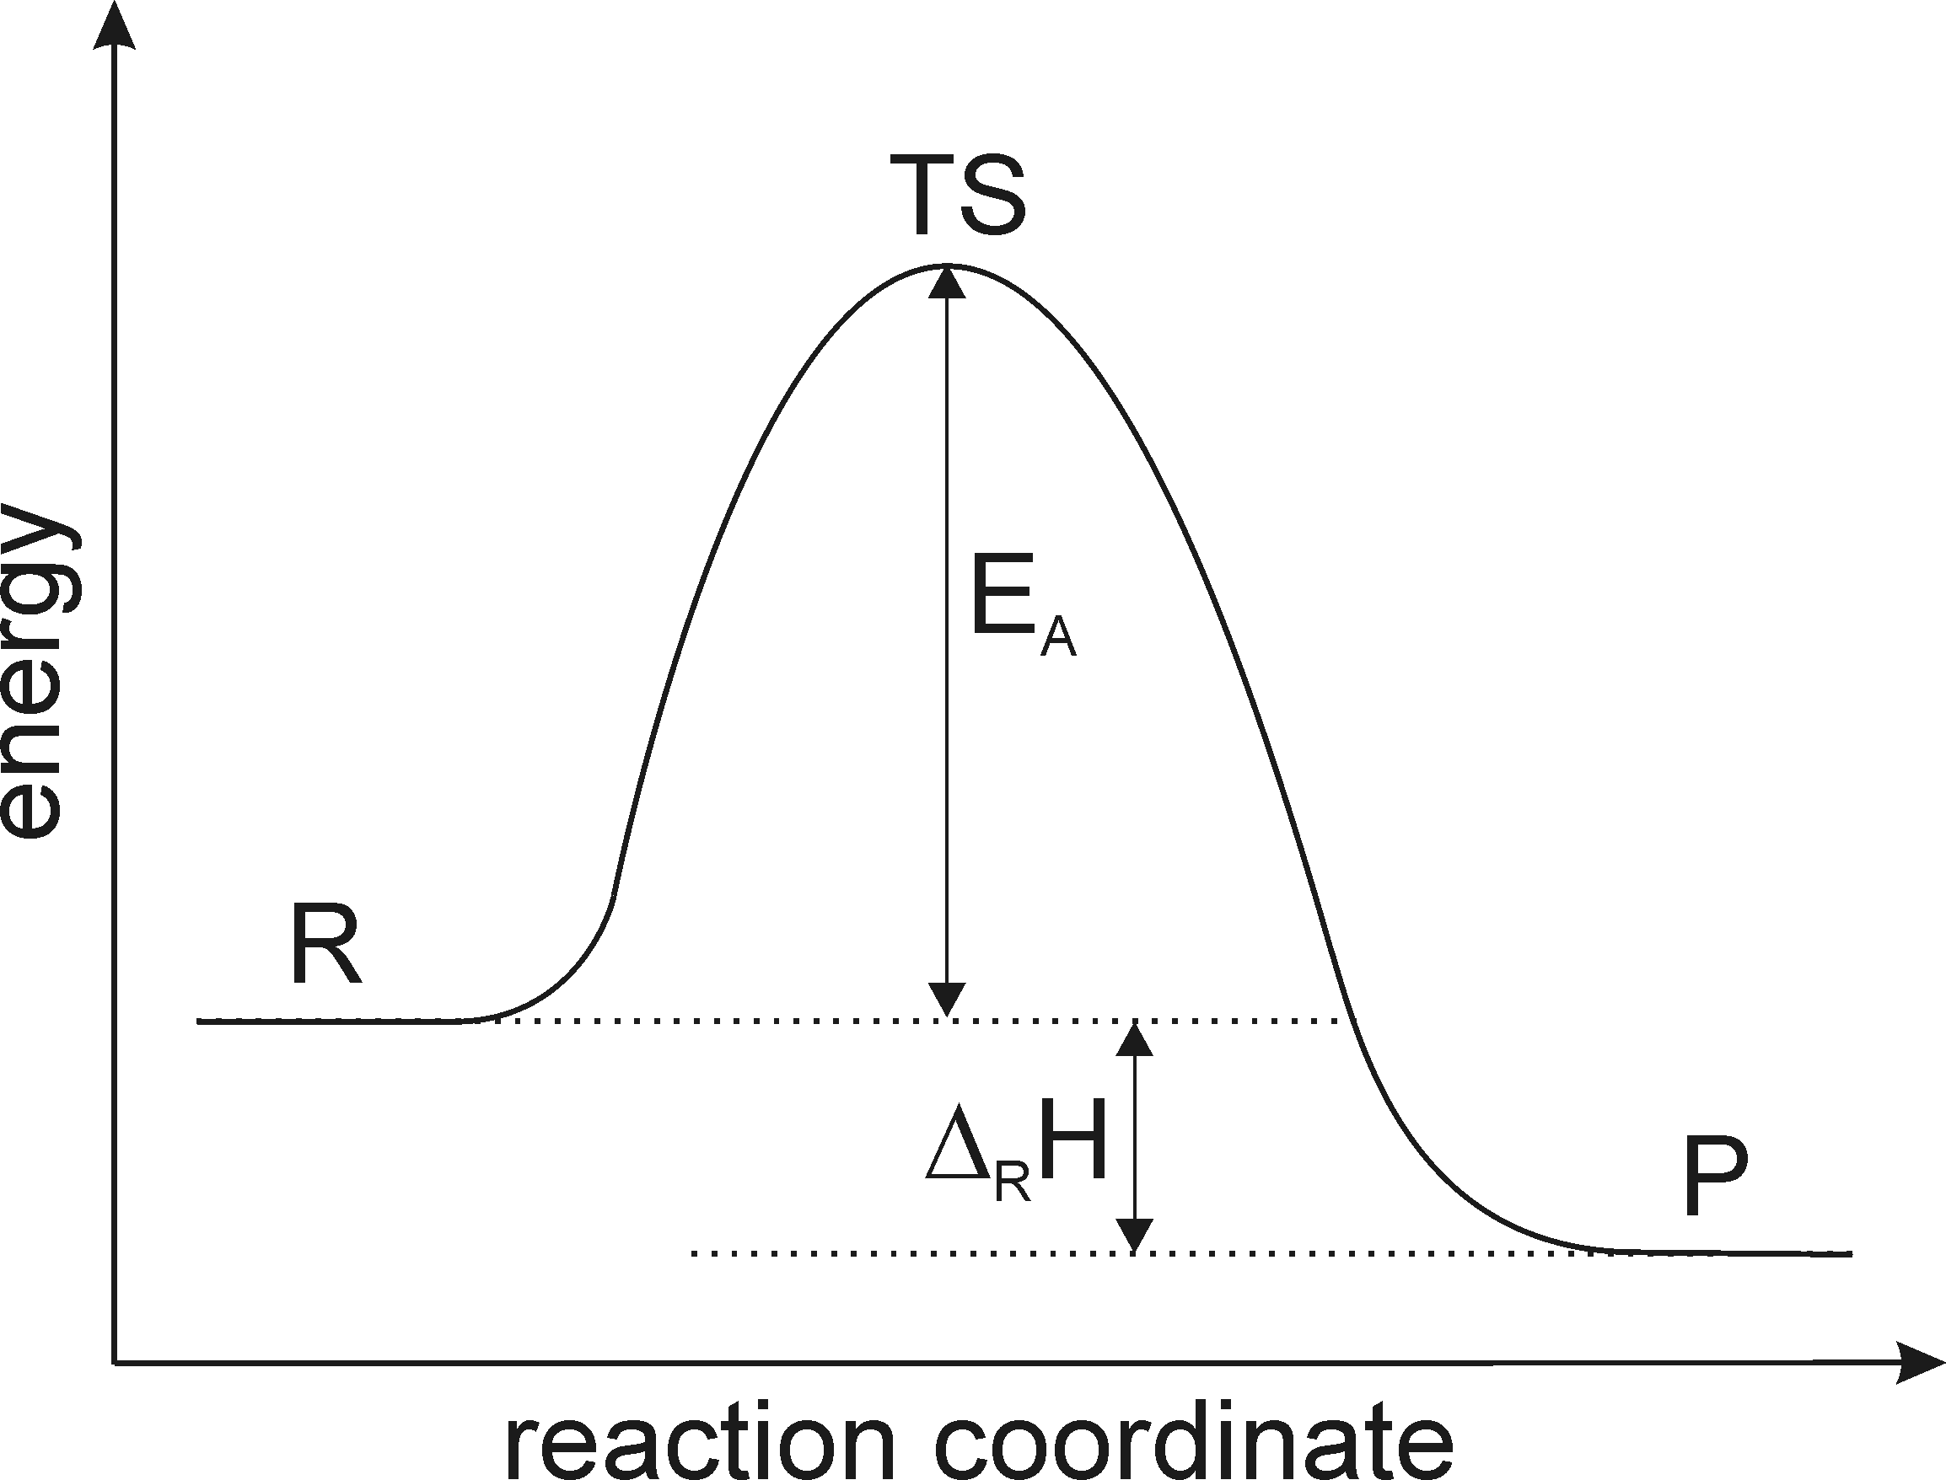
Introduction
ν_{a}A + ν_{b}B ↔ ν_{c}C + ν_{d}D
Thermodynamic
Kinetics
r₊ = k₊[A]^{va}[B]^{vb}
[C]^{vc}[D]^{vd}
^{K =} [A]^{va}[B]^{vb}
r₋ = k₋[C]^{vc}[D]^{vd}
[C]^{vc}[D]^{vd}
k₊
K =
[A]^{va}[B]^{vb}
=
= const.
k
-
2

Slide 28
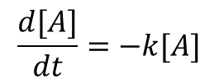


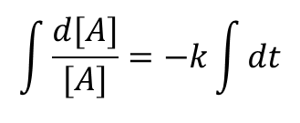
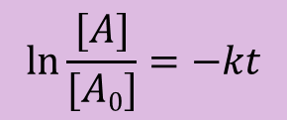






1. Order Reaction
A →→ Products
ln [A₀]
ln [A]
t
half live time: t_{½}
t_{½}
[A₀]

Slide 29
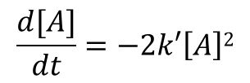



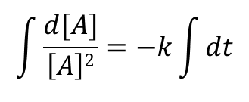
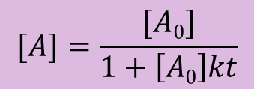
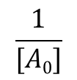
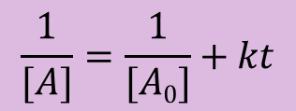
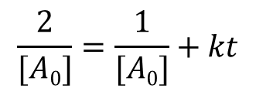



2. Order Reaction
2 A →→ Products
t
half live time: t_{½}
t_{½}
[A₀]
4

Slide 30











Complex Reaction Systems
consecutive reactions
irreversible
parallel reactions
C
A 2 B C
E + F
2 A
B
D
2 G
reversible
A
2 B
C

Slide 31

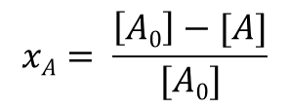
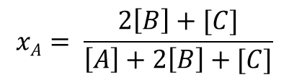

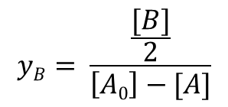
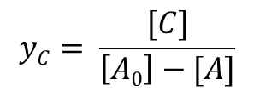

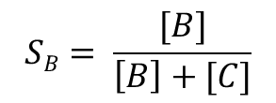
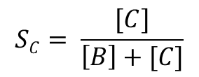
Conversion-Yield-Selectivity
A 2 B + C
Conversion (x)
Yield (y)
Selectivity (S)

Slide 32
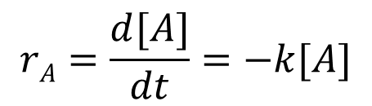
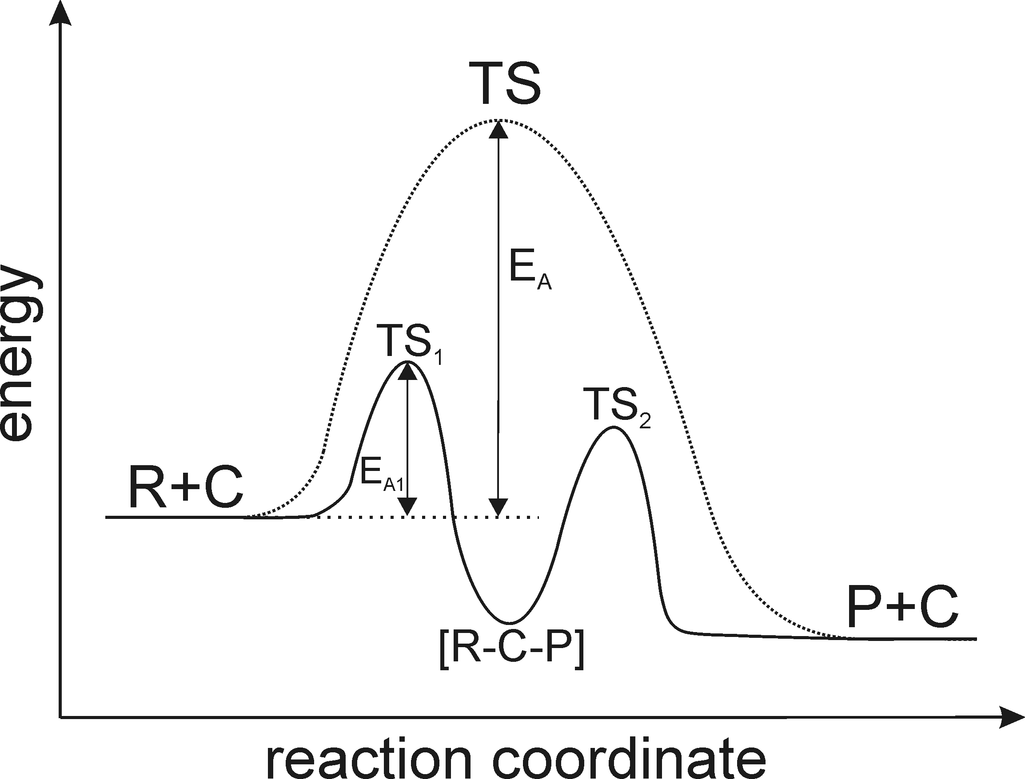
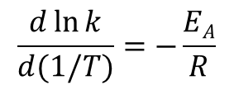




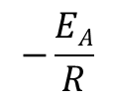



Activation Energy
temperature dependency of the kinetic constant
Arrhenius law:
diffusion
chem. kinetics
+ diffusion
chemical kinetics
preexponential factor temperature dependency small compared to exponential term

Slide 33




Order – Molecularity – Rank
Products
Products 2 E
Products
G
A
B + C
D
F
2 H + I
Order: Molecularity:
Rank:
1st (A) unimolecular
---
1st (B), 1st (C) bimolecular primary (B,C)
1st (D), 2nd (E) trimolecular primary (D of B+C) secondary (D of A)
1st (F) unimolecular
primary (F of D+2E) secondary (F of B+C) tertiary (F of A)
S_{i}
x_{A}
...in real world:
Kinetic orders and molecularities cannot be predicted from stoichiometries, it has
to be deduced from observations
do the experiment!

Slide 34


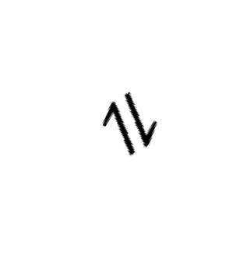




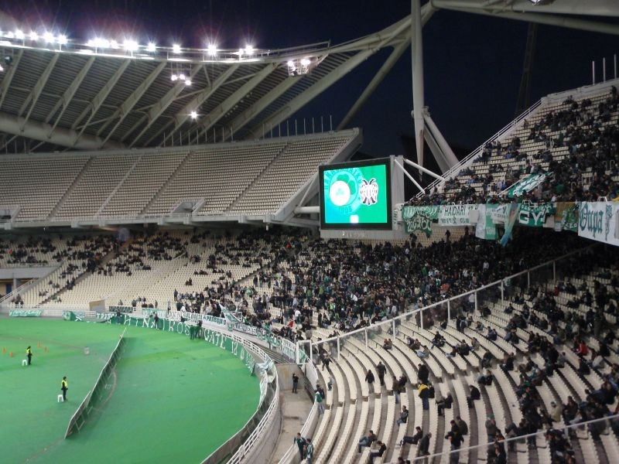




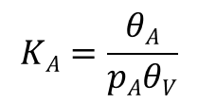
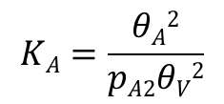
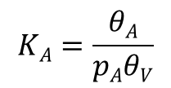
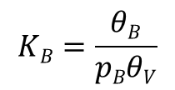




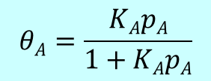
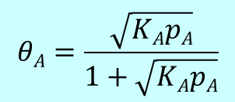
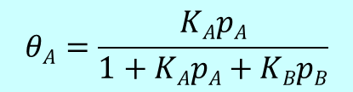
Adsorption
A
A
A₂
A
B
A*
A*
A* A*
AB*
molecular
dissociation
competitive

Slide 35
Homogeneous Catalysis
Action • catalyst and reactants are in the same phase
• reaction proceeds through an intermediate species with lower energy
• there is usually more than one reaction step
• transition metal ions are often involved - oxidation state changes
Example
Acids Esterificaton
Conc. sulphuric acid catalyses the reaction between acids and alcohols
CH₃COOH + C₂H₅OH CH₃COOC₂H₅ + H₂O
NB Catalysts have NO EFFECT ON THE POSITION OF EQUILIBRIUM
but they do affect the rate at which equilibrium is reached

Slide 36
Homogeneous Catalysis
Action • catalyst and reactants are in the same phase
• reaction proceeds through an intermediate species with lower energy
• there is usually more than one reaction step
• transition metal ions are often involved - oxidation state changes
In homogeneous catalysis the catalysts are present in the same phase as the substances which are going into the reaction phase. The most widely used industrial unit operation are either homogeneous or heterogeneous catalysts as these are better suited for the industrial operations that are undertaken. Whether we are looking at hetero or homogeneous forms of catalysts the catalysts does not undergo chemical changes but the physical states of these substances undergo substantial changes in the size of the particles or the changes in colours. It is also noticeable that unlike other forms of catalysts, the homogenous form of catalysts supported reactions, the rate of catalytic reactions are proportional to the concentration of catalysts like what we see in cane sugar inversion process.

Slide 37
Homogeneous Catalysis
Action • catalyst and reactants are in the same phase
• reaction proceeds through an intermediate species with lower energy
• there is usually more than one reaction step
• transition metal ions are often involved - oxidation state changes
Examples
Gases Atmospheric OZONE breaks down naturally O₃ ——> O• + O₂
- it breaks down more easily in the presence of chlorofluorocarbons (CFC's).
There is a series of complex reactions but the basic process is :-
CFC's break down in the presence of
UV light to form chlorine radicals CCl₂F₂ ——> Cl• + • CClF₂
chlorine radicals then react with ozone O₃ + Cl• ——> ClO• + O₂
chlorine radicals are regenerated ClO• + O ——> O₂ + Cl•
Overall, chlorine radicals are not used up so a small amount of CFC's can
destroy thousands of ozone molecules before the termination stage.

Slide 38
Homogeneous vs Heterogeneous
Homogeneous catalysis | Heterogeneous catalysis
These types of catalysts usually are common in either liquid phase or gas phase | These are found in liquid phase, gas phase and solid phase
Operative temperature for homogeneous catalysis is generally low except only when under high pressure | Operative temperature for heterogeneous catalysis is harsh as compared to homogeneous process
As the reactants and catalysts are in same phase the diffusion in homogeneous catalysis process is very high | The heterogeneous catalysis process diffusivity is low as the absorbance surface is low
The heat transfer in homogeneous catalysis is very high as all the molecules of reactants and catalysts are in same phase | The heat transfer is relatively low as compared to homogeneous catalysis as the reactant molecules and catalysts are in different phase
The active site is very well defined | The active site is not very well defined as different phase sites might have different catalytic properties for the same particle

Slide 39
Homogeneous catalysis | Heterogeneous catalysis
Recycling methods are not very cost effective as it’s a long drawn process and as it’s a difficult treatment method for spent catalysts | These catalysts although require reactivating treatment process but still quite cost effective
Modification of homogenous catalysts is very easy as it depends upon the tuning of electronic and steric properties on metal | The modification of heterogeneous catalysts is relatively difficult as the controlling methods of particle site as well as the active size at molecular level is really difficult
Reaction mechanism easier to find as varied techniques are available | Reaction mechanism is difficult to fins as the techniques utilised as the product is scrutinised and not the catalysts
Selectivity of homogeneous catalysts are very high | Selectivity of heterogeneous catalysts is low

Slide 40
THANK YOU

