Slide 1
NATURE OF CHEMICAL BONDS: COVALENT BOND
Presented by
Dr. M.P. KESAVAN M.Sc., Ph.D.,
Assistant Professor
Department of Chemistry
Hajee Karutha Rowther Howdia College
Uthamapalayam.

Slide 2
What is Chemical Bond?

Slide 3
Chemical Bonds
Definition
Chemical bonds are forces that hold atoms together to make compounds or molecules. Chemical bonds include ionic, covalent, and coordinate bonds.
Ionic bonds
Atoms with large differences in electronegativity transfer electrons to form ions. The ions then are attracted to each other. This attraction is known as an ionic bond.
This attraction usually forms between a metal and a non-metal, and the valence electrons are typically represented as being transferred from the metal atom to the nonmetal.
Example: NaCl, NaF, etc.,

Slide 4
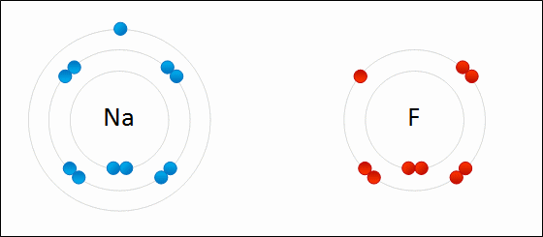
Formation of sodium fluoride
The transfer of electrons and subsequent attraction of oppositely charged ions.

Slide 5
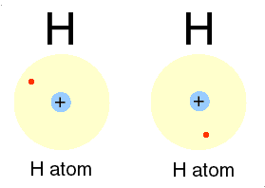
Covalent bonds
Atoms with relatively similar electronegativity, share electrons equally between them and are connected by covalent bonds.
This interaction typically forms between two non-metals.
In other words, atoms with equal or similar electronegativity form covalent bonds, in which the valence electron density is shared between the two atoms. The electron density resides between the atoms and is attracted to both nuclei. Example: H2, HCl, F2, etc.,

Slide 6
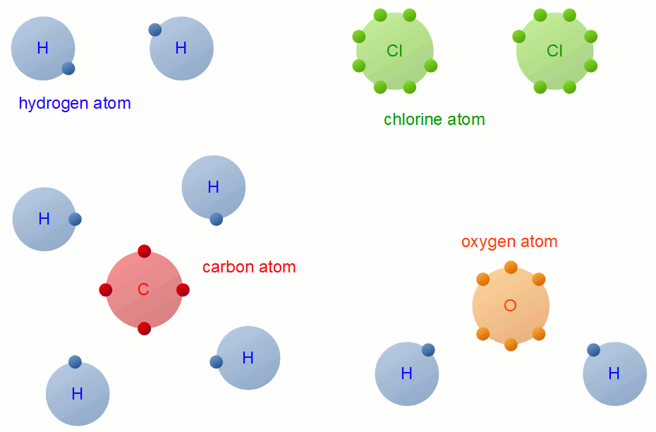
Formation of covalent bonds

Slide 7
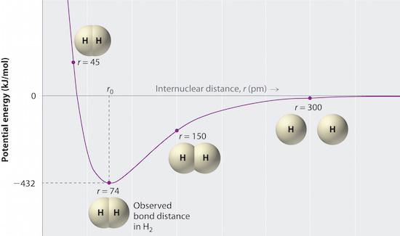

Slide 8
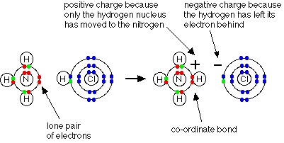
Coordinate bonds
A co-ordinate bond (also called a dative covalent bond) is a covalent bond (a shared pair of electrons) in which both electrons come from the same atom.
Example:
NH3(g)+HCl(g)→NH4Cl(s)
Ammonium ions, NH4+, are formed by the transfer of a hydrogen ion (a proton) from the hydrogen chloride molecule to the lone pair of electrons on the ammonia molecule.

Slide 9
Covalent bonds

Slide 10
Theory of Covalent bond formation
Valence Bond (VB) Theory
The overlapping of two half-filled valence orbitals of two different atoms results in the formation of the covalent bond. The overlapping causes the electron density between two bonded atoms to increase. This gives the property of stability to the molecule.
In case the atomic orbitals possess more than one unpaired electron, more than one bond can be formed and electrons paired in the valence shell cannot take part in such a bond formation.
A covalent bond is directional. Such a bond is also parallel to the region of overlapping atomic orbitals.

Slide 11
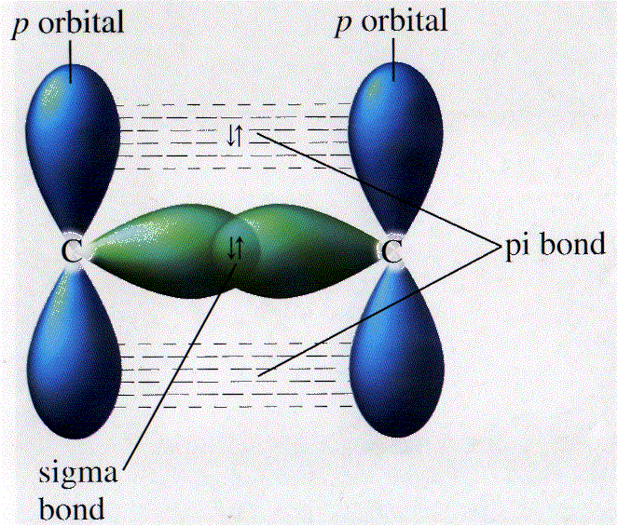
Based on the pattern of overlapping, there are two types of covalent bonds: sigma bond and a pi bond. The covalent bond formed by sidewise overlapping of atomic orbitals is known as pi bond whereas the bond formed by overlapping of atomic orbital along the inter nucleus axis is known as a sigma bond.

Slide 12
Limitations
It fails to explain the tetra-valency of carbon.
This theory does not discuss the electrons’ energies.
As an example,
Let us consider the water molecule, in which we have one oxygen atom bonding to two hydrogen atoms.
Oxygen has the electron configuration 1s 2s 2p , with two unpaired electrons (one in each of the two 2p orbitals).
Valence bond theory would predict that the two O–H bonds form from the overlap of these two 2p orbitals with the 1s orbitals of the hydrogen atoms.
If this were the case, the bond angle would be 90°, as shown in the following Figure, because p orbitals are perpendicular to each other.

Slide 13
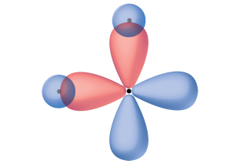
Experimental evidence shows that the bond angle is 104.5°, not 90°. The prediction of the valence bond theory model does not match the real-world observations of a water molecule; a different model is needed
The hypothetical overlap of two of the 2p orbitals on an oxygen atom (red) with the 1s orbitals of two hydrogen atoms (blue) would produce a bond angle of 90°.

Slide 14
Introduction of hybridization concept

Slide 15
Quantum-mechanical calculations suggest why the observed bond angles in H2O differ from those predicted by the overlap of the 1s orbital of the hydrogen atoms with the 2p orbitals of the oxygen atom.
The mathematical expression known as the wave function, ψ, contains information about each orbital and the wavelike properties of electrons in an isolated atom.
When atoms are bound together in a molecule, the wave functions combine to produce new mathematical descriptions that have different shapes.
This process of combining the wave functions for atomic orbitals is called hybridization and is mathematically accomplished by the linear combination of atomic orbitals, LCAO, The new orbitals that result are called hybrid orbitals.

Slide 16
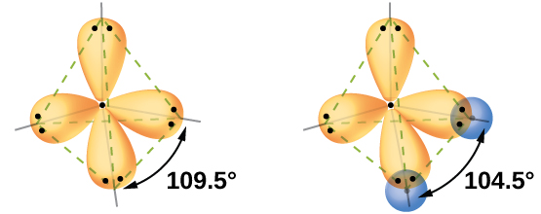
The valence orbitals in an isolated oxygen atom are a 2s orbital and three 2p orbitals. The valence orbitals in an oxygen atom consist of four equivalent hybrid orbitals that point approximately toward the corners of a tetrahedron. Consequently, the overlap of the O and H orbitals should result in a tetrahedral bond angle (109.5°).
The observed angle of 104.5° is experimental evidence for which quantum-mechanical calculations give a useful explanation: Valence bond theory must include a hybridization component to give accurate predictions.

Slide 17
The following ideas are important in understanding hybridization:
Hybrid orbitals do not exist in isolated atoms. They are formed only in covalently bonded atoms.
Hybrid orbitals have shapes and orientations that are very different from those of the atomic orbitals in isolated atoms.
A set of hybrid orbitals is generated by combining atomic orbitals. The number of hybrid orbitals in a set is equal to the number of atomic orbitals that were combined to produce the set.
All orbitals in a set of hybrid orbitals are equivalent in shape and energy.
The type of hybrid orbitals formed in a bonded atom depends on its electron-pair geometry as predicted by the VSEPR theory.
Hybrid orbitals overlap to form σ bonds. Unhybridized orbitals overlap to form π bonds.

Slide 18
sp Hybridization
The beryllium atom in a gaseous BeCl2 molecule is an example of a central atom with no lone pairs of electrons in a linear arrangement of three atoms.
There are two regions of valence electron density in the BeCl2 molecule that correspond to the two covalent Be–Cl bonds. To accommodate these two electron domains, two of the Be atom’s four valence orbitals will mix to yield two hybrid orbitals.
This hybridization process involves mixing of the valence s orbital with one of the valence p orbitals to yield two equivalent sp hybrid orbitals that are oriented in a linear geometry

Slide 19
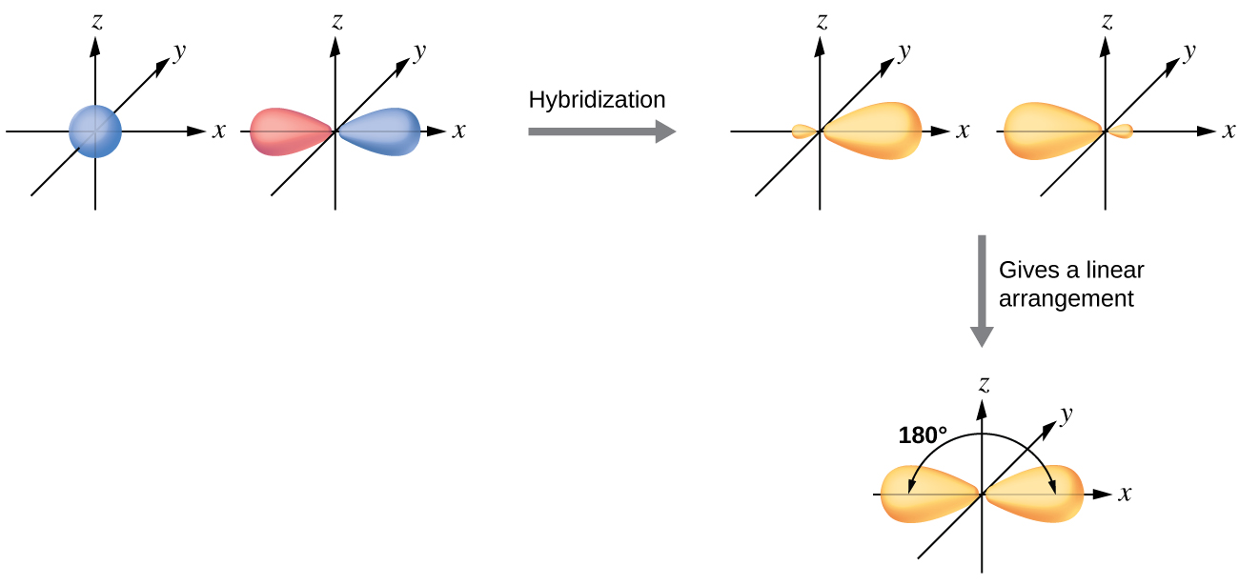

Slide 20
sp² Hybridization
The valence orbitals of a central atom surrounded by three regions of electron density consist of a set of three sp2 hybrid orbitals and one unhybridized p orbital.
This arrangement results from sp2 hybridization, the mixing of one s orbital and two p orbitals to produce three identical hybrid orbitals oriented in a trigonal planar geometry
Example:
The observed structure of the borane molecule, BH3, suggests sp2 hybridization for boron in this compound. The molecule is trigonal planar, and the boron atom is involved in three bonds to hydrogen atoms.

Slide 21
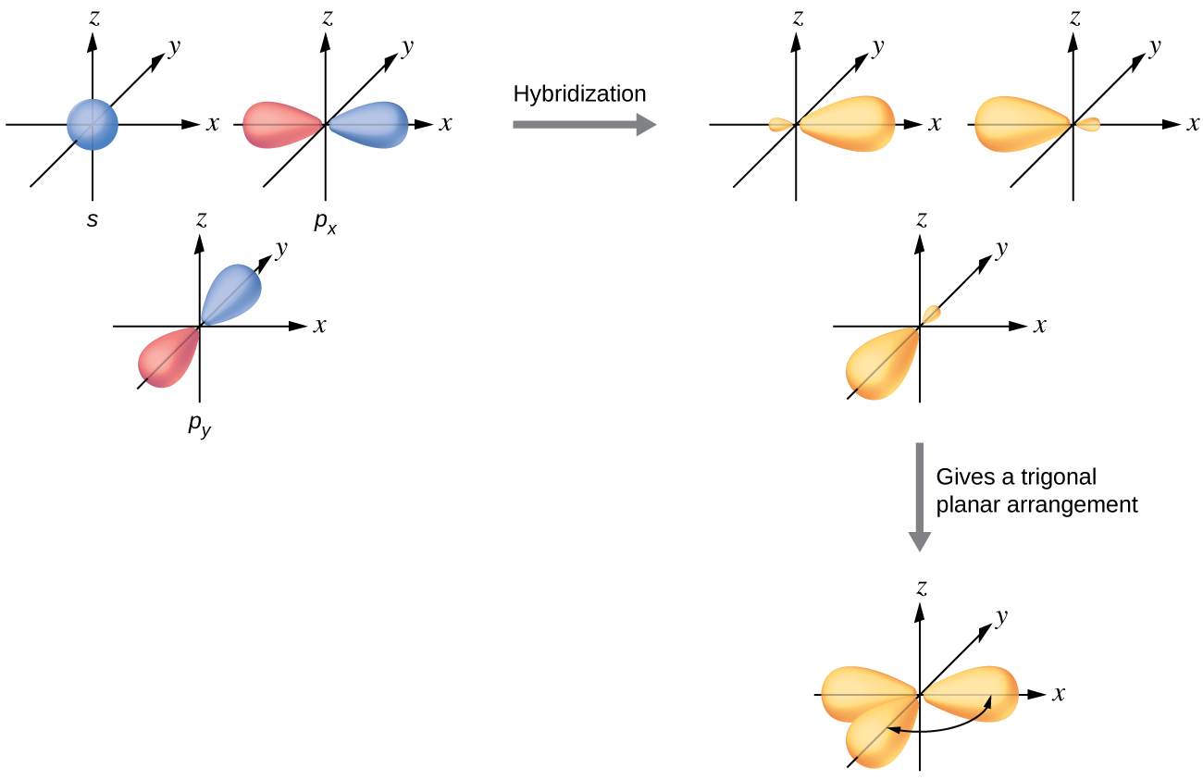
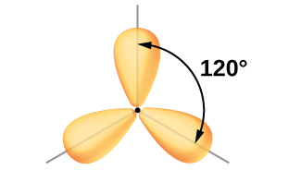

Slide 22
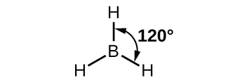

Slide 23
sp³ Hybridization
The valence orbitals of an atom surrounded by a tetrahedral arrangement of bonding pairs and lone pairs consist of a set of four sp3 hybrid orbitals. The hybrids result from the mixing of one s orbital and all three p orbitals that produces four identical sp3 hybrid orbitals.
Example:
A molecule of methane, CH4, consists of a carbon atom surrounded by four hydrogen atoms at the corners of a tetrahedron. The carbon atom in methane exhibits sp3 hybridization.
The four valence electrons of the carbon atom are distributed equally in the hybrid orbitals, and each carbon electron pairs with a hydrogen electron when the C–H bonds form.

Slide 24
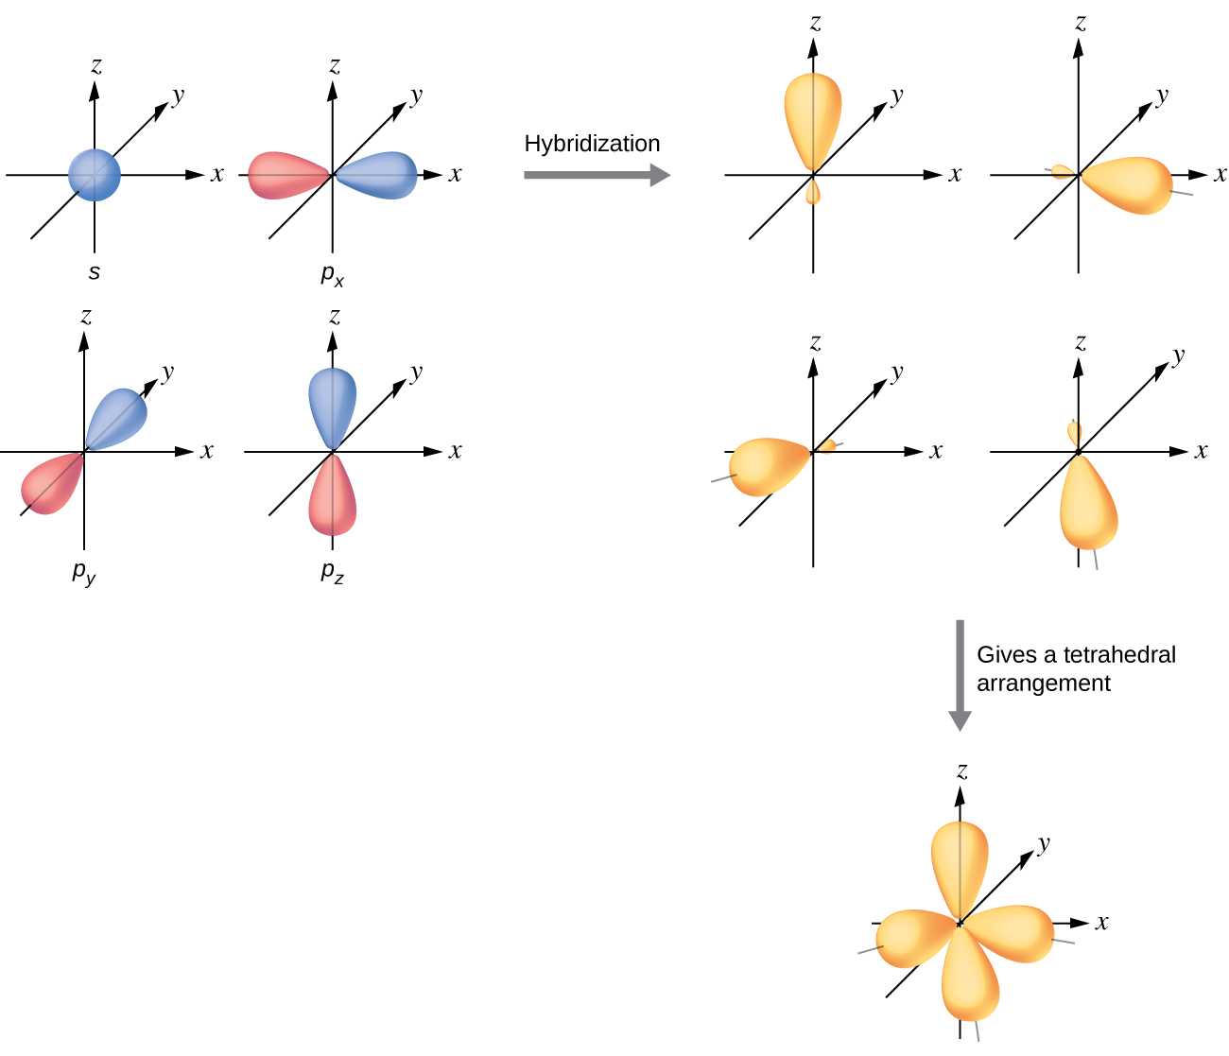

Slide 25
In Methane molecule

Slide 26
sp³d and sp³d² Hybridization
To describe the five bonding orbitals in a trigonal bipyramidal arrangement, we must use five of the valence shell atomic orbitals (the s orbital, the three p orbitals, and one of the d orbitals), which gives five sp3d hybrid orbitals.
With an octahedral arrangement of six hybrid orbitals, we must use six valence shell atomic orbitals (the s orbital, the three p orbitals, and two of the d orbitals in its valence shell), which gives six sp3d2 hybrid orbitals. These hybridizations are only possible for atoms that have d orbitals in their valence subshells (that is, not those in the first or second period).

Slide 27
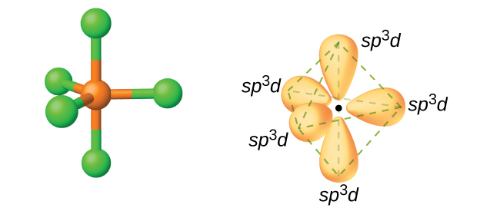
Examples for sp³d Hybridization
In a molecule of phosphorus pentachloride, PCl5, there are five P–Cl bonds (thus five pairs of valence electrons around the phosphorus atom) directed toward the corners of a trigonal bipyramid. We use the 3s orbital, the three 3p orbitals, and one of the 3d orbitals to form the set of five sp3d hybrid orbitals that are involved in the P–Cl bonds. Other atoms that exhibit sp3d hybridization include the sulfur atom in SF4 and the chlorine atoms in ClF3 and in ClF+4

Slide 28
Examples for sp³d² Hybridization
The sulfur atom in sulfur hexafluoride, SF6, exhibits sp3d2 hybridization. A molecule of sulfur hexafluoride has six bonding pairs of electrons connecting six fluorine atoms to a single sulfur atom.
There are no lone pairs of electrons on the central atom.
To bond six fluorine atoms, the 3s orbital, the three 3p orbitals, and two of the 3d orbitals form six equivalent sp3d2 hybrid orbitals, each directed toward a different corner of an octahedron.
Other atoms that exhibit sp3d2 hybridization include the phosphorus atom in PCl−6 , the iodine atom in the interhalogens IF+6 , IF5, ICl−4 , IF−4 and the xenon atom in XeF4.

Slide 29
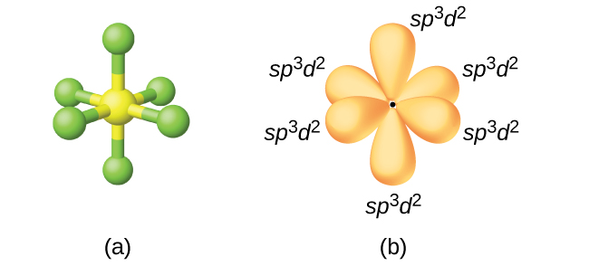
(a) Sulfur hexafluoride, SF₆, has an octahedral structure that requires sp³d² hybridization. (b) The six sp³d² orbitals form an octahedral structure around sulfur.

Slide 30
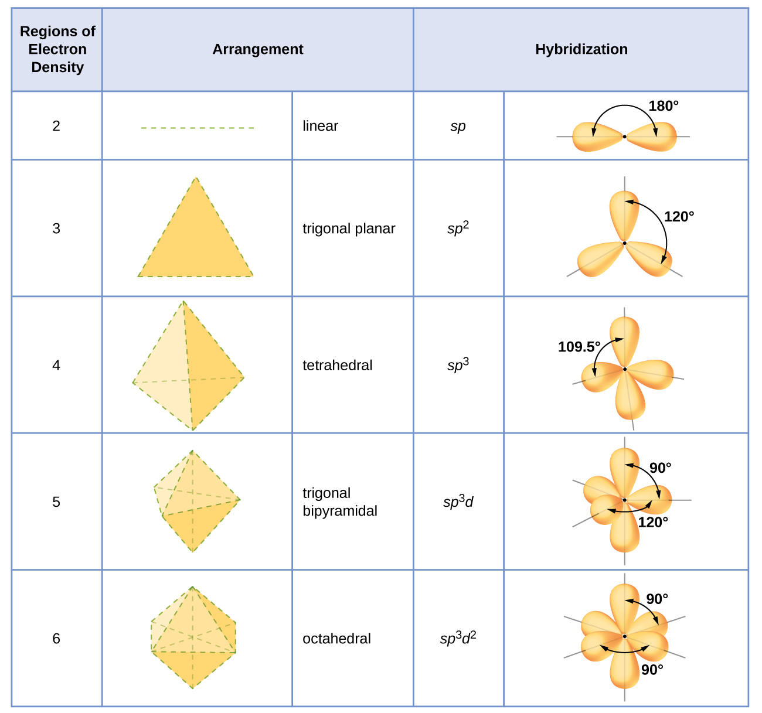

Slide 31
Total number of sigma (σ) bonds | Nature of Hybridization State | Examples
2 | sp | BeCl₂, HgCl₂,C₂H₂,CO₂,CO,CdCl₂, ZnCl₂ etc.
3 | sp² | BCl₃, AlCl₃,C₂H₄,C₆H₆,SO₂,SO₃,HNO₃, H₂CO₃,SnCl₂, PbCl₂ etc.
4 | sp³ | NH₄⁺, BF₄⁻, H₂SO₄, HClO₄,PCl₃, NCl₃, AsCl₃, HClO₃,ICl₂⁺,OF₂,HClO₂,SCl₂,HClO, ICl, XeO₃ etc.
5 | sp³d | PCl₅, SbCl₅, SF₄, ClF₃, BrF₃, XeF₂, ICl₂⁻ etc.
6 | sp³d² | SF₆, AlF₆³⁻, SiF₆²⁻, PF₆⁻, IF₅, BrF₅, XeOF₄, XeF₄, BrF₄⁻, ICl₄⁻ etc.
7 | sp³d³ | IF₇, XeF₆ etc.

Slide 32
Bent’s Rule
The rule states: “atomic s character tends to concentrate in orbitals that are directed toward electropositive groups and atomic p character tends to concentrate in orbitals that are directed toward electronegative groups ”.
This rule, which is experimentally observed and supported by molecular orbital calculations.

Slide 33
Hybrid orbitals for main group elements consist of one s and three p orbitals, with the s orbital having lower energy. To have more s character means that the bonding orbital is lower in energy and shaped more like an s orbital rather than a p orbital.
In other words, ligand orbitals tend to be rich in p character because of higher electronegativity, with s character concentrated on the central metal. However, in cases where the metal has a lone pair, the lone pair orbital is high in s character.
This is because s orbitals are closer to the nucleus, allowing for greater stabilization of the lone pair.

Slide 34
Bent’s rule was derived from the comparison of experimentally determined physical properties of molecules, correlated with valence bond structures and bond hybridization.
This rule has been used to qualitatively describe molecular geometries and predict the structure of substituted atoms or molecules.
While Bent’s rule was originally intended to describe bonding in elements of the first row of the periodic table, it also experimentally holds true for transition metal complexes.

Slide 35
Examples
In the molecule methyl fluoride for example, the H-C-F bond angle (108.73°) is less than the H-C-H bond angle (110.2°). This difference can be attributed to more p character in the C−F bonding and more s character in the C−H bonding orbitals.
The bond length between similar atoms also shortens with increasing s character. For example, the C−H bond length is 110.2 pm in ethane, 108.5 pm in ethylene and 106.1 pm in acetylene, with carbon hybridizations sp3 (25% s), sp2 (33% s) and sp (50% s) respectively.

Slide 36
References
F. A. Cotton and G. Wilkinson, "Advanced Inorganic Chemistry", 5th Edition, John Wiley&Sons, Singapore, 1998.
K.M. Mackay and R. A. Mackay, Introduction to Modern Inorganic chemistry, 4th Edn. Prentice Hall, New Jersy, 1989.
James E. Hugheey, Ellen A. Keitler and Richard L. Keitler, Inorganic Chemistry, 4th Edn, Harper COllinsCOllege Publishes, New York, 1993.
https://study.com/academy/lesson/hybridization-in-molecules-containing-double-triple-bonds.html

