Slide 1
Polymer Degradation II. M.Sc., Chemistry
Dr. S. SIVAKUMAR
Assistant Professor
Department of Chemistry
Hajee Karutha Rowther Howdia College
Uthamapalayam

Slide 2
Polymer Degradation
Degradation means that a reduction in the molecular weight.
Uncontrolled change in the molecular weight or constitution of the polymer.
Degradation during fabrication process is due to heating.
During the daily usage polymer face mechanical stresses, solar radiations, oxygen and moisture.

Slide 3
Types of Polymer Degradation
Two types namely
chain end degradation or unzipping degradation or depolymerisation.
Random Degradation
chain end degradation
Degradation starts from chain ends resulting in successive release of monomer units.

Slide 4
CHAIN END DEGRADATION
It is reverse of propagation step.
Hence it is depolymerisation
Ex: poly methyl styrene is converted into monomer at 60⁰C and on cooling at -70⁰C polymer can be obtained.
Polymethyl methacrylate at 300⁰C give back the monomer.
Polymers formed by chain polymerisation undergo unzipping.

Slide 5
CHAIN END DEGRADATION
Chain end degradation occurs when the backbone bonds are weaker than the bonds of the side groups.
Polymer molecules carrying active chain ends with free radical, cation, anion undergo Chain end degradation.
Enzyme beta amylase degrade starch to maltose beginning with chain ends.

Slide 6
Random degradation
It occurs at any random point along the polymer chain instead of at the chain ends and hence the name Random degradation.
Reverse of polycondensation process
Polymer degrade to low molecular weight fragments.
No monomer is liberated.
Almost all polymer undergo random degradation

Slide 7
Random degradation
For random degradation to occur the polymer chain need not carry any active site.

Slide 8
Thermal degradation
Thermal degradation follows unzipping or random degradation.
Unzipping gives pure monomer and random gives low molecular weight products.
Many polymers have C-C chain as the backbone , their thermal stability is dependent on the stability of C-C bond.

Slide 9
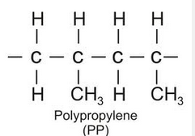
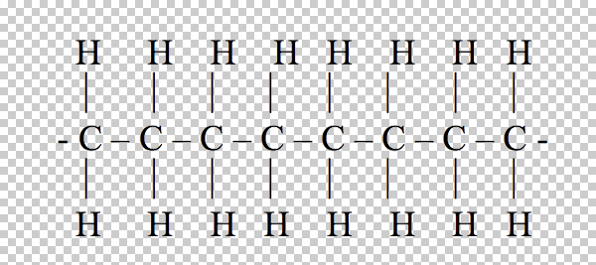
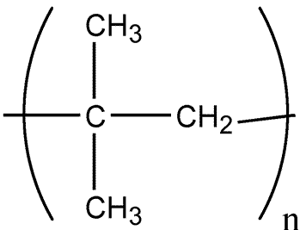
Poly ethylene
Poly iso butylene

Slide 10
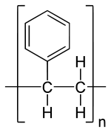
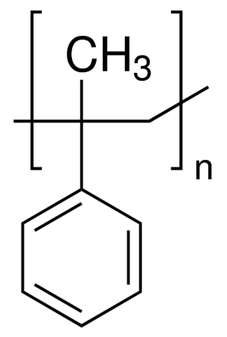
Thermal degradation
The number of substituents increases and the stability of the polymer backbone bond decreases.
Polyethylene
stable
Poly methyl styrene
Still less stable
Polystyrene
Less stable

Slide 11
Thermal degradation
The bond dissociation energies decreases for C-C in CH₃-CH₃= 88 , CH₃-CH₂-CH₃= 85
(CH₃)₃-C-CH₃= 80, C₆H₅-CH₂-CH₃= 70
All substituents donot always reduce thermal stability of the polymeric system.
Ex: Teflon is most stable polymer upto 400⁰C without undergoing degradation.
Its high thermal stability is attributed to high dissociation energy . High electronegative nature of F protect C-C bond from external attack.
The aromatic groups in a polymer backbone increases the thermal stability.

Slide 12
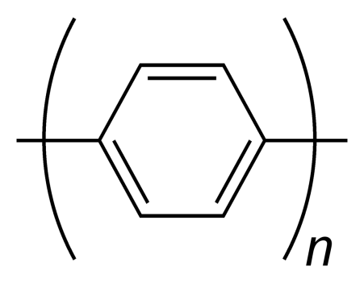
Thermal degradation
Polycarbonate
less stable
Teflon
Polyphenylene
More stable
Poly tetra fluorophenylene most stable due to phenyl and C-F bond.

