Slide 1
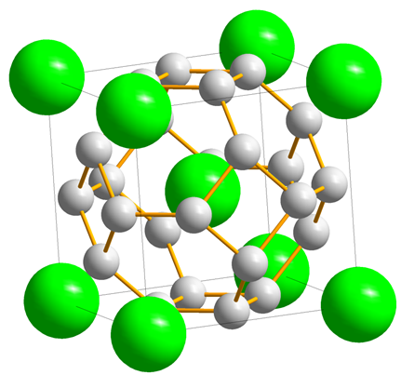
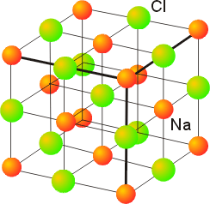
SOLID STATE CHEMISTRY
Presented by
Dr. M.P. KESAVAN M.Sc., Ph.D.,
Assistant Professor
Department of Chemistry
Hajee Karutha Rowther Howdia College
Uthamapalayam.

Slide 2

What is Metallic Bond?

Slide 3
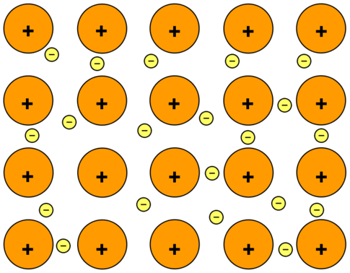
Metallic Bond
Definition
Metallic bonding is a type of chemical bonding that rises from the electrostatic attractive force between conduction electrons (in the form of an electron cloud of delocalized electrons) and positively charged metal ions.

Slide 4
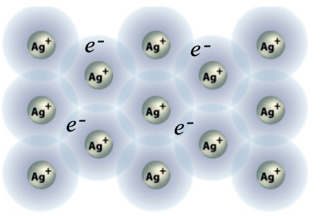

Slide 5
Crystal defects
In an ideal crystal, the atomic arrangement is perfectly regular and continuous throughout.
But real crystals are never perfect; lattice distortion and various imperfections, irregularities or defects generally present in them.
The mechanical, electrical and magnetic properties of crystalline solids, particularly metals and alloys, are affected by the imperfections in the crystals.
If atoms in the solid are not arranged in a perfectly regular manner, it is called defects in crystals.

Slide 6
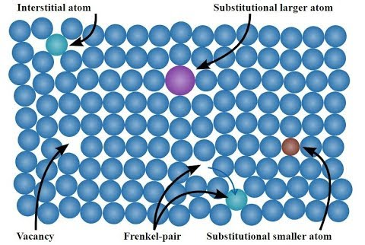
Types of Crystal defect
Point defects
Line defects or dislocation
Surface Defects or plane defects

Slide 7
Point defects
Point defect is also called zero dimensional imperfections.
In a crystal lattice, point defect is one which is completely local in its effect, e.g. a vacant lattice site.
The introduction of point defect into a crystal increases its internal energy as compared to that of the perfect crystal. They change the electrical resistance of a crystal.
Point defects are created during crystal growth and application of thermal energy, mechanical stress or electric field.
Further they are created by irradiating the crystal by x-ray, microwaves and light.
Different types of point defects are described below.

Slide 8
Intrinsic Vacancies
A vacancy is the simplest point defect in a crystal. This refers to a missing atom (or) a vacant atomic site. Such defects may arise either from imperfect packing density crystallization process or from thermal vibration of atoms at high temperature. Vacancy may also occur if an atom leaves its own site and dissolved interstitially into the structures. The vacancies may be single or divacancies or trivacancies and so on.

Slide 9
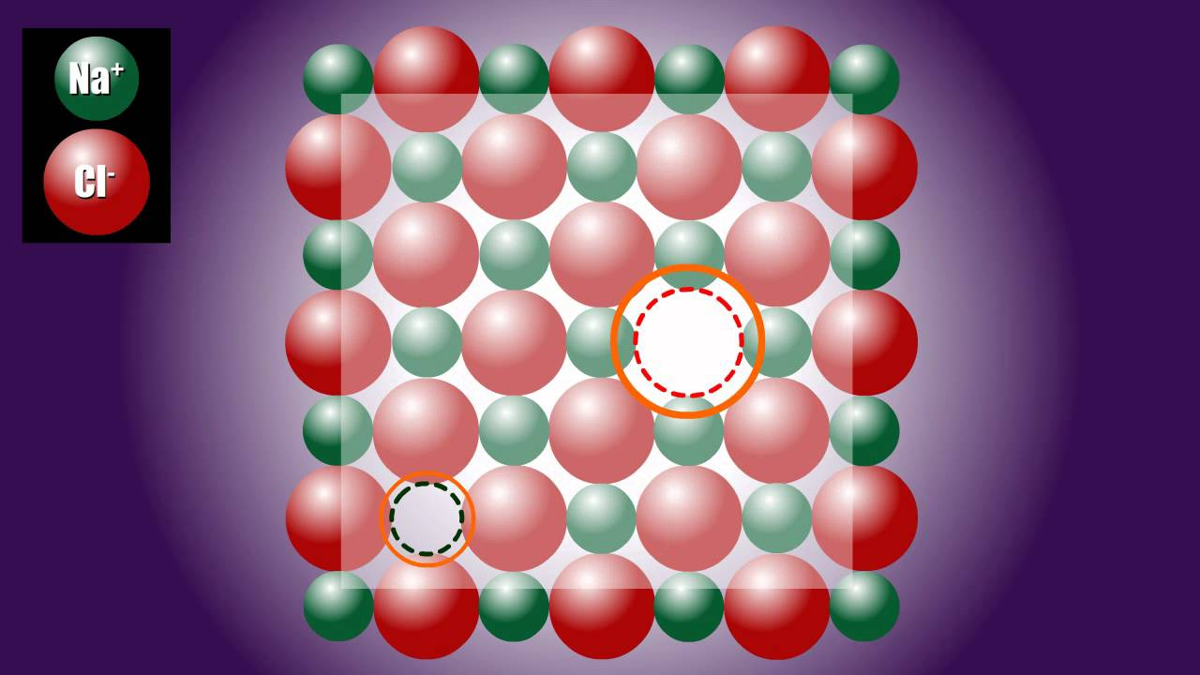
Schottky defects
In general the missing of pair of ions in ionic crystal is called Schottky defect. This defect is the combination of one cation vacancy and one anion vacancy. This also means the crystal will neither be too positive or too negative because the crystal will always be in equilibrium in respect to the number of anions and cations. The concentration of Schottky defect decreases the density of the crystal. This type of point defect is dominant in alkali halides.

Slide 10
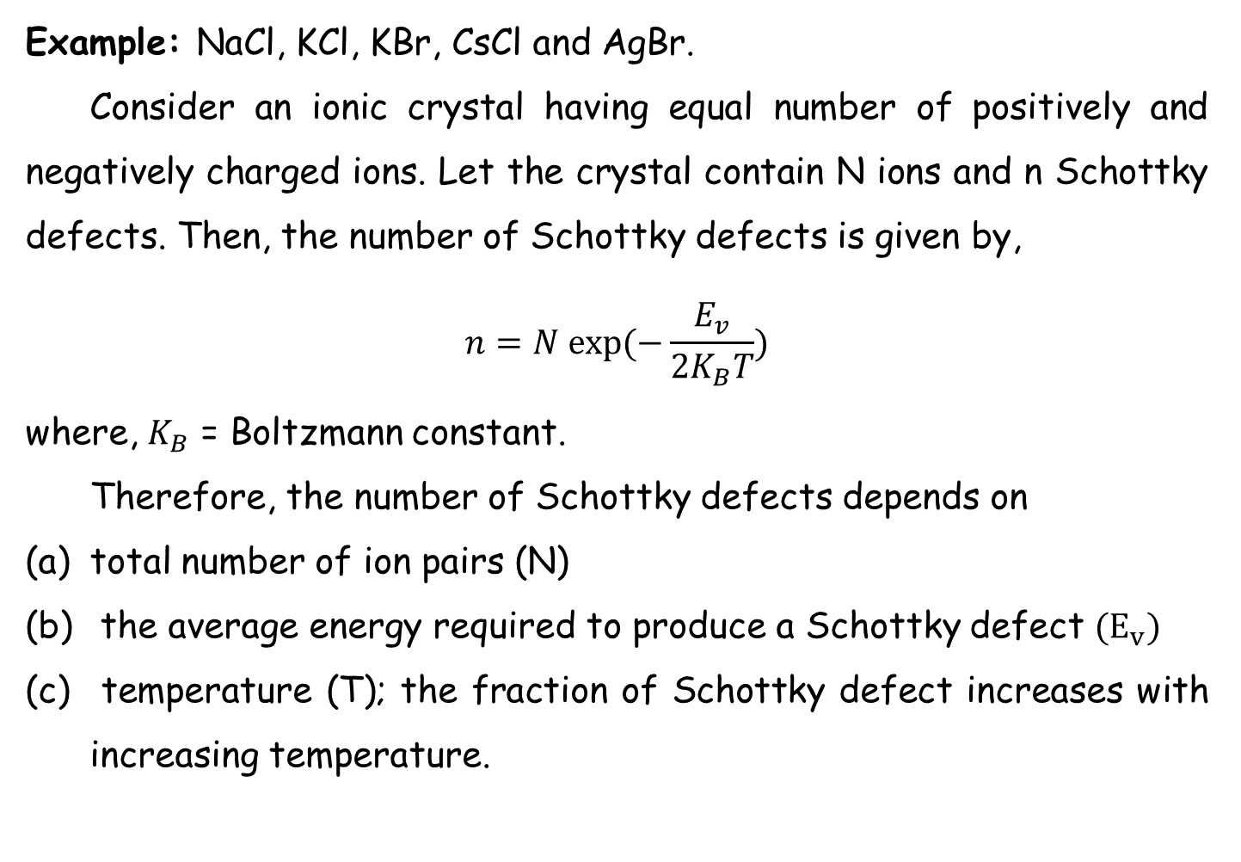
Example: NaCl, KCl, KBr, CsCl and AgBr.
Consider an ionic crystal having equal number of positively and negatively charged ions. Let the crystal contain N ions and n Schottky defects. Then, the number of Schottky defects is given by,
$$n=N exp⁡(−\frac{E_{v}}{2K_{B}T})$$
where, $K_{B}$ = Boltzmann constant.
Therefore, the number of Schottky defects depends on
total number of ion pairs (N)
the average energy required to produce a Schottky defect ${(E}_{v})$
temperature (T); the fraction of Schottky defect increases with increasing temperature.

Slide 11
(ii) Frenkel defect
Frenkel vacancies refer to the shift of cation from the regular site to interstitial site. As cations are generally the smaller ions, it is possible for them to get displaced into the void space (interstitial) present in the lattice. The concentration of Frenkel defects does not change the density of the crystal and the overall electrical neutrality of the crystal.
Example: ZnS, AgCl, AgBr, and AgI.

Slide 12
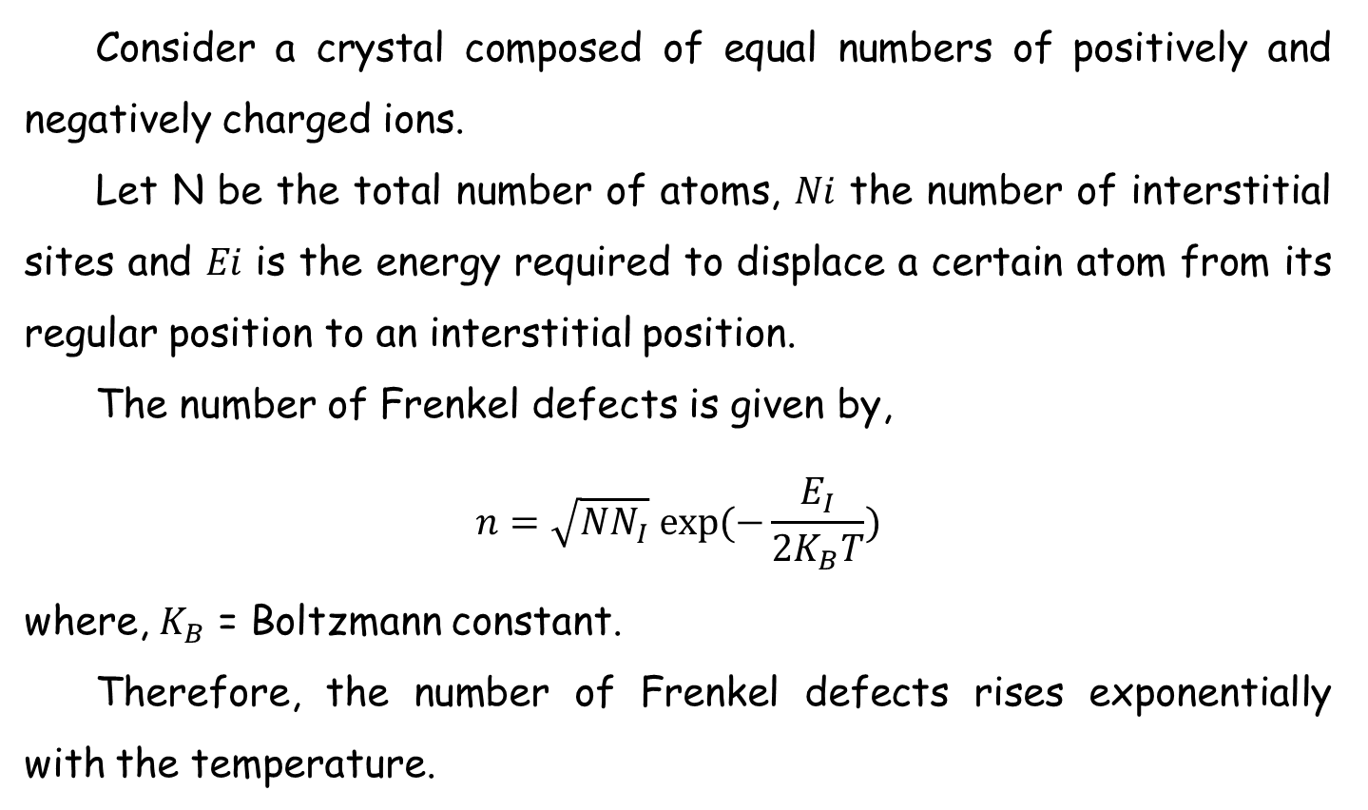
Consider a crystal composed of equal numbers of positively and negatively charged ions.
Let N be the total number of atoms, 𝑁𝑖 the number of interstitial sites and 𝐸𝑖 is the energy required to displace a certain atom from its regular position to an interstitial position.
The number of Frenkel defects is given by,
$$n=\sqrt{NN_{I}} exp⁡(−\frac{E_{I}}{2K_{B}T})$$
where, $K_{B}$ = Boltzmann constant.
Therefore, the number of Frenkel defects rises exponentially with the temperature.

Slide 13
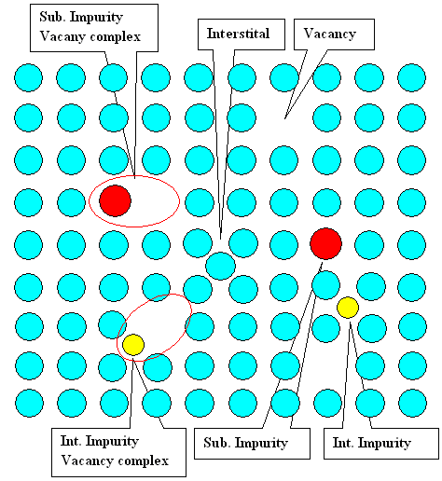
b. Extrinsic vacancies (Impurities)
This is a defect in which a foreign atom occupies a regular lattice site. Foreign atoms generally have atomic radii and electronic structures differing from those of the host atoms and therefore act as centers of distortion. Basically there are two types of impurity defects.

Slide 14
Substitutional impurity
It refers to a foreign atom substitutes or replaces a parent atom in the lattice.
Example: In the case of semiconductor technology, Aluminum and phosphorus doped in silicon are substitutional impurities in the crystal.

Slide 15
(ii) Interstitial impurity
It is a small sized atom occupying the void space in the parent crystal, without dislodging any of the parent atoms from their sites. An atom can enter the interstitial or void space only when it is substantially smaller than the parent atom.
Example: Presence of carbon in iron.

Slide 16
Line defects or dislocation
Line defects are called dislocations. A dislocation may be defined as a disturbed region between two substantially perfect parts of a crystal.
It is a line defect in a crystal structure whereby a part plane of atoms is displaced from its symmetrically stable positions in the array.
Dislocation is the region of localized lattice disturbance separating the slipped and unslipped regions of a crystal.
Movement of dislocation is necessary for plastic deformation.
The two basic types of dislocations are:
(a) Edge dislocation
(b) Screw dislocation

Slide 17
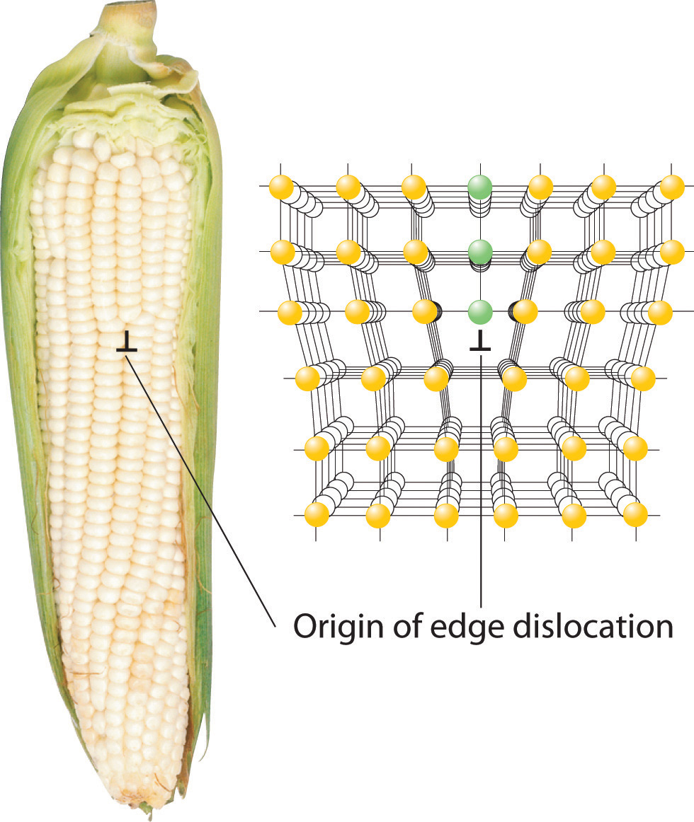
Edge dislocation
An edge dislocation is a defect where an extra half-plane of atoms is introduced mid way through the crystal, distorting nearby planes of atoms. The atoms below the edge of dislocation are squeezed together and are in a state of compression. Just above the edge of the extra plane, the atoms are pulled apart and are in a state of tension.
If the insertion of the extra plane in the crystal is from the bottom of the crystal, the edge dislocation is said to be negative and it is denoted by T.
when the insertion of the extra plane in the crystal is from the top of the crystal, the edge dislocation is said to be positive and it is denoted by ⊥.

Slide 19
b. Screw dislocation
Screw dislocation results from a displacement of the atoms in one part of a crystal relative to the rest of the crystal, forming a spiral ramp around the dislocation line. When the atoms are displaced in two separate planes perpendicular to each other, the imperfection produced is called screw dislocation.
The diagram shows what happens when one part of the crystal is displaced relative to the rest of the crystal and the displacement terminates within the crystal.
The row of atoms marking the termination of the displacement is the screw dislocation.

Slide 20
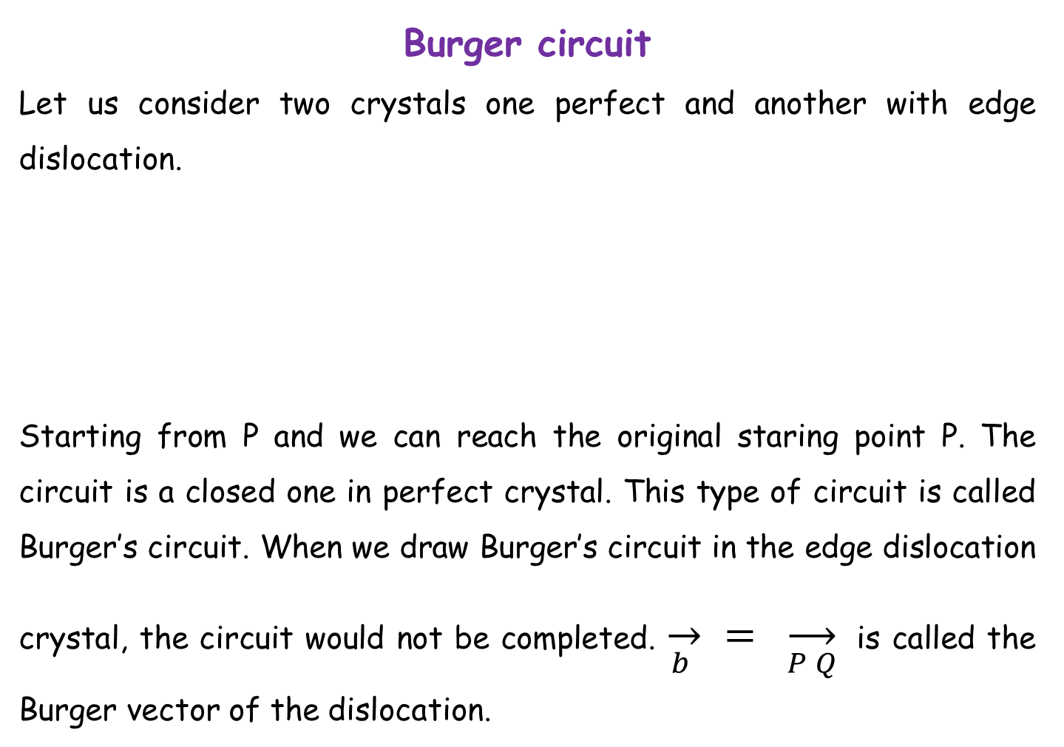
Burger circuit
Let us consider two crystals one perfect and another with edge dislocation.
Starting from P and we can reach the original staring point P. The circuit is a closed one in perfect crystal. This type of circuit is called Burger’s circuit. When we draw Burger’s circuit in the edge dislocation crystal, the circuit would not be completed. $\overset{→}{b } = \overset{→}{P Q}$is called the Burger vector of the dislocation.

Slide 21
References
James E. Hugheey, Ellen A. Keitler and Richard L. Keitler, Inorganic Chemistry, 4th Edn, Harper COllinsCOllege Publishes, New York, 1993.
P. W. Atkins, D. k. Shriver and C. H. Langfood, Inorganic Chemistry, Oxford ELRS, UK, 1990.
N.B. Hanny, SOlid State chemistry.
https://www.nde-ed.org/EducationResources/CommunityCollege/Materials/Structure/linear_defects.htm

Slide 22


