Slide 1
Fructose, differences between glucose and fructose, interconversions of monosaccharides & epimerization
Course code: 17UCHS51
Course title: Organic and Pharmaceutical Chemistry
Class: III B.Sc., Chemistry
Unit: I
Dr. M. Jannathul Firdhouse
Assistant Professor
Department of Chemistry
Hajee Karutha Rowther Howdia College

Slide 2
Fructose
Fructose, also called fruit sugar, is the only naturally occurring ketohexose.
It is also referred to as levulose because it has an optical rotation that is strongly levorotatory.
It is found in trees, berries, honey, flowers, vine and tree fruits, and most root vegetables.

Slide 3
Preparation
From cane sugar: Fructose can be prepared in the laboratory by the hydrolysis of alcoholic solution of cane sugar with dilute HCl.
The reaction mixture is treated with milk of lime when calcium fructosate is precipitated while calcium glucosate remains in solution.
When CO₂ is passed through the suspension, CaCO₃ is precipitated leaving fructose in solution.
The precipitate is filtered off and the filtrate is concentrated by evaporating in vacuum pans when fructose crystallizes out.

Slide 4
From inulin:
Fructose can be manufactured by the hydrolysis of inulin with dilute H₂SO₄
The excess of acid is neutralized with calcium carbonate and filtered to remove the precipitated calcium sulphate.
The filtrate is concentrated by evaporation in vacuum pans, when fructose crystallizes out.

Slide 5
Physical Properties:
It is a white crystalline solid.
Fructose has a lower melting point compared with other sugars of 103°C.
These carbohydrates are highly soluble when compared to other sugars.
These compounds dehydrate rapidly to give hydroxymethylfurfural.

Slide 6
Chemical properties of fructose
Formation of Oxime:
Fructose condense with hydroxylamine to yield fructose oxime.

Slide 7
2. Formation of Cyanohydrin:
With hydrogen cyanide they produce fructose cyanohydrin.

Slide 8
3. Oxidation:
Mild oxidizing agents like bromine water fail to oxidize fructose.
Strong oxidizing agents like nitric acid oxidize fructose into a mixture of acids each containing lesser number of carbon atoms than fructose.

Slide 9
4. Reduction:
a) When reduced with sodium amalgam in aqueous solution fructose gives a mixture of sorbitol and mannitol.

Slide 10
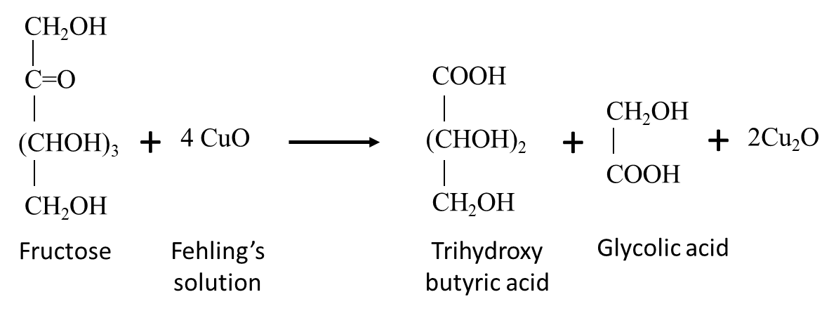
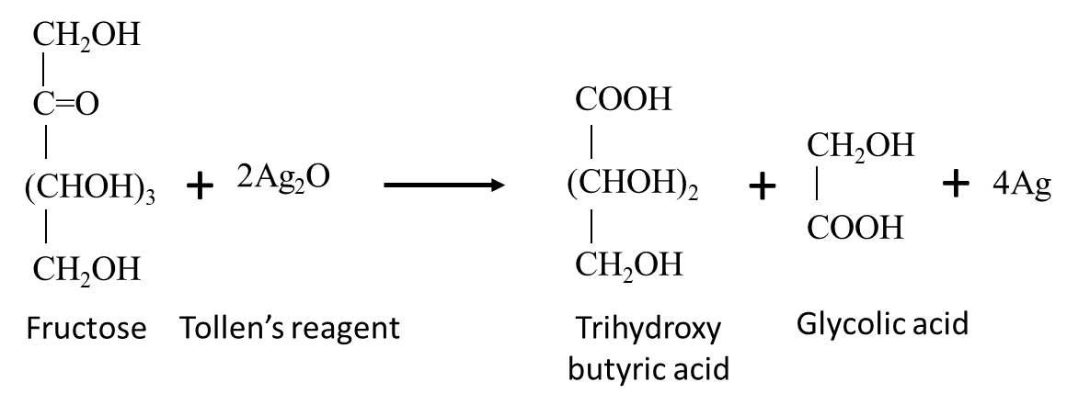
5. Reducing action:
It reduces blue Fehling’s solution to red precipitate of cuprous oxide (Cu₂O) and Tollen’s reagent to metallic silver (Test for fructose).

Slide 11
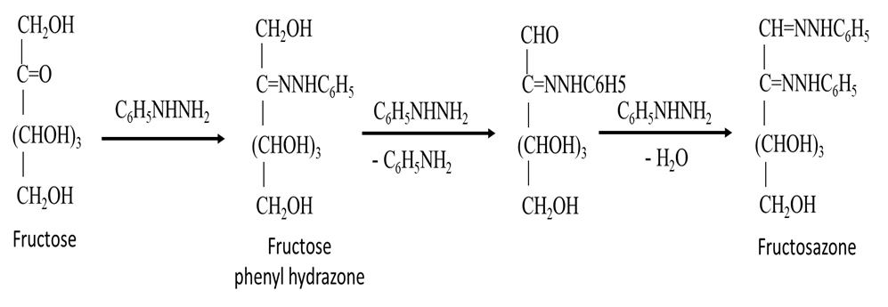
6. Formation of Osazone:
Fructose reacts with excess of phenyl hydrazine in acetic acid it produces yellow needle crystals of fructosazone.

Slide 12
7. Fermentation: Fructose undergoes fermentation by the enzyme zymase present in yeast to yield ethyl alcohol and carbon dioxide. The reaction proceeds in the absence of air (anaerobic reaction).
8. Dehydration: When heated with conc. H₂SO₄, glucose chars due to dehydration.

Slide 13
Uses of Fructose
Crystalline fructose is used in enhancing the taste in food industries.
It is used in flavoured water, energy drinks, low-calorie products, etc.
Fruit sugar is used in the manufacturing of soft moist cookies, nutrition bars, reduced-calorie products etc.

Slide 14
Difference between Glucose and Fructose
S.No | Glucose | Fructose
1 | Also known as grape sugar | Also known as fruit sugar
2 | It is an aldohexose | It is a ketohexose
3 | Dextrorotatory | Laevorotatory
4 | Reduced to sorbitol by sodium amalgam. | Fructose gives a mixture of sorbitol and mannitol.
5 | Oxidized by mild oxidized agents, like bromine water to gluconic acid. | Mild oxidizing agents like bromine water fail to oxidize fructose.
6 | Oxidized by nitric acid to yield glucaric acid, containing the same number of carbon atom. | Oxidized by nitric acid to yield a mixture of acids each containing lesser number of carbon atoms than fructose.
7 | Forms water soluble calcium glucosate with lime. | Forms insoluble calcium fructosate with lime.
8 | Forms a pyranose ring structure | Forms a furan ring structure
9 | Gives a brown resin with Conc. alkali | No brown resin is formed.
10 | Less fat producing | More fat producing

Slide 15
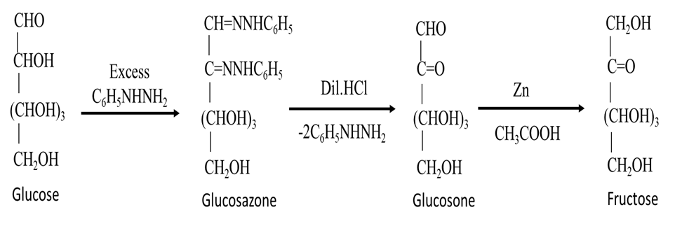
Interconversion of Monosaccharides:
1. Conversion of an aldose to a ketose:
eg. Glucose Fructose
i. Glucose when warmed with excess of phenyl hydrazine forms glucosazone.
ii. Glucosazone is hydrolyzed with dilute hydrochloric acid to produce glucosone.
iii. Glucosone is finally reduced by zinc and acetic acid to fructose.

Slide 16
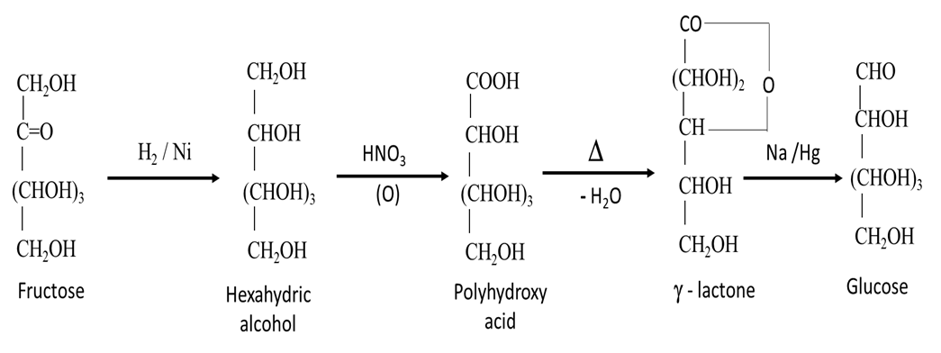
2. Conversion of a ketose into an aldose:
eg. fructose glucose
i. Fructose on catalytic reduction gives hexahydric alcohol (hexitol). (Mixture of sorbitol and mannitol)
ii. Hexitol on oxidation with conc. HNO₃ gives hexanoic acid. (Mixture of gluconic and mannonic acid)
iii. Hexanoic acid on heating gives a γ-lactone.
iv. The γ- lactone is reduced with sodium amalgam to glucose.

Slide 17
Mutarotation
Normally D-(+)-glucose has a melting point of 146°C. However, when D-(+)-glucose is crystallized by evaporating an aqueous solution kept above 98°C, a second form of D-(+) glucose with a melting point of 150°C can be obtained.
When the optical rotations of these two forms are measured, they are found to be significantly different, but when an aqueous solution of either form is allowed to stand, its rotation changes.
The specific rotation of one form decreases and the other increases, until both solutions show the same value.

Slide 18
For example, a solution of α -D-(+)-glucose (mp 146°C) specific rotation gradually decreases from an initial value of + 112.2° to + 52.7°, while The β -D-(+)-glucose (mp 150°C) specific rotation gradually increases from an initial value of + 18.7° to + 52.7°.
The three forms of glucose reach equilibrium concentrations with the specific rotation of +52.7.
This change ("mutation") in the specific rotation toward equilibrium is called mutarotation.

Slide 19
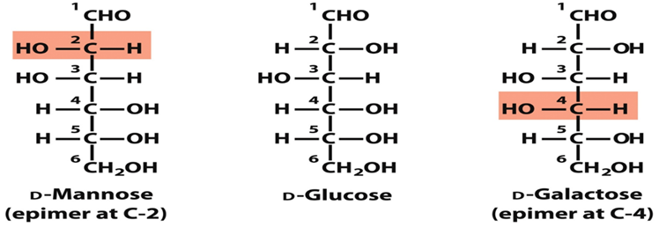
Epimers are stereoisomers that differ in configuration of only one asymmetric carbon atom.
Example: D-Galactose is an epimer of D-glucose because the two sugars differ only in the configuration at C-4.
D-Mannose is an epimer of D-glucose because the two sugars differ only in the configuration at C-2.

Slide 20
Epimerization
It is process of conversion of one aldose configuration to another called its epimer.
The conversion of glucose to mannose is epimerization. Under basic conditions, the stereochemistry is lost at the carbon atom next to carbonyl group.
In base H on C2 may be removed to form a common intermediate enediol an enolate ion.
Reprotonation may change the stereochemistry of C2, result in a mixture of epimers.

Slide 21
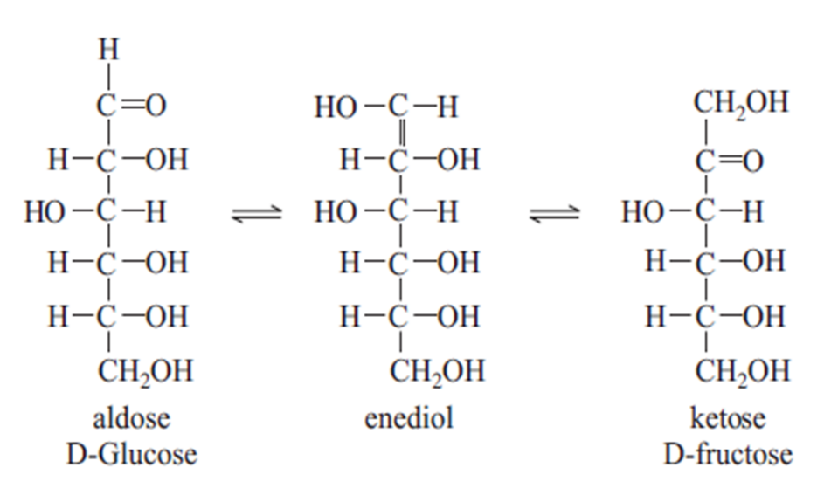

Slide 22
Thank you

