Slide 1
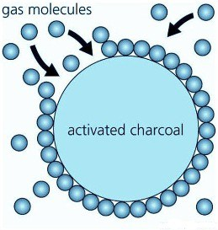
ADSORPTION
Course code : 17PCHC31 Course title : Physical Chemistry - I Class : II BSc Chemistry
Unit : III
Dr. M. Jannathul Firdhouse Assistant Professor of Chemistry Hajee Karutha Rowther Howdia College (Autonomous)
Uthamapalayam, Theni District, Tamilnadu

Slide 2
Hydrated ferric oxide
Fe₂O₃ . 3H₂O

Slide 3
“CHEMISTRY ON SURFACE OF SOMETHING” –
SURFACE CHEMISTRY

Slide 4
Content
Definition
Types of adsorption
Factors influencing adsorption

Slide 5
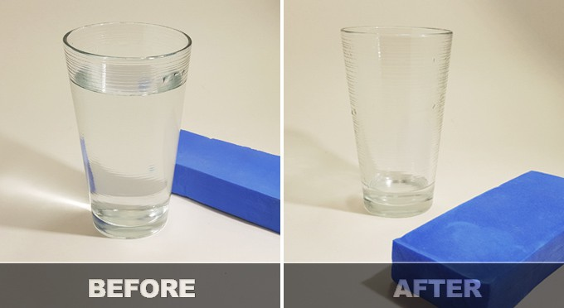
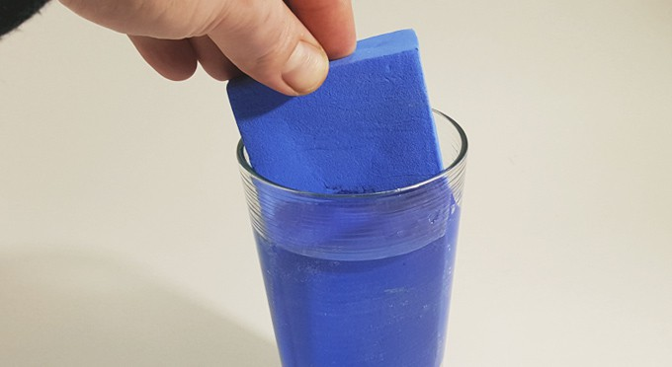
“The particles moves into the substance” - Absorption
It is a bulk phenomenon.

Slide 6
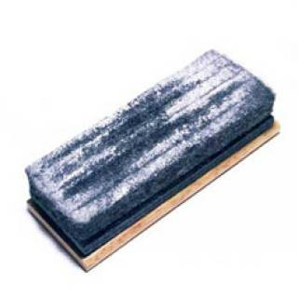
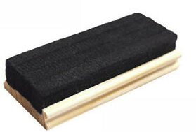
“The particles sits on substance” - Adsorption
Particles – adsorbate (chalk particles)
Substance - adsorbent (duster)
It is a surface phenomenon.

Slide 7
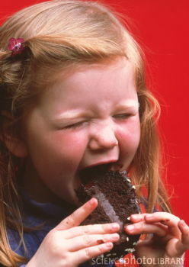
Absorption vs. Adsorption
Bulk (Volume)
Phenomenon
Surface Phenomenon

Slide 8
The bulk phase can be a pure compound or a solution.
The bulk phases may be solid – liquid, solid – gas, solid – vacuum, liquid – gas etc.
The term Adsorption was first coined in 1881 by a German physicist named Heinrich Kayser.
The process of adsorption arises due to presence of unbalanced or residual forces at the surface of liquid or solid phase.
These unbalanced residual forces have tendency to attract and retain the molecular species with which it comes in contact with the surface.

Slide 9
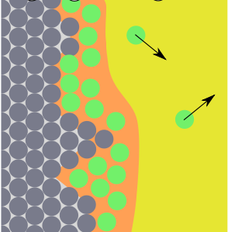
Adsorption
The phenomenon of higher concentration of any molecular species at the surface than in the bulk of a solid is known as adsorption.
Examples:
Ammonia adsorbed by charcoal
water vapour adsorbed by silica gel
Adsorbate: substance which is held on the surface
Adsorbent: surface of the solid on which the adsorption occurs
ADSORBENT
ADSORBATE

Slide 10
Interface: The common surface separating the two phases adsorbent and adsorbate
Positive adsorption occurs when the concentration of adsorbate is greater on the surface of adsorbent than in the bulk.
Negative adsorption occurs when the concentration of adsorbate is less on the surface of adsorbent than in the bulk.

Slide 11
“Both adsorption and absorption takes place” - Sorption

Slide 12
“Removal of adsorbate from adsorbent” - Desorption
“Reverse of adsorption”

Slide 13
Differences between Absorption and Adsorption
S. No | Absorption | Adsorption
 | Bulk phenomenon | Surface phenomenon
2. | The substance is not only retained at the surface, but passes through the surface to become uniformly distributed throughout a solid or liquid | The substance is only retained at the surface, but do not pass through the surface of a solid or liquid.
3. | It is not spontaneous. | Adsorption of gas on solid is spontaneous.
4. | It is not affected by temperature. | It is favoured by low temperature
5. | Endothermic process | Exothermic process
6. | Greater molecular interaction. | Less molecular interaction.
7. | Attainment of equilibrium is very slow. | Attainment of equilibrium is instantaneous
8. | Eg. Absorption of NH₃ on water, Absorption of water vapour by anhydrous CaCl₂ | Eg. Adsorption of NH₃ on charcoal, Adsorption of acetic acid on charcoal

Slide 14
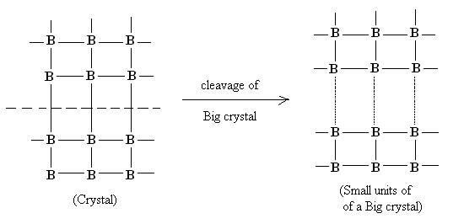
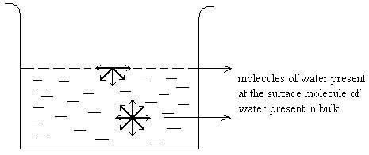
Some modern techniques have been used to study surface.
• Low energy electron diffraction (LEED).
• Photo electron spectroscopy (PES).
• Scanning Tunneling microscopy (STM).
Adsorption in Liquids
Adsorption in Solids

Slide 15
Facts about adsorption process
Adsorption is a spontaneous process
For reaction or process to be spontaneous, there must be decreases in free energy of the system
ΔG = ΔH – TΔS
And during this process of adsorption, randomness of the molecule decreases which ΔS is negative. Therefore, for a reaction to be spontaneous ΔH has to be negative
Adsorption is an exothermic process
Forces of attraction exist between adsorbate and adsorbent and due to these forces of attraction, heat energy is released.
So, adsorption is an exothermic process.

Slide 16
Types of Adsorption
Adsorption
Physisorption
Chemisorption

Slide 17
Physisorption | Chemisorption
If accumulation of gas molecules on the surface of solids occurs due to weak van der Waals’ forces of attraction. | When atoms or molecules of gases are held by solids on its surface by chemical bonds.

Slide 18
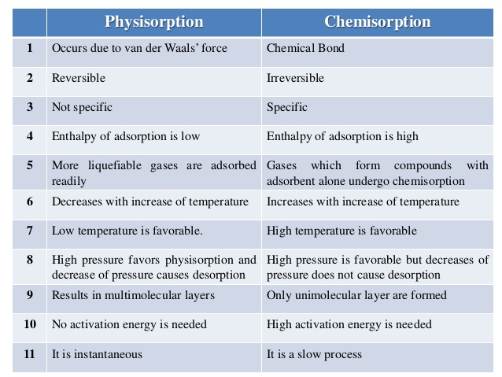

Slide 19
Factors Influencing Adsorption
Nature of Adsorbate
NH₃, CO₂ and HCl – readily adsorbed than H₂, N₂, O₂
Nature of Adsorbent
Large surface area can adsorb large volume of gases
Pressure
Adsorption of gas increases as pressure increases
Temperature
Adsorption of gas decreases with increase in temperature

