Slide 1
ANTIBIOTICS
Course code: 17UCHS51
Course title:–Organic and Pharmaceutical Chemistry
Class: III B.Sc., Chemistry
Unit: IV
Dr. M. Jannathul Firdhouse
Assistant Professor
Department of Chemistry
Hajee Karutha Rowther Howdia College

Slide 2
Antibiotics
An antibiotic is a product produced by a microorganism or a similar substance produced wholly or partially by chemical synthesis, which in low concentrations, inhibits the growth of other microorganisms.
Antibiotics are also called antimicrobials.

Slide 3
History
Alexander Fleming
Microbes make antibiotics
ORIGIN: moldy culture plate
DRUG: Penicillin (1928)
NOBEL: 1945
Notes:
Alexander Fleming
penicillin developed in US in 1941 - spores from mold on coats of scientists

Slide 4
History
Selman Waksman
Soil Streptomyces make antibiotics
comes up with definition of antibiotic
ORIGIN: Penicillin development
DRUG: Streptomycin (1943)
NOBEL: 1952
Notes:
Selman Waksman
streptomycin - bacteria produced antibiotics too. Many began screening soils looking for antibiotics.

Slide 5
Classification based on the Spectrum of Activity
Broad Spectrum – against large number of microorganisms and curing several aliments.
Ex. Tetracyclines, Chloramphenicol, Penicillin, Streptomycin
Narrow Spectrum – specific in their action and used against some specific diseases.
Penicillin G, Streptomycin, Erythromycin

Slide 6
Classification based on the type of bacteria
Gram-positive antibiotics- Penicillin, cloxacillin and erythromycin should be enough to cover 90 per cent of Gram-positive infections.
Gram-positive bacteria appear violet in colour when smeared with crystal violet and iodine solution.
Gram-negative antibiotics - Chloramphenicol, polymyxim –B
Gram-negative bacteria appear red in colour

Slide 7
Classification based on the chemical structure
Beta-lactam Antibiotics: Penicillins, Cephalosporins, Carbapenems
Aminoglycoside Antibiotics: Streptomycin, Gentamycin, Kanamycin, Amikacin
Tetracyclines: Tetracycline, Doxycycline, Minocycline, Oxytetracycline
Quinolones: Ciprofloxacin, Norfloxacin, Ofloxacin
Macrolides: Erythromycin, Azithromycin, Roxithrmycin, Clarithromycin
Nitroimidazoles: Metronidazole, Tinidazole

Slide 8
Clinical Uses
PATHOGENS | TYPICAL DRUG
Gram positive Pen-ase (-) Pen-ase (+) | Penicillin G (oral or IM) Methicillin, Nafcillin
Gram negative Enterics, etc. Pseudomonas B. fragilis | Ampicillin, gentamicin, etc. Ticarcillin, tobramycin Clindamycin

Slide 9
Clinical Uses
PATHOGENS | TYPICAL DRUG
Mycobacterium | Streptomycin Iso-nicotinic hydrazide (INH)
Fungi: Cutaneous Deep | Nystatin Amphotericin B, ketoconazole
Parasites: Plasmodium Giardia | Chloroquine Quinacrine

Slide 10
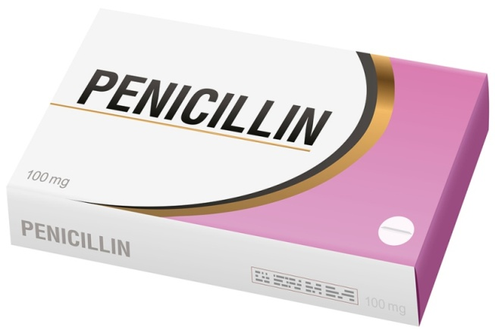
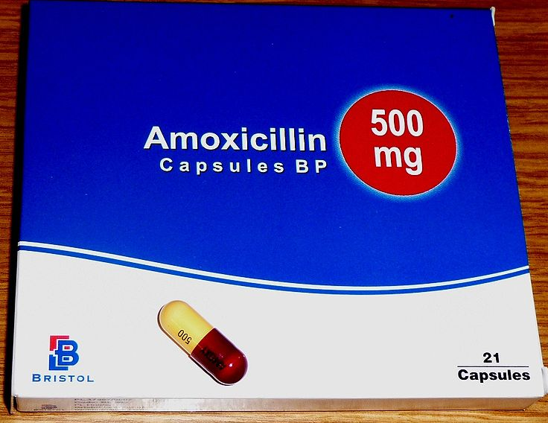
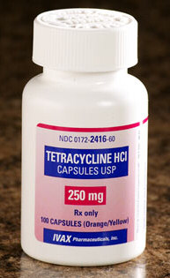
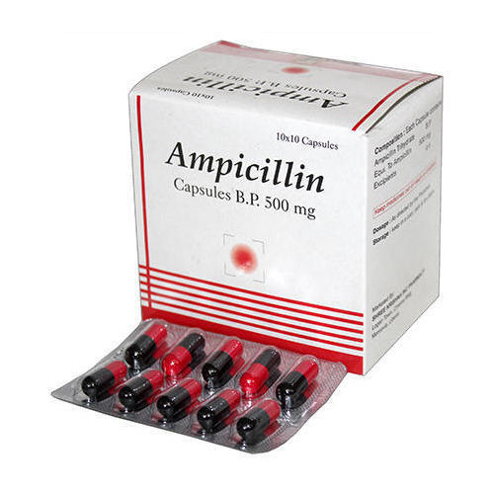
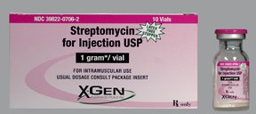
Penicillin Amoxicillin Ampicillin Tetracyclin Streptomycin

Slide 11
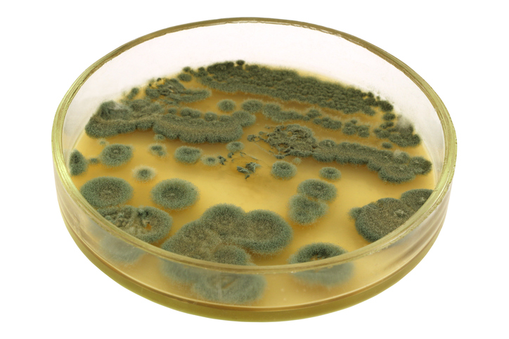
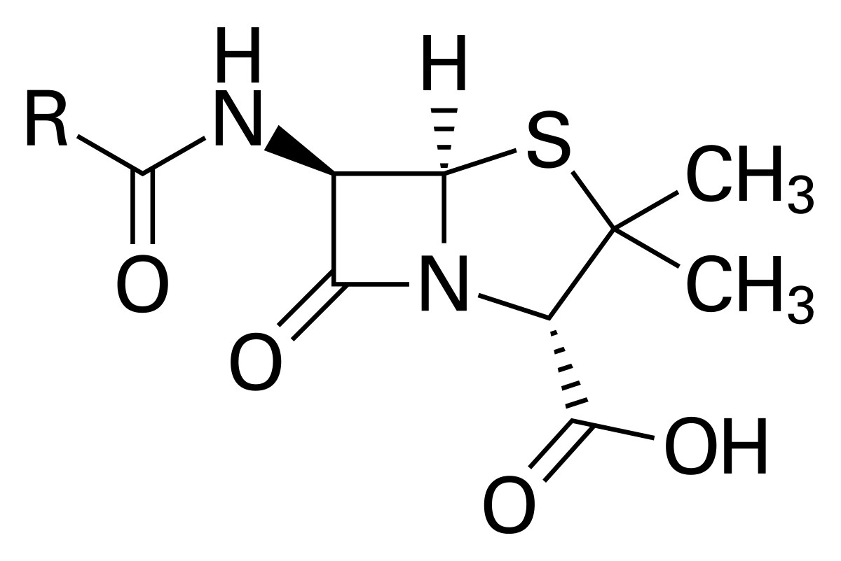
Penicillin
Penicillin was discovered in 1928 by Scottish scientist Alexander Fleming.
It is derived from Penicillium fungi.
It is used to treat infections in 1942 and effective against bacteria.

Slide 12
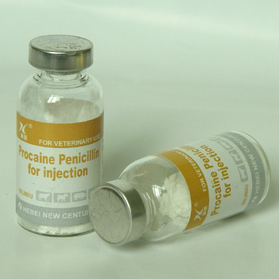
Penicillin (PCN or pen) is a group of antibiotics which include
penicillin G (intravenous use),
penicillin V (use by mouth),
procaine penicillin, and
benzathine penicillin (intramuscular use).

Slide 13
Amoxicillin
Amoxicillin is an antibiotic used for the treatment of a number of bacterial infections.
Amoxicillin was discovered in 1958 and came into medical use in 1972.
It is taken by mouth, or less commonly by injection.
It may be used for middle ear infection, strep throat, pneumonia, skin infections, and urinary tract infections.
Common adverse effects include nausea and rash.

Slide 14
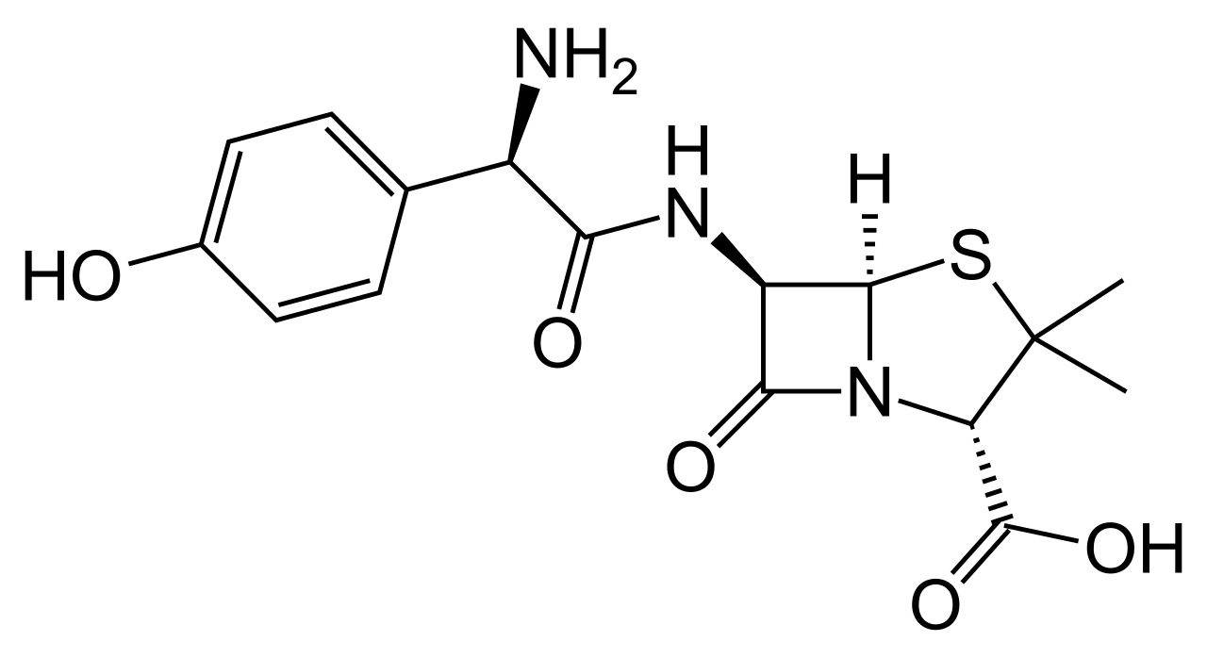
t is a moderate-spectrum, bacteriolytic,
β-lactam antibiotic in the amino penicillin family.
It is used to treat susceptible Gram-positive and Gram-negative bacteria.
It is usually the drug of choice within the class because it is better-absorbed, following oral administration, than other β-lactam antibiotics.

Slide 15
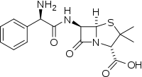
Ampicillin
Ampicillin is in the penicillin group of beta-lactam antibiotics and is part of the amino penicillin family.
Ampicillin was discovered in 1958 and came into commercial use in 1961
Ampicillin is comparatively less toxic than other antibiotics

Slide 16
It is an antibiotic used to prevent and treat a number of bacterial infections, such as respiratory tract infections, urinary tract infections, meningitis, salmonellosis, and endocarditis.
It may also be used to prevent group B streptococcal infection in newborns.
It is used by mouth, by injection into a muscle, or intravenously.
Common side effects include rash, nausea, and diarrhea.
Its use during pregnancy and breast feeding appears to be generally safe.

Slide 17
Streptomycin
Streptomycin is an antibiotic produced by the soil actinomycete Streptomyces griseus (1943)
It acts by inhibiting the initiation and elongation processes during protein synthesis.
The chemical classification of streptomycin is Aminoglycosides.
Common side effects include vertigo, vomiting, numbness of the face, fever, and rash.
It is used to treat tuberculosis, Mycobacterium avium complex, endocarditis, brucellosis, Burkholderia infection, plague, tularemia, and rat bite fever.

Slide 18
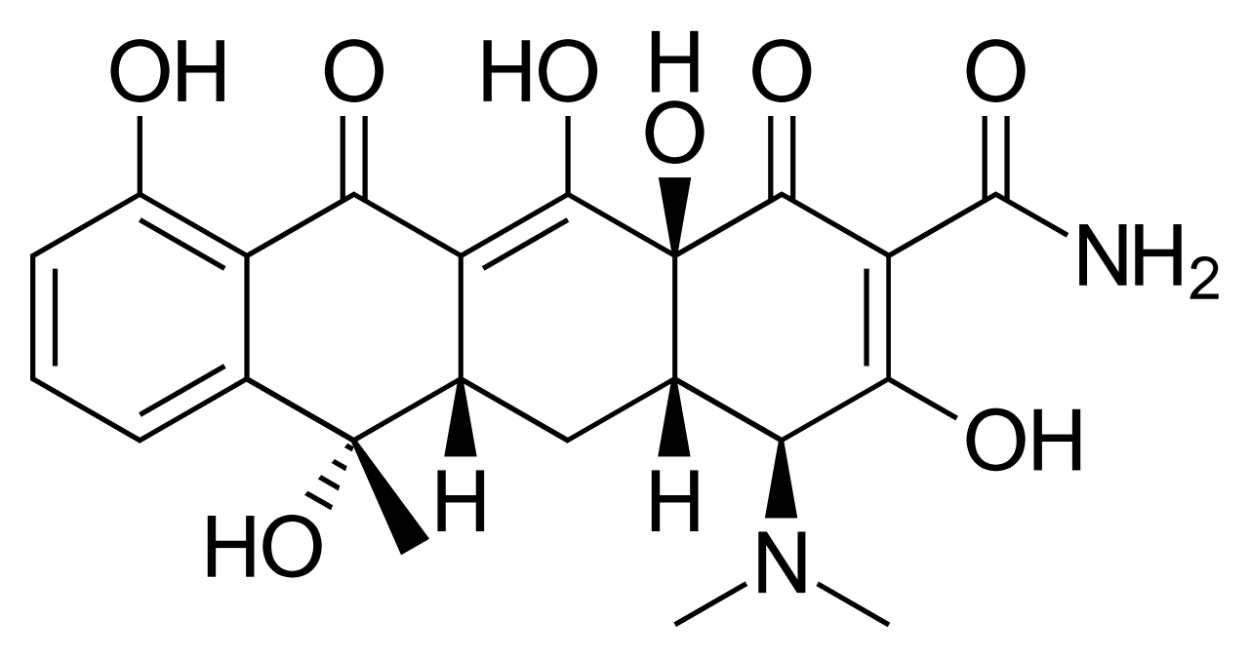
Tetracyclines
Tetracyclines are broad-spectrum against many bacteria.
It was patented in 1953 and came into commercial use in 1978.
Well-known drugs such as: doxycycline, tetracycline, minocycline

Slide 19
Tetracycline is in the tetracyclines family of medications.
It is used to treat acne, cholera, brucellosis,
plague, malaria and syphilis.
It works by blocking the ability of bacteria to make proteins.
Common side effects include vomiting, diarrhea, rash, and loss of appetite.

