Slide 1
Nanochemistry
Course code: 17PCHC32
Course title: Inorganic Spectroscopy and Nanotechnology
Unit: IV
Dr. M. Jannathul Firdhouse
Assistant Professor of Chemistry
Hajee Karutha Rowther Howdia College
Uthamapalayam

Slide 2
Unit - IV
Nanochemistry
Basic Idea of Nano chemistry – Definitions in Nano technology – Size of Nano–Techniques of Methodology.
Fullerenes: Introduction – Properties.
Nano particles: Introduction – Properties – Classifications – Production.
Nano tubes: Structure and characterization single walled carbon nano tubes –Nanotubes properties –applications of Nano tubes.
Nano structured Polymers: Conducting polymers –block –copolymers-Nano cages.

Slide 3
What is a nanoparticle?
Nanoparticle is any material having atleast one of its dimensions in the range of 1-100 nm.
“Nano”–derived from a Greek word “Nanos” meaning DWARF or small.
'Norio Taniguchi, 1974 -- coined the term nanotechnology
A nanometer is one billionth of a meter (10⁻⁹ m).
3

Slide 4
Nano- Simple example
The population of India is one billion or 100 crores. Each Indian – you or me is nano in comparison with the total population of India.
4

Slide 5
Nano- Simple example
One rupee
One rupee in 100 crore rupees
5

Slide 7
UNITS
Millimeter (mm) = 10⁻³ m
Micrometer (mm) = 10⁻⁶ m
Nanometer (nm) = 10⁻⁹ m
Picometer (pm) = 10⁻¹² m
Femtometer (fm) = 10⁻¹⁵ m

Slide 8
Nanoscience & Nanotechnology
Nanoscience – is nano-materials,
the study of properties
their
and related phenomena.
Nanotechnology application of
– is the nanoscience to
produce devices and products.
http://www.androidauthority.com/quantum-dot-vs-oled-explained-659321/

Slide 9
What is scale all about?

Slide 10
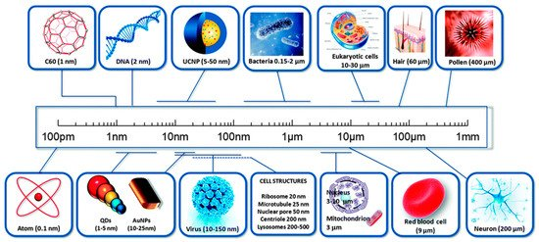
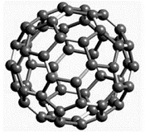
Size of Nano
Notes:
Scale of Things—Nanometers:
Hence, nanotechnology refers to the process, act or ability to work with materials or matter at the scale of 1 to 100 nanometers. The ability of working at this scale renders novel benefits to numerous products and applications such as those found in the semiconductor manufacturing, material science, medicine, etc.
However, what is the size of 1 nanometer? Albert Einstein estimated that the size of 1 sugar molecule was equal to 1 nanometer. One nanometer would also be equal to the linear size of 10 hydrogen atoms stacked side by side (Roueckes, et al., 2002). It is the same as one-billionth of a meter – a single bacterium is a few hundred nanometers in diameter and a DNA strand is approximately 2-12 nanometers across (NNI, 2007). The un-aided human eye can see down to about 10,000 nanometers (Ratner & Ratner, 2003).
A popular diagram found at www.nano.gov shows size comparisons of natural and manmade things relative to the nanometer.
Fig. 1.5 - http://www.nano.gov/html/facts/The_scale_of_things.html.

Slide 11
Object | Size
Width of hair | 50,000 nm
Red blood cell | 7,000 nm
Bacterium | 1,000 nm
Virus | 100 nm
Width of DNA | 2.5 nm
Aspirin molecule | 1 nm

Slide 12
Why small is Good?
Nano-objects are:
Faster
Lighter
Can get into small spaces
Cheaper
More energy efficient
Different properties at very small scale
Surface area increases as size decreases
12

Slide 13
Surface area-to-volume ratio
1mm
1mm
2 mm
2 mm
1mm
Surface Area (mm) | Surface area = Height x Width x No. of sides x No. of cubes | 24 (2x2x6x1) | 48 (1x1x6x8)
Volume (mm) | Volume = Height x Width x Length x No. of cubes | 8 (2x2x2x1) | 8 (1x1x1x8)
Surface Area/Volume ratio | Surface area/Volume | 3 (24:8) | 6 (48:8)
13

Slide 14
Surface area-to-volume ratio
As surface to volume ratio increases
A greater amount of a substance comes in contact with
surrounding material
This results in better catalysts, since a greater proportion of the material is exposed for potential reaction
•
14

Slide 15
2. Quantum confinement effect
Quantum confinement effect in materials with delocalized electrons Atoms have there well known as atomic orbitals.
The core of the orbitals is confined to a relatively small volume and remain localised.
Each of the N atoms contributes with its atomic state to a band so that although the width of the band increases slightly, when more atom is added, the density of the state within the band is basically proportional to the no of atom with an ensemble with extended band structure.
Thus, the density of state is very large for a bulk amount of matter but low for small clusters

