Slide 1
Unit – I
Water
Course code: 17UCHA11
Course title: Ancillary Chemistry Paper-I (Organic, Inorganic and Physical chemistry)
Class: II B.Sc., Physics
Dr. M. Jannathul Firdhouse
Assistant Professor
Department of Chemistry
Hajee Karutha Rowther Howdia College
Uthamapalayam

Slide 2
Unit – I
Water: Hardness of water – types of hardness – removal of hardness – industrial implications of hardness in water – estimation by EDTA method (outline only) - Units of hardness of water.

Slide 3
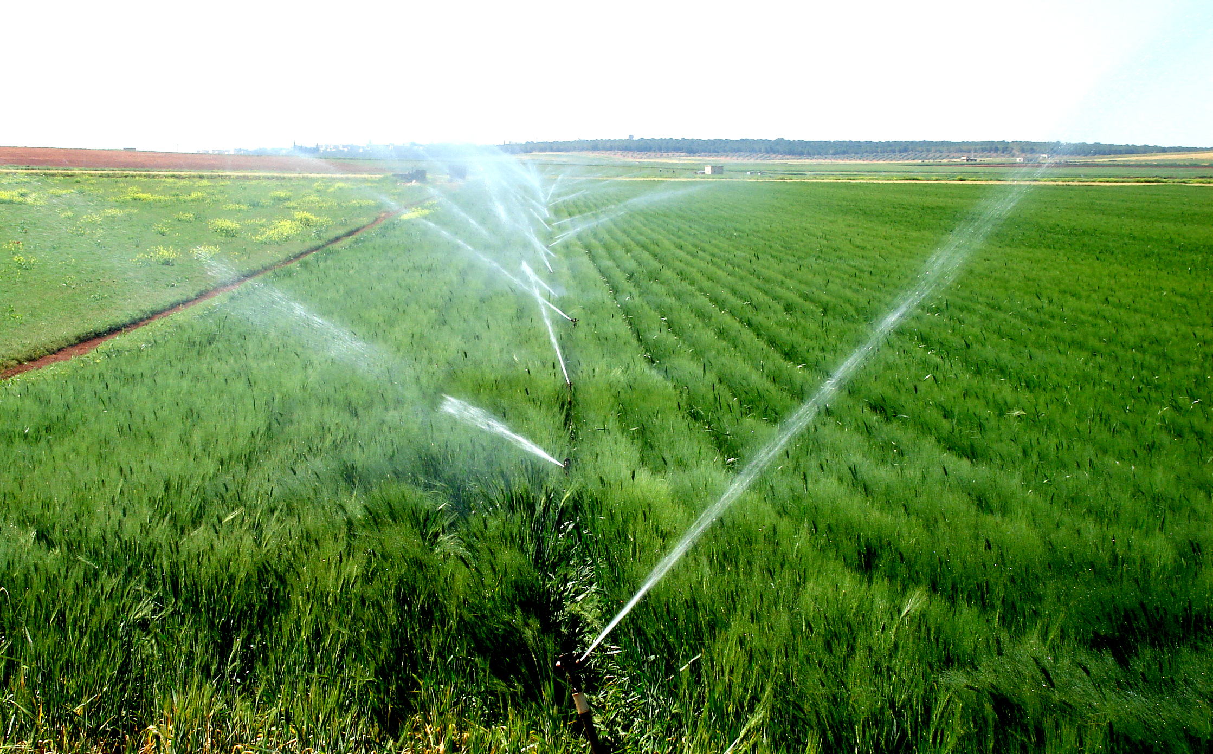
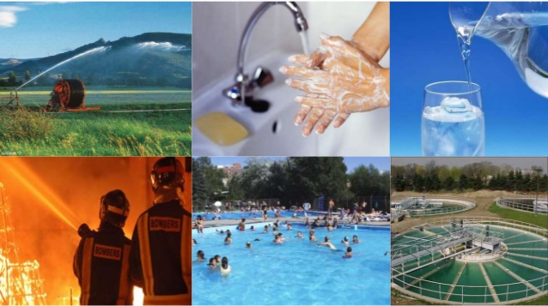
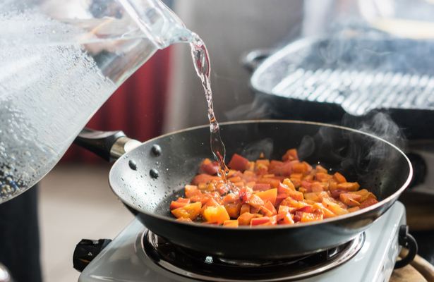
Introduction:
Water is nature’s most wonderful, abundant and useful compound.
Water is not only essential for the lives of animals and plants, but also occupies a unique position in industries.
The distribution of water on the Earth’s surface is extremely uneven.

Slide 4
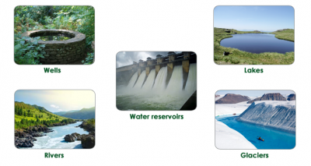
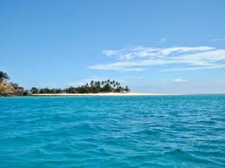
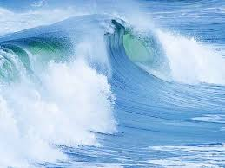
Only 3% Of freshwater (69% resides in glaciers, 30% underground, and less than 1% is located in lakes, rivers and swamps.) of water on the surface is fresh; the remaining 97% resides in the ocean.
Only one percent of the water on the Earth’s surface is usable by humans, and 99% of the usable quantity is situated underground.

Slide 5
Types of Impurities present in water:
The natural water is usually contaminated by different types of impurities.
They are mainly three types.
➢ Physical impurities
➢ Chemical impurities
➢ Biological impurities

Slide 6
Physical impurities:
➢ Colour: in water is caused by metallic substances like salts.
➢ Turbidity: is due to the colloidal, extremely fine suspensions such as insoluble substances like clay, slit, and micro-organisms.
➢ Taste: presence of dissolved minerals in water produces taste. Bitter taste can be due to the presence of Fe, Al, Mn, Sulphates and lime. Soap taste can be due to the presence of large amount of sodium bicarbonate.
➢ Odour: In water is undesirable for domestic as well as industrial purpose.

Slide 7
2. Chemical impurities:
➢ Inorganic chemicals: Cations (Al⁺³, Ca⁺², Mg⁺², Fe⁺², Zn⁺², Cu⁺² Na⁺, K⁺), Anions (Cl⁻, SO₄⁻², NO₃⁻, HCO₃⁻, F⁻, NO₂⁻)
➢ Organic chemicals: dyes, paints, petroleum products, pesticides, detergents, drugs textile materials, other organic related materials.
3. Biological Impurities:
➢ Biological impurities are Algae, pathogenic bacteria, fungi, viruses, pathogens, parasite-worms.

Slide 8
Potable water and its specifications
Water free from contaminants or water that is safe for human consumption is called potable water.
The following are the specifications of water drinking purpose.
The water should be clear (colorless), odorless and pleasant taste.
The optimum hardness of water must be 125ppm.
The pH of potable water should be 7.0 to 8.5.
The recommended maximum concentration of total dissolved solids (TDS) in potable water must not exceed 500 ppm.
The turbidity in drinking water should not exceed 25 ppm.
The water must be free from heavy metals like Lead, Arsenic, Chromium and Manganese.
The water must be free from pathogenic bacteria
The water must be free from dissolved gases like H2S, CO2 and NH3.

Slide 9

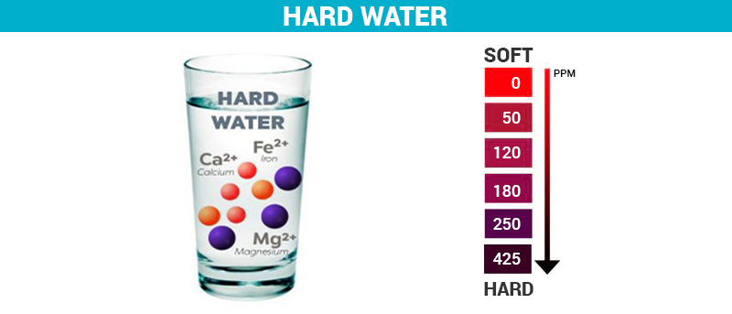
Generally soaps create foam in water, but in present of some materials the foam creation is reduced and need more soap for producing foam, and this condition of water is called water hardness.
The presence of Calcium, Magnesium salt i.e. bicarbonates, sulphates, chloride in water is called causes of hardness of water. The water which contains these salts is called hard water.

Slide 10
Hardness of water
Hardness of water defined as which prevent the lathering of soap.
This is due to presence of certain salts like Ca⁺², Mg⁺² and other heavy metals dissolved in water.
Soaps (Sodium or Potassium salts of higher fatty acids) like Stearic acids (C₁₇H₃₅COONa).

Slide 11
Soft Water:
The water which gives more lather with soap is called soft water.
C₁₇H₃₅COONa + H₂O → C₁₇H₃₅COOH + NaOH
soap Stearic acid
Hard Water:
The water which does not give lather with soap is called hard water. This is due to presence of certain salts like Ca⁺², Mg⁺² and other heavy metals dissolved in water
2C₁₇H₃₅COONa + CaCl₂/MgCl₂ → (C₁₇H₃₅COO)₂Ca/Mg +2NaCl
soap (soluble) salts (soluble) insoluble scum

Slide 12
WHAT CAUSED THE HARDNESS OF WATER?
Mainly due to Four Dissolved Compounds :
Calcium Bicarbonate
Magnesium Bicarbonate
Calcium Sulphate
Magnesium Sulphate
Less Common:
Calcium Chlorides and Nitrates
Magnesium Chloride and Nitrates
Iron and Manganese salts
Aluminium Compounds

Slide 13
HOW HARDNESS CLASSIFIED?
CLASSIFICATION OF HARDNESS
Temporary Hardness
(Carbonate Hardness)
Calcium bicarbonate - Ca(HCO₃)₂
Magnesium bicarbonate - Mg(HCO₃)₂
Permanent Hardness
(Non- Carbonate hardness)
Calcium sulphate - CaSO₄
Magnesium sulphate - MgSO₄
Calcium nitrate- Ca(NO₃)₂ Magnesium nitrate - Mg(NO₃)₂ Calcium chloride - CaCl₂
Magnesium chloride - MgCl₂

Slide 14
Temporary Hardness:
Temporary hardness is due to the presence of bi-carbonates of calcium and magnesium.
Because it can be removed by easy means like boiling.
When temporary hard water is boiled, the carbonates decompose with liberation of carbon-dioxide and precipitation of the insoluble Carbonates which are reformed.
MgCO₃ is slightly soluble in water but heating will cause its hydrolysis into the much less soluble Mg(OH)₂.
MgCO₃ + H₂O → Mg(OH)₂ + CO₂
So simple boiling and filtering of water remove temporary hardness.
Ca(HCO₃)₂ CaCO₃ ↓ + CO₂ + H₂O
Mg(HCO₃)₂ MgCO₃ ↓ + CO₂ + H₂O

Slide 15
Permanent Hardness:
It is due to the presence of chlorides and Sulphates of Calcium and Magnesium.
This type of hardness is called permanent hardness.
These salts do not decompose on boiling.
So permanent hardness can’t be removed easily.
It can be removed by lime when MgSO₄ is responsible for hardness.
CaSO₄ + Na₂CO₃ → Na₂SO₄ + CaCO₃
MgSO₄ + Na₂CO₃ → Na₂SO₄ + MgCO₃
MgSO₄ + Ca(OH)₂ (Lime) → Mg(OH)₂ + CaSO₄

Slide 16
consequences of Hardness in water

Slide 17
1. In Domestic use:
➢ Washing: Hard water, when used for washing purposes, does not producing lather freely with soap. As a result, cleaning quality of soap is decreased and a lot of it is wasted.
➢ Bathing: Hard water does not lather freely with soap solution, but produces sticky scum on the bathtub and body. Thus, the cleaning quality of soap is depressed and a lot of it is wasted.
➢ Cooking: The boiling point of water is increased because of presence of salts. Hence more fuel and time are required for cooking.
➢ Drinking: Hard water causes bad effects on our digestive system. Moreover, the possibility of forming calcium oxalate crystals in urinary tracks is increased.

Slide 18
2. Industrial Use:
➢ Textile Industry: Hard water causes wastage of soap. Precipitates of calcium and magnesium soaps adhere to the fabrics and cause problem.
➢ Sugar Industry: The water which containing sulphates, nitrates, alkali carbonates are used in sugar refining, cause difficulties in the crystallization of sugar.
➢ Dyeing Industry: The dissolved salts in hard water may reacts with costly dyes forming precipitates.
➢ Paper Industry: Calcium, magnesium, Iron salts in water may affect the quality of paper.
➢ Pharmaceutical Industry: Hard water may cause some undesirable products while preparation of pharmaceutical products.

Slide 19
3. Steam generation in Boilers:
➢ For steam generation, boilers are almost invariably employed.
If the hard water is fed directly to the boilers, there arise many troubles such as: Scales & sludges formation, Corrosion, Priming & Foaming and Caustic embrittlement.

Slide 20
Units of Hardness:
The expression of hardness producing salts usually expressed in terms of an equivalent amount of CaCO₃.
Calcium Carbonate is chosen as a standard because:
Its molecular weight (100) and equivalent weight (50) is a whole number, so the calculations in water analysis can be simplified.
It is the most insoluble salt that can be precipitated in water treatment.

Slide 21
1. Parts per Million (ppm): The number of parts of calcium carbonate equivalent hardness presents in 10⁶ parts of water.
1ppm = 1 part of CaCO₃ eq hardness in 10⁶ parts of water.
2. Milligrams per litre (mg/l): The number of milligrams of calcium carbonate equivalent hardness presents in litre of water.
1 mg/L = 1 mg of CaCO₃ eq hardness in 1 litre of water.
But one litre of water weights =1 kg =1000g = 1000 x 1000 mg = 10⁶ mg = 1 ppm.

Slide 22
Removal of temporary hardness from water
1. Boiling (physical method)
Ca(HCO₃)_{2(aq)} CaCO_{3(s)} + CO_{2(g)} + H₂O_{(l)}
Mg(HCO₃)_{2(aq)} MgCO_{3(s)} + CO_{2(g)} + H₂O_{(l)}
2. Clark’s lime process
Ca(HCO₃)_{2(aq)} + Ca(OH)_{2(aq)} 2CaCO_{3(s)} + 2H₂O_{(l)}
Mg(HCO₃)_{2(aq)} + 2Ca(OH)_{2(aq)} 2CaCO_{3(s)} + Mg(OH)₂+2H₂O_{(l)}

Slide 24
Removal of permanent hardness from water
i) Clark’s soda process:
Na₂CO₃+ CaSO₄ Na₂SO₄ + CaCO₃(s)
Na₂CO₃+ CaCl₂ 2 NaCl + CaCO₃(s)
Na₂CO₃+ MgSO₄ Na₂SO₄ + MgCO₃(s)
Na₂CO₃ + MgCl₂ 2 NaCl + MgCO₃(s)

Slide 25
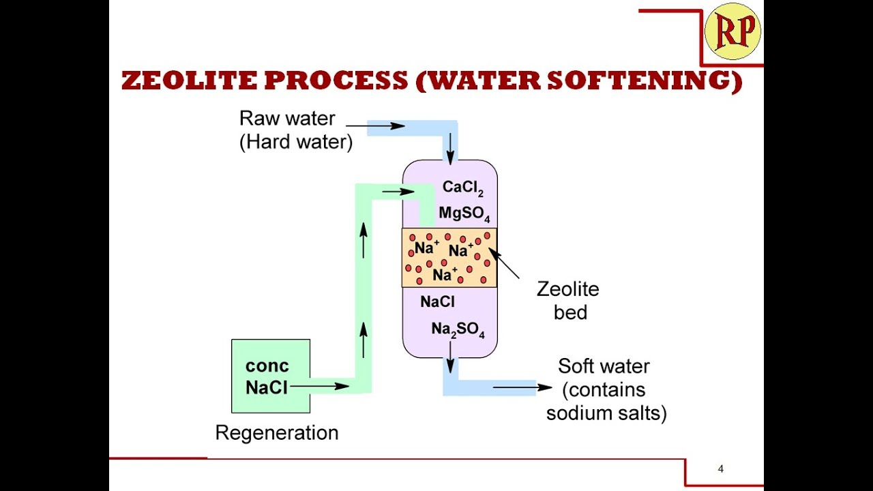
Permutit process:
Convenient method for removing both temporary and permanent hardness on a large scale.
Hard water is passed through a chemical synthetic zeolite called permutit.
It is generally represented as Na₂Z.

Slide 26
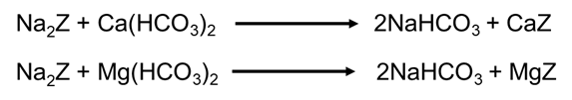
Removal of temporary hardness
Removal of temporary hardness
Na₂Z + CaSO₄ Na₂SO₄ + CaZ
Na₂Z + CaCl₂ 2 NaCl + CaZ
Na₂Z + MgSO₄ Na₂SO₄ + MgZ
Na₂Z + MgCl₂ 2 NaCl + MgZ

Slide 27
Ion-exchange process:
It is also known as demineralization process. Ion- Exchange resins are insoluble.
Cross linked long chain organic polymers with “functional Groups” attached to the chains
Cation Exchange Resins: Resins with acidic functional group are capable of exchanging H⁺ ions with other cations.
Anion Exchange Resins: Resins with basic functional groups are capable of exchanging OH⁻ions with other anions.

Slide 28
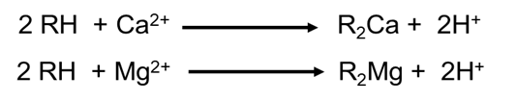
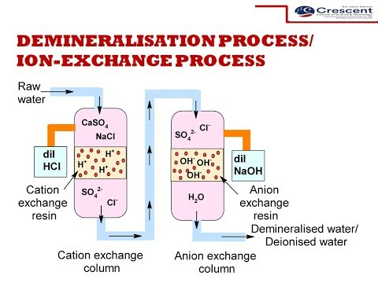

Slide 29
Merits
The process can be used to soften highly acidic or alkaline water.
It produces water of very low hardness (2ppm)
So it is very good for treating water for use in high-pressure boilers.
Demerits
The equipment is costly and more expensive chemicals are needed.
If water contains turbidity, the output of the process is reduced.

Slide 30
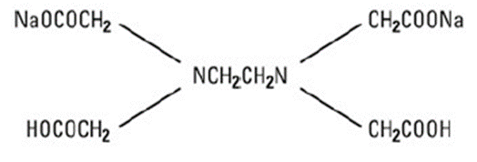
Determination of hardness By Complexometric Method / EDTA Method
Principle:
The determination of hardness is carried out by titrating water sample with Sodium salt of Ethylene Diamine Tetra Acetic Acid (EDTA) using Eriochrome Black-T as an indicator and keeping the pH of the water at 9.0 - 10.0.
The end point is the change in colour from wine - red to blue, when the EDTA solution complexes the calcium and magnesium salt completely.

Slide 31
Chemicals Required:
Preparation of standard hard water (0.01M): Dissolve 1g of pure, dry CaCO₃ in distilled water to make 1 Litre solution.
Preparation of EDTA solution: Dissolve 4 g of pure EDTA crystals + 0.lg MgCl₂ in 1 Litre of distilled water.
Preparation of Indicator (EBT): Dissolve 0.5 g of Eriochrome Black−T in 100mL alcohol.
Preparation of Buffer solution: Add 67.5g of NH₄Cl to 570 ml of Con. Ammonia solution and then dilute with distilled water to 1 Litre.

Slide 32
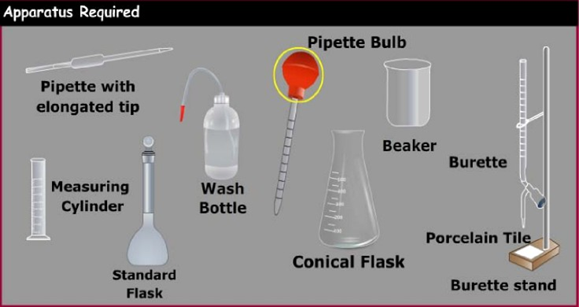

Slide 33
Various steps involved in this method
Standardization of EDTA solution:
Rinse and fill the burette with EDTA solution.
Pipette out 20 ml of standard hard water (M₁) in a conical flask.
Add 4ml of buffer solution and 2 drops of EBT indicator.
Titrate with EDTA solution till wine-red colour changes to clear blue. Let volume used by ‘X’ ml.
M₁ V₁ = M₂ V₂
Where, M₁ = Molarity of Standard Hard water (0.01M),
V₁ = Volume of Standard Hard water (20 ml),
M₂ = Molarity of EDTA
V₂ = Volume of EDTA (Xml).

Slide 34
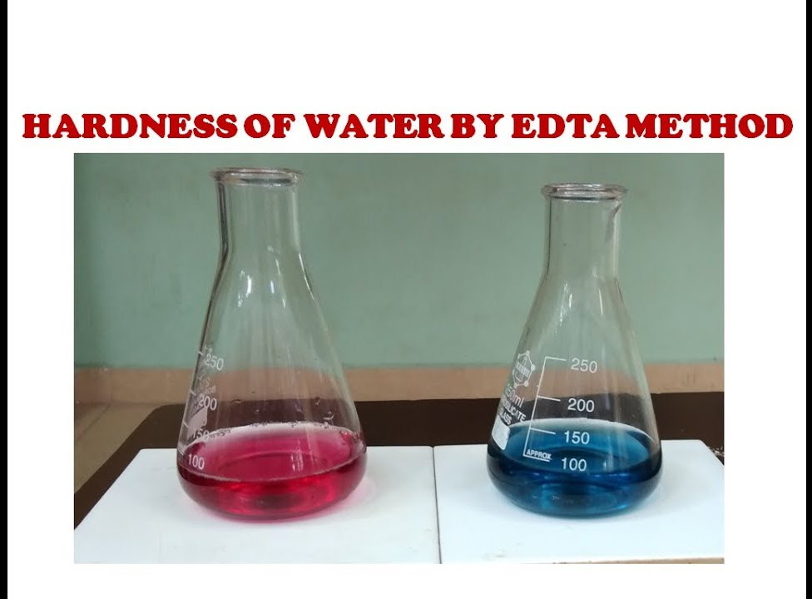

Slide 35
Determination of Total Hardness:
Rinse and fill the burette with EDTA solution.
Pipette out 20 ml of sample water (V₃) in a conical flask.
Add 4 ml of buffer solution and 2 drops indicator.
Titrate with EDTA solution till wine-red colour changes to clear blue.
Let volume used by ‘Y’ ml.
M₂ V₂ = M₃ V₃
Where, M₂ = Molarity of EDTA
V₂ = Volume of EDTA (Y ml)
M₃ = Molarity of sample water
V₃ = Volume of Sample water (20 ml)
Total Hardness = M₃ × Molecular weight of CaCO₃ (100) × One Litre (1000 ml)
= M₃ × 10⁵ ppm

Slide 36
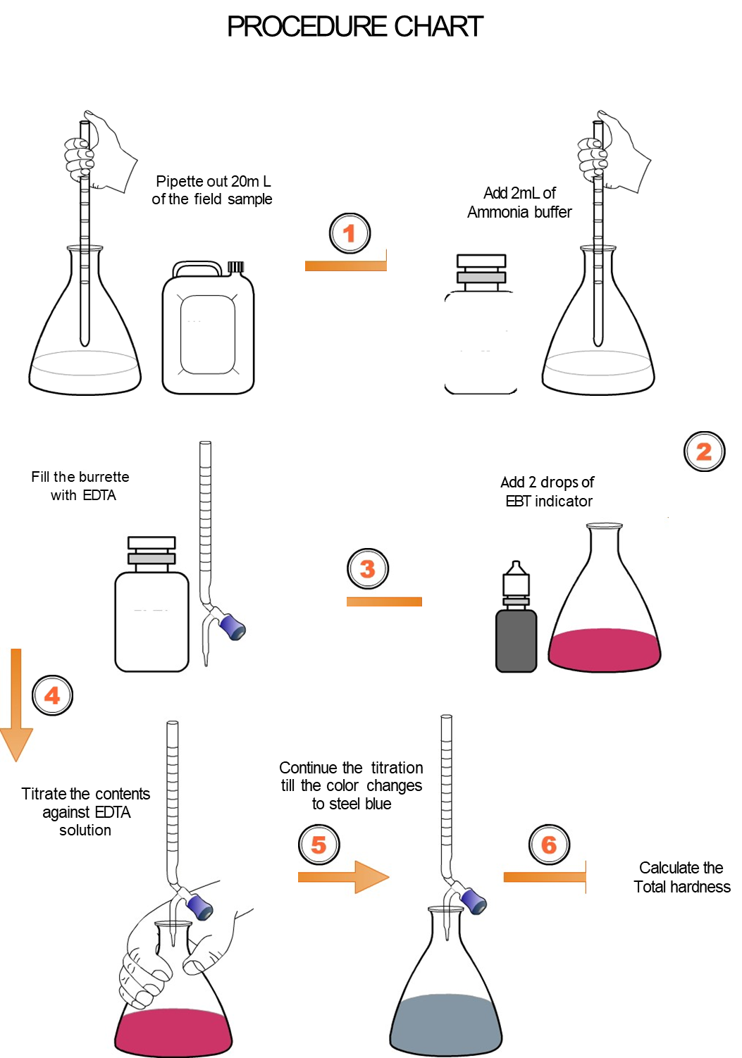

Slide 37
Determination of Permanent Hardness:
Take 100 ml of sample water in 250 ml beaker. Boil it to remove temporary hardness to about half of its volume and cool to room temperature, filter through filter paper to remove insoluble salts.
Make up the volume to the original 100ml by adding distilled water. Now Pipette out 20 ml of this solution (V₄) in a conical flask.
Add 4 ml of buffer solution and 2 drops indicator.
Titrate with EDTA solution till wine-red colour changes to clear blue. Let volume used by ‘Z’ ml.

Slide 38
M₂ V₂ = M₄ V₄
Where, M₂ = Molarity of EDTA,
V₂= Volume of EDTA (Z ml).
M₄ = Molarity of Permanent hard water,
V₄ = Volume of Permanent hard water (20 ml)
Permanent Hardness = M₄ × Molecular weight of CaCO3 (100) × One Litre (1000ml)
= M₄ × 10⁵ ppm
Determination of Temporary Hardness:
Temporary Hardness = Total Hardness - Permanent Hardness

Slide 39
Thank you

