Slide 1
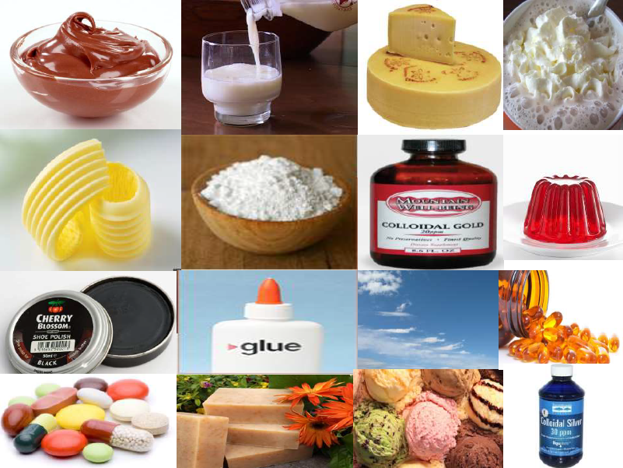
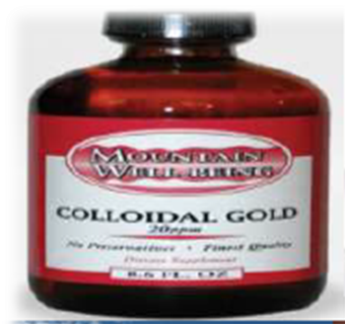
Unit – V
Colloids
Course code: 17UCHA11
Course title: Ancillary Chemistry Paper-I (Organic, Inorganic and Physical chemistry)
Class: II B.Sc., Physics
Dr. M. Jannathul Firdhouse
Assistant Professor
Department of Chemistry
Hajee Karutha Rowther Howdia College, Uthamapalayam

Slide 2
COLLOIDS

Slide 3
Unit - V Colloids Colloidal states of matter – various types – classification - Sols – dialysis – electro osmosis – electrophoresis – stability of colloids – protective action – Hardy Schulze law – gold number - Emulsion: Types of emulsions – emulsifier with examples - Gels : Classification, preparation - Applications of colloids.

Slide 4
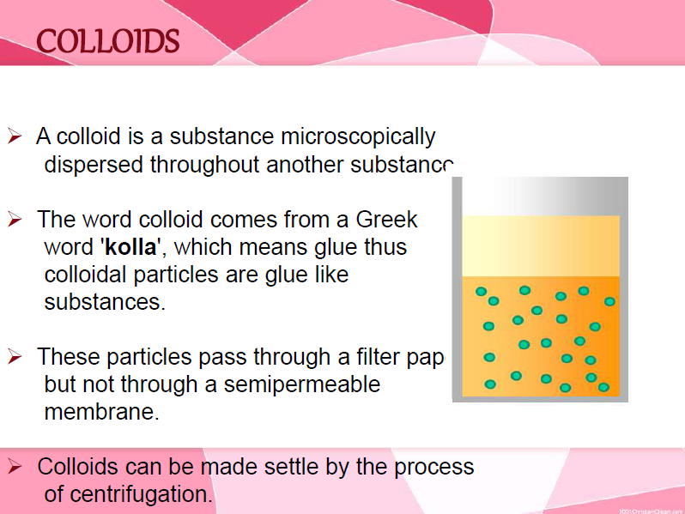

Slide 5
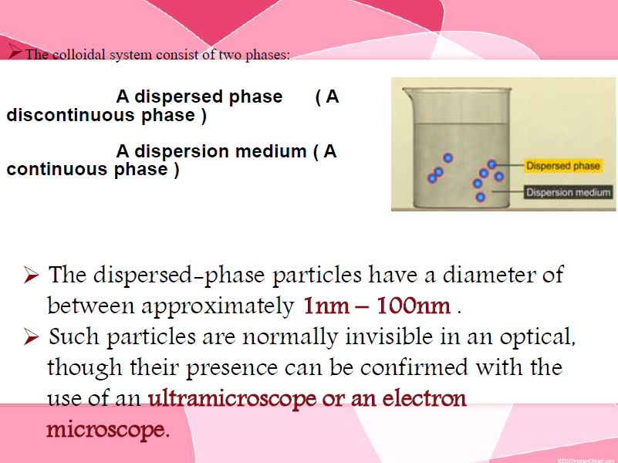

Slide 6
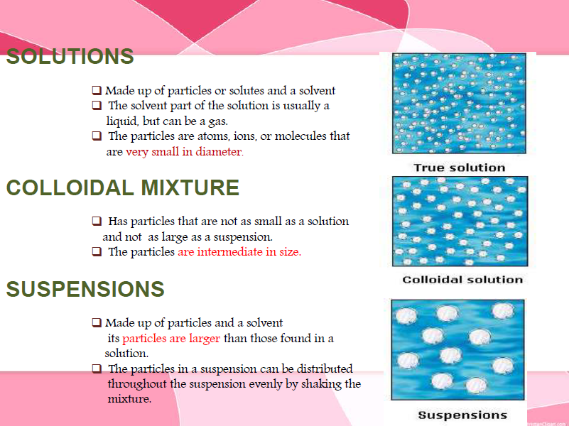

Slide 7
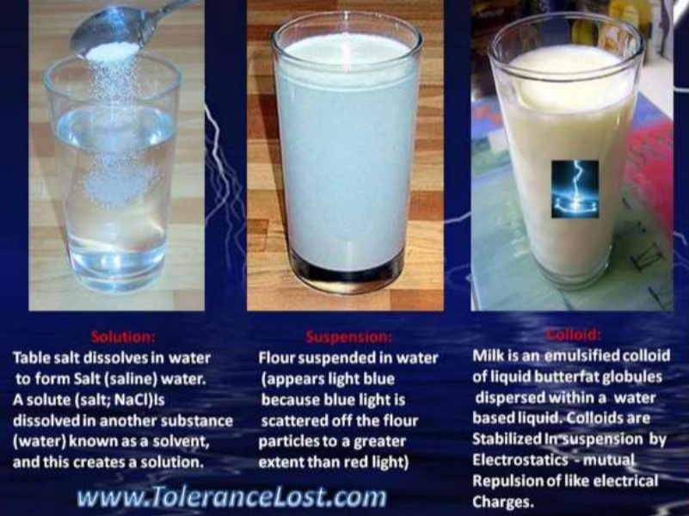

Slide 8
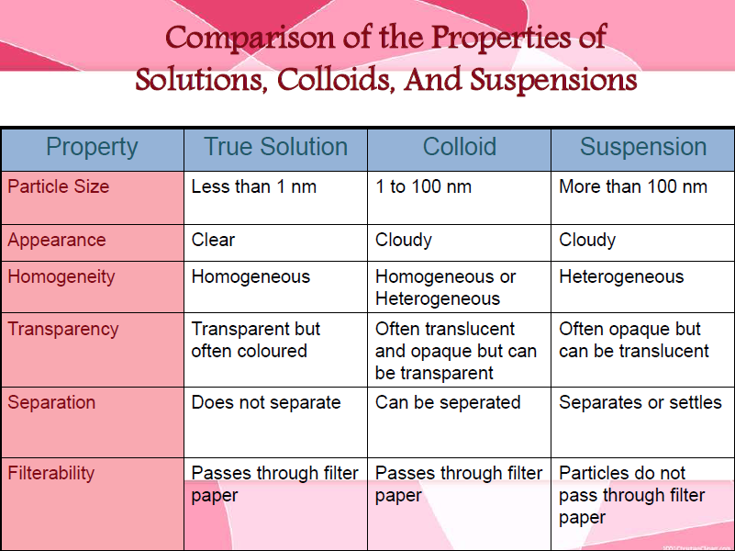

Slide 9
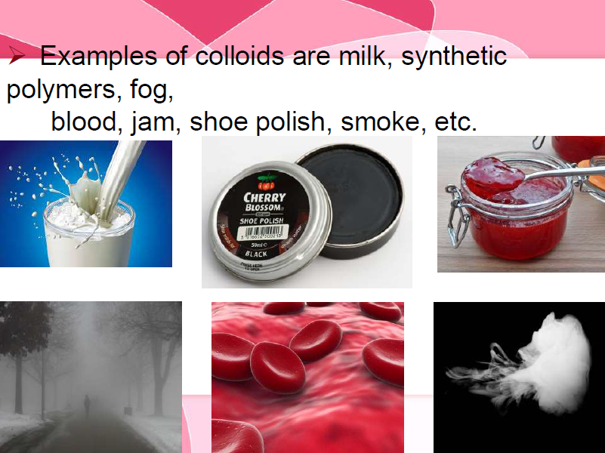

Slide 10
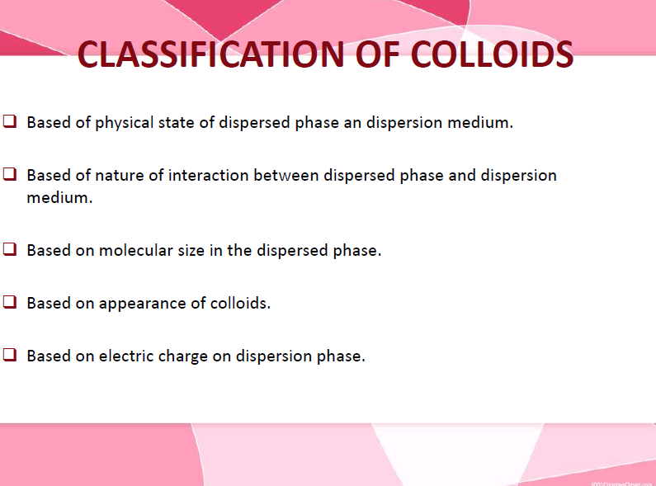

Slide 11
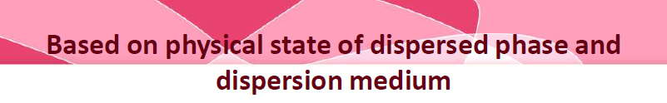
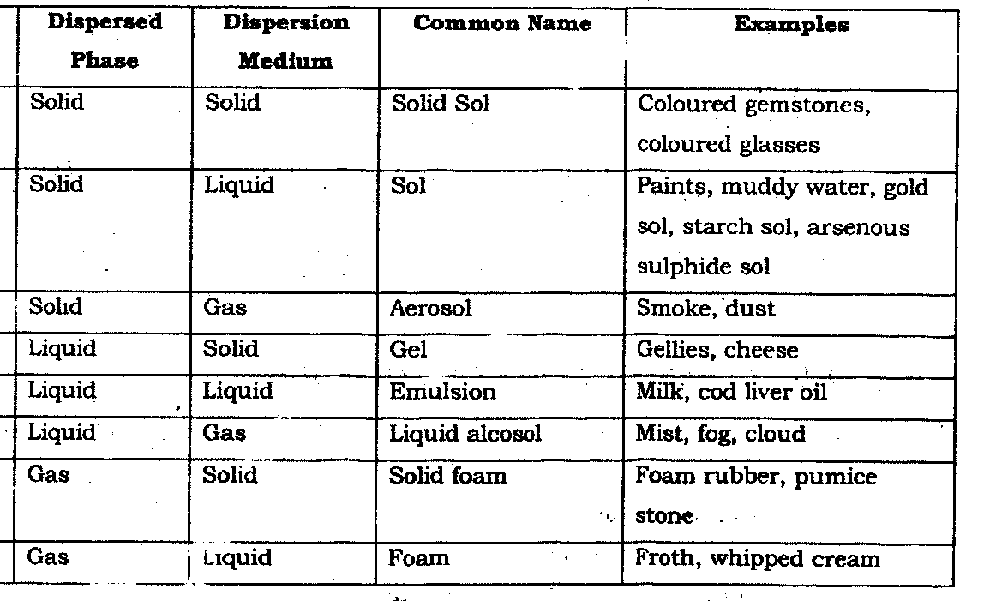

Slide 12
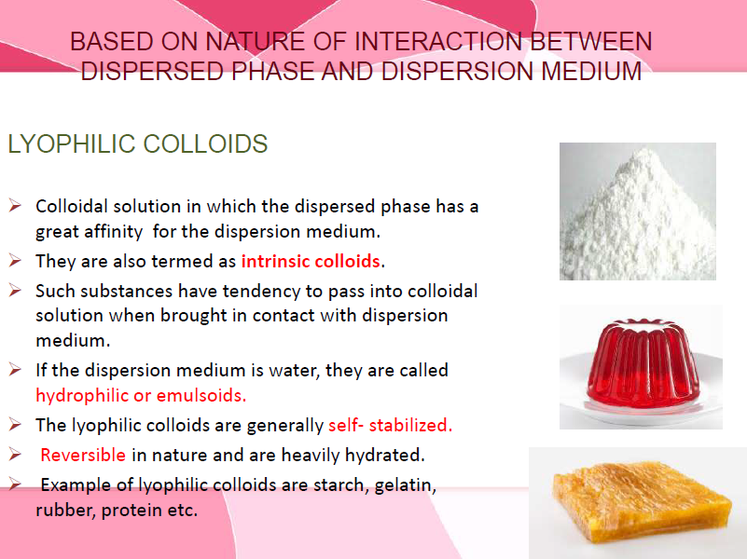

Slide 13
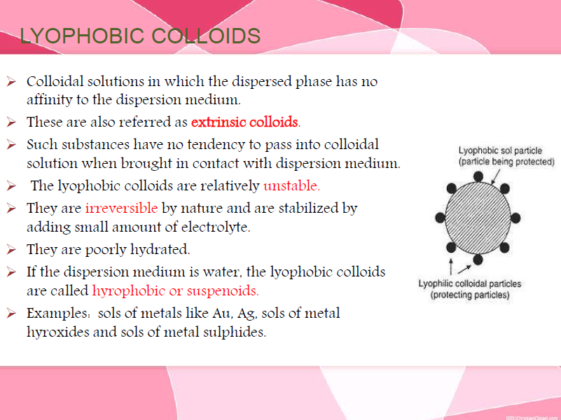

Slide 14
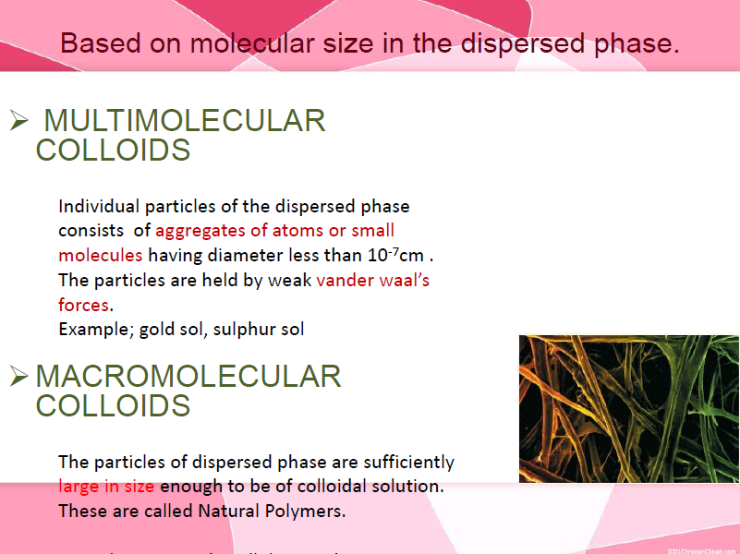

Slide 15
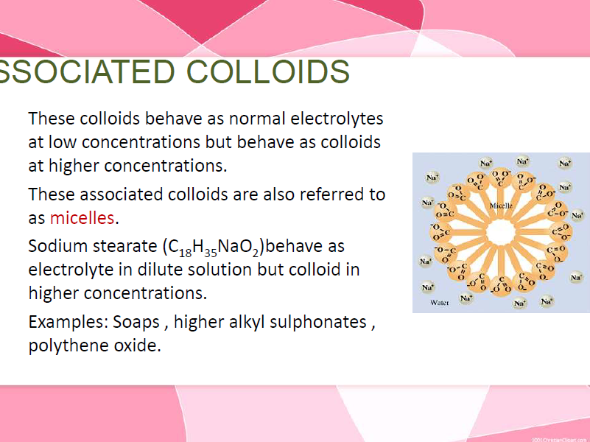

Slide 16
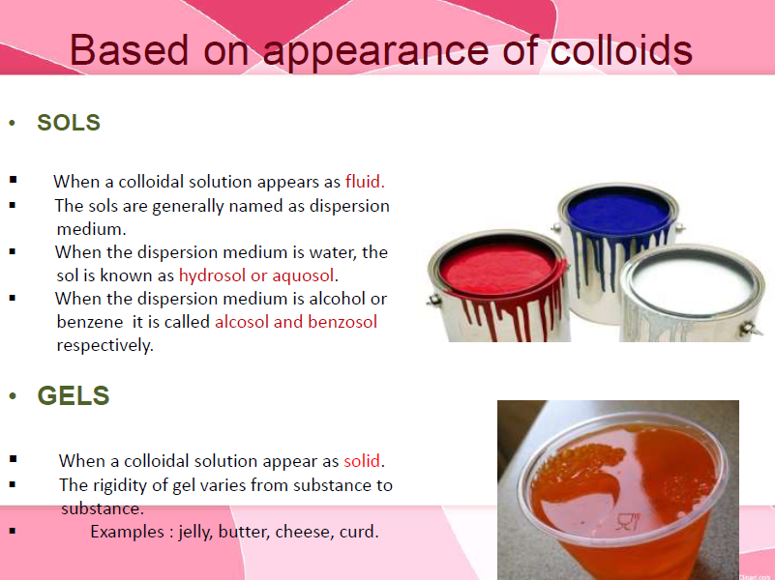

Slide 17
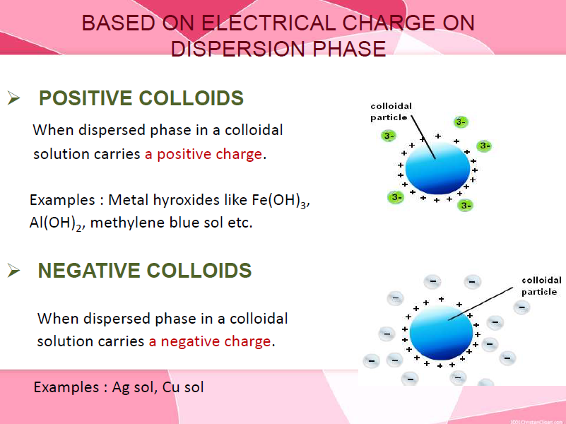

Slide 18
Preparation of Colloids
Preparation of lyophilic sols: The colloidal solutions of lyophilic colloids like starch, glue, gelatin etc., can be readily prepared by dissolving these substances in water either in cold or on warming.
2. Preparation of lyophobic sols: Lyophobic sols are prepared by special methods. These methods fall into two categories.
Dispersion methods: By splitting macro-sized particles into colloidal size.
ii. Aggregation or condensation methods: By aggregating small particles (single ions or molecules) into the colloidal particles.

Slide 19
Dispersion Methods
1. Mechanical dispersion using colloidal mill
The solid along with the liquid is fed into a colloidal mill. The mill consists of two steel plates nearly touching each other and rotating in opposite directions with high speed. The solid particles are ground down to colloidal size and then dispersed in the liquid. Colloidal graphite (lubricant) and printing inks are made by this method.
Colloidal mill

Slide 20
2. Electro-dispersion method: (Bredig’s Arc Method)
This method is suitable for the preparation of colloidal solution of metals like gold, silver, platinum etc. An arc is struck between the metal electrodes under the surface of water containing some stabilising agent such as trace of alkali. The water is cooled by immersing the container in a cold bath. The intense heat of the arc vapourises some of the metal which condenses under cold water.

Slide 21
Aggregration methods
3. Chemical Methods
chemical reaction in a medium in which the dispersed phase is sparingly soluble. Some of the methods are
(i) Oxidation: A colloidal solution of sulphur is obtained by passing H₂S into a solution of sulphur dioxide.
2H₂S + SO₂ →2H₂O + 3S
(ii) Hydrolysis: Colloidal solutions of the hydroxides of Fe, Cr, Al etc can be prepared by hydrolysis of their salts. A colloidal solution of ferric hydroxide is obtained by boiling a dilute solution of ferric chloride.
FeCl₃ + 3H₂O → Fe(OH)₃ (red sol) + 3HCl

Slide 22
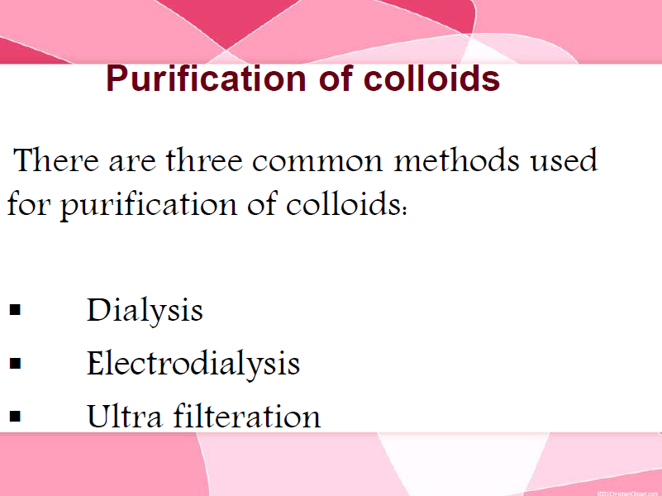
When a colloidal solution is prepared is often contains certain electrolytes which tend to destabilize it. The following methods are used for purification:

Slide 23
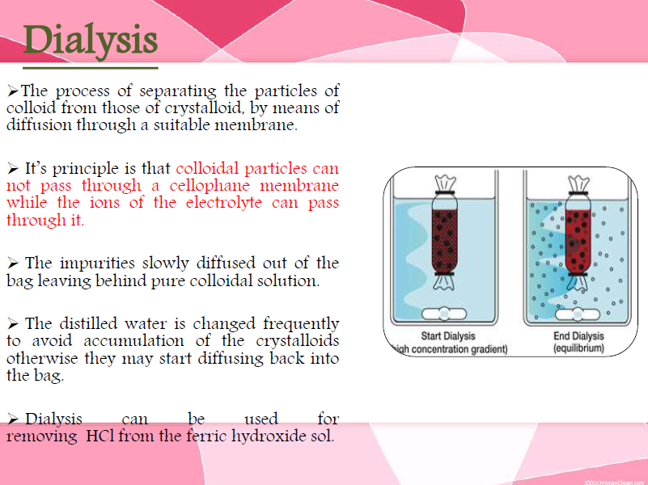

Slide 24
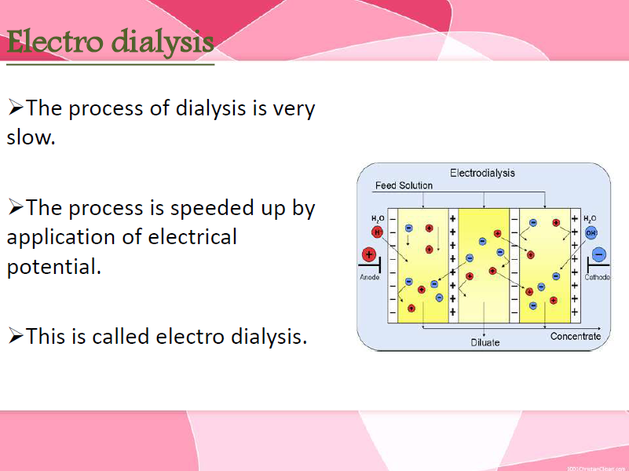

Slide 25
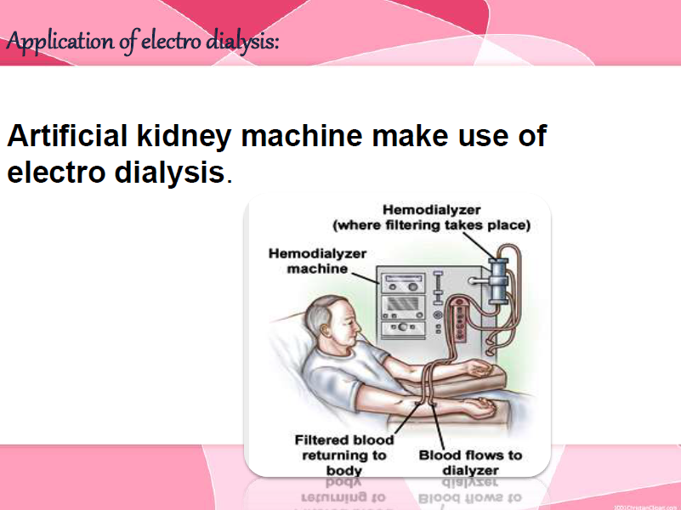
Electrodialysis:
In the dialysis unit, the movement of ions across the membrane can be speeded up by applying an electric current through the electrodes induced in the solution.
The most important use of dialysis is the purification of blood in artificial kidney machines.
The dialysis membrane allows small particles (ions) to pass through but the colloidal size particles (haemoglobin) do not pass through the membrane.

Slide 26
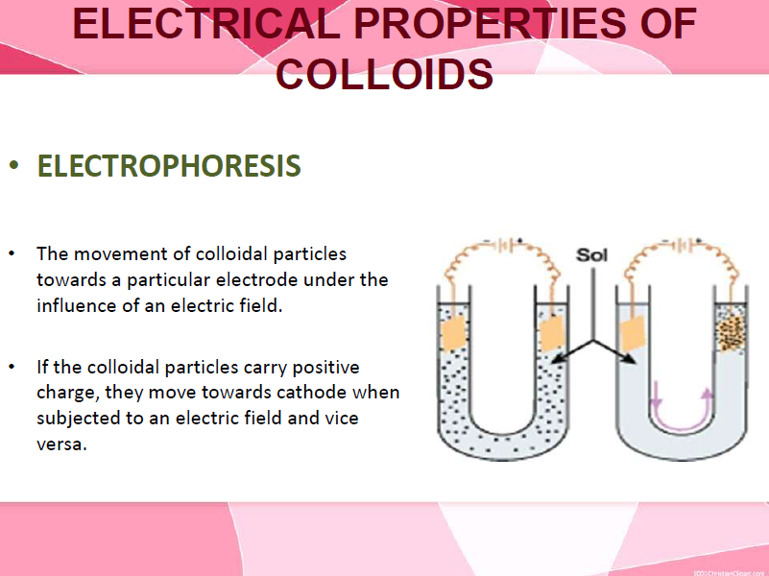
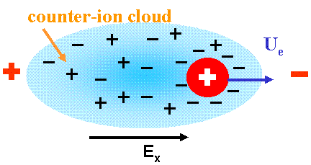

Slide 27
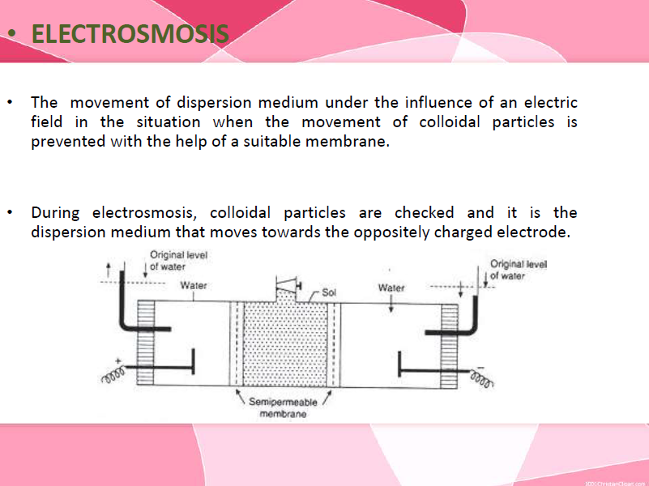

Slide 28
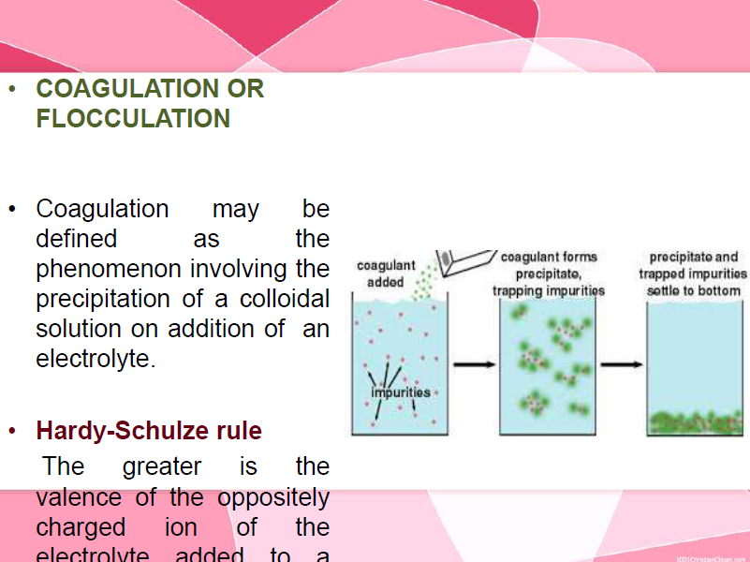

Slide 29
Stability of Colloids
Coagulation or Flocculation may be defined as the phenomenon involving the precipitation of a colloidal solution by the addition of an electrolyte.
Hardy and Schulze studied the coagulation of sols by electrolyte and formulated a rule known as Hardy-Schulze rule which states
the ion which is effective in causing coagulation of sol (known as counter ion) is the one with charge opposite to that of dispersed phase (counter-ion) and
greater the charge of counter-ion, greater is the coagulation power of the electrolyte.

Slide 30
For a negatively charged sol, the flocculation power of counter ions will be in the order Na⁺ < Ba²⁺ < Al³⁺ and for a positively charged sol, the flocculation power of counter ions will be in the order Cl⁻ < SO₄²⁻< PO₄^{3- .}
Flocculation value is defined as the minimum concentration of milli-moles of electrolyte required for coagulation of one litre sol.
In addition, the colloids can be coagulated by many other ways.
1. Increase in temperature
2. Presence of impurities
3. Agitation

Slide 31
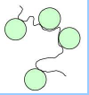
Protective action of colloids
The property of lyophilic sols to prevent the precipitation of lyophobic sol is called protection.
The lyophilic colloids forms a coating around lyophobic sol thus it prevents the lyophobic sol from precipitation is referred to as a protective colloid.
Ex: hydrophilic sols like gelatin, glue, starch, albumin.

Slide 32
Gold number: It is used to describe the protecting power of many protecting colloids.
It is defined as “the number of milligrams of protective colloid that must added to 10 ml of the standard gold sol so that addition of 1 ml of 10% NaCl solution just prevents its coagulation”.
Smaller the gold number greater is the protective power of lyophilic colloid.
Protective action of colloids is very useful in making of ice-cream, use of Ag sols in medicine, etc.

Slide 33
Emulsions
The liquid-liquid colloidal dispersions are called emulsions. An emulsion may be defined as follows:
The colloidal dispersion of two immiscible liquids in which one liquid acts as the dispersion medium and the other as dispersed phase is called an emulsion.

Slide 34
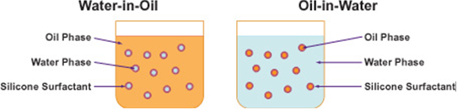
Types of Emulsion
Depending upon the nature of dispersed phase, emulsions can be classified into following two types.
Oil-in-water (O/W) type emulsions: In oil-in-water emulsions, an oil acts as the dispersed phase while water acts as the dispersion medium. The most common example of oil in water type emulsion is milk which consists of liquid fat globules dispersed in water.

Slide 35
Water-in-oil (W/O) type emulsions:
In water-in-oil type emulsions, water acts as the dispersed phase, whereas oil acts as the dispersion medium. This type of emulsions is also referred to as oil emulsions.
Cod liver oil emulsion is a typical example of this type of emulsions in which water is dispersed in cod liver oil.

Slide 36
Property | Oil in water | Water in oil
Dispersion medium | Water | oil
Dispersed phase | Oil | water
viscosity | Slightly more than water | More than water
Electrical conductivity | Nearly equal to that of water | Very low
Dye test – addition of oil soluble dye like methylene blue | Dye remains insoluble in the form of coloured spots | Dye dissolves giving a bright colour

Slide 37
Preparation of Emulsions
Emulsions are usually prepared by vigorously mixing the two liquids by using either a high speed mixing machine or by using ultrasonic vibrators. The process is known as emulsification.
Since the two liquids used for the preparation of an emulsion are completely immiscible, a stabilizing substance, known as emulsifying agent or emulsifier is required to stabilize the resulting emulsion.

Slide 38
In the absence of emulsifying agent, the dispersed phase particles of colloidal size combine together resulting in the breaking up of emulsion into two separate layers.
Some of the important emulsifying agents are soaps, detergents, proteins, gums and agar.
Among these, soaps and detergents are most commonly used emulsifiers.

Slide 39
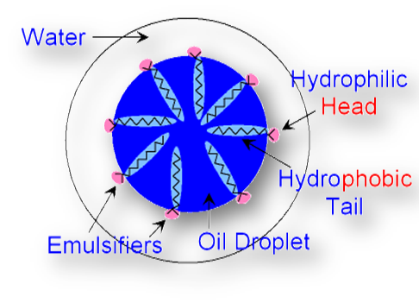
Role of Emulsifier
The emulsifiers form a protective film around the oil droplets dispersed in water.
This prevents them to come closer and to coalesce, i.e. to combine together. Thus, the emulsion gets stabilized.
For example, let us consider the role of soap which acts as an emulsifier for an oil-in-water emulsion.

Slide 40
Gels
A gel is a jelly-like colloidal system in which a liquid is dispersed in a solid medium.
The gel possesses honey-comb like structure.
The dispersion medium of the gel will be hydrated colloid particles.
The gel can be converted into sol by heating. It cannot be dehydrated.
Viscosity of the gel is very high. The process of transformation of a sol into a gel is known as gelation.

Slide 41
Gel may be classified into two types:
Elastic gels: These are those gels which possess the property of elasticity. They change their shape when external force is applied on them but restore their original shape when the force is removed. In elastic gel, the phases are held by electrostatic forces. These are reversible. Examples: Gelatin, agar-agar and jellies.
Non- elastic gels: These are the gels which are rigid, due to a network of chemical bonds. These gels are prepared by appropriate chemical action. Silica gel is an example of non-elastic gels which is produced by adding concentrated hydrochloric acid to sodium silicate solution of the correct concentration. These are irreversible. Examples are silica, alumina and ferric hydroxide gels.

Slide 42
Preparation of gels
Gels can be prepared by any one of the following methods
Cooling of sols of moderate concentrations – gels of gelatin and agar-agar, are obtained by cooling their sol of moderate concentrations prepared in hot water.
2. Double decomposition – the hydrophobic sols like silicic acid and aluminium hydroxide (silica gel and alumina gel) are prepared by this method. By adding hydrochloric acid to an aqueous solution of sodium silicate, silicic acid gets precipitated which is allowed to stand then set into a gel.
3. Change of solvent – when ethanol is added to a solution of calcium acetate and allowed to stand, a semi-rigid gel of calcium acetate is formed.

Slide 43
Applications of colloidal solutions
Food and medicines: Many of the food materials which we eat are of colloidal nature. Milk and also many milk products like cheese, cream butter etc. are colloids. Bread is colloidal system in which air is dispersed in baked dough. Colloids also have applications in the form of medicines. Colloidal medicines are competitively more effective as they are easily absorbed by the body. That is why many medicines are emulsion. Examples: antibiotics like penicillin and streptomycin.

Slide 44
Water Purification: One of the very popular methods used for water purification is the addition of electrolytes like potash alum. Addition of these electrolytes results in coagulation of the impurity which can be separated by filtration. It usually contains dispersed colloidal particles which cannot be removed by filtration.
Sewage disposal: The charged particles of impurities present in sewage may be removed by electrophoresis. For this purpose the sewage water is passed through a tunnel which is fitted with metallic electrodes and is maintained at a high potential difference.

Slide 45
Smoke precipitation: Smoke is also a colloidal system which mainly consists of charged particles of carbon depressed in air. For this again the process of electrophoresis is used.
Artificial rain: Clouds are also colloidal system. The water molecules present in cloud have electric charge on them and are of colloidal size. So, if the charged on the molecules is neutralized somehow, they will start raining. Sometimes it is done by spraying some electrolytes over the clouds and the rain resulted from this is called artificial rain.

Slide 46
Rubber industry: rubber is synthesized from the latex obtained from the rubber trees. This latex is an emulsion in which negatively charged particles of rubber are dispersed in water. This coagulated mass is then vulcanized to solidify as natural rubber.
Leather tanning: Tanning is the process of treating the skins of animals to obtain the leather. Skin of animals is also a colloidal system in which the colloidal particles are positively charged. During the process, the charged particles of skin are coagulated using negatively charged material like tannin and some compounds of aluminum and chromium.

Slide 47
Cleansing action of soaps: The soap solution is a colloidal system and it removes the oil and dirt by forming water soluble emulsions.
Blue colour of the sky: The blue colour of sly is due to scattering of the blue colour of sun light by the colloidal particles of dust dispersed in the air present in atmosphere. (Tyndall effect).
Preparation of Nano-materials: Nano-materials which are used as catalyst are prepared by using reverse micelles.
Metallurgical operations: The froth floatation process used for metallurgy of sulphide ores involves the treatment of the ore in emulsion of pine oil.

Slide 48


