Slide 1
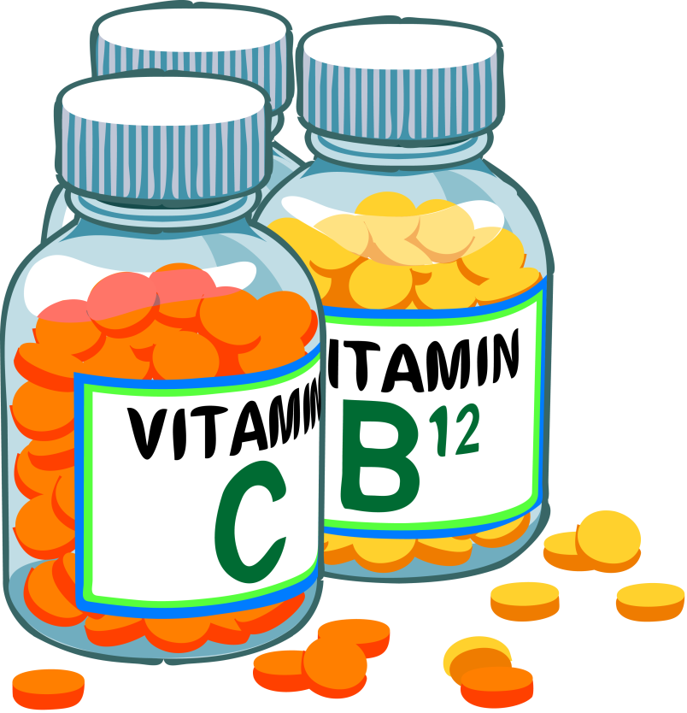
VITAMINS
Presented by
Dr. M.P. KESAVAN M.Sc., Ph.D.,
Assistant Professor
Department of Chemistry
HKRH College
Uthamapalayam.

Slide 2
What is Vitamin?

Slide 3
VITAMINS
Definition
Vitamins are organic substances required in small amount by animals (including man) to maintain normal growth and health and whose absence cause deficiency diseases.
Vitamins cannot be produced by the body and hence must be supplied through the diet. They are, therefore, called accessory dietary factors.
Vitamin D, however, may be supplied in food or may be produced in the skin by irradiation of sterols with ultraviolet rays.

Slide 4
VITAMINS
Examples
There are 13 essential vitamins. This means that these vitamins are required for the body to work properly.
• Vitamin B1 (thiamine)
• Vitamin B2 (riboflavin)
• Vitamin B3 (niacin)
• Vitamin B5 (pantothenic acid)
• Vitamin B6 (pyridoxine)
• Vitamin B7 (biotin)
• Vitamin B9 (folic acid)
• Vitamin B12 (cyanocobalamin)
• Vitamin A (retinol)
• Vitamin C (ascorbic acid)
• Vitamin D (calciferol)
• Vitamin E (tocopherol)
• Vitamin K (phytonadione)

Slide 5
CLASSIFICATION OF VITAMINS
Vitamins are broadly classified into two types based on their solubility,
VITAMINS
Fat-soluble vitamins
Water-soluble vitamins

Slide 6
CLASSIFICATION OF VITAMINS
Fat-soluble vitamins
Fat-soluble vitamins are soluble in fat (oil). They are stored in the body's fatty tissue (adipose tissues).
The fat-soluble vitamins are stored in the body for long periods of time and generally pose a greater risk for toxicity than water-soluble vitamins when consumed in excess.
These vitamins are absorbed more easily by the body (intestinal tract) in the presence of dietary fat. They are present in foods containing fats. They obtain from plant and animal foods or dietary supplements.
They are not easily lost in cooking.

Slide 7
CLASSIFICATION OF VITAMINS
Examples for Fat-soluble vitamins
Vitamin A (retinol)
Vitamin D (calciferol)
Vitamin E (tocopherol)
Vitamin K (phytonadione)

Slide 8
CLASSIFICATION OF VITAMINS
Water-soluble vitamins
Water-soluble vitamins are soluble in water.
They are not stored in the body.
Any left over water-soluble vitamins leave the body through the urine.
Although, the body keeps a small reserve of these vitamins, they have to be taken on a regular basis to prevent shortage in the body.
They also obtain from plant and animal foods or dietary supplements.
They are easily lost in cooking.

Slide 9
CLASSIFICATION OF VITAMINS
Examples for Water-soluble vitamins
Vitamin C (ascorbic acid)
Vitamin B1 (thiamine)
Vitamin B2 (riboflavin)
Vitamin B3 (niacin)
Vitamin B5 (pantothenic acid)
Vitamin B6 (pyridoxine)
Vitamin B7 (biotin)
Vitamin B9 (folic acid)
Vitamin B12 (cyanocobalamin)
Note: B12 is the only water-soluble vitamin that can be stored in the liver for many years.

Slide 10
VITAMIN A
Structure
Vitamin A is a fat-soluble vitamin. Vitamin A is a group of unsaturated nutritional organic compounds that includes retinol, retinal, and several provitamin A carotenoids (most notably beta-carotene).
All forms of vitamin A have a beta-ionone ring to which an isoprenoid chain is attached, called a retinyl group. Both structural features are essential for vitamin activity.

Slide 11
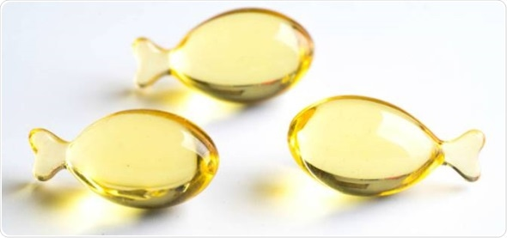
VITAMIN A
Sources
Milk
Eggs
Meat
Cheese
Liver
Fish oil
Green leafy vegetables
Carrots
Tomatoes
Red palm oil

Slide 12
VITAMIN A
Functions
Vitamin A helps form and maintain healthy teeth, skeletal and soft tissue.
Vitamin A is important for normal vision, the immune system, and reproduction.
It produces the pigments in the retina of the eye. Vitamin A deficiency causes ‘night blindness’ (inability to see objects in dim light).
Xerophthalmia is a major cause of blindness in childhood. Due to the antixerophthalmic factor, vitamin A is called Bright eyes vitamin.
It helps in maintaining the integrity of epithelial cells of the skin and mucous membranes of the eyes. Deficiency of vitamin A results in Keratomalacia (softening of the cornea).

Slide 13
VITAMIN A
Functions (cont.)
Vitamin A also helps the heart, lungs, kidneys, and other organs work properly.
Vitamin A also has a role in healthy pregnancy and breast feeding.
Vitamin A, along with zinc, may reduce the risk of developing advanced age-related macular degeneration by about 25 percent.
Vitamin A also helps skin grow and repair skin.
The recommended daily amount of vitamin A is 900 micrograms (mcg) for adult men and 700 mcg for adult women.

Slide 14
VITAMIN B COMPLEX
Structure
Vitamin B complex is composed of eight B vitamins. They are,
Vitamin B1 (thiamine)
Vitamin B2 (riboflavin)
Vitamin B3 (niacin)
Vitamin B5 (pantothenic acid)
Vitamin B6 (pyridoxine)
Vitamin B7 (biotin)
Vitamin B9 (folic acid)
Vitamin B12 (cyanocobalamin)

Slide 15
VITAMIN B COMPLEX
Structure

Slide 16
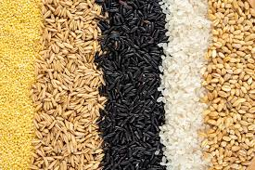
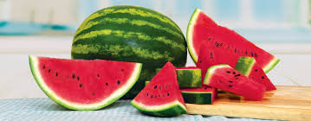
VITAMIN B COMPLEX
Sources
Milk, Cheese
Eggs, Liver And Kidney
Meat, such as chicken and red meat, Fish
Dark green vegetables, such as spinach
Beets, avocados, and potatoes
Whole grains , Beans
Nuts and seeds, Fruits, such as citrus, banana, and watermelon

Slide 17
VITAMIN B COMPLEX
Functions
Vitamin B complex have a direct impact on your energy levels, brain function, and cell metabolism.
Vitamin B complex helps prevent infections and helps support or promote:
good digestion
healthy appetite
proper nerve function
hormones and cholesterol production
cardiovascular health
muscle tone
cell health
growth of red blood cells
energy levels
good eyesight
healthy brain function

Slide 18
VITAMIN B COMPLEX
Functions (cont.)
Vitamin B complex are especially important for women who are pregnant and breastfeeding.
These vitamins aid in fetal brain development as well as reduce the risk of birth defects.
Vitamin B complex may boost energy levels, ease nausea, and lower the risk of developing preeclampsia.
Vitamin B complex are thought to increase testosterone levels in men, which naturally decrease with age.

Slide 19
VITAMIN B COMPLEX
Functions (cont.)
They may also help men build muscle and increase strength.
Vitamin B complex deficiency could increase your risk of developing, anemia, digestive issues, skin conditions, infections, peripheral neuropathy.
Vitamin B12 deficiency, in particular, may increase your risk of neuropsychiatric disorders.

Slide 20
VITAMIN B COMPLEX
Recommended daily intake
WOMEN
MEN
B-1: 1.1 milligrams (mg)
B-2: 1.1 mg
B-3: 14 mg
B-5: 5 mg
B-6: 1.3 mg
B-7: 30 micrograms (mcg)
B-9: 400 mcg
B-12: 2.4 mcg
B-1: 1.2 mg
B-2: 1.3 mg
B-3: 16 mg
B-5: 5 mg
B-6: 1.3 mg
B-7: 30 mcg
B-9: 400 mcg
B-12: 2.4 mcg

Slide 21
VITAMIN C
Structure
Vitamin C, also known as ascorbic acid and ascorbate.
Ascorbic acid is a weak sugar acid structurally related to glucose.
In biological systems, ascorbic acid can be found only at low pH, but in solution above pH 5 is predominantly found in the ionized form, ascorbate.

Slide 22
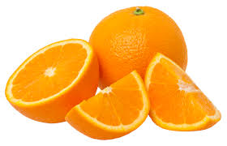
VITAMIN C
Sources
Amla
Citrus fruit, such as oranges
Peppers
Strawberries
Green leafy vegetables (cauliflower, cabbage)
Tomatoes
Potatoes

Slide 23
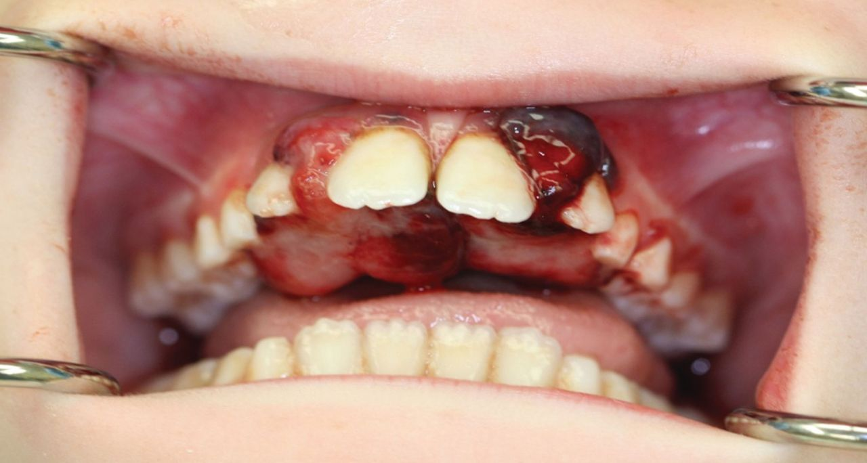
VITAMIN C
Functions
The chief function of vitamin C is to help the formation and maintenance of intercellular substances including collagen of connective tissues, osteoid tissues of bone and dentine of teeth.
Severe vitamin C deficiency leads to Scurvy, a disease characterised by swelling of limbs, bleeding of gums and loosening of teeth.

Slide 24
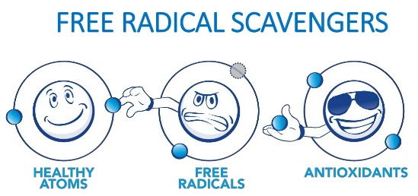
VITAMIN C
Functions (cont.)
Vitamin C is required for the absorption of iron
It is necessary for the normal growth, maturation and reproduction of cells.
It builds up body resistance against infections by inactivating bacterial toxin.
Vitamin C is one of many antioxidants that can protect against damage caused by harmful molecules called free radicals, as well as toxic chemicals and pollutants like cigarette smoke.
For adults, the recommended daily amount for vitamin C is 65 to 90 milligrams (mg) a day, and the upper limit is 2000 mg a day.

Slide 25
References
S.F. Dyke, Chemistry of vitamin, Interscience Publishers, 1965.
I. L. FInar, Organic chemistry, Vol. II. ELBS, 1975.
https://medlineplus.gov/ency/article/002399.htm
https://www.health.harvard.edu/staying-healthy/listing_of_vitamins

