Slide 1
Stress Management during COVID-19
M.Moahamed Ilyas
Assistant Professor of Commerce,
Hajee Karutha Rowther Howdia College,
Uthamapalayam

Slide 9
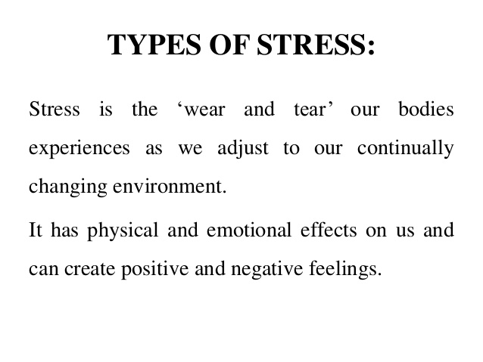

Slide 10
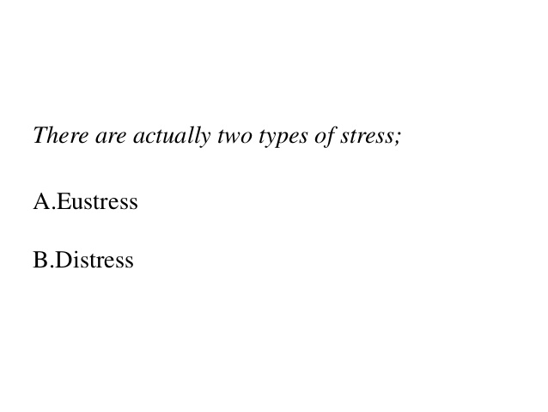

Slide 15
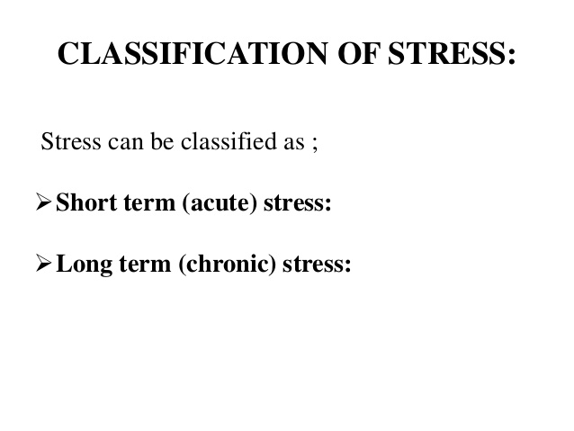

Slide 19
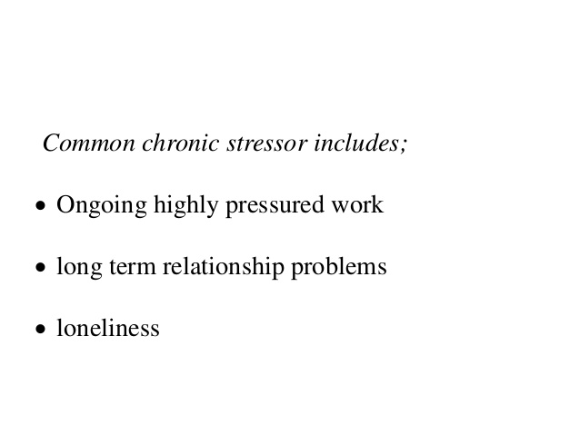

Slide 21
“Stress” means feeling troubled or threatened by life.

Slide 22
COVID-19: common reactions
As the COVID-19 pandemic and its far-reaching implications continue to unfold globally and in our community, it's normal for people to experience a wide range of thoughts, feelings and reactions including:

Slide 23
Frustration, irritability, or anger
Restlessness or agitation
Feeling helpless
Difficulty concentrating or sleeping
Feeling disconnected from others
Apprehension about going to public spaces

Slide 24
Feeling stressed or overwhelmed
Anxiety, worry, or fear
Racing thoughts
Sadness, tearfulness, loss of interest in usual enjoyable activities
Trouble relaxing

Slide 25
Physical symptoms such as increased heart rate, stomach upset, fatigue, or other uncomfortable sensations

Slide 26
These experiences are all understandable in
the face of this significant challenge.
There has been loss of life, rapid changes to our way of life (e.g., study, work, social gatherings),
disrupted plans due to travel restrictions
social (physical) distancing measures in our efforts to slow the spread of transmission. People are naturally concerned for their own and their loved ones’ health and safety.

Slide 27
Looking after our wellbeing in times like this can help to reduce stress, and is crucial in enabling us to still take calm and effective action in the midst of this global crisis.

Slide 28
Strategies to cope with stress, anxiety or distress
One of the most effective ways we can manage stress and anxiety is to focus on the actions that are in our control.

Slide 29
Along with the Recommended important actions we can all take to protect against infection and prevent the virus from spreading including practising good hygiene, self-isolation, and social (physical) distancing.

Slide 30
Here are some ways you can take intentional steps to look after your physical and emotional wellbeing during this challenging time:

Slide 31
Acknowledge your feelings.
Whatever you are feeling right now, know that it’s okay to feel that way.
Allow yourself time to notice and express what you’re feeling. This could be through journalling, talking with others, or channelling your emotions into something creative (e.g., drawing, painting, poetry, music).
meditation exercises can help us stay grounded in the midst of an emotional storm.
You can learn how to witness and let thoughts and feelings come and go in their own time, without getting overwhelmed by them.
Mindfulness

Slide 32
Make a conscious shift to focus on the activities we are still able to do, or those that we may have more opportunity to do if we're at home more often. Some ideas could be to:
•Keep learning and maintaining your study
•Read a book
•Listen to a podcast
•Try out a new hobby or skill (e.g., cook a new recipe, play an instrument, learn a language, learn how to sew, gardening).

Slide 33
Maintain your day-to-day activities and a routine as much as possible.
Having a healthy routine can have a positive impact on your thoughts and feelings.
Go back to basics: eating healthy meals, physical exercise (e.g., walking, stretching, running, cycling), getting enough sleep, and doing things you enjoy.
Even if you're in self-quarantine, or working from home, there are many ways to develop new routines and stay healthy.

Slide 34
Stay connected.
Receiving support and care from others has a powerful effect on helping us cope with challenges. Spending time with supportive family and friends can bring a sense of comfort and stability.
Talking through our concerns, thoughts, and feelings with others can also help us find helpful ways of thinking about or dealing with a stressful situation.

Slide 35
Remember that physical distancing does not need to mean social disconnection. There are many ways we can use technology to stay connected, and both give and receive support (remotely). You could:
•Call, text, or video-chat with friends and family
•Share quick and easy recipes
•Start a virtual book or movie club
•Schedule a workout together over video chat
•Join an online group or peer forum.

Slide 36
Contribute.
Showing care towards friends, family, or vulnerable people in our community can be all the more important during times like this. It can foster a sense of hope, purpose, and meaning. Some ideas can be to:
•Send someone you care about a message of encouragement or affirmation
•Cook, pack and deliver a meal to someone in your neighbourhood
•Donate to a cause.

Slide 37
Keep things in perspective.
In a situation that’s uncertain, it’s natural to have many ‘what if?’ questions in our minds. In the absence of information, our anxious mind will often fill in the blanks with worst case scenarios, which can leave us feeling overwhelmed, helpless, or vulnerable.

Slide 38
some questions you can ask yourself to shift your thinking from catastrophizing to a more helpful mindset:
•What are the things within my control?
•Am I overestimating the likelihood of the worst-case scenario?
•What strategies have helped me cope with challenging situations in the past that will serve me well during this time?
•What is a small helpful or positive action that I can take now?

Slide 39
Seek accurate information.
Finding credible sources you can trust is important to avoid the fear and panic that can be caused by misinformation.

Slide 40
Set limits around news and social media.
It’s understandable to want to keep informed and prepared. At the same time, constantly reading, watching, or listening to upsetting media coverage can unnecessarily intensify worry and agitation. When you get the urge to check updates, see if you can pause, notice the urge, delay acting on the urge, and let it pass without judgement. Schedule a specific time to check in with the news instead. It's also okay to take breaks from conversations with others about COVID-19 and suggest talking about other topics.

Slide 41
How can I reduce stress down during the coronavirus pandemic?
Take up a relaxation practice. When stressors throw your nervous system out of balance, relaxation techniques such as deep breathing, meditation, and yoga can bring you back into a state of equilibrium. Regular practice delivers the greatest benefits, so see if you can set aside even a little time every day.

Slide 42
Can alcohol or drugs help me to cope with stress during the coronavirus disease pandemic?
Avoid using unhelpful coping strategies such as use of tobacco, alcohol or other drugs. In the long term, these can worsen your mental and physical well-being. The COVID-19 outbreak is a unique and unprecedented scenario for many workers, particularly if they have not been involved in similar responses

Slide 43
How to take care of one's physical and mental health during coronavirus pandemic?
During this difficult time, it's important to continue looking after your physical and mental health. This will not only help you in the long-term, it will also help you fight COVID-19 if you get it.
First, eat a health and nutritious diet, which helps your immune system to function properly. Second, limit your alcohol consumption, and avoid sugary drinks. Third, don't smoke. Smoking can increase your risk of developing severe disease if you become infected with COVID-19. Fourth, exercise.

Slide 44
What can help me prevent anxiety during the coronavirus disease pandemic?
Minimize watching, reading or listening to news about COVID-19 that causes you to feel anxious or distressed; seek information only from trusted sources and mainly so that you can take practical steps to prepare your plans and protect yourself and loved ones.Mar 18, 2020

Slide 45
Advice and guidance from WHO on COVID-19 : https://www.who.int/emergencies/diseases/novel-coronavirus-2019 https://www.epi-win.com/

Slide 46
Thank You
STAY SAFE

