Slide 1
FINANCIAL SYSTEM K MOHAMED IRSHAD ASSISTANT PROFESSOR OF COMMERCE HAJEE KARUTHA ROWTHER HOWDIA COLLEGE (AUTONOMOUS).

Slide 2
FINANCIAL SYSTEM
A set of institutions, instruments and markets which foster savings and channel them to their most efficient use.
The Indian financial system consists of the many financial institution and mechanisms which affects the generation, mobilistation and distribution of savings of the community among all those who demand for funds for investment purposes.

Slide 3
The Indian financial system consists of two groups:
1. All institutions that promote savings among the public , collect and transfer the same to the investors
( it includes banking system, the insurance companies, mutual funds and investment funds)
2. The investors or borrowers in the country.
(This category comprises individual investors, industrial and trading companies and government.)

Slide 4
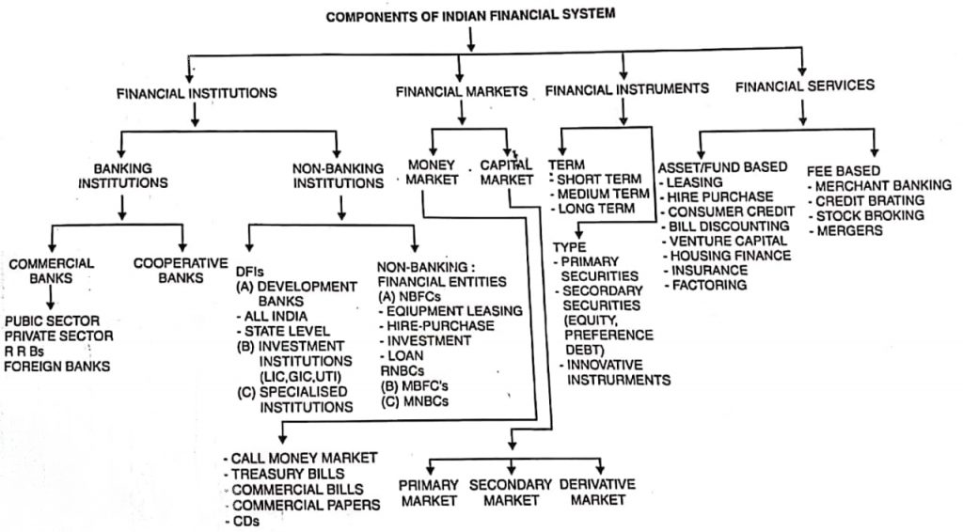
STRUCTURE OF INDIAN FINANCIAL SYSTEM
Financial Market

Slide 5
Financial Market
Money Market
Capital Market
Government Securities Market
Foreign Exchange Market

Slide 6
Financial Institutions
Growth of Financial Institutions
Monetary Institution
Non-Monetary Institution
Functions of Financial Institutions
Financial Intermediaries

Slide 7
Functions of financial institutions:
Promoting the overall savings of the economy.
Surveying existing savings in a more efficient manner so that those in great need get priority in allotment.
Creating credit and deposit money for facilitating the transactions of trade and distribution in the economy.

Slide 8
Long-term financial institutions
It is the quantitative expansion and functional diversification of the banking system.
It may be classified into as:
1. Primary financial institution and
2. Secondary financial institution

Slide 9
Primary Financial Institution:
Raise the bulk of their resources from the original savers (Households and Business).
In India Unit Trust of India (UTI) and Life Insurance Corporation (LIC) are examples of this type.
where UTI raise Funds by the sale of Units and
LIC raises funds through insurance premium.

Slide 10
Secondary Financial Institutions:
This depend mainly on the primary institutions, banks, the central bank and the government for the bulk of their resources.
Their main function is to purchase primary securities from ultimate lenders
The Industrial Finance Corporation of India(IFCI) and State Financial Corporation(SFC) comes under this category.
The major financial institution at national level are IDBI, IFCI and ICICI.
Apart from these specialised institutions are EXIM Bank, IRBI, ECGC and large number of state level corporations organised as SFC’s and the State Industrial Development Corporation (SIDCs)

Slide 11
Financial Intermediaries:
A financial intermediary is a firm or an institution that acts an intermediary between a provider of service and the consumer.
They issue indirect securities and use thus funds raised to purchase primary securities.
Their principal function is to deal in and to hold securities
the intermediaries undertake the important process that the funds or savings of the surplus sectors are channeled to deficit sectors.
Funds are transferred through the creation of liabilities such as bonds and equity shares.

Slide 12
Financial intermediaries are divided in to two categories:
Bank or monetary financial intermediaries.
Non-bank financial intermediaries.
The fundamental difference between banks and non-bank financial intermediaries is that the financial assets created by banks (deposits) are generally accepted as means of payments. It is Money. But, in the case of non-bank financial intermediaries, the assets which they create are not acceptable as a means of payments, and they have to be converted into money in order to make payments.

Slide 13
Bank Or Monetary Financial Intermediaries:
The RBI as the Central Bank of the country is at the apex of the Indian financial system.
It formulates and implements monetary and credit policies.
Commercial banks are represented as the most important institutions

Slide 14
Non-bank Financial Intermediaries:
The non bank financial intermediaries create non-monetary claims on themselves by issuing indirect securities such as savings deposits, shares, equities and other obligations. The funds so collected are used to purchase primary securities.

Slide 15
Financial instruments
Money Market Instruments
T-Bills
Bills of Exchange or Trade Bills
Finance Bills
Commercial Papers
Certificate of Deposits
Capital Market Instruments
Ordinary shares or Equity Shares
Preference Shares
No Par Stock
Different types of Debentures
Gild-edged Securities

