Slide 1
LEARNING FROM ENTREPRENEURAL LEADERSHIP
M.Mohamed Ishaq,
Assistant Professor of Commerce,
Hajee Karutha Rowter Howdia College,
Uthamapalayam

Slide 2
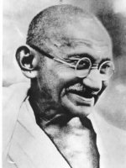
When the situation needs improvement, Gandhi offers guidance: “You must be the change you wish to see in the world.”

Slide 3
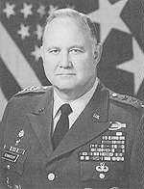
“Leadership is a potent combination of strategy and character. But if you must be without one, be without strategy.” General H. Norman Schwarzkopf

Slide 4
Can you make a difference?

Slide 5
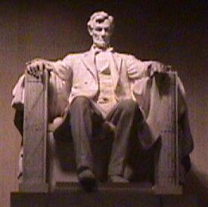
“To sin by silence when they should protest makes cowards of men.”
Abraham Lincoln

Slide 6
“Leadership is a potent combination of strategy and character. But if you must be without one, be without strategy.” General H. Norman Schwarzkopf

Slide 7
We do lots of Stuff. The only way you are going to have success is to have lots of failures first” — Sergey Brin

Slide 8
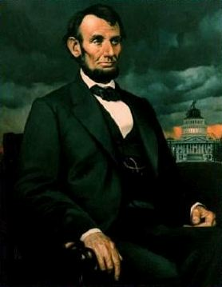
President Lincoln said: Honor is better than honors.

Slide 9
Steves Jobs
In Steve Jobs perspective, entrepreneurship is all about doing really crazy things to accomplish amazing things. It’s simply putting a dent in the universe.
Jobs dropped out of college because his family couldn't handle the financial burden of his education. He unofficially continued to audit classes, living off free meals from the local Hare Krishna temple and returning Coke bottles for change just to get by. Jobs credited the calligraphy class he stopped in on as his inspiration for the Mac's revolutionary typefaces and font design.
Jobs went on to have an unbelievable career, eventually forming the Apple Computer Company

Slide 10
Andrew Carnegie
He had a really rough life growing up. He spent his childhood working in factories, and at night he forced himself to sleep as a way to forgetting his hunger.
Carnegie eventually became a superintendent for the Pennsylvania Railroad Company before creating several of his own businesses, the most successful being the Carnegie Steel Mill. Despite being one of the richest Americans of all-time, he also serves as a class act example of generosity.

Slide 11
John D. Rockefeller
One of the world's wealthiest individuals of all time, Rockefeller was born the son of a traveling salesman. He showed early entrepreneurial promise selling candy and doing odd jobs for neighbors, eventually going on to become the founder of the Standard Oil Company.

Slide 12
Bill Gates
Co-founder of the world's largest PC software company, Microsoft, Gates was one of the defining figures of the personal computer revolution.
Be your own boss and start early

Slide 13
Mark Zuckerberg
There are very few people who are not aware of Mark Zuckerberg as he’s the founder of widely popular social media platform Facebook.
“The biggest risk is not taking any risk… in a world that is changing really quickly, the only strategy that is guaranteed to fail is not taking risks.”

Slide 14
Jeff Bezos
A brand for a company is like a reputation for a person. You earn reputation by trying to do hard things well.” Jeff Bezos
Amazon founder

Slide 15
Ritesh Agarwal.
Have you ever heard of Oyo Rooms? If you’re an Indian who especially loves to travel might have already stayed at Oyo Rooms at least for once. Oyo Rooms was founded by Ritesh Agarwal.
“Start small, nail it and then make it big”.

Slide 16
Leadership and Entrepreneurship
Leadership is characterized by;
Goals, Missions and Vision
Plan of Action
Working on the Plan to reach the goal
Team building
Model Building by SELF PRACTICE

Slide 17
Entrepreneurship
Entrepreneurship is characterized by
IDEA conception
transformation to product or service
Enterprise formation
risk taking
profit making AND LEADERSHIP

Slide 18
Linkages
ALL LEADERS ARE NOT ENTREPRENEURS
ALL ENTREPRENEURS NEED TO BE LEADERS
Non Entrepreneurial LEADERS look for COMMON GOOD
Not necessarily PROFIT AND ENTREPRISE BUILDING

Slide 19
Societal Extension
LEADERSHIP role of Entrepreneurs extend to
Society today
MODEL BUILDING is the Key to stay in Business

Slide 20
Learning from Entrepreneurial Leadership
Learn From Success
Story of Fire and SUN
Entrepreneurs who Walked over Fire Never Fade in the SUN
Learn From failure
Causative Factors
Ensure Inclusivity – I ALONE CANNOT GROW
Ensure Sustainability –MY System alone cannot Sustain

Slide 21
THANK YOU
Q & A

