Slide 1
S.Peer Mohaideen Mudalali,
Department of Computer Science,
Hajee Karutha Rowther Howdia College.

Slide 2
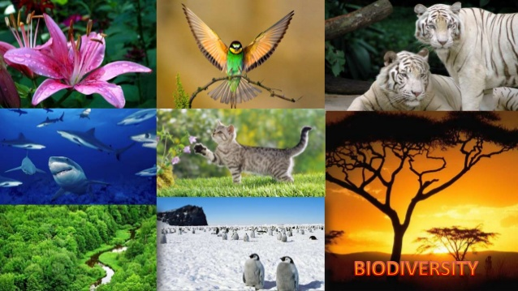

Slide 3
Conservation of Biodiversity
The maintenance and preservation of biodiversity is called biodiversity conservation. It is the conservation of different species of plants and animals

Slide 4
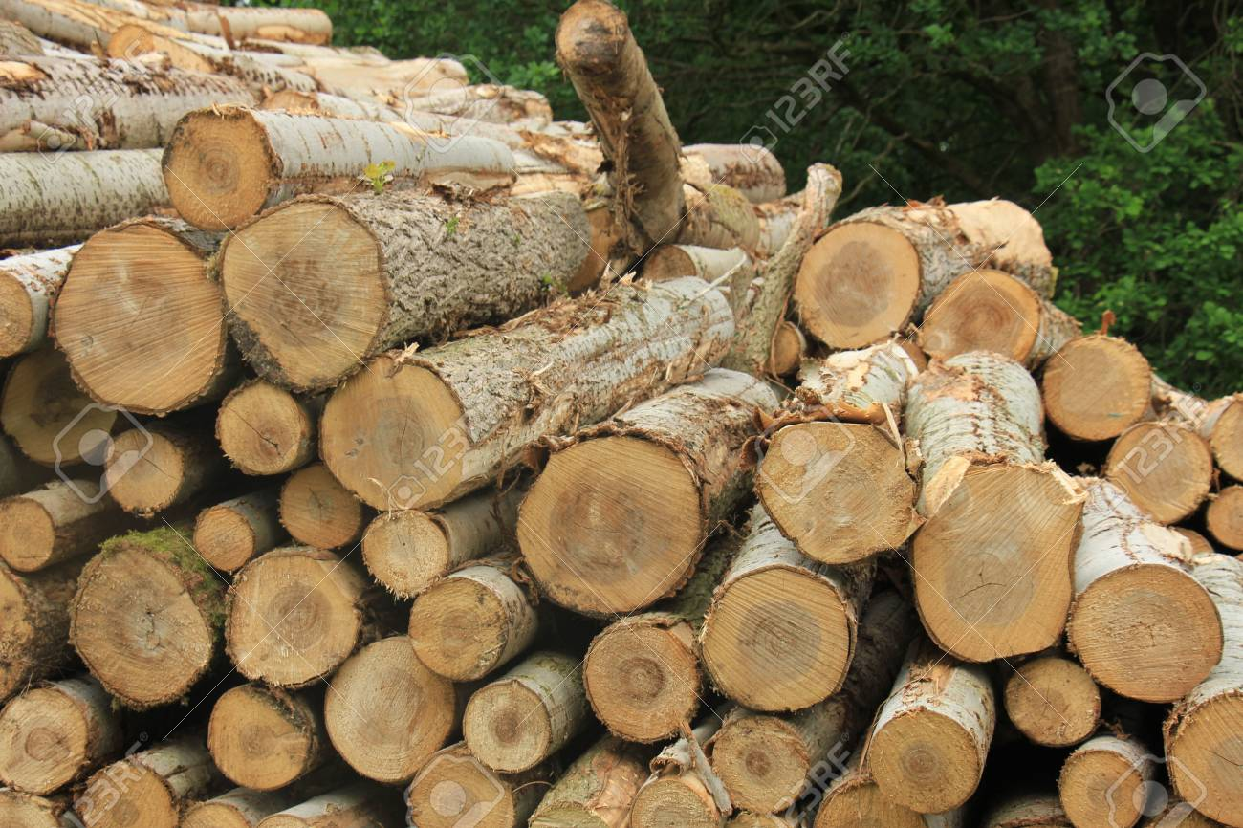
Need for Biodiversity Conservation:
An ecosystem is referred to as natural when it is relatively undistributed by human activities.
It natural ecosystem like forest is overused or misused for fuel wood ,fodder ,fiber ,gum ,resign and medicines or by changing into farmland or urban areas ,their productivity eventually decreases.
Fuel wood

Slide 5
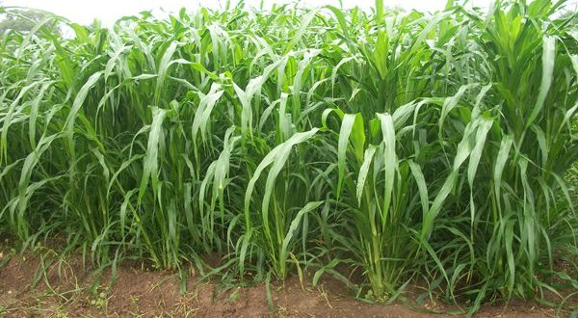
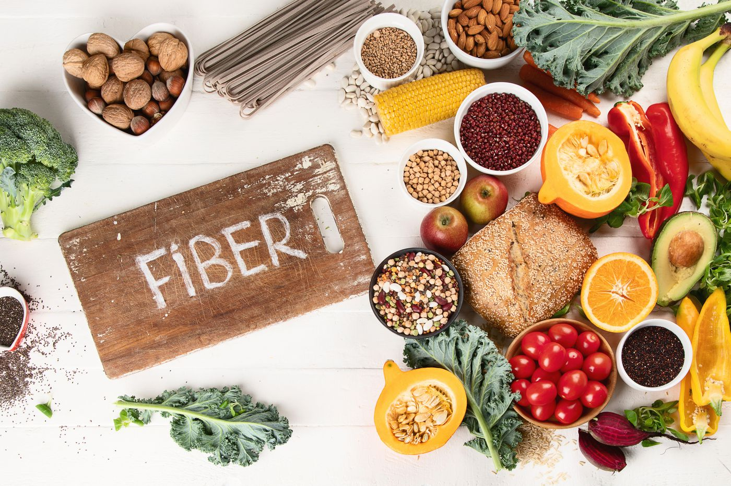
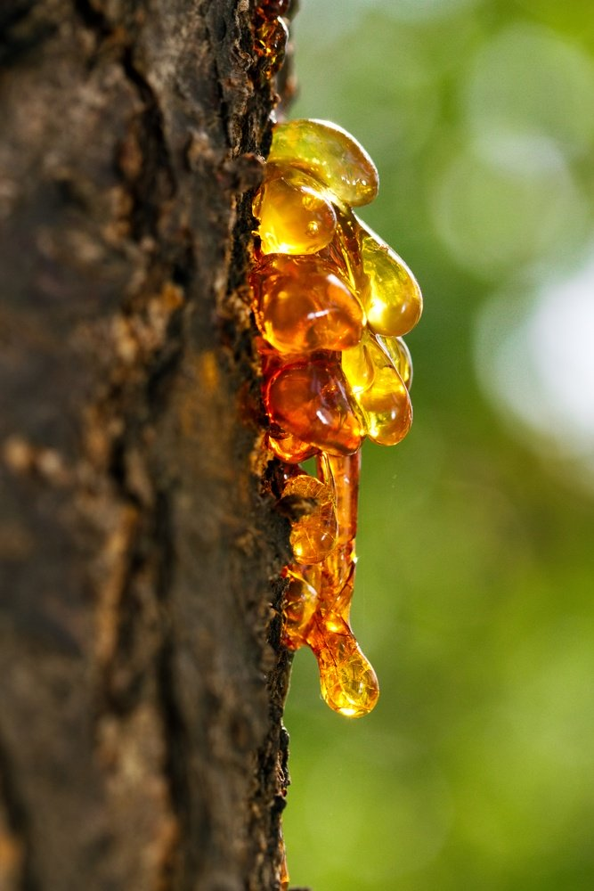
fooder
resin

Slide 6
This tremendous prodigality of nature has astonished and delighted humans and is ultimately the source for their sustenance.
There is an enormous variety of plants and animals on earth with high degree of species richness

Slide 7
Yet , in using plants and animals for food and clothing , for building houses and for medicine ,humans are endangering this immense richness of species.
This current rate of loss of species diversity and the reduction in the genetic variability of crops and wild species could seriously affect human welfare.
Therefore in considering the immense values of biodiversity and subsequent rapid loss of the same, the various ecosystem and their biodiversity of the same , the various ecosystem and their biodiversity should be protected and conserved.

Slide 8
Biodiversity Conservation strategies
The biodiversity has to be conserved to keep an ecological equilibrium necessary for maintaining a sustainable environment for future generation.
The conservation of biological is of two types. They are,
1.In-situ Conservation
2.Ex-situ Conservation

Slide 9
1.In-situ Conservation
The conservation of genetic resources in their natural habitats or man-made ecosystem is called in-situ Conservation.
It easy and suitable method for the maintenance of many plant and animal species.
An area is selected and declared to be a protected area and special measures are taken to conserve the biodiversity.
Viable populations of different species are allowed to grow by offering proper protection.

Slide 10
If the ecosystem of the area is badly degraded, the threatened species are rehabilitated and maintained properly.
If an animal species is threatened, it is bred in a suitable zoo and re-introduced to preserve it in the ecosystem.
Those people which harmfully affected the sustainability of biodiversity are maintained at controlled level.

Slide 12
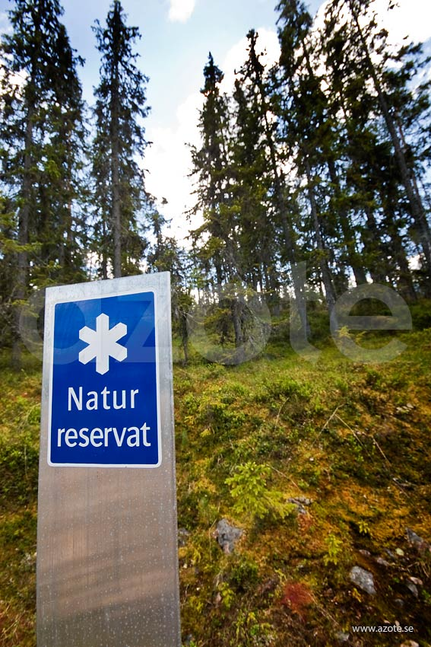

Slide 13
2.Ex-situ Conservation
Ex-situ conservation is the conservation of genetic resources outside their natural habitants.
Plants , animal and microbial species are preserved in ex-situ conservation systems.
For ex-situ conservation, genetic resources are maintained in.

Slide 14
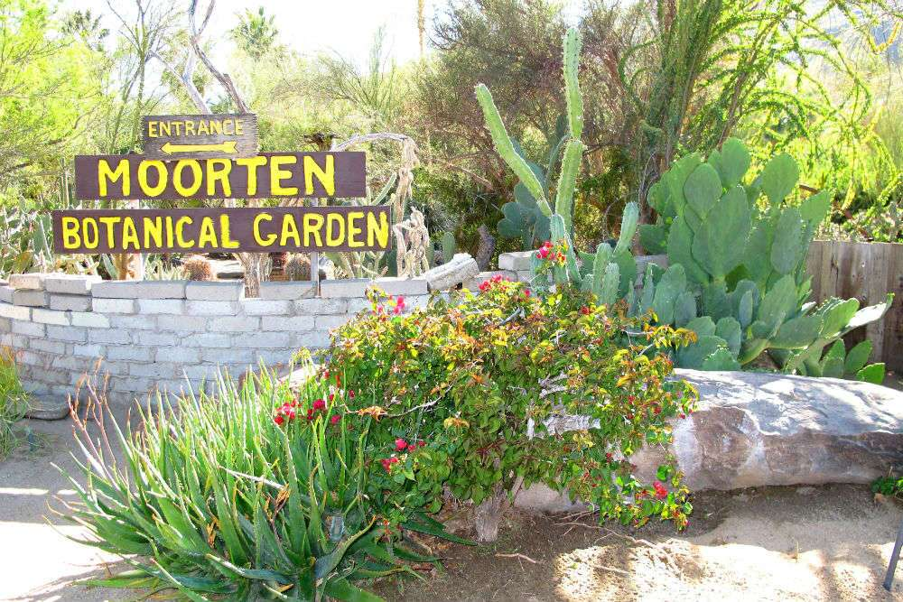
Zoos(for animals)
Botanical garden(for plants)

Slide 15
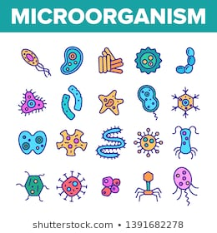
Culture collection(for micro- organisms)
Cryo banks(for gametes cells and tissuses)

Slide 16
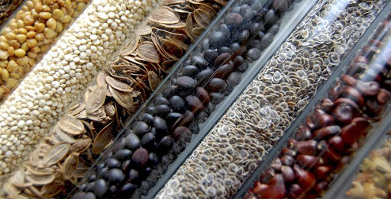
Germplasm banks(for seeds,semen,cells,ova)

Slide 17
The centre for plant genetic resources, New Delhi, has maintained cultured tissuses,pollen,seeds,etc.
The preserved pecimen may be carried to in-situ conservation systems for maintenance.

Slide 19
Thank you….

