Slide 1
RESOURCES Renewable Resources Non-renewable Resources
Mr. S. Sirajudeen
Associate Professor of Computer Science
Hajee Karutha Rowther Howdia College(Autonomous)
Uthamapalayam

Slide 2
Mr. S. Sirajudeen
Associate Professor of Computer Science
Hajee Karutha Rowther Howdia College(Autonomous)
Uthamapalayam

Slide 3
Resources
Natural resources are the wealth of the earth they are the materials available in nature and useful to human begins, animals and plants
Example:
Water, air, land, plants, animals, coal, petroleum, minerals, forest, wood, etc.
Type of Resources:
There are two types of resources namely
Renewable Resources
Non-Renewable Resources

Slide 4
Renewable Resources
The Renewable resources can be replaced after their use . These are available continuously.
Example:
Solar energy, Wind Energy, Water, Aqua food, Forest, Grassland, Animals, etc.

Slide 5
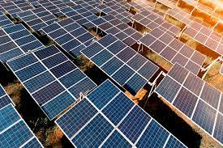
Solar Energy
Sunlight is the solar energy. It forms the major energy source for the plants. Planets synthesize starch with the help of sunlight. All animals in the world depend on the energy stored by the plants.
The Solar energy is also used for solar cooker, solar light, solar calculator, etc. The solar energy consists of tremendous electric energy. Technologies must be developed to exploit the sunlight. Solar cells generate electricity using sunlight. They are pollution free.

Slide 6
Wind Energy
Wind energy is also the renewable energy resources It is available day and night. It is used to generate electric current. In TamilNadu, Muppandal has the highest concentration in mills to produce electricity.

Slide 7
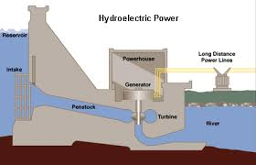
Hydroelectric Energy
Hydroelectric power is generated by the flow of water on a turbine. The water stored in dams is used to rotate the turbines of the power generators.

Slide 8
Non-Renewable Resources
The non-renewable resources cannot be replaced after their use. They remain on earth in a different form and unless recycled become waste material.
Example:
Coal, Petroleum, Iron, Natural gas, etc.

Slide 9
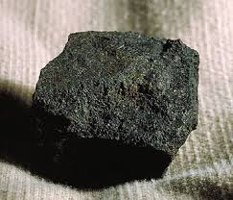
Coal
Coal is a fossil fuel. It is a non-renewable natural resource. It is found under the Earth. It is an organic compound.
It is a black product formed by organic decomposition of plant materials millions of years ago. Coal is found in stratified beds.
The coal is of four types, namely
Anthracite
Bituminous coal
Sub-bituminous coal
Lignite

Slide 10
Anthracite:
Anthracite is the hard coal. It has the lowest moisture content. Highest carbon content and highest heat value.
Bituminous:
Bituminous coal is the most abundant one.
Sub Bituminous:
Lignite:
Lignite is the brown coal. It has 50% of water content. Low carbon content and low heat value.

Slide 11
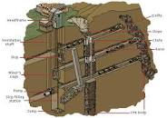
Underground Mining
Coal is collected by underground mining methods. About 6,000 billion tons of coal lie under the earth. By now about 200 billion tons have been used.

Slide 12
Coal is a primary source of industrial energy. The coal used by thermal power plants. Iron and steel industries, Bricks and kiln factories, railways, cement factories, fertilizer industries, etc.
Neyveli has a deposit of about 3,300 million tons of coal. The coal available in neyveli is lignite. It is about 90% of countries have lignite reserves.
The states having major coal reserves are Bihar, Orissa, West Bengal, Madhya Pradesh, Andhra Pradesh and Maharashtra.

Slide 13
Oil
Oil is a non-renewable resource Oil is the most abundant fluid in the Earth’s crust, next to water. It is a hydrocarbon. It is the mineral oil. It is a fossil fuel. The crude oil is petroleum. It is formed by the decomposition of buried plants, millions of years ago.
Crude oil is refined to produce petrol, diesel, kerosene, propane, gasoline, jet fuel, heating oil, motor oil, paraffin wax, petroleum jelly, etc. The chemicals present in oil are isolated and used for the production of plastics, medicines, etc. The oils are rich in the following regions of the World USA, Mexico, Russia, Iran, Iraq, Saudi Arabia, Kuwait, etc. In India oil is available in Gujarat, Assam, Thar Desert, Andaman and Nicobar Island, Bombay, etc.

Slide 14
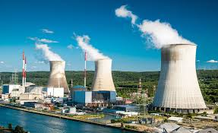
Nuclear energy
Nuclear energy is the non-renewable energy resource. It is obtained from the fission of atoms of radioactive elements. Radioactive elements are used in atomic power stations are located in Tarapur (Mumbai), Kota (Rajasthan) and Kudankulam (TamilNadu).

