Slide 1
BASIC RULES OF MATHEMATICS
Dr.K.Abdul Rahim
Associate professor of economics
HKRH COLLEGE
Uthamapalayam

Slide 2
BASIC RULES OF MATHEMATICS
BODMAS
B = BRACKET
O = OF
D = DIVISION
M= MULTIPLICATION
A = ADDITION
S = SUBTRACTION
Example:
Solve: 2+ 4(6÷3) ̶ 4( $\frac{1}{4}$ )
Solution:2 +4 (2) ̶ $\frac{4}{4}$
2+ 8 ̶ 1
10 ̶ 1 =9

Slide 3
Addition,Subtraction,Multiplication and Division
Addition and Subtraction
Multiplication and Division
+4 (+2) = +8 ; $\frac{+4}{+2}$ = +2
̶ 4 ( ̶ 2) = + 8 ; $\frac{−4}{−2}$ = +2
+ 4( ̶ 2) = ̶ 8 ; $\frac{+4}{−2}$ = -2
̶ 4 (+ 2) = ̶ 8 ; $\frac{−4}{+2}$ = -2
+4 + 6 = +10
̶ 4 ̶ 6 = ̶ 10
+ 6 ̶ 4 = + 2
̶ 6 + 4 = ̶ 2

Slide 4
Examples
1.simplify;2+12+(+4)÷ 2 ̶ 6
Solution:
+ 2+12+ 4 ÷ 2 ̶ 6
+ 2 + 12 +2 ̶ 6
+16 ̶ 6 = +10
2.simplify;+5(+4) ̶ 12(+4) ÷ 2 ̶ 4
Solution: +20 ̶ 48 ÷ 2 ̶ 4
+20 ̶ 24 ̶ 4
+20 ̶ 28 = ̶ 8

Slide 5
3.simplify; 4(25 ÷ 5 ) + 8(2) ̶ 4
Solution: +4(5)+16 ̶ 4
+20 +16 ̶ 4
+36 ̶ 4 =+32
4.simplify; 8 (¾) + 5($\frac{4}{5}$ ) + 10 -5
Solution: $\frac{24}{4}+\frac{20}{5}$ +10 - 5
6 + 4 +10 -5
20 – 5 = 15

Slide 6
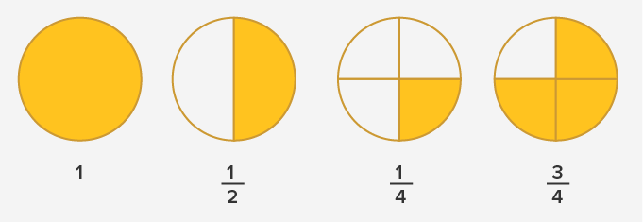
FRACTION(The word ‘fraction’ has been derived from the Latin ‘fractus’ which means “broken”).
Meaning:
Fractions represent equal parts of a whole or a collection.
Fraction of a whole: When we divide a whole into equal parts, each part is a fraction of the whole.
Example:

Slide 7
TYPES OF FRACTION
There are two types of fraction.
1.COMMAN FRACTION
2.DECIMAL FRACTION
COMMAN FRACTION-MEANING
If any fraction can be easily understood as a fraction is called common fraction.
Example: $\frac{2}{3} , \frac{4 }{6}$

Slide 8
A fraction has two parts.
1. The number on the top of the line is called the numerator. It tells how many equal parts of the whole or collection are taken.
2. The number below the line is called the denominator. It shows the total divisible number of equal parts the whole into or the total number of equal parts which are there in a collection

Slide 9
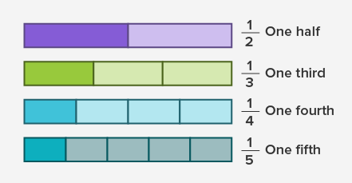
Types of comman fractions
1.Unit fractions Fractions with numerator 1 are called unit fractions.

Slide 10
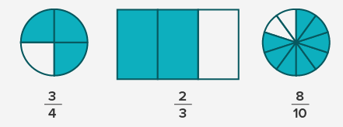
2.Proper fractions
Fractions in which the numerator is less than the denominator are called proper fractions.

Slide 11
3.Improper fractions
Fractions in which the numerator is more than or equal to the denominator are called improper fractions.
Example: $\frac{4}{4}$ ,$\frac{6}{3}$ ,$\frac{8}{2}$
4.Mixed fractions
Mixed fractions consist of a whole number along with a proper fraction.
Example: 2 $\frac{4}{6}$ , 5$\frac{3}{5}$
,

Slide 12
Addition and Subtraction in Common Fraction
Same Denominator
Denominators are different
1.Simlify: $\frac{4}{2}$ +$\frac{6}{5}$
$\frac{4\left(5\right)+6\left(2\right)}{2×5}$
$\frac{20+12}{10}=\frac{32}{10}=3⋅2$
2.Simlify: $\frac{4}{2}$ ̶$\frac{6}{5}$
$\frac{4\left(5\right) ̶ 6\left(2\right)}{2×5}$
$\frac{20 − 12}{10}=\frac{8}{10}=0⋅$8
1.Simlify: $\frac{4}{5}$ +$\frac{6}{5}$ = $\frac{4+6}{5}$ = $\frac{10}{5}$ = $\frac{2}{1}$ =2
2.Simlify: $\frac{2}{9}$ + $\frac{3}{9}$ $+\frac{4}{9}$
$\frac{2+3+4}{9}$ = $\frac{9}{9}$ = 1
3.Simlify: $\frac{6}{5}$ $− \frac{4}{5}$ = $\frac{6−4}{5}$ = $\frac{2}{5}$
4.Simlify: $\frac{2 }{9 }$ ̶ $\frac{3 }{ 9 }$ $̶ \frac{4}{9}$
$\frac{2 ̶ 3 ̶ 4}{9}$ = $\frac{2−7}{9}$ = $\frac{−5}{9}$

Slide 13
Denominators are different
1.Simlify: $\frac{2 }{3 }$ + $\frac{3 }{ 4 }$ $+ \frac{4}{5}$
Solution: $\left(2×4×5\right)$ + $\left(3×3×5\right)$+ $\left(4×3×4\right)$
$\left(3×4×5\right)$
$\left(40\right)$ + $\left(45\right)$ + $\left(48\right)$
$\left(60\right)$
$\left(133\right)$
$\left(60\right)$

Slide 14
Denominators are different
1.Simlify: $\frac{2 }{3 }$ ̶ $\frac{1 }{ 4 }$ $− \frac{6}{5}$
Solution:
$\frac{\left(2×4×5\right) ̶ \left(1×3×5\right) − \left(6×3×4\right) }{\left(3×4×5\right)}$
$\frac{\left(40\right) ̶ \left(15\right) − \left(72\right) }{\left(60\right)}$
$\frac{ \left(40 − 87\right) }{\left(60\right)}$ = $\frac{−47 }{60}$

Slide 15
Multiplication in Common Fraction
Can you name the parts of a fraction?
$$\frac{3}{4}$$
?
numerator
?
denominator

Slide 16
What sort of fractions / numbers are these:
$$\frac{7}{8}$$
?
proper fraction
?
$$2\frac{3}{8}$$
mixed number
?
$$\frac{9}{7}$$
improper fraction

Slide 17
Multiplication in Common Fraction

Slide 18
Multiplying Fractions
$\frac{2}{3}$×$\frac{3}{4}$ =
Multiply the numerators.
Multiply the denominators.
Cancel down.
2 × 3 6
$$\frac{1}{2}$$
=
=
3 × 4 12

Slide 19
$\frac{2}{5}$ × $\frac{3}{4}$ =
$\frac{1}{4}$ × $\frac{1}{2}$ =
$\frac{3}{4}$ × $\frac{4}{5}$ =
$\frac{4}{7}$ × $\frac{2 }{5}$=
$\frac{1}{6}$ × $\frac{2}{5}$ =
$\frac{5}{12}$ × $\frac{2}{5}$ =
$\frac{5}{9}$ × $\frac{2}{3}$ =
$\frac{3}{8}$ × $\frac{4}{9}$ =
$\frac{6}{20 }$=$\frac{3}{10}$
$$\frac{1}{8}$$
$\frac{12}{20}$=$\frac{3}{5}$
$$\frac{8}{35}$$
$\frac{2}{30}$ =$\frac{1}{15}$
$\frac{10}{60}$ =$\frac{1}{6}$
$$\frac{10}{27}$$
$\frac{12}{72}$ = $\frac{1}{6}$

Slide 20
Multiplying mixed numbers.
2$\frac{2}{5}$ × $\frac{1}{2}$
Change the mixed number to an improper fraction.
Multiply as before.
Cancel down and change to mixed number if necessary.
$\frac{12}{5}$ × $\frac{1}{2}$
= $\frac{12}{10}$
= $\frac{6}{5}=1\frac{1}{5}$
=

Slide 21
$\frac{5}{4}$ × $\frac{2}{7}$ = $\frac{10}{28}=\frac{5}{14}$
1$\frac{1}{4}$ × $\frac{2}{7}$ =
2$\frac{1}{3}$ × $\frac{1}{2 }$ =
$\frac{3}{4}$ × 1$\frac{4}{5}$ = $\frac{3}{4}$ × $\frac{9}{5}$ = $\frac{27}{20}$ = 1$\frac{7}{20}$
1$\frac{4}{7}$ × 1$\frac{2}{5}$ = $\frac{11}{7}$ × $\frac{7}{5}$ = $\frac{77}{35}$ = $2\frac{7}{35}$
$\frac{7}{3}$ × $\frac{1}{2}$ = $\frac{7}{6}$ = 1$\frac{1}{6}$
$\frac{9}{5}$ = $\frac{27}{20}$ = 1$\frac{7}{20}$

Slide 22
$$\frac{3}{4} ×\frac{6}{1}=\frac{18}{4}=\frac{9}{2}=4\frac{1}{2}$$
$\frac{7}{8} ×\frac{12}{1}=\frac{84}{8}=\frac{21}{2}=10\frac{1}{2}$
X $\frac{5}{1} ×\frac{3}{10}=\frac{15}{10}=\frac{3}{2}=1\frac{1}{2}$
$\frac{5}{7} ×\frac{4}{1}=\frac{20}{7}=2\frac{6}{7}$
X $\frac{7}{1} ×\frac{2}{5}=\frac{14}{5}=2\frac{4}{5}$
$\frac{3}{4}$ × 6 =
$\frac{7}{8}$ × 12 =
5 × $\frac{3}{10}$ =
$\frac{5}{7}$ × 4 =
7 × $\frac{2}{5}$ =

Slide 23
$\frac{5}{8}$ × $\frac{16}{25}$ = $\frac{80}{200}$ = $\frac{2}{5}$ (OR)
Cancelling method
$\frac{5}{8}$ × $\frac{16}{25} \text{=}\frac{1}{1} \text{× }\frac{2 }{5} \text{= }\frac{2}{5}$
$\frac{5}{8}$ × $\frac{16}{25}$
$$\frac{2}{5}$$

Slide 24
Multiplying always makes things bigger:
2 x 3 = 6
6 is bigger than both 2 and 3
Is he correct?

Slide 25
If you multiply a number by 1,
it does not increase or decrease.
3 x 1 = 3
If you multiply a number by 0, you get 0
3 x 0 = 0
If you multiply a number larger than 1 by a proper fraction, the product is less than the original number.
4 x $\frac{1}{2}$ = 2 (2 < 4)

Slide 26
Dividing fractions and whole numbers
1.Simlify: $\frac{12}{5}$ ÷ $\frac{1}{2}$
$\frac{12}{5}\text{ × }\frac{2}{1}\text{ =} \frac{24}{5}$ = $4\frac{4}{5}$
2.Simlify: (4 ÷ $\frac{1}{2}$ )
Solution: $\frac{4}{1}\text{ × }\frac{2}{1}\text{ =} \frac{8}{1}$ = 8

Slide 27
Dividing mixed numbers.
2$\frac{2}{5}$ ÷ $\frac{1}{2}$
Change the mixed number to an improper fraction.
Divide as before.
Cancel down and change to a mixed number if necessary.
$\frac{12}{5}$ ÷ $\frac{1}{2}$
= $\frac{12}{5}$ × $\frac{2}{1}$ = $\frac{24}{5}$
=$4\frac{4}{5}$
=

Slide 28
1$\frac{4}{5} ÷$ $\frac{1}{3}=$
$\frac{9}{5}$ ÷ $\frac{1}{3}$ = $\frac{9}{5}$ × $\frac{3}{1}$ = $\frac{27}{5}$ = 5$\frac{2}{5}$
2$\frac{1}{3} ÷$ $\frac{7}{9}=$
$\frac{7}{3}\text{÷}\frac{7}{9}\text{ =}\frac{7}{3}$ × $\frac{9}{7}$ = $\frac{63}{21}$ = 3
3$\frac{1}{2} ÷$ $\frac{3}{8}=$
$\frac{7}{2}\text{÷}\frac{3}{8}\text{ =}\frac{7}{2}$ × $\frac{8}{3}$ = $\frac{56}{6}$ = 9$\frac{1}{3}$
3$\frac{2}{3} ÷$ 1$\frac{1}{6}=$
$\frac{11}{3}\text{÷}\frac{7}{6}\text{ =}\frac{11}{3}$ × $\frac{6}{7}$ = $\frac{66}{21}$ = 3$\frac{1}{7}$
$\frac{9}{10} ÷$ 1$\frac{1}{5}=$
$\frac{9}{10}\text{÷}\frac{6}{5}\text{ =}\frac{9}{10}$ × $\frac{5}{6}$ = $\frac{45}{60}$ = $\frac{3}{4}$

Slide 29
$\frac{6}{1} ÷$ $\frac{6}{1} × \frac{3}{2}= \frac{18}{2}=9$
$\frac{4}{1} ÷\frac{2}{5}=$ $\frac{4}{1} × \frac{5}{2}= \frac{20}{2}=10$
$÷\frac{5}{6}=$ $\frac{7}{1} × \frac{6}{5}= \frac{42}{5}=8\frac{2}{5}$
$$\frac{5}{1} ÷\frac{6}{7}$$
$6÷ \frac{2}{3}$ = 6 X $\frac{3}{2}$ = 9
$7÷ \frac{5}{6}$ = 7 X $\frac{6}{5 }$ = $\frac{7}{1}$ X $\frac{6}{5}$ = $\frac{42}{5}$
$5÷ \frac{6}{7}$ = 5 X $\frac{7}{6}$ = $\frac{5}{1}$ X $\frac{7}{6}$ = $\frac{35}{6}$ = 5$\frac{5}{6}$
$8÷ \frac{7}{9}$ = 8 X $\frac{9}{7}$ = $\frac{8}{1}$ X $\frac{9}{7}$ = $\frac{72}{7}$ =10 $\frac{2}{7}$
$\frac{3}{4} ÷6$ = $\frac{3}{4}÷$ $\frac{6}{1} =$÷ $\frac{3}{4} X\frac{1}{6}=\frac{3}{24}=\frac{1}{8}$÷÷XX

Slide 30
Division always makes things smaller. If I divide up a rich, tasty chocolate cake, I always get a smaller piece than the whole cake.
12 ÷ 4=3
3 is less than 12
Is she correct?

Slide 31
If you divide a number by 1,
it does not increase or decrease.
3 ÷ 1 = 3
If you divide 1, or a number larger than 1, by a proper fraction, the answer is greater than the original number.
4 ÷ $\frac{1}{2}$ = 8 (8 > 4)

Slide 32
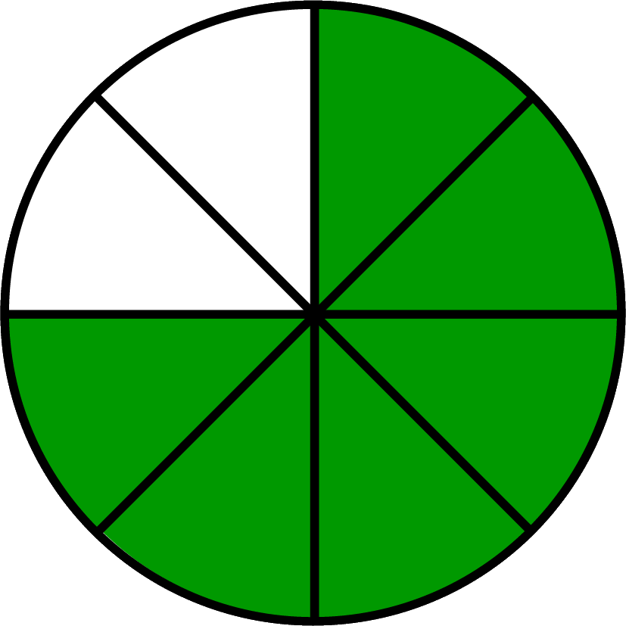
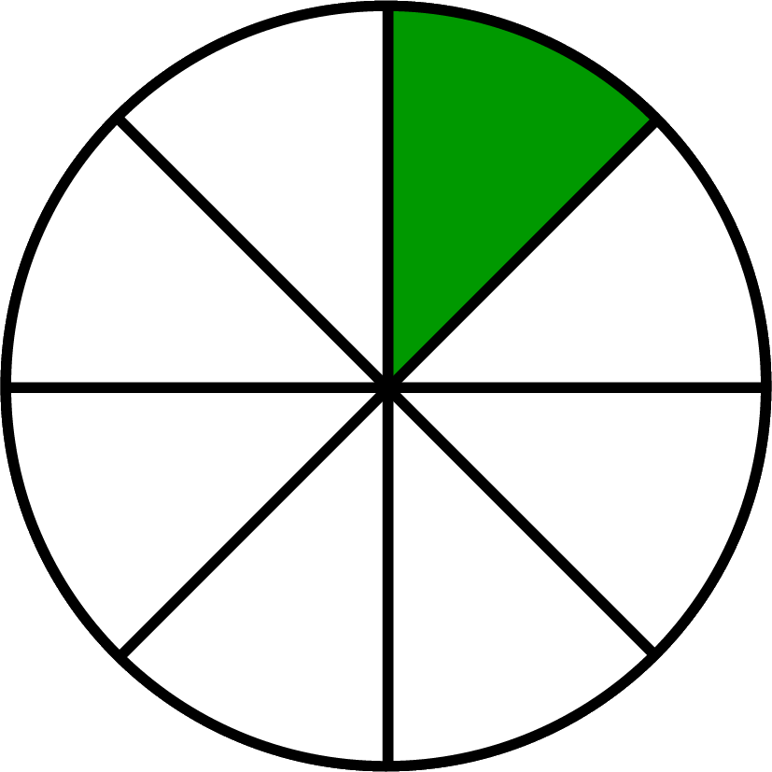
If you divide a larger fraction by a smaller
one, the answer will be more than 1.
$\frac{3}{4}$ ÷ $\frac{1}{8}$ = 6
÷ = 6
How many $\frac{1}{8}$ are there in $\frac{3}{4}$? 6

Slide 33
Exercise
1.Simlify: $\frac{2 }{9 }$ + $\frac{3 }{ 9 }$ $̶ \frac{4}{9}$
Solution: $\frac{2+ 3 ̶ 4}{9}$ = $\frac{5−4}{9}$ = $\frac{1}{9}$
2.Simlify: $\frac{2 }{2 }$ + $\frac{8 }{ 4 }$ $̶ \frac{4}{6}$
Solution: $\frac{2(4)(6)+8(2)(6) ̶ 4(2)(4)}{2(4)(6)}$ = $\frac{\left(48\right)+(96)−(32)}{(48)}$ = $\frac{144−32}{48}$ = $\frac{112}{48}$
3.Simlify: $\frac{2 }{2 }$ + $\frac{8 }{ 4 }$ ÷$\frac{4}{6}$
solution: $\frac{2 }{2 }$ + $\frac{8 }{ 4 }$ x$\frac{6}{4}$
$\frac{2}{2}+$ $\frac{48}{16}$ = $\frac{2\left(16\right)+48(2)}{2 x16}$ = $\frac{32+96}{32}$ = $\frac{128}{32}$ = 4

Slide 34
Exercise
4.Simlify: $\frac{2 }{2 }$ ̶ $\frac{8 }{ 4 }$ ÷$\frac{4}{6}$
solution: $\frac{2 }{2 }$ ̶ $\frac{8 }{ 4 }$ x$\frac{6}{4}$
$\frac{2}{2} −$ $\frac{48}{16}$ = $\frac{2\left(16\right) − 48(2)}{2 x16}$ = $\frac{32 − 96}{32}$ = $\frac{−64}{ 32}$ = ̶ 2
5.Simlify: $\frac{2 }{2 }$ x $\frac{8 }{ 4 }$ ÷$\frac{4}{6}$
solution: $\frac{2 }{2 }$ x $\frac{8 }{ 4 }$ x$\frac{6}{4}$ = $\frac{ 96}{32}$ = 2

Slide 35
2.DECIMAL FRACTION
Meaning: The fraction whose denominator (bottom number) is
10 or power of 10,i.e.100,1000,10000 etc., are called
Decimal Fraction.
Example: $\frac{7 }{10 }$ , $\frac{7 }{ 100 }$ ,$\frac{7}{1000}$
1) $\frac{9 }{10 } =0.9$
2) $\frac{23 }{100 }$ = 0.23
3) $\frac{31 }{1000 }$ = 0.031
4) $\frac{1 }{4 } = 0.$25
Question 1:Convert the 2% into decimal fraction
Answer: $\frac{2 }{100 } = 0.0$2

