Slide 1
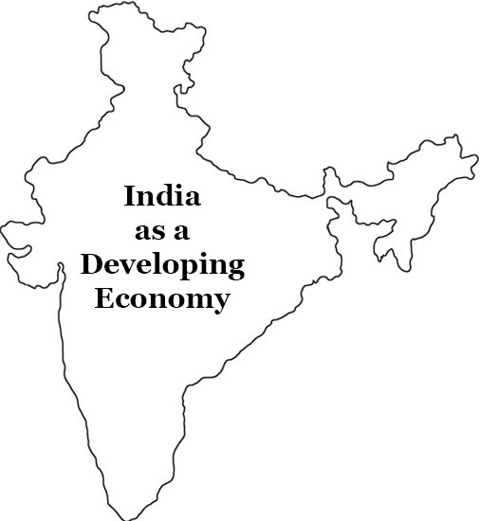
India as a Developing Economy
Dr. K. Abdul Rahim
Associate Professor of Economics
HKRH COLLEGE
Uthamapalayam.

Slide 2
INTRODUCTION
During the last 4 decades a number of significant changes have taken place in the Indian Economy. These changes point to the fact that the Indian Economy should not be classified along with other UDC. It should rather be called a DEVELOPING ECONOMY

Slide 3
Meaning of Developing Economy
Developing Economy like India is characterised by
1.high population growth rate
2.abundant but under utilised natural
resources
3.A low rate of capital formation
4.Low standard of living
accompanied by continuous and sustained efforts to raise it through a proper
utilisation of available natural resources
Man power
Financial and
Entrepreneurial resources.

Slide 4
As a result
that countries gradually increase their
Tehnology
Use of natural resources
GDP
Per Capita Income

Slide 5
Features of India as a Developing Economy
sustained growth
Self reliance(self dependence)
Agricultural Transformation
Industrial change
Change in Foreign Trade
Development of Infrastructure
Expansion of Science and Technology
Social Changes

Slide 6
Sustained Growth
Sustained Growth means steady growth. During the last five decades the GDP growth rate of India has been steadily increased around 3.5% and above.The following table shows the this fact.
YEAR | GDP (%)
1950-1960 | 3.5
1970 | 5.16
1980 | 6.74
1990 | 5.53
1999 | 8.85
2000 | 3.84
2010 | 8.50
YEAR | GDP (%)
2015 | 8.00
2016 | 8.26
2017 | 7.4
2018 | 6.12
2019 | 5.02
2020 | 4.5(expected)

Slide 7
Self reliance(self dependence)
Self Reliance or self sufficient Economyis when a country is completely independent,produce its own goods and does not import goods or services.(or)
Self reliant means the economic growth process should not become dominated or dependent on another country.
Indian Economy mainly depent on
1.Import dependent for energy
2.Dependence on foreign exchange
3.Defence equipment
4.Electronic and pharmaceuticals
“Atma nirbhar” Self reliance of the country in future

Slide 8
Agricultural Transformation
Agriculture sector in india has moved from a traditional agriculture in the 1950s to the modern technologically dynamic high capital intensive agriculture,in which along with food and non food crops,horticulture and allied activities.
Indian agriculture has transferred from
Subsistence to market oriented
Traditional to technology oriented
Extensive to intensive
Mono crop to multi crop
India has emerged as the
largest and low cost producer of milk and bananas
Second in vegetable, fruits and sugarcane production
Third in tobacco production
fourth in wheat and oil seeds production.

Slide 9
Industrial change
“Fast Economic Development everywhere has been made possible essentially due to rapid Industrialisation.
In our plans aimed at building the Indian Economy in a self-reliant and self-sustained unit.
Towards the achievement of this goal,the path of industry-led-growth was pursued.As a result India has the ability to
construct big and giant industries with our indigenous technology.
gradually increases the industrial productivity
increases the efficiency of industrial labour&productivity
Develop the large number of entrepreneurs
Reduces the technological dependence
Develop computer&internet technology-artificial intelegence technology- pharmaceutical industries.

Slide 10
Change in Foreign Trade
Foreign Trade means export and import (exchange) of goods and services across the national boundaries.
International Trade is a major source of economic revenue for any nation that is considered a world power’
In 1950s-1960s foreign trade in Indian context meant only
imports
In mid 1960s-mid 1970s foreign trade meant both export and import substitution
In mid 1970s foreign trade has come to mean exports and imports,
it implies that the development role of exports and imports and import management rather than import restrictions is entering as a specific feature of the policy frame

Slide 11
Development of Infrastructure
Infrastructure is the basic physical and organisational structure and facilities of a nation
Example
Transport,communication,network, water and sewage facility,medical, education and electric system
They are Capital intensive and high cost investments
They are vital to a country's economic development and prosperity.
Since the independence India strongly develop the
Trasport system (Indian rail way II in the world,Indian shipping is one of the top 16 in the world)
Electric power system and communication system
Banking and finance system
Health and education system
Entrepreneurial capabilities
Disciplined labour force
Un-skilled labour-skilled labour-knowledge worker

Slide 12
Expansion of Science and Technology
The expansion of science and technology in India has received the attention of the world because India has the ability
1.To construct the nuclear power station which require a high
technology and knowledge
2.India is 8th rank among the top 16 countries of world for con
tributing the scientist
3.India has 1300 research institutions doing specialised research-atomic energy- space-aeronautics-agriculture-forestry-defence-electrical&electronics and health
4.Ability to build satelites and polar satellite launching vehicles
5.Ability to produce nuclear weapons
6.Green revolution, white revolution,

