Slide 1
MIXED ECONOMY
Dr.k.abdul Rahim
Associate professor of economics
Hkrh college
Uthamapalayam.

Slide 2
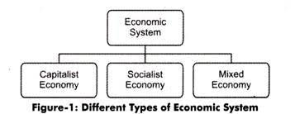

Slide 3
ECONOMIC SYSTEM
CAPITALISM
COMMUNISM
FREE MARKET ECONOMY
LAISSEZFAIRE-GOVT INVOLMENT IS LOW IN ECONOMY
ALL THE BUSINESS ACTIVITIES ARE CONTROLLED BY PRIVATE
CONTROLLED ECONOMY/
COMMAND ECONOMY
CENTRAL GOVT CONTROLL ALL BUSINESS ACTIVITY
IN BUSINESS, NO ROLL IN PRIVATE SECTOR

Slide 4
MIXEDM ECONOMIC SYSTEM
MIXED ECONOMIC SYSTEM MEANS THE CO-EXISTENCE OF PUBLIC SECTOR AND PRIVATE SECTOR OR
THE CO-EXISTENCE OF CAPITALISM AND COMMUNISM
OR
IT INTEGRATE THE BENEFITS OF BOTH CAPITALISM AND COMMUNISM

