Slide 1
A. Sumaya Banu
Assistant Professor of English
H.K.R.H College
English for Enrichment - I
Diamond Necklace – Guy De Maupassant

Slide 2
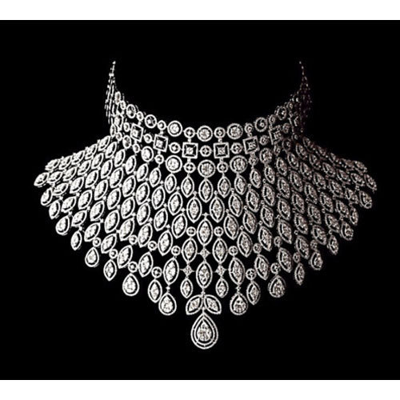
THE DIAMOND NECKLACE
THE DIAMOND NECKLACE
THE DIAMOND NECKLACE
THE DIAMOND NECKLACE
THE DIAMOND NECKLACE
THE DIAMOND NECKLACE
THE DIAMOND NECKLACE
THE DIAMOND NECKLACE

Slide 3
GUY DE MAUPASSANT
1850-1893
He grew up with wealthy parents North West France.
He spent almost every Sunday with the great French Novelist Gustanve Flaubert, who inspired him to begin writing.
In his teenage years, he served in the Franco-Prussian War. He got promoted to become a government clerk and he spent most of his free time in writing
Between 1880 and 1890, Maupassant had successfully written 300 short stories,6 novels,3 travel books, and his only volume of verse.

Slide 4
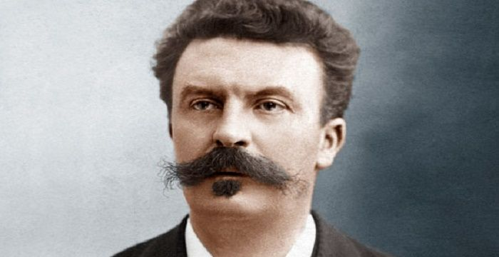
A lot of his stories were about “inexplicable, illogical, and contradictory catastrophes”.
Also many of his stories were about humorous and warm-hearted
He is one of the most indispensible authors of French Literature, thanks to his many great short stories like this one, `The Diamond Necklace’

Slide 5
ELEMENTS OF THE STORY
CHARACTERS:
Madam Mathilde Loisel
Madam Jeanne Forestier
Cabinet Officials
Monsieur Loisel
Jeweller
SETTINGS:
Set in Paris, France in the late 1800

Slide 6
Selfish
Dissatisfied
MATHILDE
LOISEL
Unhappy
Jealous

Slide 7
Practical
Hard working
MONSIEUR
LOISEL
Loyal
Clerk

Slide 8
Wealthy
Generous
MADAME
FORESTIER
Kind
Trusting

Slide 9
Sequence of Events
Mathilde Loisel is in her apartment dreaming of a better life. She is unhappy and dissatisfied with her social status mediocre surroundings.
One day her husband Monsieur Loisel announced that they will be attending a ball.
Mathilde Loisel felt unhappy because she would look poor. She thought that she has nothing to wear no gown nor fine jewelleries.
She borrowed a diamond necklace to Madame Forestier
She enjoyed the night, dancing and meeting people while her husband was alone sleeping in another room.

Slide 10
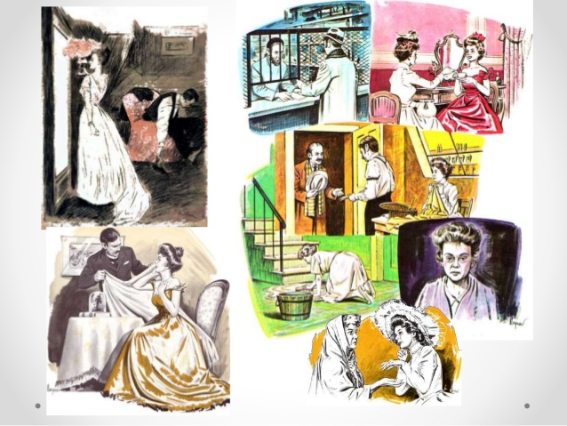

Slide 11
PLOT
At home, She felt her neck and realized she lost the borrowed necklace.
Monsieur Loisel went back to the streets to look for the necklace but he was unfortunate.
The couple decided to buy the 36,000 francs diamond necklace they thought looks the same with the borrowed necklace.
They work so hard and suffered much to pay for their debts to buy the necklace.
One day, Loisel saw Forestier. She told her about the necklace. Forestier laughed and told her that it was just a fancy jewelry which cost 500 francs.

Slide 12
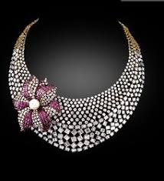
SYMBOLISM
The diamond necklace stands for everything. Madam Loisel has ever wanted- beauty and wealth.

Slide 13
Irony
The Loisel live on the `streets of martyrs’ and end up making a ten-years-long sacrifice.
Madame Loisel borrows a necklace that make her feel beautiful and wealthy, and it turns out to be fake.
If Madame Forestier had opened the case, she would have seen a much more valuable necklace than the one she originally loaned Madame Loisel.

Slide 14
THEME
HONESTY IS THE BEST POLICY
The theme of the Necklace is about honesty and telling the truth. The author is trying to stress the importance of telling the truth.

Slide 15
THEME
LIVE WITHIN YOUR MEANS
It is also about the contentment of what you have.
People should learn to be happy and thankful of what they have. If they want more, they should work harder to achieve it.

